Slide 1






Microservice with lambda, API Gateway and DynamoDB
POST Request
Sent to Lambda
Create item
Amazon API Gateway
AWS Lambda
Amazon DynamoDB
Amazon CloudWatch
Anthony Usoro
AWS SAA, DVA
DevOps Instructor

Slide 2
Lambda
Lambda is central to everything in that diagram.
So first create a lambda IAM Role to enable it
Write to DynamoDB table
Write to Cloudwatch Logs
IAM Role in notepad

Slide 3
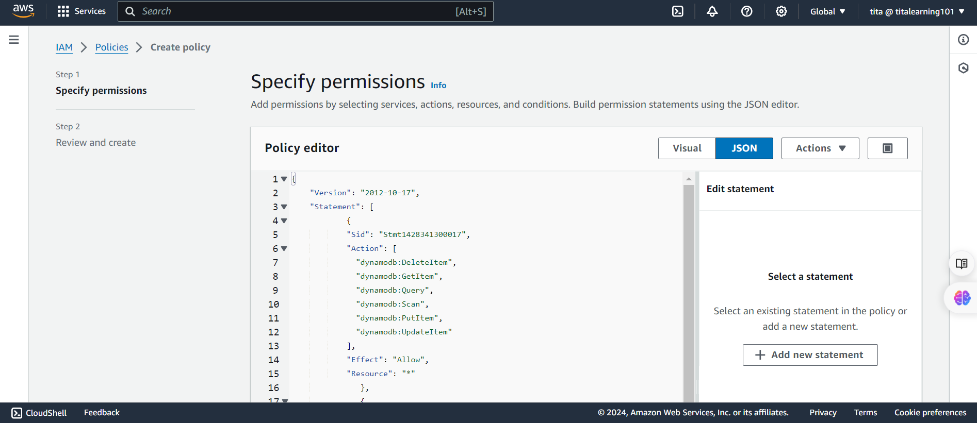
Create Policy in IAM

Slide 4
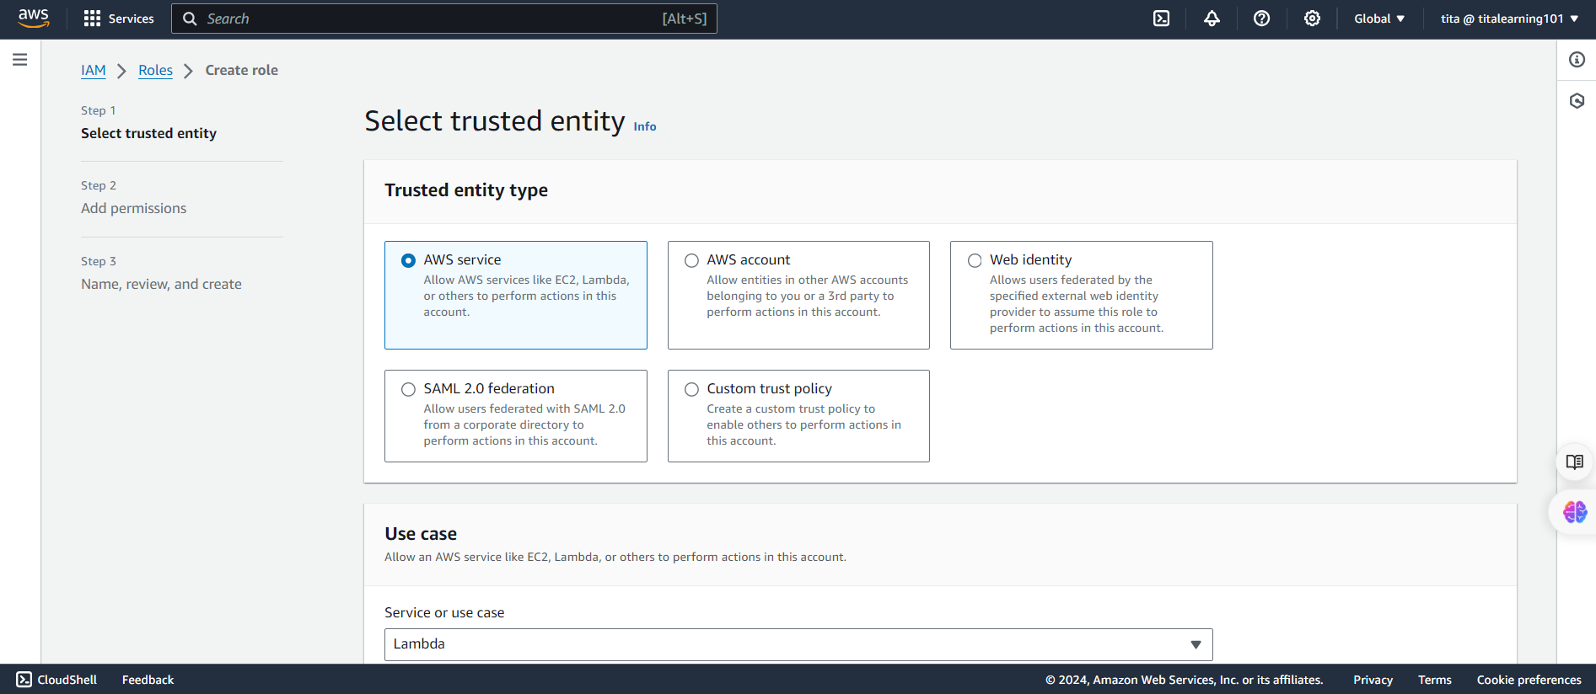
Create a Lambda ROLE in IAM to use that Policy

Slide 5
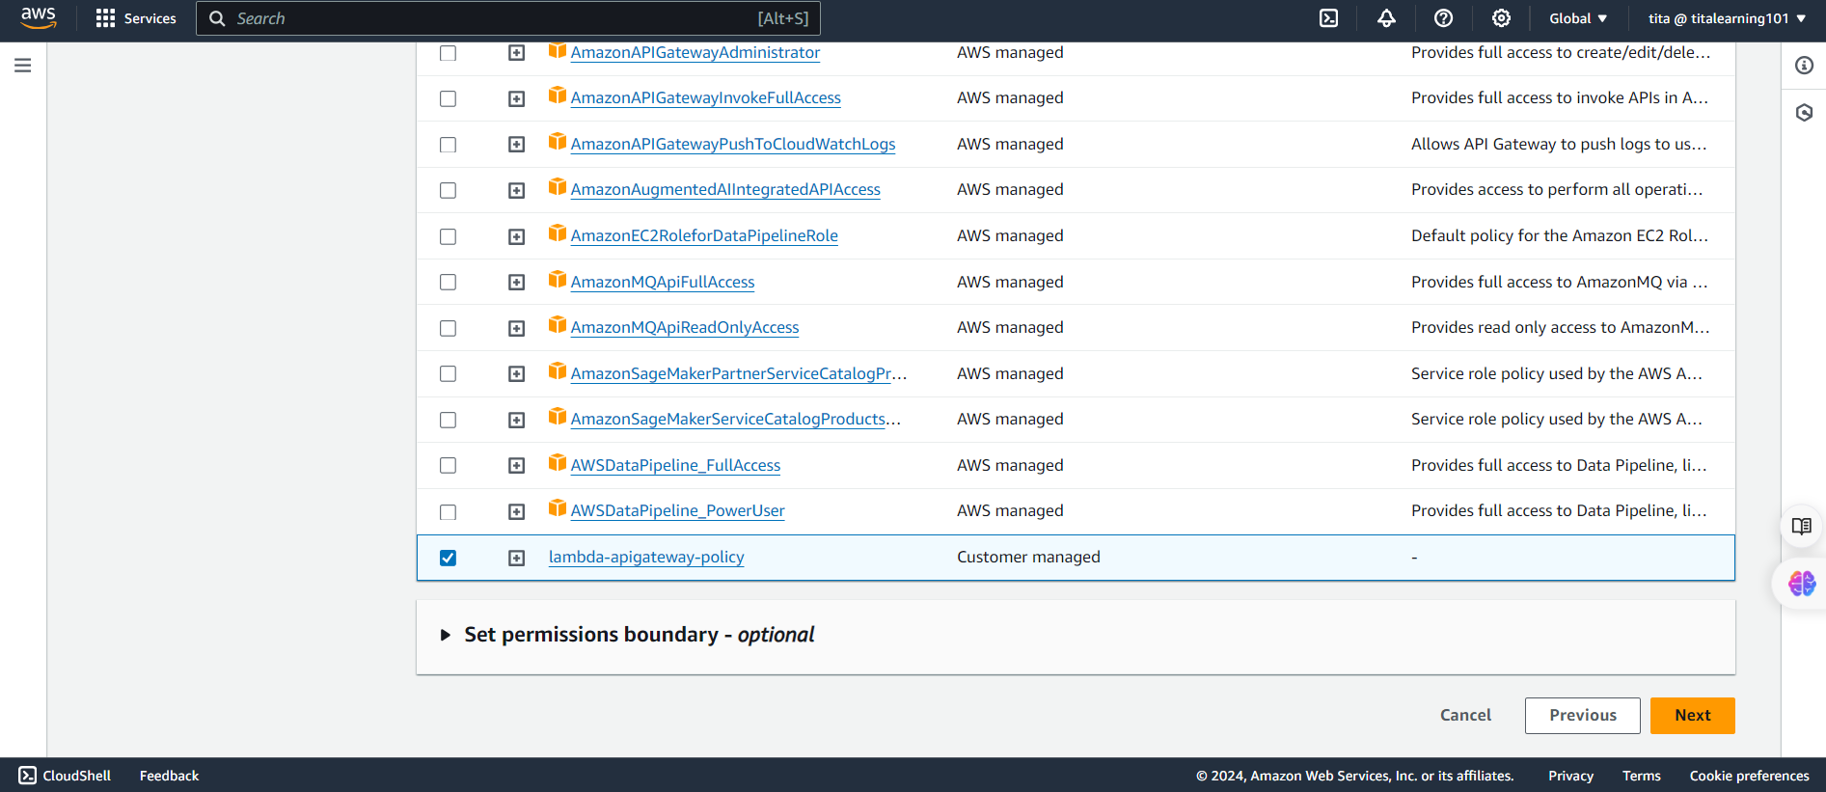

Slide 6
Lambda
Next Create Lambda function

Slide 7
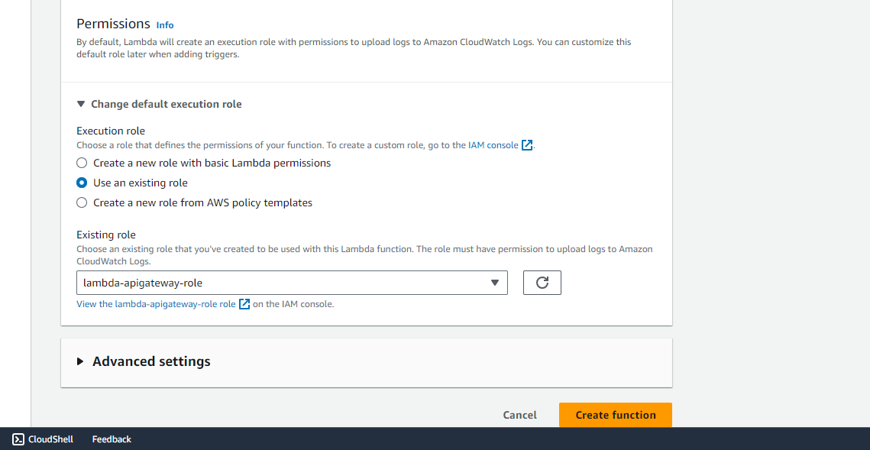
Ensure you select Use Existing role

Slide 8
Paste attached code and test

Slide 9
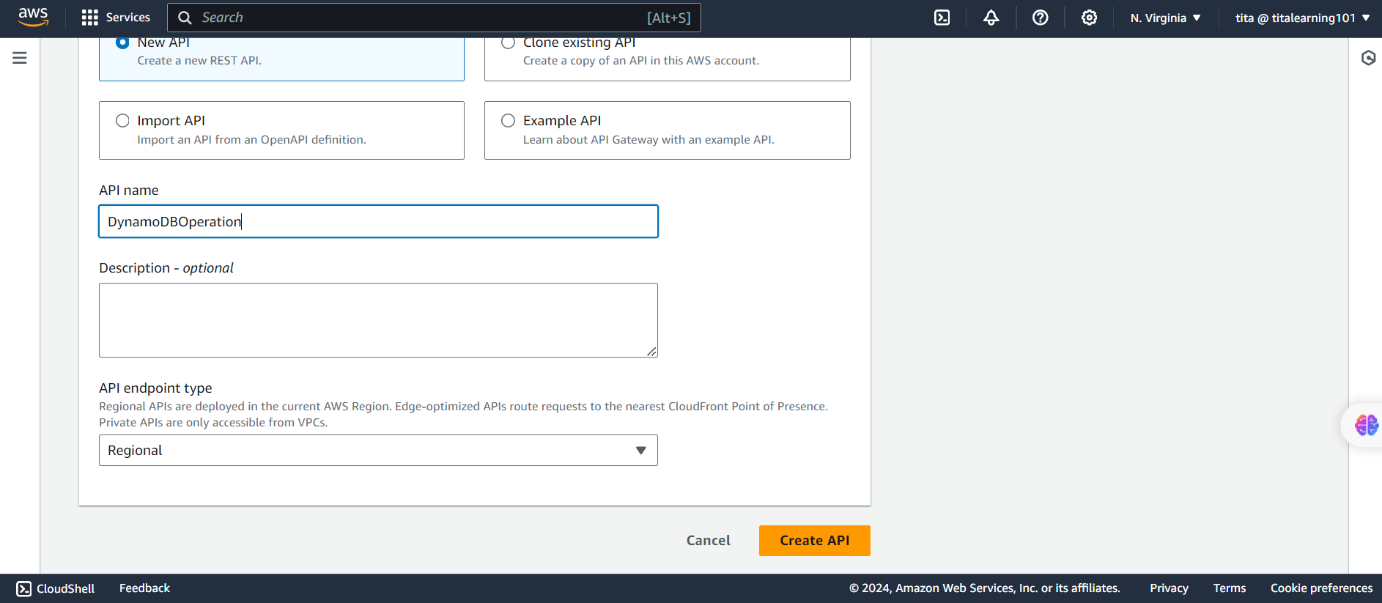
Setup RestAPI

Slide 10
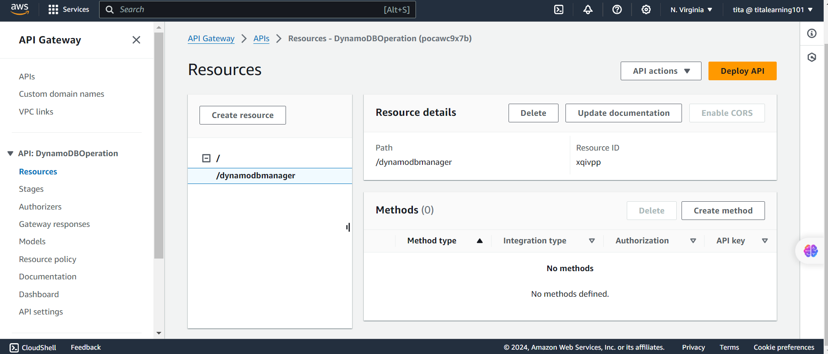
Create Resource

Slide 11
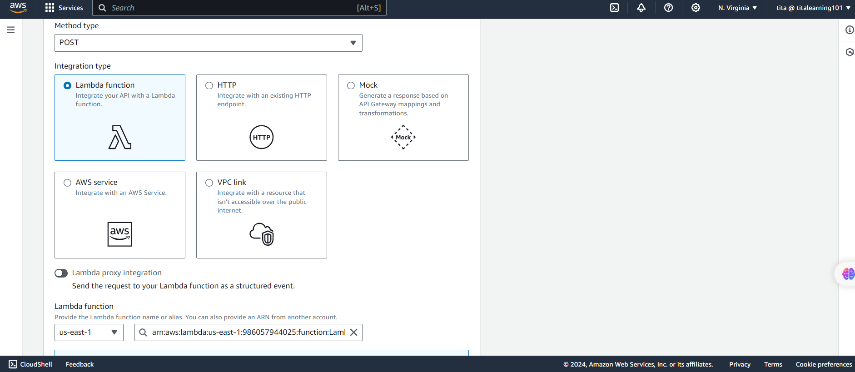
Create Method

Slide 12
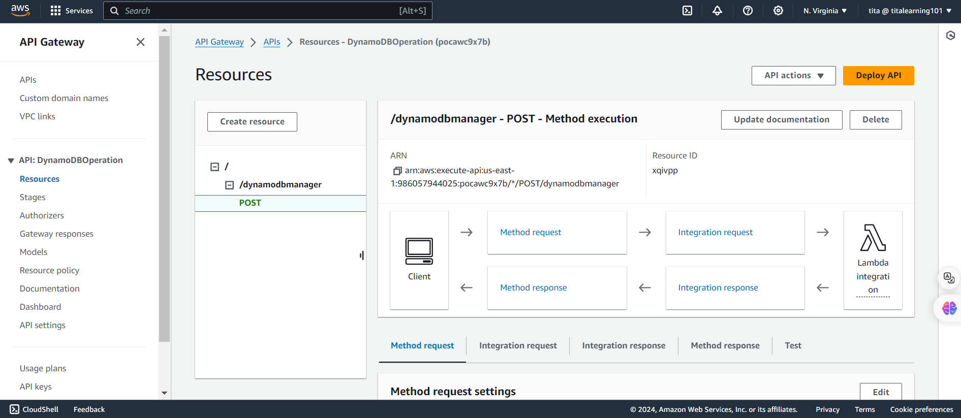
RestAPI with Resources and POST Method Configured

Slide 13
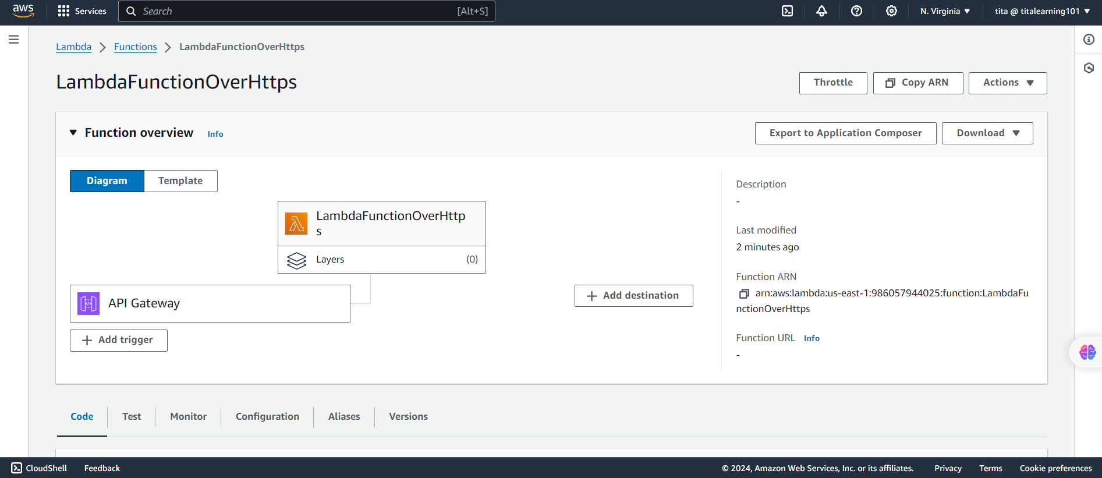
Back to Lambda

Slide 14
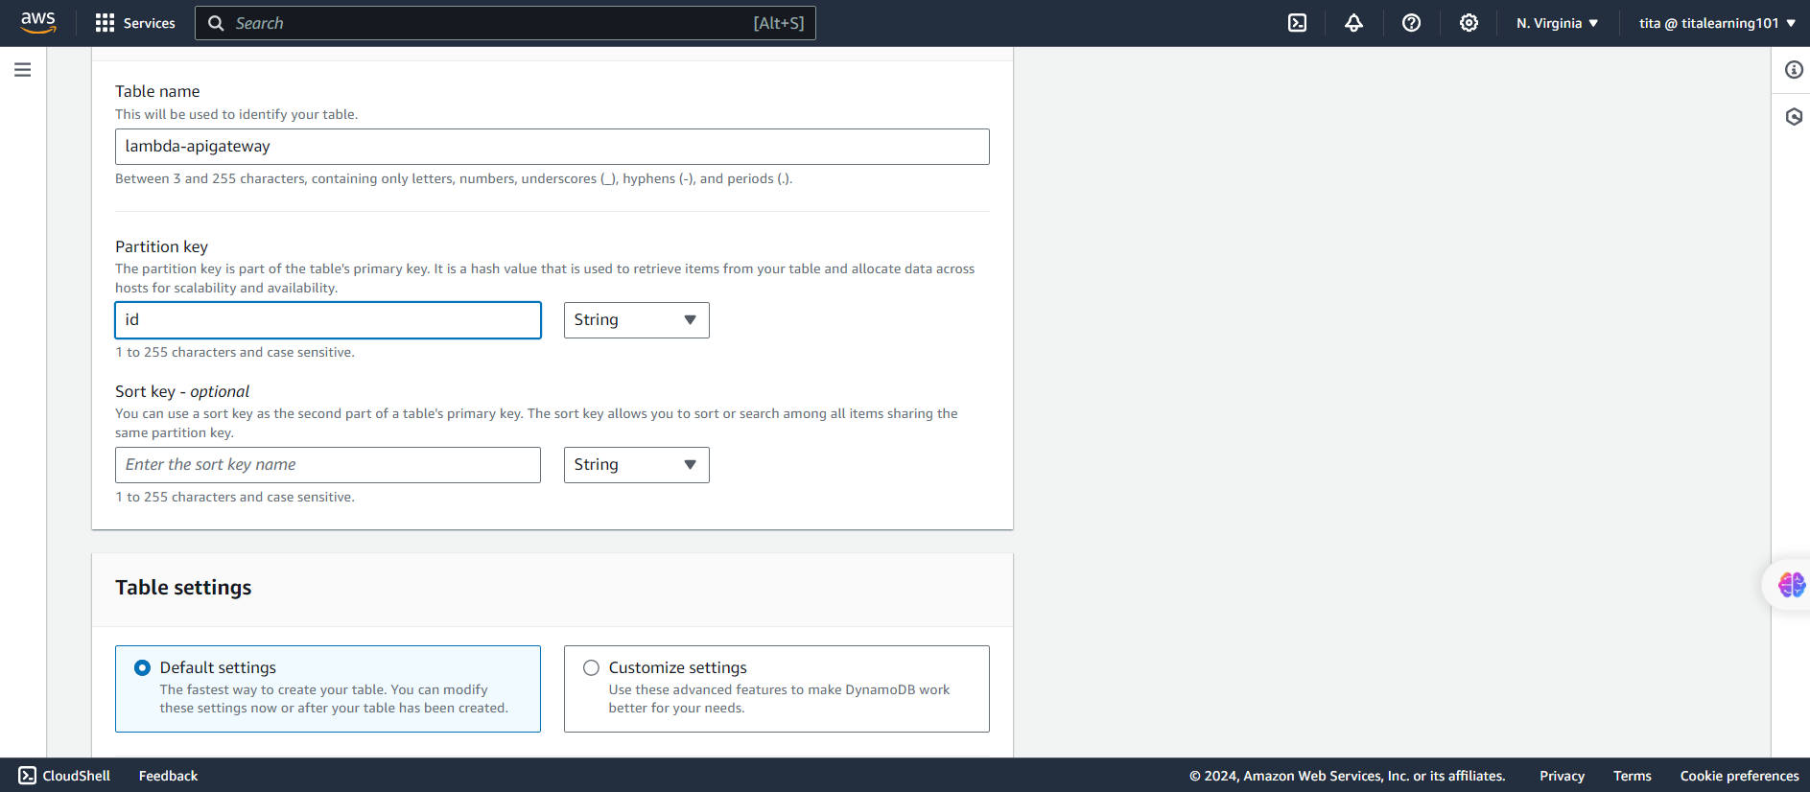
DynamoDB Table Creation

Slide 15
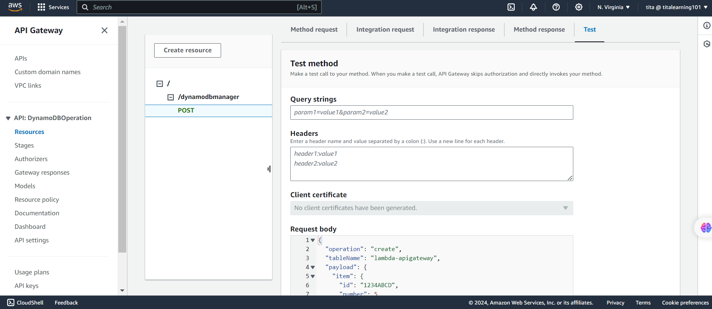
Test on RestAPI

Slide 16
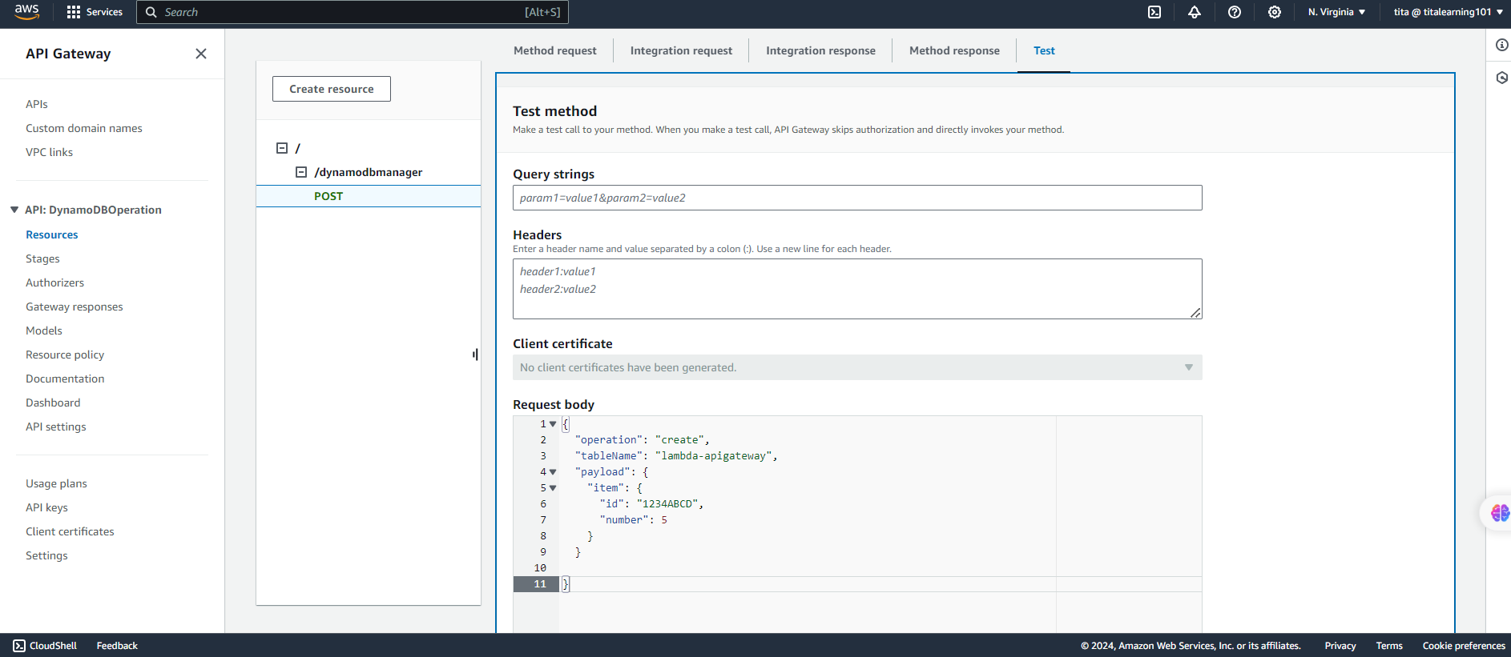
Test on RestAPI

Slide 17
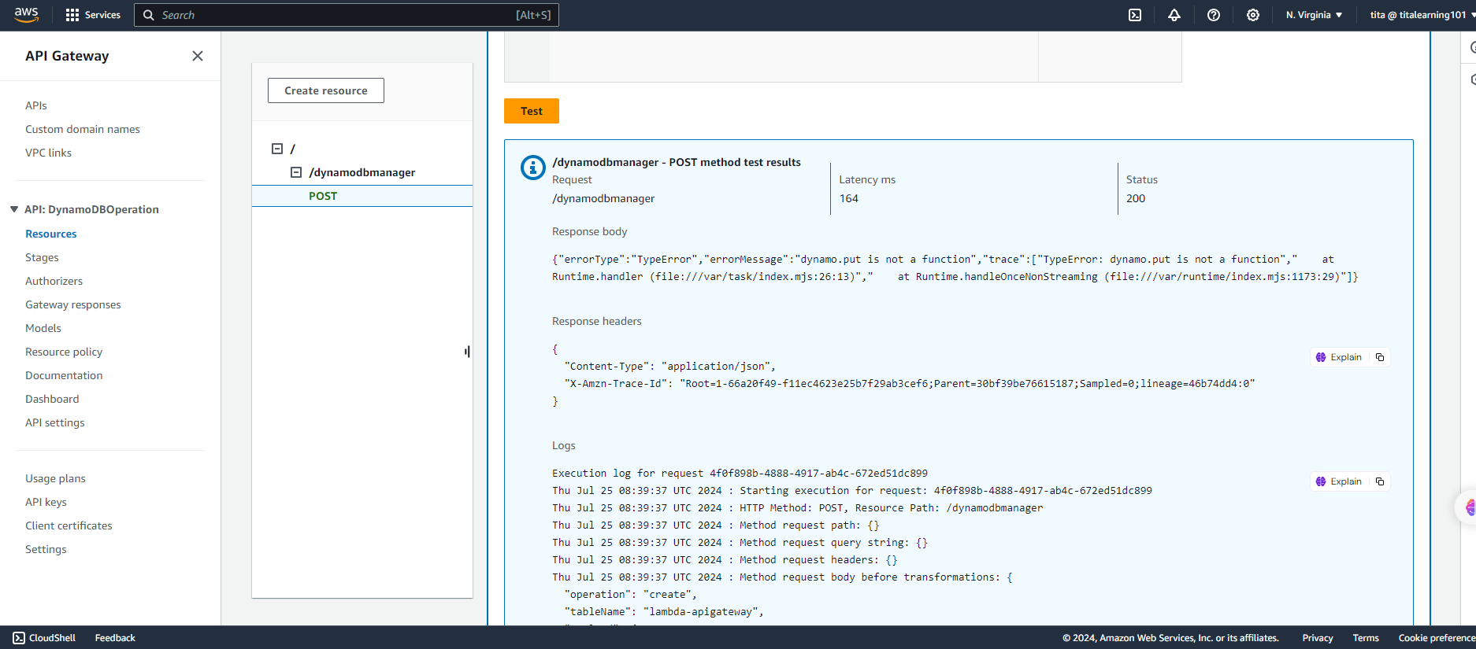
Status 200 on RestAPI

