Slide 1







REST API with a Lambda proxy integration
AWS Cloud
Browser
Lambda Invoke
Git users
Amazon API Gateway
AWS Lambda
Amazon CloudWatch
Anthony Usoro
AWS SAA, DVA
DevOps Instructor

Slide 2
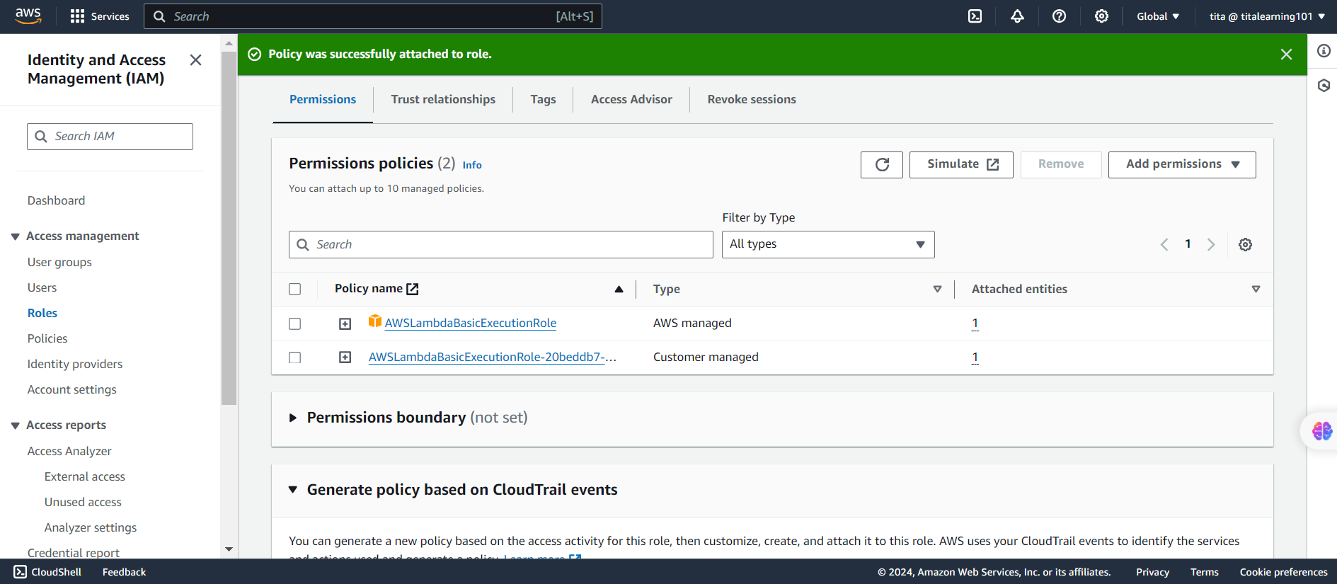
Lambda IAM Role

Slide 3
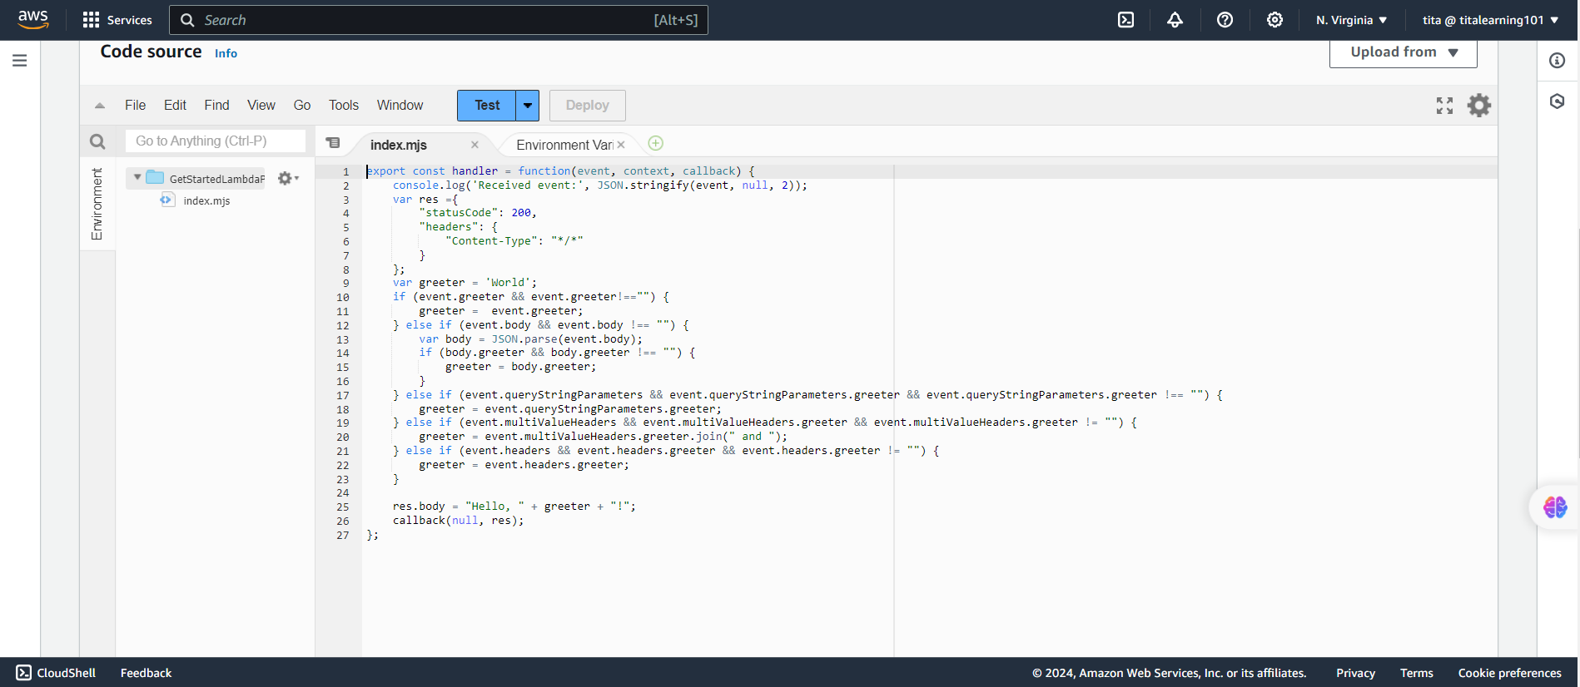

Slide 4
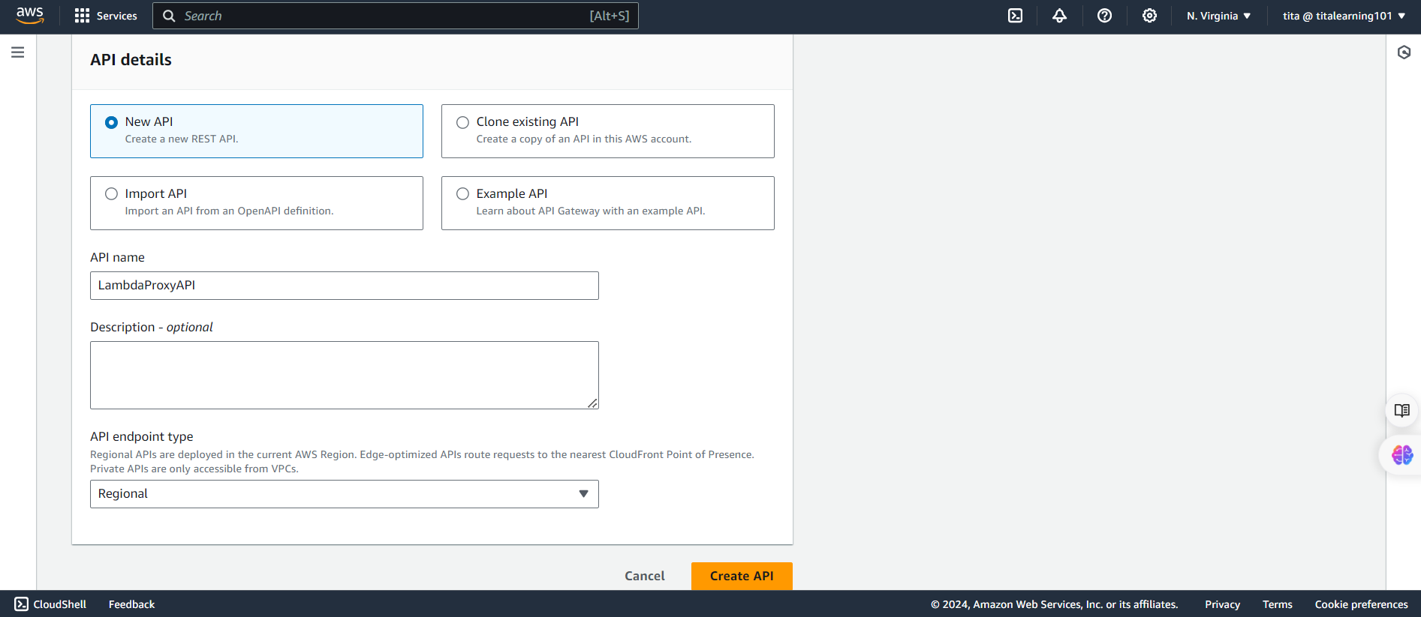
Restful API Setup

Slide 5
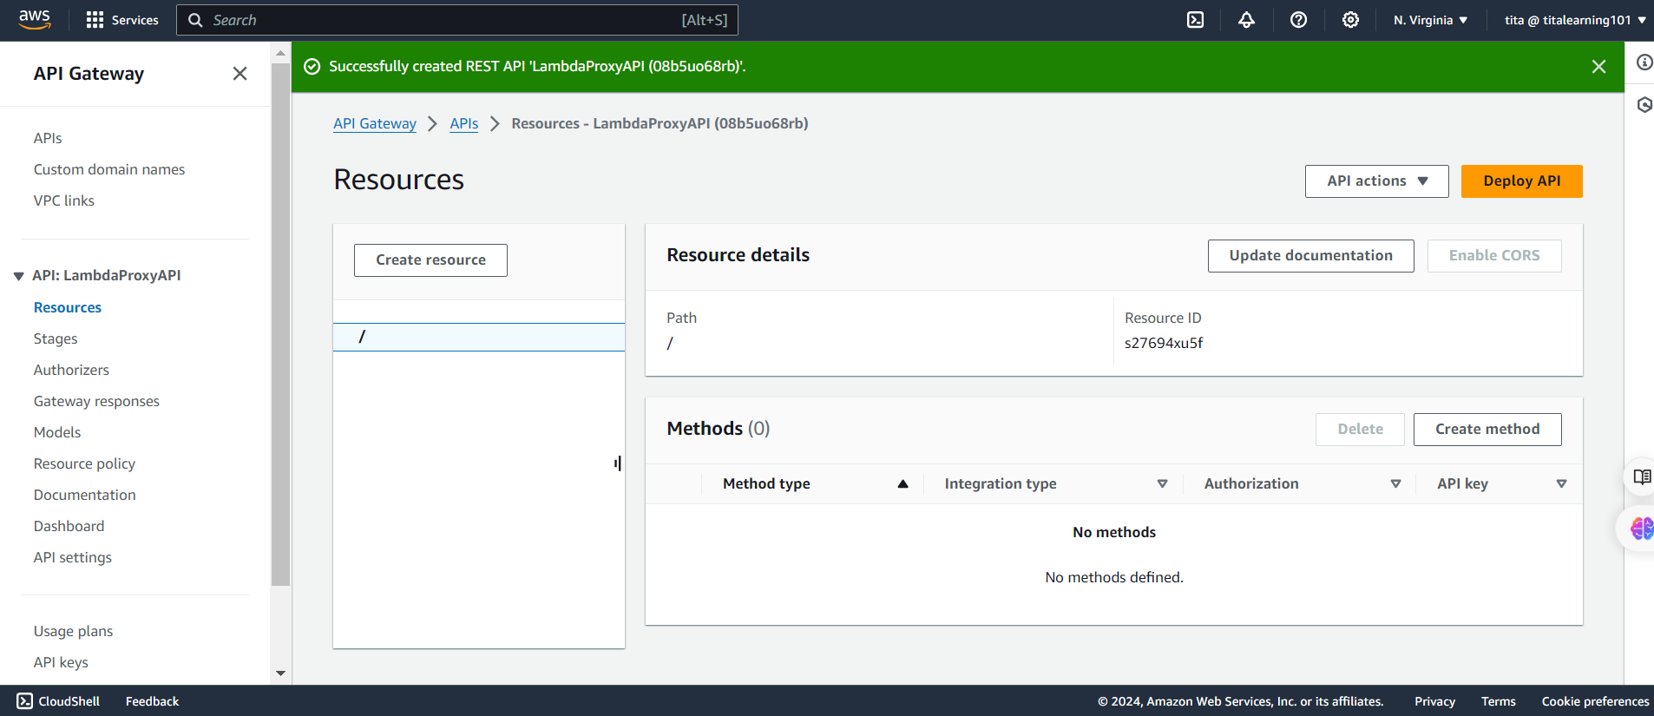

Slide 6
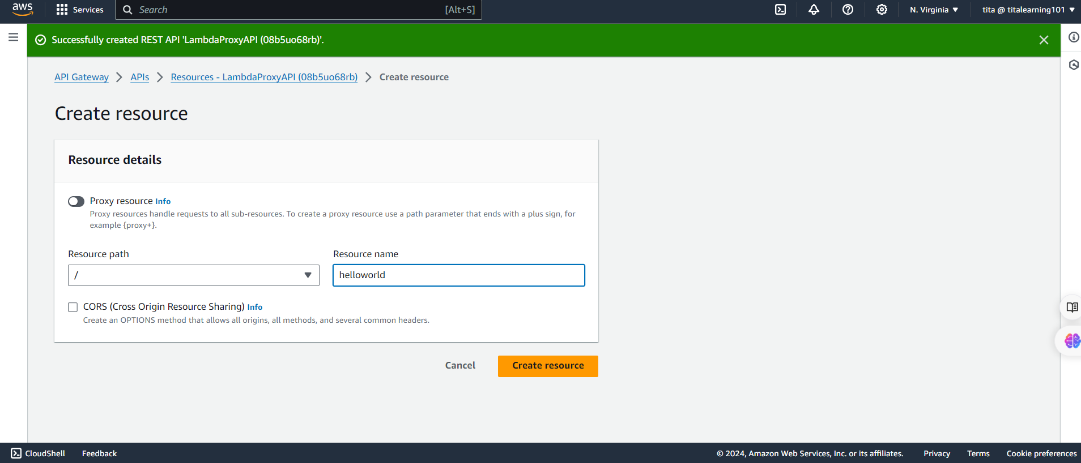

Slide 7
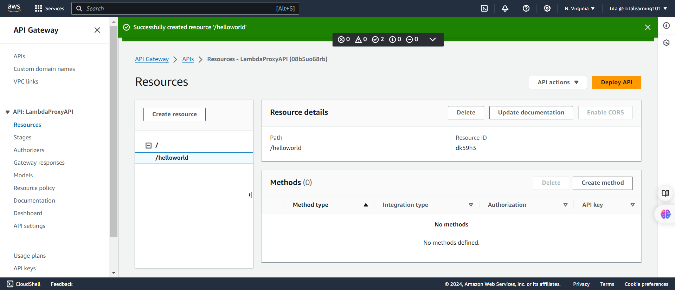

Slide 8
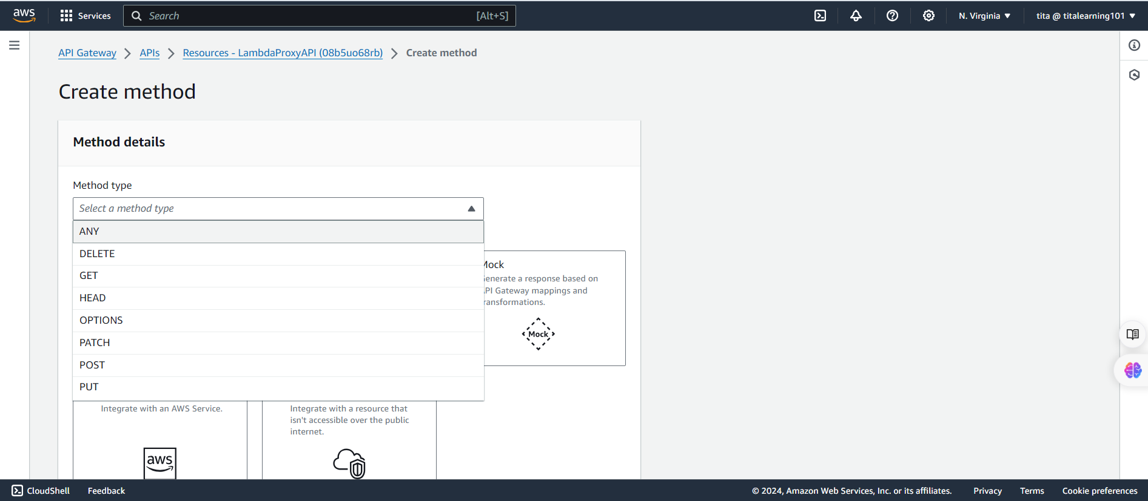

Slide 9
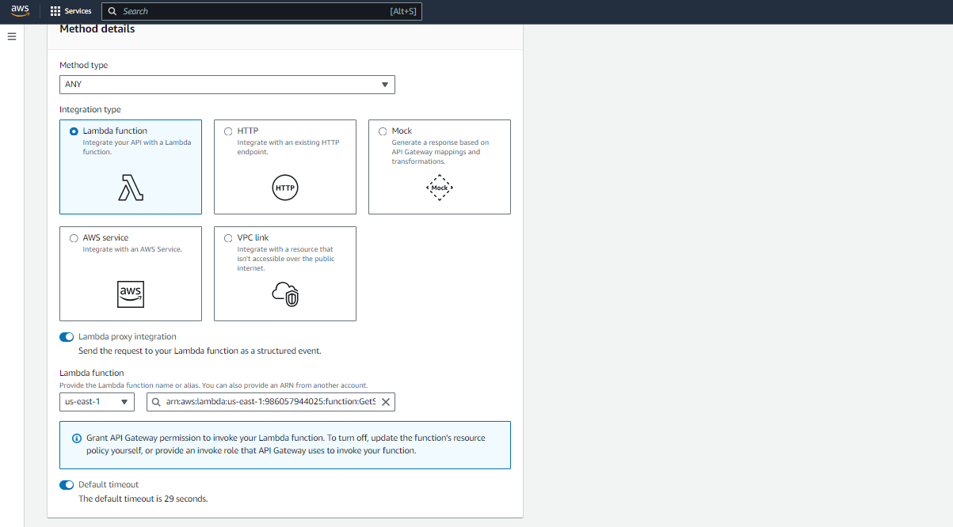

Slide 10
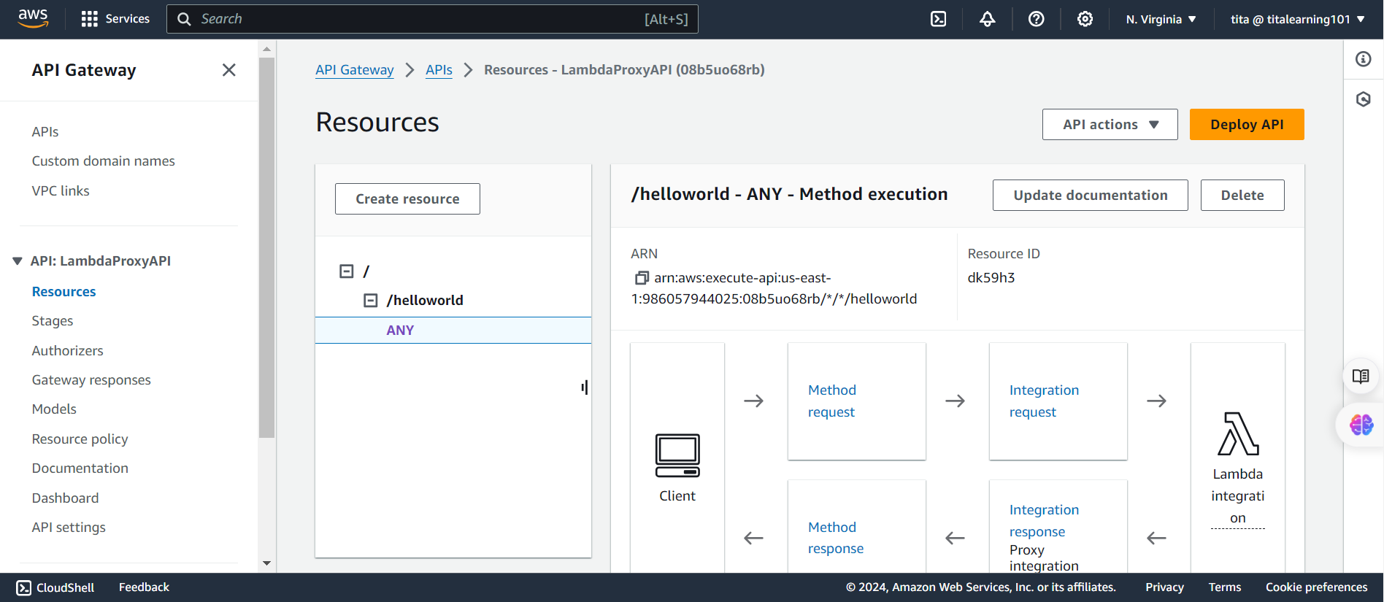

Slide 11
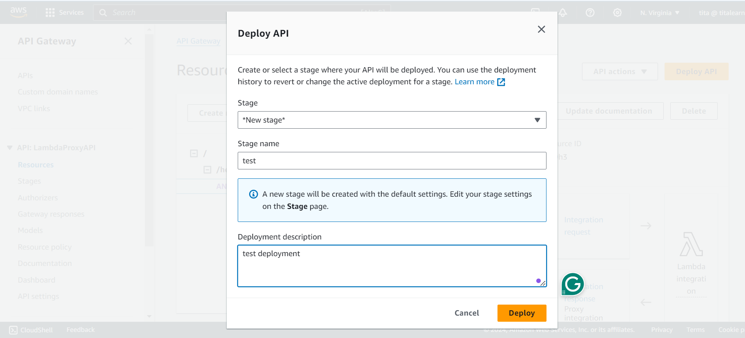

Slide 12
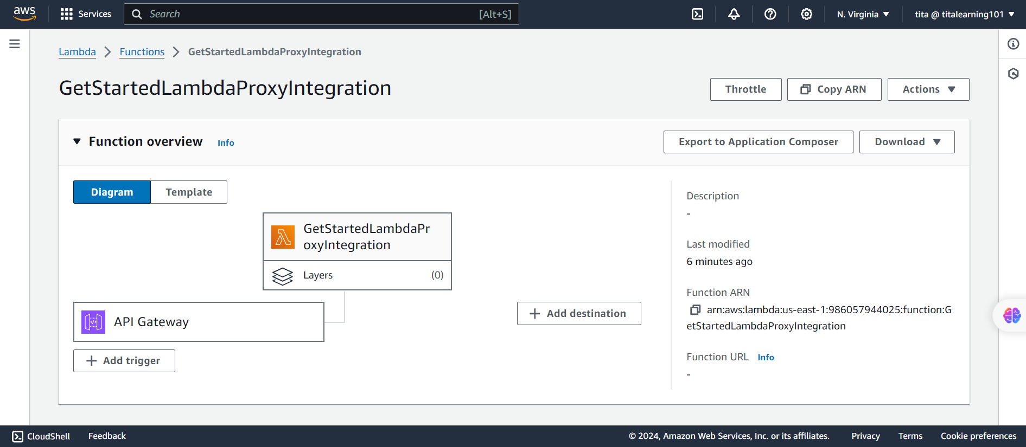

Slide 13
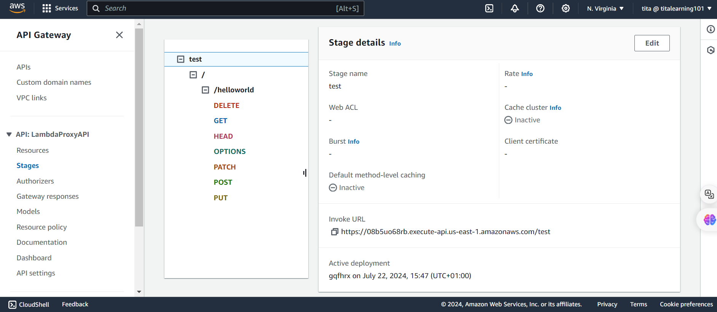

Slide 14
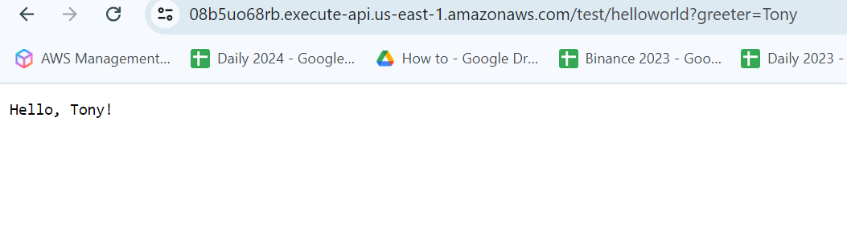
Check on browser
https://08b5uo68rb.execute-api.us-east-1.amazonaws.com/test/helloworld?greeter=Tony

Slide 15
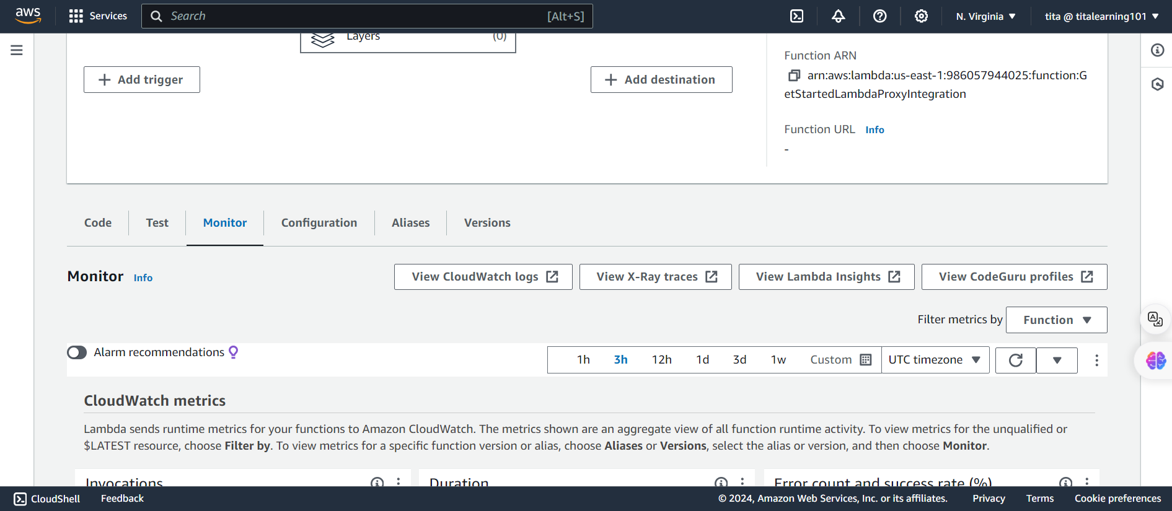
Cloudwatch

Slide 16
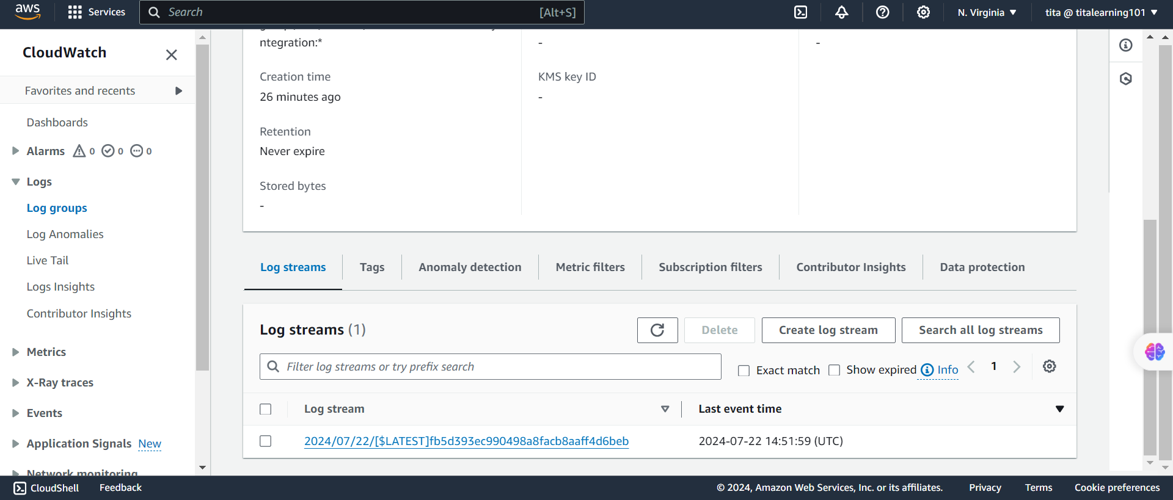

Slide 17
