Slide 1
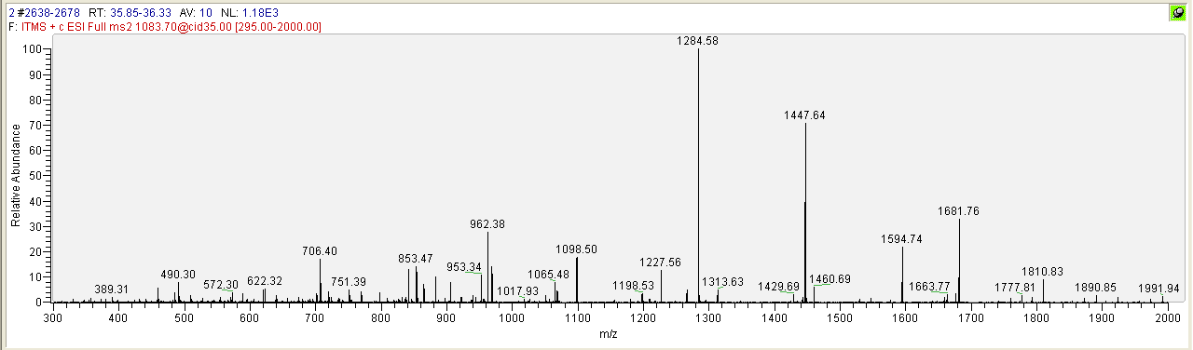
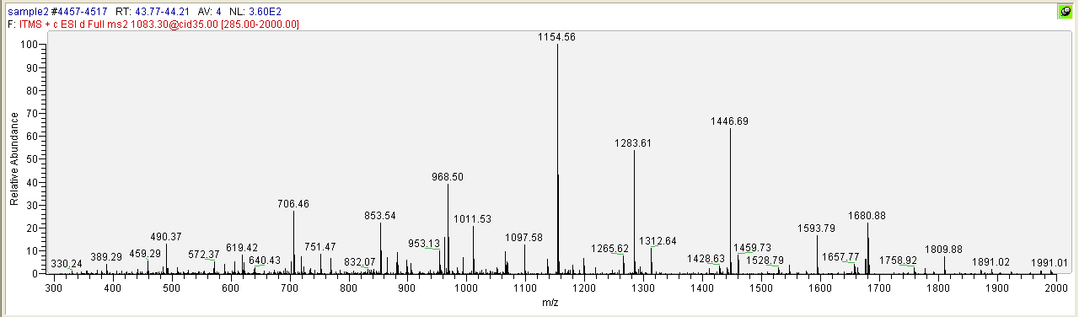
MS/MS spectra for IEIESFYGEEDFSETLTR (internal standard)
MS/MS spectra for IEIESFYEGEDFSETLTR (product of GRP68 trypsin digestion)

Slide 2
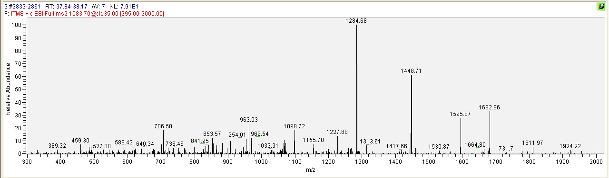
MS/MS spectra for IEIESFYGEEDFSETLTR (internal standard) + IEIESFYEGEDFSETLTR (product of GRP68 trypsin digestion)

Slide 3
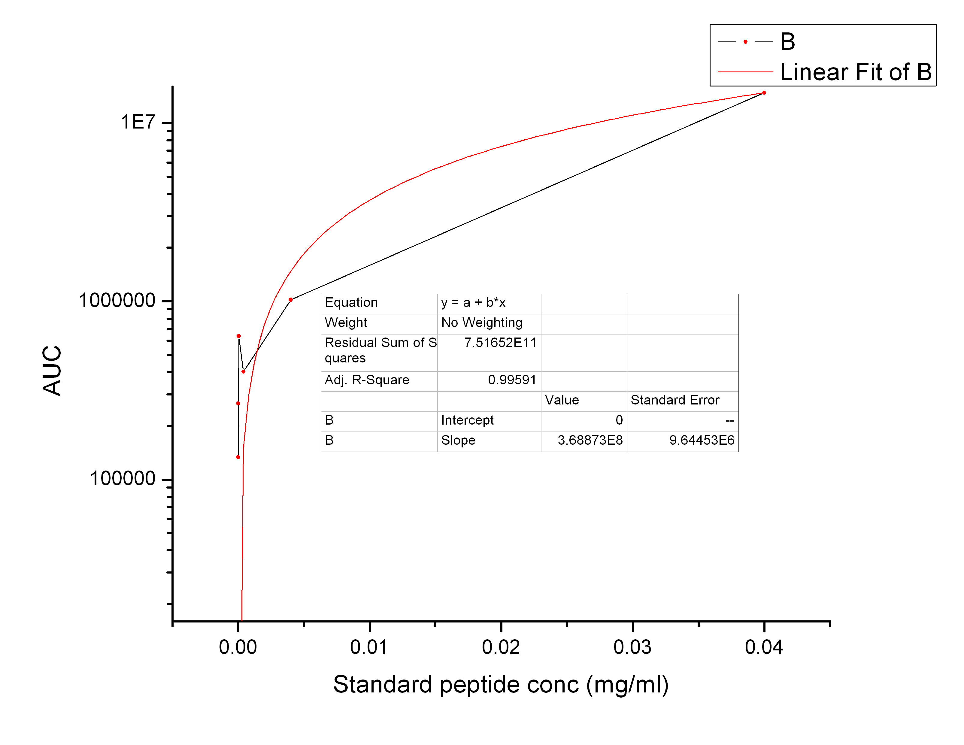
IEIESFYEGEDFSETLTR
Standard curve - concentration as a function of signal intensity
0.6 μg
6 pg

