Slide 1
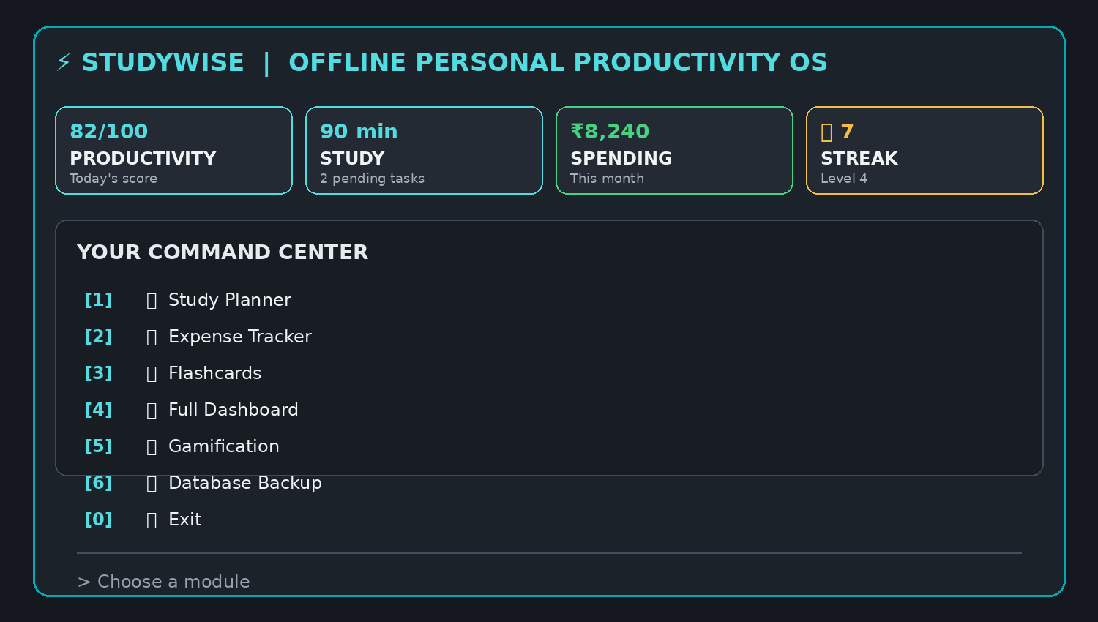
STUDYWISE CLI
OFFLINE PERSONAL PRODUCTIVITY SYSTEM
A simple terminal app for students
HACKATHON PROJECT
AI AVENGERS • NTTF MURBAD • CP08 / CS2
PLAN • TRACK • LEARN • GROW

Slide 2
01
INTRODUCTION
StudyWise CLI is one terminal application that helps students manage daily productivity.
📚 STUDY
💰 EXPENSES
🧠 FLASHCARDS
Create tasks and track study time.
Record spending and set a budget.
Revise topics using question cards.
Everything is saved locally using SQLite.
STUDYWISE CLI • AI AVENGERS
HACKATHON 2026–27

Slide 3
02
Problem Statement
Students use different apps for different daily tasks.
01 SCATTERED TOOLS
02 MISSED REVISION
03 NO SINGLE VIEW
Study and expenses are kept separately.
Students may forget to revise on time.
Progress is not visible in one place.
Our idea: combine these simple needs into one CLI.
STUDYWISE CLI • AI AVENGERS
HACKATHON 2026–27

Slide 4
03
Our Solution
One simple command-line system for planning, learning and tracking.
📚 STUDY PLANNER
💰 EXPENSE TRACKER
🧠 FLASHCARDS
Tasks • subjects • study timer
Expenses • budget • summary
Cards • review • scheduling
📊 DASHBOARD
🏆 GAMIFICATION
Shows daily progress.
XP, levels and streaks.
STUDYWISE CLI • AI AVENGERS
HACKATHON 2026–27

Slide 5
04
Main Features
Study Planner
Expense Tracker
Flashcards
Create and complete study tasks.
Add expenses and monthly budget.
Create decks and revise cards.
Spaced Revision
Dashboard
Gamification
Shows cards again after a gap.
Shows important daily stats.
Earn XP and build streaks.
STUDYWISE CLI • AI AVENGERS
HACKATHON 2026–27

Slide 6
05
User Interface
• Simple numbered menu
• Easy-to-read tables
• Progress bars and panels
• All features run inside the terminal
Goal: easy for a student to use every day.
STUDYWISE CLI • AI AVENGERS
HACKATHON 2026–27

Slide 7
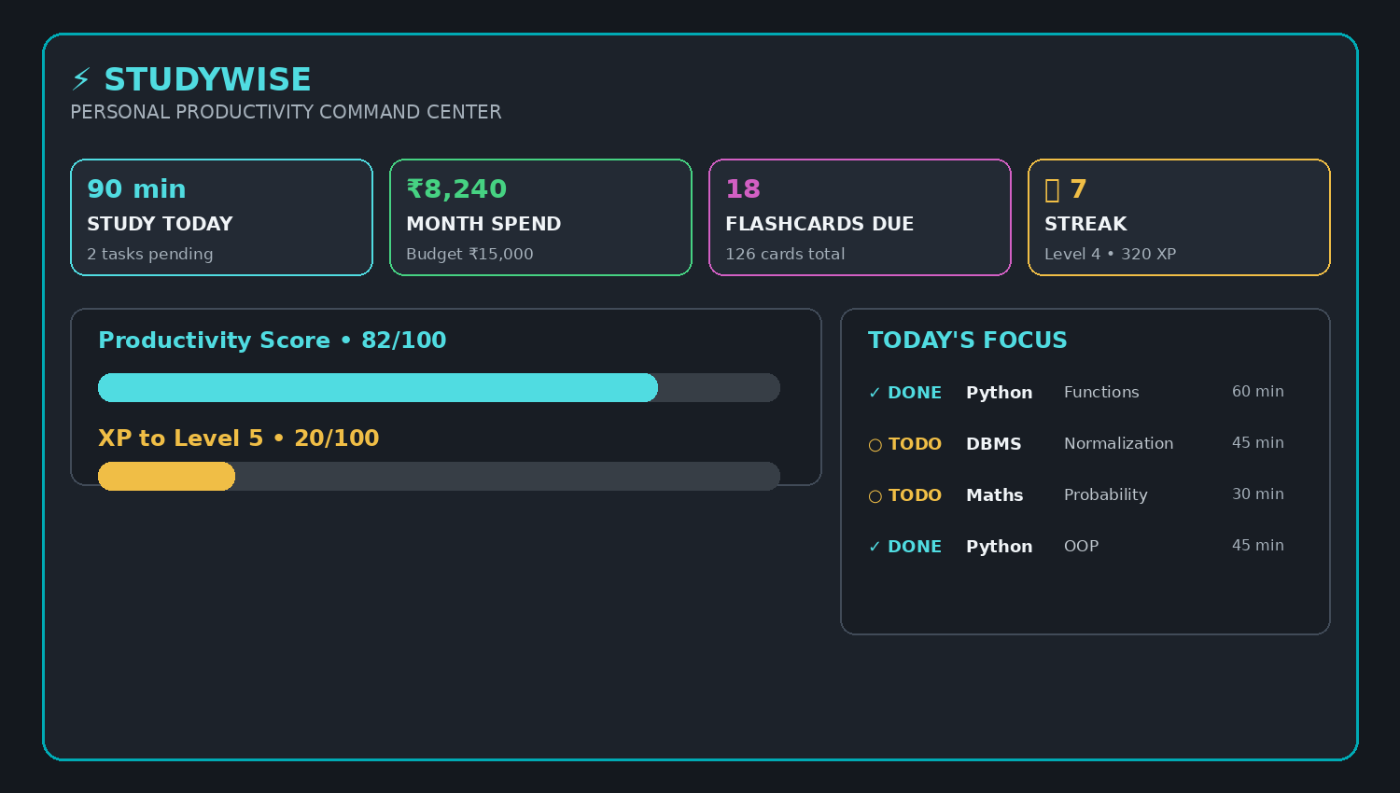
06
Dashboard
• Study time
• Pending tasks
• Monthly spending
• Flashcards due
• XP and streak
One screen = quick progress check.
STUDYWISE CLI • AI AVENGERS
HACKATHON 2026–27

Slide 8
07
How It Works
1
2
3
4
5
PLAN
FOCUS
TRACK
REVISE
CHECK
Add a task
Study with timer
Add an expense
Review flashcards
View dashboard
The result is a simple daily productivity cycle.
STUDYWISE CLI • AI AVENGERS
HACKATHON 2026–27

Slide 9
08
Technology Used
PYTHON
RICH
SQLITE
Main programming language
Terminal design
Local database
PYTEST
GIT / GITHUB
Testing
Team collaboration
Why? Fast to build • easy to run • no server needed
STUDYWISE CLI • AI AVENGERS
HACKATHON 2026–27

Slide 10
10
Advantages
ADVANTAGES
LIMITATIONS
• One app for daily student needs
• Works offline
• Easy terminal interface
• Saves data locally
• Shows progress clearly
• Terminal only
• No cloud sync yet
• No mobile app
• Basic analytics
Good hackathon MVP with clear room to improve.
STUDYWISE CLI • AI AVENGERS
HACKATHON 2026–27

Slide 11
11
Future Scope
CALENDAR
ANALYTICS
AI
Add reminders
Better progress charts
Personal study suggestions
CLOUD
MOBILE
Sync across devices
Android / iOS app
Future goal: make StudyWise useful on every device.
STUDYWISE CLI • AI AVENGERS
HACKATHON 2026–27

Slide 12
CONCLUSION
STUDYWISE CLI
THANK YOU
One simple tool for student productivity.
AI AVENGERS
NTTF MURBAD
Questions?
PLAN
TRACK
LEARN
GROW
Hackathon 2026–27

Slide 13





12
Team — AI AVENGERS
ADINATH.S
DIPALI.R
KRISHNA.P
SHIVAM.T
SAHIL.B
PRESENTATOR
TESTER
DOCUMENTATOR
DEVLOPER
DEBUGER
Team goal: build one complete, working CLI product.
STUDYWISE CLI • AI AVENGERS
HACKATHON 2026–27

