Slide 1
Information theory project:
Cloud storage
Samuel Van de Velde
Samuel.VandeVelde@telin.ugent.be
Prof. Heidi Steendam
Department of Telecommunications and Information Processing TELIN/UGent
University of Ghent – February 2015
pag. <number>

Slide 2
Practical
Groups of 2-3 people
groups can be made on Minerva
deadline: Friday 22th of May 2015
Hand in printed report
Technicum floor ‘–T’, then take the stairs up.
Upload matlabcode
Minerva
zip-file: groupXX.zip with a map groupXX
Score: 20% of total (participation is mandatory)
University of Ghent - February 2015
pag. <number>

Slide 3


Goal
Create a reliable system for distributed (mass) data storage
University of Ghent – February 2015
pag. <number>

Slide 4
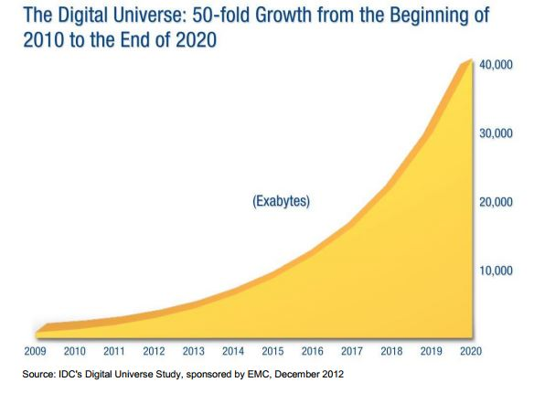
Distributed data storage
Every year, the amount of data to be stored increases with 40%
Value | Abbr. | Metric
1000 | kB | kilobyte
1000² | MB | megabyte
1000³ | GB | gigabyte
1000⁴ | TB | terrabyte
1000⁵ | PB | petabyte
1000⁶ | EB | exabyte
University of Ghent – February 2015
pag. <number>

Slide 5
Goal
Design goal
We will design a distributed storage system with:
3 datacenters spread over the world
2 racks in each datacenter
600 disks (6-10 TB) in each rack
Total raw capacity: 36 petabytes (PB)
University of Ghent – February 2015
pag. <number>

Slide 6
Distributed data storage
Modern requirements for mass data storage
Scalable
High reliability
High availability
Flexibility
Low cost / low maintance
University of Ghent – February 2015
pag. <number>

Slide 7
Distributed data storage
Why reliability?
Large storage systems are in the order of petabytes (around 1000-3000 disks).
Disks fail!
Cheap disks fail even more.
Power outage or natural disaster in datacenter
University of Ghent – February 2015
pag. <number>

Slide 8
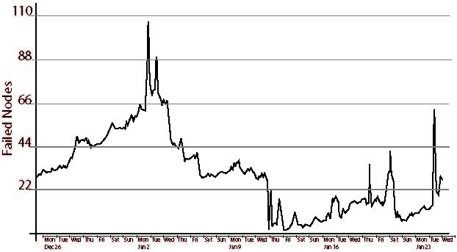
Distributed data storage
Number of failed nodes over a single month period in a 3000 node production cluster of Facebook.
University of Ghent – February 2015
pag. <number>

Slide 9
Distributed data storage
High reliability
Several ways to obtain reliability
Replication: make several copies on different disks of the same data (RAID 1)
Single parity: Add a redundant disk that can recover one failed disk (RAID 5)
Double parity: two redundant disks for 2 parities. This can recover 2 failed disks (RAID 6)
Erasure codes: can recover more than 2 failed disks.
University of Ghent – February 2015
pag. <number>

Slide 10
Distributed data storage
RAID 5:
If disk 1 failes we can recover the data by XOR-ing the data on the remaining disks:
111 XOR 011 XOR 001 = 101
Disk 1 | Disk 2 | Disk 3 | Redundant disk
101 | 111 | 011 | 101 XOR 111 XOR 011 = 001
University of Ghent – February 2015
pag. <number>

Slide 11
Distributed data storage
What are erasure codes?
They are a subclass of error-correcting codes.
For error-correcting you don’t know where the error was. In erasure coding, you know this (for example, which hard disk failed)
Examples of optimal erasure codes: Reed-Solomon codes
In this project you will use an RS-code for reliability.
University of Ghent – February 2015
pag. <number>

Slide 12

Project
Project information
Assignment available on Minerva
The project is implemented in MATLAB
A number of files will be available on Minerva, you will have te complete the given functions.
Input en output arguments of the functions cannot be altered.
University of Ghent – February 2015
pag. <number>

