Slide 1
Week 2 Amazon Web Services Introduction
Dr Zhi Zhang

Slide 2
Overview
Brief introduction to virtualization
AWS introduction
Lab submission, marking rubrics and AWS resources

Slide 3

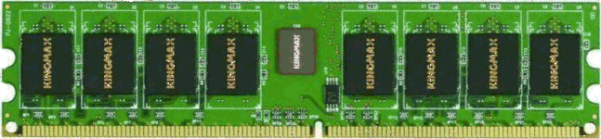





Virtualization: the core technique of cloud computing
Bob
Charlie
Alice
Physical machine
Daniel
Suppose Alice has a machine with 16 CPUs and 64 GB of memory. There are three customers:
Bob wants a machine with 8 CPUs and 32 GB of memory
Charlie wants a machine with 8 CPUs and 32 GB of memory
Daniel wants a machine with 4 CPUs and 8 GB of memory
What should Alice do?

Slide 4


Virtualization: the core technique of cloud computing
Bob
Virtual machine monitor
Charlie
Alice
Physical machine
Virtual machines
Daniel
Alice installs a virtual machine monitor (VMM) and provides each customer with a guest OS/virtual machine (VM) and the requested resources
Bob is assigned with 8 vCPUs and 32 GB of guest physical memory
Charlie is assigned with 8 vCPUs and 32 GB of guest physical memory
Daniel is assigned with 4 vCPUs and 8 GB of guest physical memory
From each customer's perspective, it appears as if they owned the physical machine all by themselves (indicating VM isolation)
Obviously, more resources are provided by virtualization.

Slide 5
VM live migration
Bob
Virtual machine monitor
Alice
Charlie
Virtual machines
Daniel
Physical machines
What if the machine needs to be shut down for maintenance?
Alice can migrate the running VMs to different physical machines without interrupting any customers.

Slide 6
VM isolation
Bob
Virtual machine monitor
Charlie
Alice
Physical machine
Virtual machines
Daniel
One customer cannot access data of another customer

Slide 7
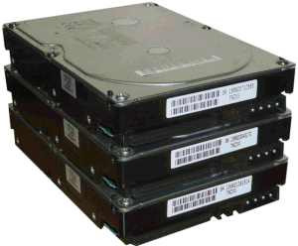
How is virtualization implemented?
VM 1
VM 2
VM | Mem_Idx in VM | Mem_Idx in VMM
1 | 0-99 | 0-99
1 | 300-399 | 100-199
2 | 0-99 | 300-399
2 | 200-299 | 500-599
2 | 600-699 | 400-499
App
App
App
OS 1
OS 2
VMM
Translation table
Physical machine
VMM ("Hypervisor") has translation tables that map virtual (guest) memory to physical memory
Example: VM 1 accesses memory cell #0; VMM maps this to memory cell #0. VM 2 accesses memory cell #0; VMM maps this to memory cell #300.

Slide 8
How is virtualization implemented?
VM 1
VM 2
VM | Mem_Idx in VM | Mem_Idx in VMM
1 | 0-99 | 0-99
1 | 300-399 | 100-199
2 | 0-99 | 300-399
2 | 200-299 | 500-599
2 | 600-699 | 400-499
App
App
App
OS 1
OS 2
VMM
Translation table
Physical machine
VMM ("Hypervisor") has translation tables that map virtual (guest) memory to physical memory.
VMs also time-share CPUs
(a time-multiplexed manner)
Time-multiplex does not work for memory. Why?
What if Alice serves more customers?

Slide 9
The benefits of virtualization
Flexible to cloud providers, who
can generate VMs with different resource capabilities
can migrate VMs if necessary (e.g., for maintenance)
can increase load by overcommitting resources
Secure to VMs
One VM cannot access another without permission
Convenient to customers
Complete control over the virtual 'hardware' (can install their own operating systems, applications, ...)
But there might be performance impacts
Load changes in one VM may affect the performance of another VM on the same physical machine
e.g., Bob is allowed to increase his vCPUs from 8 to 16.

Slide 10
Amazon: the pioneer
Jul 2002: Amazon Web Services launched
Mar 2006: Amazon S3 (Simple Storage Service) launched
Proposed the ‘pay-per-use’ business model, which is now the standard in cloud computing
Aug 2006: Amazon EC2 (Elastic Compute Cloud) launched
Nov 2009: Microsoft Azure Beta launched
Microsoft’s online services are gradually transitioning to Azure
Dec 2013: Google Compute Engine launched

Slide 11
What services does a cloud provide?
Three common types of cloud services:
Software as a service (SaaS)
SaaS delivers functional software on a subscription basis.
Platform as a service (PaaS)
PaaS provides a platform and pre-configured environment for users to develop their software.

Slide 12
What services does a cloud provide?
Three common types of cloud services:
Software as a service (SaaS)
SaaS delivers fully functional software on a subscription basis.
Platform as a service (PaaS)
PaaS provides a platform and pre-configured environment for users to develop their software.
Infrastructure as a service (IaaS)
IaaS offers basic computing resources such as virtual machines, storage, and network bandwidth.

Slide 13

Software as a Service (SaaS)
SaaS provider
Application
Middleware
Hardware
Cloud provides an entire application
Email, Drive, Doc, Slides,...
Example: Google Workspace

Slide 14
Platform as a Service (PaaS)
PaaS provider
Application
Middleware
Hardware
Cloud provides middleware
Common Language Runtime environment
Example: Heroku

Slide 15
Infrastructure as a Service (IaaS)
IaaS provider
Application
Middleware
Hardware
Cloud provides hardware resources
Virtual Machines, Virtual Memory, Virtual Disk,...
Examples: AWS Elastic Compute Cloud (EC2)

Slide 16
What services does a cloud provide?
Three common types of cloud services:
Software as a service (SaaS)
Platform as a service (PaaS)
Infrastructure as a service (IaaS)
Other XaaS (anything as a service) types have been defined, but are less common
Desktop as a service (DaaS)
Network as a service (NaaS)
...

Slide 17

Public/Community/Private clouds
Company A
Company B
Public
Community
Private
Targeting different customers:
Public cloud: open to general public.
Example: AWS, Microsoft Azure, Google Compute Engine
Community cloud: shared by multiple organizations with common interests and requirements.
Example: Healthcare Sectors
Private cloud: exclusively used by a single organization.
Example: Google’s internal datacenter

Slide 18
Practice Questions
[7 marks] Q1: What is XaaS cloud computing? Describe the different categories of XaaS cloud computing can provide and specific examples of each service.

Slide 19
Practice Questions
[7 marks] Q1: What is XaaS cloud computing? Describe the different categories of XaaS cloud computing can provide and specific examples of each service.
[1 mark] Cloud computing offers a range of services, referred to as "XaaS," which stands for "Anything as a Service."
[2 marks] Infrastructure as a Service that provides virtualized computing resources. An example is AWS EC2.
[2 marks] Platform as a Service that provides a runtime environment for developers to build, deploy, and manage applications. An examples is Google App Engine or Heroku.
[2 marks] Software as a Service that delivers fully functional software applications. An example is Microsoft 365 office or Google workplace.

Slide 20
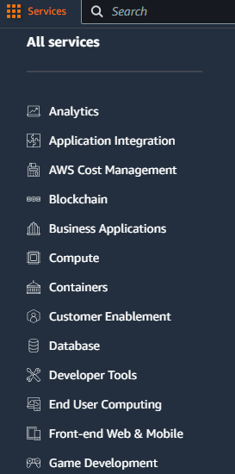
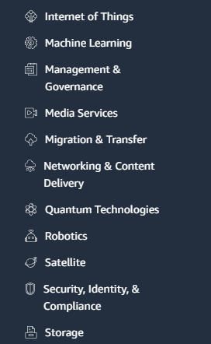
AWS: the leading cloud providing a wide range of services

Slide 21
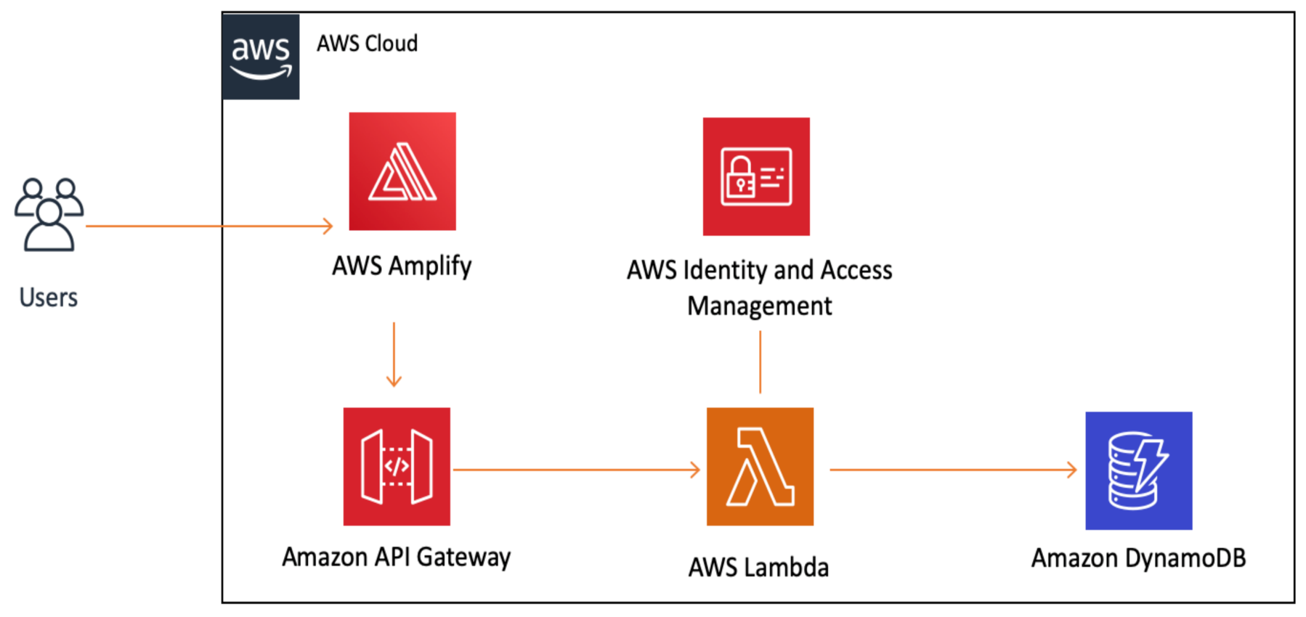
AWS: the leading cloud providing a wide range of services
The services satisfy different needs of customers:
Allowing us to design, deploy, and manage applications on the cloud, so-called application architecture.
e.g., build a web application

Slide 22
What is an application architecture?
It is the structural design and organization of a software application.
Main types of application architectures
Monolithic architecture: combines the frontend, backend, and database functionalities into a single application.
e.g., ?

Slide 23
What is an application architecture?
It is the structural design and organization of a software application.
Main types of application architectures
Monolithic architecture: combines the frontend, backend, and database functionalities into a single application.
e.g., wordpress: a content management system (CMS)

Slide 24
What is an application architecture?
It is the structural design and organization of a software application.
Main types of application architectures
Monolithic architecture: combines the frontend, backend, and database functionalities into a single application.
e.g., wordpress: a content management system (CMS)
Client/Server architecture: an application is split into two main components: the client, which handles the user requests, and the server, which handles the processing of requests and data storage.
e.g., ?

Slide 25
What is an application architecture?
It is the structural design and organization of a software application.
Main types of application architectures
Monolithic architecture: combines the frontend, backend, and database functionalities into a single application.
e.g., wordpress: a content management system (CMS)
Client/Server architecture: an application is split into two main components: the client, which handles the user requests, and the server, which handles the processing of requests and data storage.
e.g., gmail

Slide 26
What is an application architecture?
It is the structural design and organization of a software application.
Main types of application architectures
Monolithic architecture: combines the frontend, backend, and database functionalities into a single application.
e.g., wordpress: a content management system (CMS)
Client/Server architecture: an application is split into two main components: the client, which handles the user requests, and the server, which handles the processing of requests and data storage.
e.g., gmail
Three-tier architecture: a presentation tier (frontend), application logic tier (backend), and a database tier (backend).
e.g., ?

Slide 27
What is an application architecture?
It is the structural design and organization of a software application.
Main types of application architectures
Monolithic architecture: combines the frontend, backend, and database functionalities into a single application.
e.g., wordpress: a content management system (CMS)
Client/Server architecture: an application is split into two main components: the client, which handles the user requests, and the server, which handles the processing of requests and data storage.
e.g., gmail
Three-tier architecture: a presentation tier (frontend), application logic tier (backend), and a database tier (backend).
e.g., Shopify: an e-commerce application.

Slide 28
What is an application architecture?
It is the structural design and organization of a software application.
Main types of application architectures
Monolithic architecture: combines the frontend, backend, and database functionalities into a single application.
e.g., wordpress: a content management system (CMS)
Client/Server architecture: an application is split into two main components: the client, which handles the user requests, and the server, which handles the processing of requests and data storage.
e.g., gmail
Three-tier architecture: a presentation tier (frontend), application logic tier (backend), and a database tier (backend).
e.g., Shopify: an e-commerce platform.
Cloud-based serverless architecture: known as Function-as-a-Service, which is a cloud computing model where the cloud provider provisions, maintains and scales applications.
e.g., ?

Slide 29
What is an application architecture?
It is the structural design and organization of a software application.
Main types of application architectures
Monolithic architecture: combines the frontend, backend, and database functionalities into a single application.
e.g., wordpress: a content management system (CMS)
Client/Server architecture: an application is split into two main components: the client, which handles the user requests, and the server, which handles the processing of requests and data storage.
e.g., gmail
Three-tier architecture: a presentation tier (frontend), application logic tier (backend), and a database tier (backend).
e.g., Shopify: an e-commerce platform.
Cloud-based serverless architecture: known as Function-as-a-Service, which is a cloud computing model where the cloud provider provisions, maintains and scales applications.
e.g., AWS Lambda

Slide 30
Deploying a cloud application
When an application is ready, it can be deployed onto AWS via different services:
Elastic Compute Cloud (EC2): an EC2 instance is a virtual machine that runs a Windows or Linux server. It is essentially running on Virtual Machine Monitor (VMM).
Elastic Container Service (ECS): a customized environment provided by an EC2 instance.

Slide 31
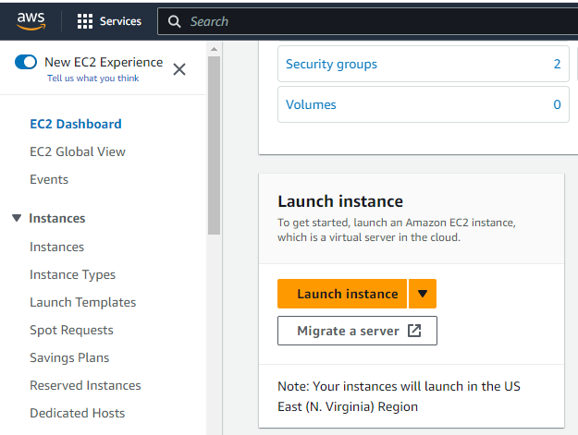
AWS EC2
Steps of creating, configuring and launching an EC2 instance :
Sign in to the AWS Management Console:
https://aws.amazon.com/ or https://489389878001.signin.aws.amazon.com/console
Navigate to EC2 Dashboard and Click “Launch instance”

Slide 32
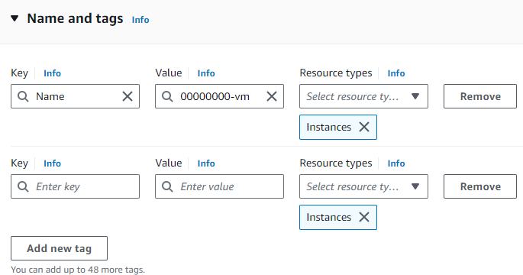
AWS EC2
Steps of creating, configuring and launching an EC2 instance :
“Name and tags”: In this step, we add a tag for the instance, e.g., Key: Name, Value: 00000000-vm. We can click the "Add new tag" button to add multiple tags as needed.

Slide 33
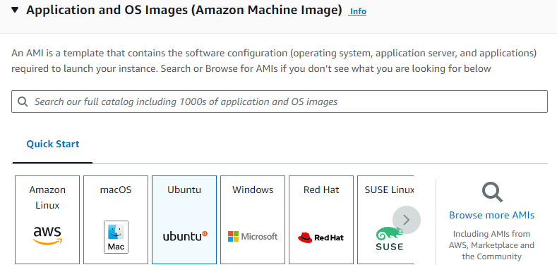
AWS EC2
Steps of creating, configuring and launching an EC2 instance :
“Application and OS Images (Amazon Machine Image)”: In this step, we select an AMI that suits our requirements.

Slide 34
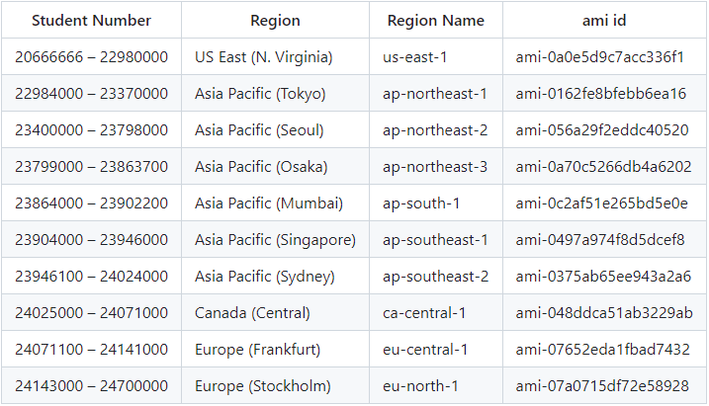
AWS EC2

Slide 35
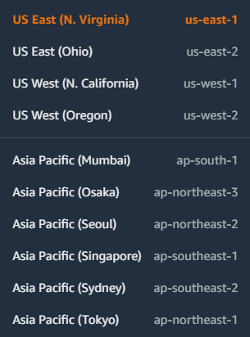
Geographical location of an instance
AWS region:
There are many different geographical locations for AWS data centers around the world, known as “Regions”, identified by names such as “us-west-2” (US West-Oregon).

Slide 36
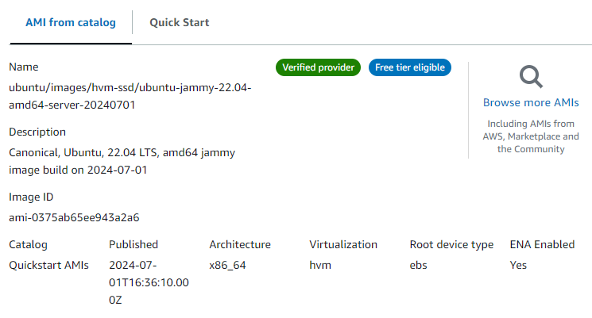
AWS EC2

Slide 37
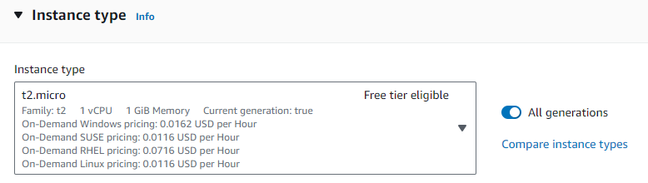
AWS EC2
Steps of creating, configuring and launching an EC2 instance :
“Instance type”: In this step, we select an appropriate instance type.

Slide 38
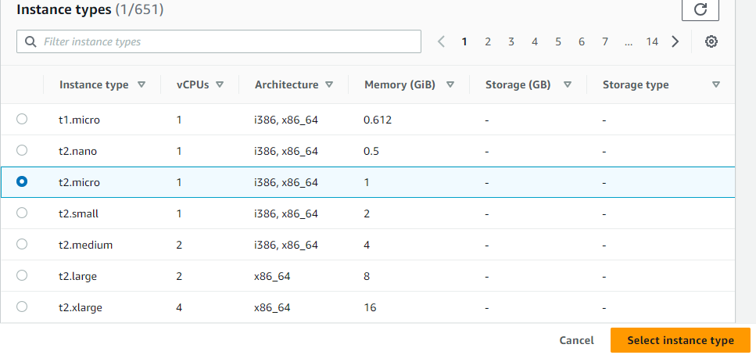
AWS EC2
Steps of creating, configuring and launching an EC2 instance :
“Instance type”
What does Architecture mean?

Slide 39
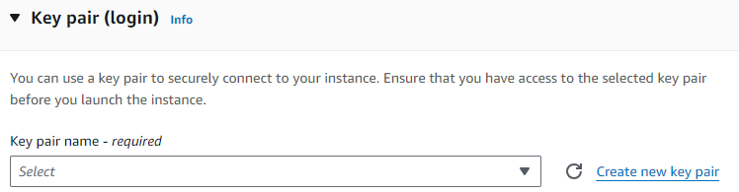
AWS EC2
Steps of creating, configuring and launching an EC2 instance :
“Key pair (login)”: In this step, we can select/create a key pair (SSH key) for secure access to our first instance.

Slide 40
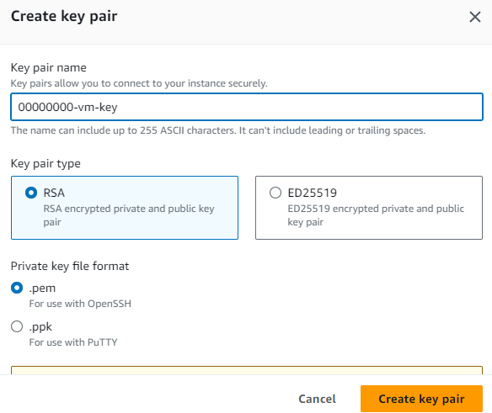
AWS EC2
Steps of creating, configuring and launching an EC2 instance :
“Key pair (login)”:

Slide 41
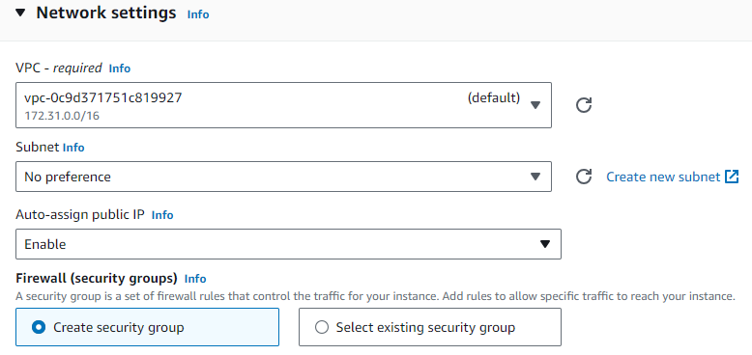
AWS EC2
Steps of creating, configuring and launching an EC2 instance :
“Network settings”

Slide 42
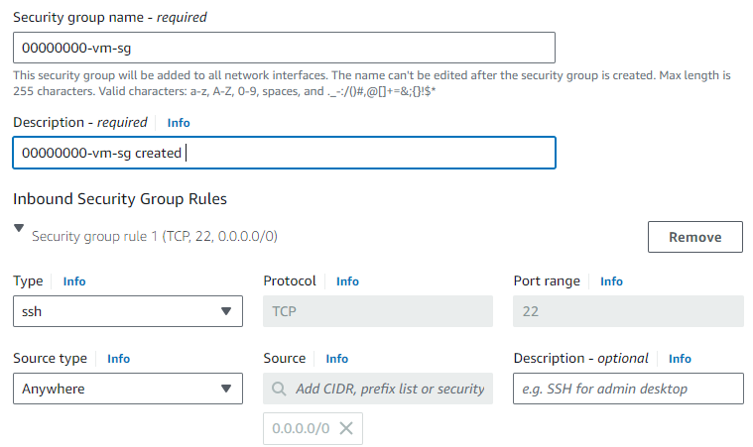
AWS EC2
Steps of creating, configuring and launching an EC2 instance :
“Network settings”
Create security group: a security group is a set of firewall rules that control the network traffic for our instance.

Slide 43
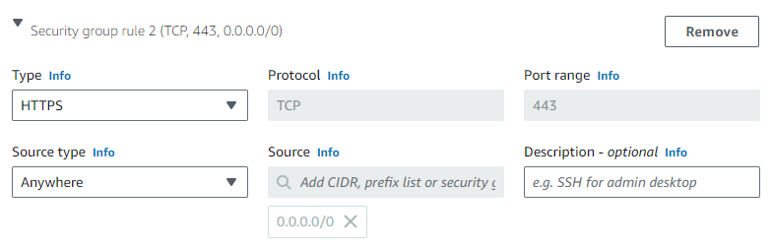
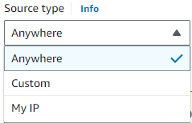
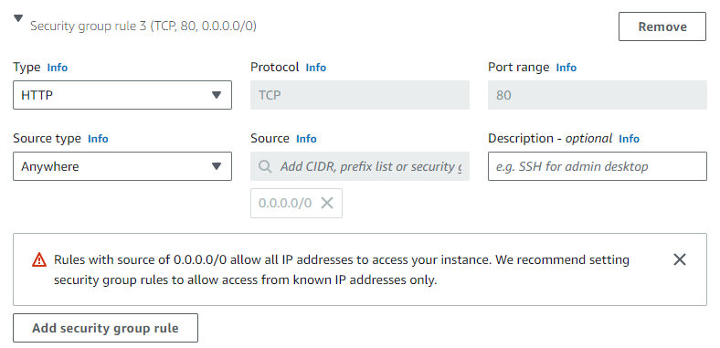
AWS EC2
Steps of creating, configuring and launching an EC2 instance :
“Network settings”
Create security group

Slide 44
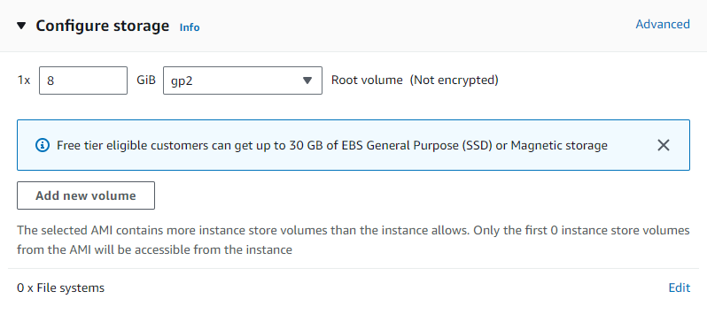
AWS EC2
Steps of creating, configuring and launching an EC2 instance :
“Configure storage”: In this step, we specify storage volume for our instance. By default, one EBS volume is attached to the instance. We can add more EBS volumes if needed.

Slide 45
AWS EC2
Steps of creating, configuring and launching an EC2 instance :
“Configure storage”
What is EBS?
EBS is a 'virtual disk’ and allocated in volumes. A volume ranges from 1GB to 1TB.
EBS provides block level storage volumes for EC2 instances.
EBS is attached to any instance in the same Availability Zone.
We pay for what we use with EBS.

Slide 46
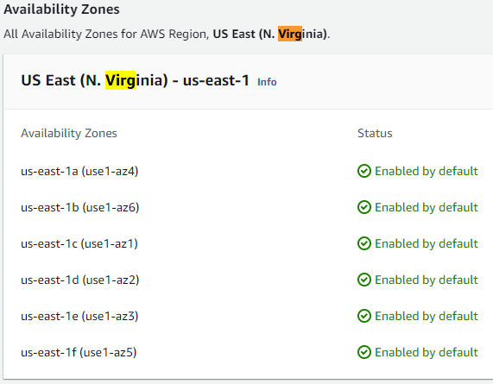
AWS EC2
Availability zone:
A region is further divided into multiple availability zones, which are identified by additional letters such as “us-west-2a” and “us-west-2b”.
Zones represent data centers in different physical locations within a region.
Each zone within a region is networked with low-latency connections

Slide 47
AWS EC2
Steps of creating, configuring and launching an EC2 instance :
“Configure storage”
EBS features
Persistent Storage: EBS volumes persist independently from EC2 instances, indicating that when an instance is terminated, the data stored on the attached EBS volume CAN be retained.
High availability: EBS replicates volumes data across multiple physical servers within the same availability zone to prevent the loss of data from hardware failures.
Snapshots: allows users to create point-in-time snapshots of their volumes. These snapshots serve as backups and can be used to restore volumes to a previous state.
Elastic volumes : allows users to dynamically adapt their volumes when the needs of their applications change.

Slide 48
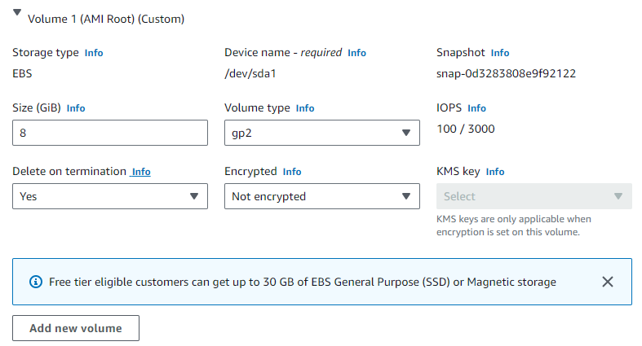
AWS EC2
Steps of creating, configuring and launching an EC2 instance :
“Configure storage”
EBS setting

Slide 49
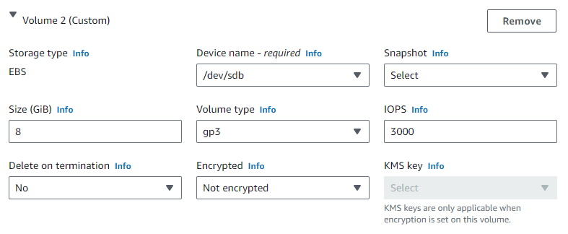
AWS EC2
Steps of creating, configuring and launching an EC2 instance :
“Configure storage”
EBS setting

Slide 50
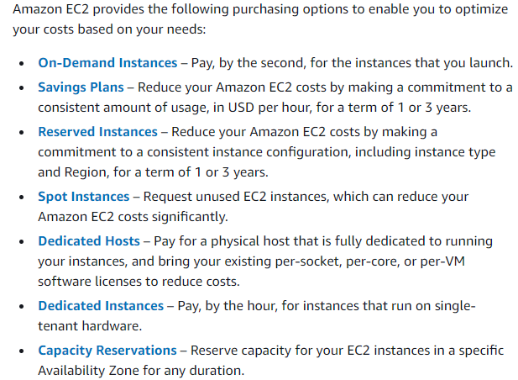
AWS EC2
Steps of creating, configuring and launching an EC2 instance :
“Advanced details”
Instance purchasing options

Slide 51
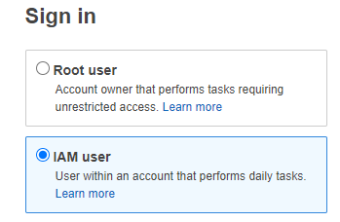
AWS EC2
Steps of creating, configuring and launching an EC2 instance :
“Advanced details”
Identity and Access Management (IAM) : It is a service that allows us to manage users, groups, and permissions to securely control access to AWS resources.
What is the principle of least privilege?

Slide 52
AWS EC2
Steps of creating, configuring and launching an EC2 instance :
“Advanced details”
Identity and Access Management (IAM) : It is a service that allows us to manage users, groups, and permissions to securely control access to AWS resources, e.g., root user and IAM user (according to the principle of least privilege).
What is the principle of least privilege?
A user only has those privileges which are essentially vital to perform their intended operations.

Slide 53
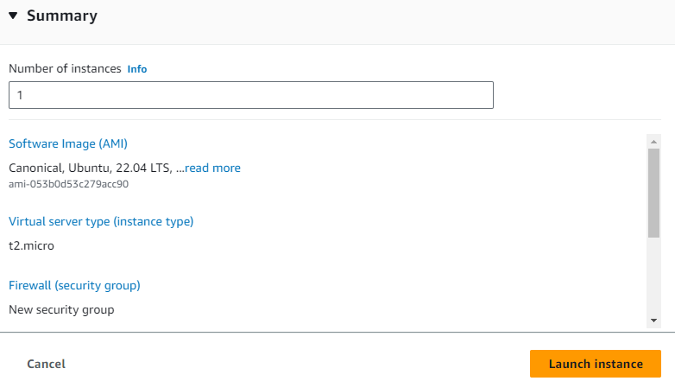
AWS EC2
Steps of creating, configuring and launching an EC2 instance :
“Review and Launch”

Slide 54
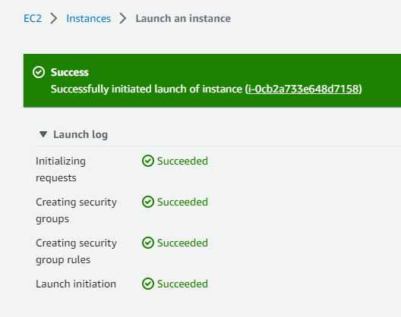
AWS EC2
Steps of creating, configuring and launching an EC2 instance :
“Review and Launch”

Slide 55
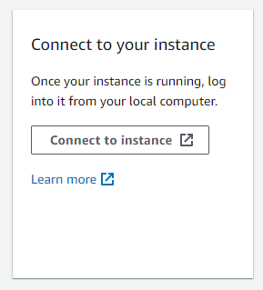
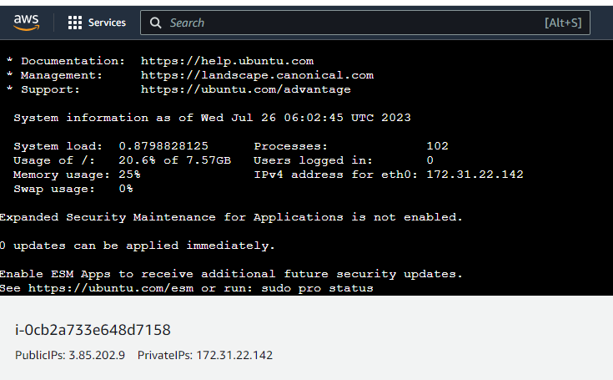
AWS EC2
Connecting to an EC2 instance :

Slide 56
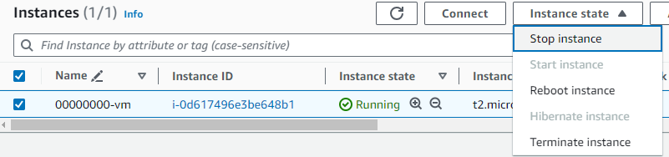
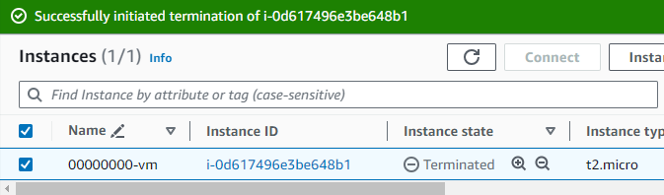
AWS EC2
Terminating an EC2 instance :

Slide 57
Practice Questions
[7 marks] Q2: Describe the main steps which you would take on AWS and the decisions that would need to be made to create, configure and launch an EC2 Instance.
[1 mark] Sign in to the AWS management console
[1 mark] Navigate to EC2 Dashboard and click “Launch instance”
[1 mark] Select/Create names and tags
[1 mark] Select AMI and Instance type
[1 mark] Select/Create Key pair for login
[1 mark] Configure network settings and storage
[1 mark] Review and launch

Slide 58
Practice Questions
[7 marks] Q3: Describe EBS and what features it offers.
[1 mark] A brief introduction to EBS.
[2 marks] One feature and its brief description.
[2 marks] One feature and its brief description.
[2 marks] One feature and its brief description.

