Slide 1
PROGRAMMING FOR DATA SCIENCE
Demand Forecasting
& Inventory Optimization
Amazon E-Commerce Purchase Analysis · 2018–2022
Tiwa Odumakinde (DAL289298) · Vimala Mehrotra (DAL683678) · Akhil Mishra(AXM240034)
Date : April 28th 2026

Slide 2
The Business Problem
Why does inventory forecasting matter for online retail?
"Which products should
a retailer stock up on,
and when?"
Overstock
Capital tied up in unsold warehouse inventory
Stockouts
Lost sales + damaged customer trust during peak periods
The core question this project answers
Demand spikes
$86,600
Seasonal patterns create binary risk windows around Q4
recovered per year from just 1% inventory accuracy improvement across the
top two revenue categories alone
Too many SKUs
546K unique products — impossible to track manually

Slide 3
The Dataset
Where the data comes from and how it was prepared
SOURCE
CLEANING STEPS
Open e-commerce 1.0
Removed 6,854 exact duplicate transactions
Berke et al. (2023) · Harvard Dataverse · DOI: 10.7910/DVN/YGLYDY
Dropped rows missing product title, ASIN, or category (~5%)
Validated in Nature Scientific Data (2024) · Pearson r = 0.978 vs Amazon public sales data
Excluded 2023 & 2024 — incomplete years
5,027
1.8M+
2018–2022
Mapped 400+ raw Amazon codes → 16 business categories
Survey participants
Raw purchases
Five full years
Created Revenue = Price × Quantity
AFTER CLEANING
967,702 rows · 5 complete years
Added time features: year, month, quarter, day
16 categories · $23.0M revenue
$23.78 avg order · 546K unique SKUs

Slide 4
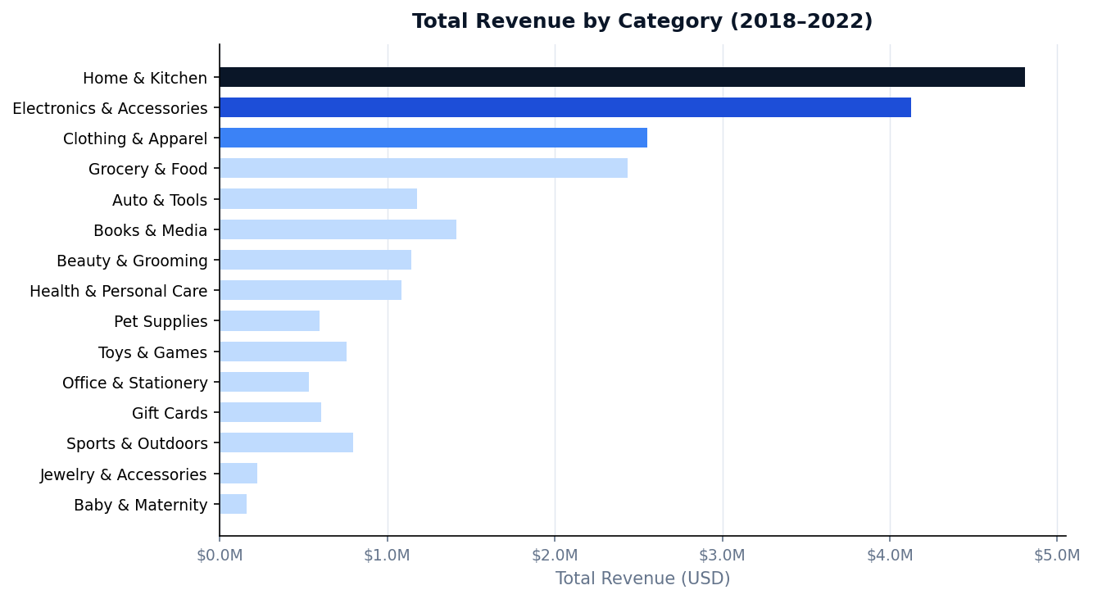
Category Revenue Rankings
Where the money actually comes from
37.6%
Revenue from top
2 categories combined
$41.85
Highest avg order
value: Electronics
$37.27
Sports & Outdoors —
high value, low traffic

Slide 5
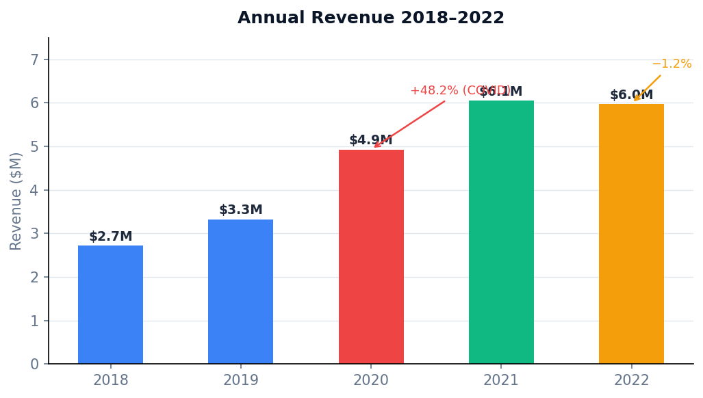
Revenue Growth 2018–2022
COVID surge, lasting shift, then a plateau
2018→19 +22.1%
Organic growth baseline
2019→20 +48.2%
COVID lockdowns drove
online shopping surge
2020→21 +22.8%
Habits held — not just
a temporary effect
2021→22 −1.2%
First contraction.
Volume-led growth is over.

Slide 6
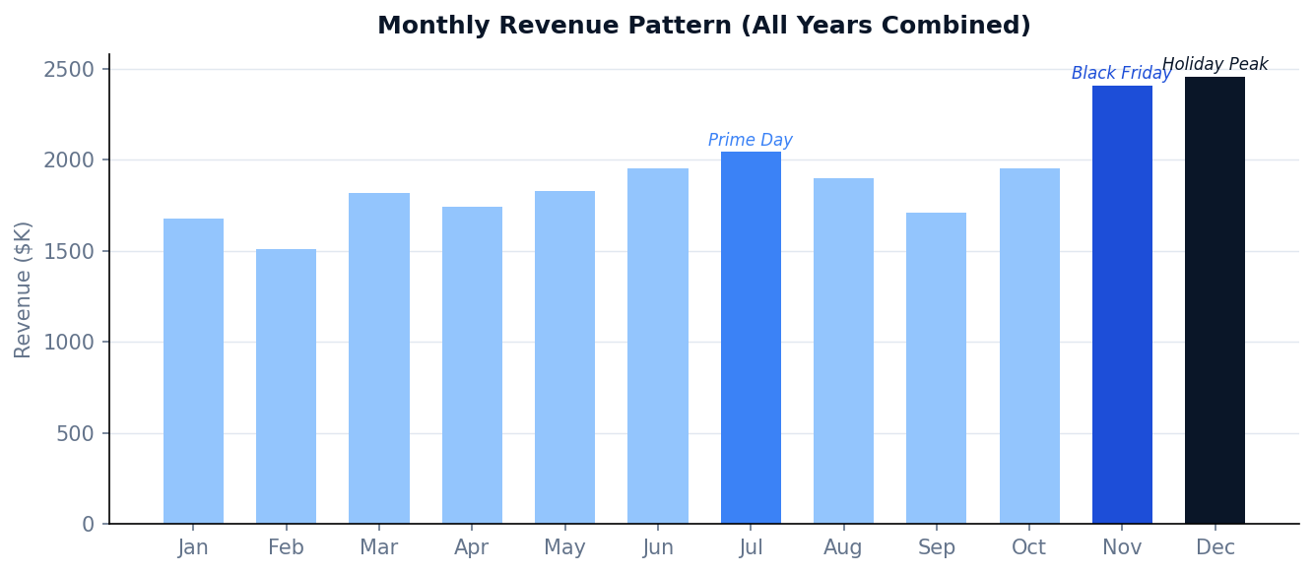
When Do Customers Buy?
Monthly and day-of-week patterns reveal when to stock up and when to run promotions
Nov + Dec
21.2%
of annual revenue in
just 2 months
July
Prime Day
Consistent secondary
peak every year
February
Lowest
Best window for
clearance & renegotiation
Monday is the highest revenue day — 16% above Saturday
Mon
Tue
Wed
Thu
Fri
Sat
Sun

Slide 7
Top Products by Demand
Unit volume and revenue don't always point to the same products
Product
Category
Units Sold
Revenue
What it tells us
Gift Card Balance Reload
Gift Cards
4,945 units
$131K
High volume, purely financial
AA Batteries 48-Pack
Electronics
351 units
$5.1K
Best true merchandise performer
Echo Dot (3rd Gen)
Electronics
265 units
$6.1K
Amazon device — strong revenue
Fire TV Stick 4K
Electronics
246 units
$10.3K
Highest revenue in top 15
Cucumber (Slicing)
Grocery
285 units
$207
High volume, near-zero revenue
Top Ramen Noodles
Grocery
207 units
$58
$0.28 per unit — replenishment only
Photo Prints 4×6
Home & Kit.
540 units
$75
540 units, yet only $75 total
Key finding: unit volume and revenue are not correlated. Electronics devices deliver 5–10× more revenue per unit than grocery items.

Slide 8
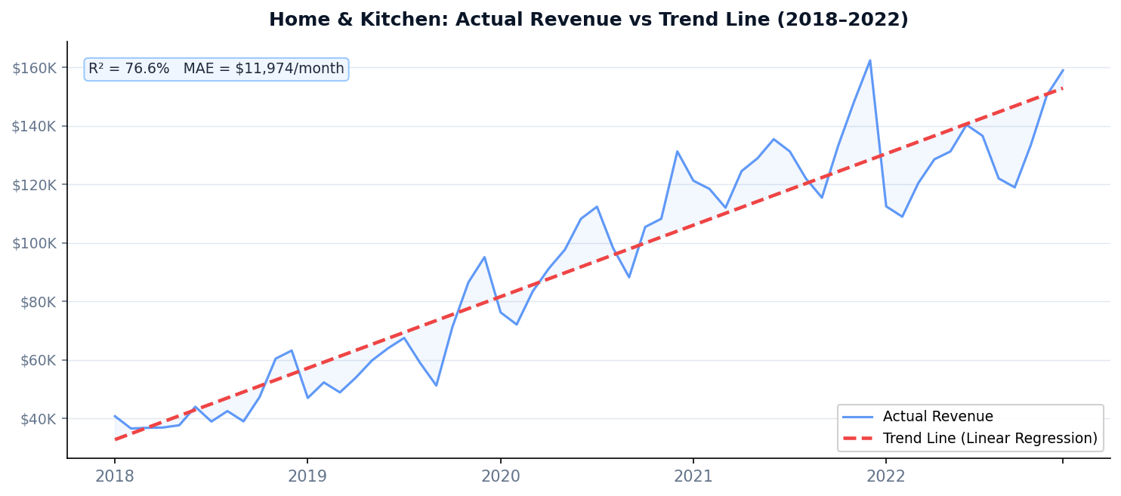
Demand Forecast: Home & Kitchen
Linear regression on 60 months of data — a concrete purchasing roadmap for 2023
MODEL PERFORMANCE
76.6%
R² — explains 76.6% of
monthly revenue variation
$11,974
Average prediction error
per month (MAE)
+$1,573
Monthly revenue growth
on the trend line
2023 MONTHLY FORECAST — HOME & KITCHEN
$128K
$145K
J
F
M
A
M
J
J
A
S
O
N
D

Slide 9
Six Recommendations
What to do with these findings
01
Zero-stockout policy
02
Build Q4 inventory by Sep 15
03
February = clearance window
Home & Kitchen + Electronics = 37.6% of revenue. Never run out in these two.
Q4 = 29.7% of annual revenue every single year. Start eight weeks early.
38.8% below December. Best time for markdowns and supplier negotiations.
04
Launch campaigns on Mondays
05
Invest in Sports & Outdoors
06
Use 2023 forecast as a floor
Monday is 16% above Saturday. Email sends and product launches go live Mon–Tue.
$37.27 avg order value but only 2.2% of orders. Doubling share = ~$800K revenue.
$128K–$145K per month for Home & Kitchen. Add 25–35% buffer for Nov–Dec.

Slide 10
Limitations
CURRENT LIMITATIONS
Survey sample — frequent buyers likely overrepresented
2020 COVID spike inflates the trend line, making 2023 forecast slightly optimistic
Model doesn't capture seasonality explicitly — $12K MAE reflects monthly swings
With 546K SKUs, product-level forecasting is not reliable on this data

Slide 11
What's Next
FUTURE ENHANCEMENTS
SARIMA / STL model
Capture monthly seasonality to reduce MAE
Multi-category forecasting
Extend beyond Home & Kitchen to all top 5
Customer segmentation
Use Survey ResponseID for RFM analysis
External features
Add Prime Day dates, inflation, consumer confidence

Slide 12
Key Takeaways
1
Home & Kitchen + Electronics = 37.6% of revenue. These two categories must never face a stockout.
2
Q4 = 29.7% of annual revenue every year without exception. Stock build must start by mid-September.
3
The 2023 forecast ($128K–$145K/month for Home & Kitchen) gives a concrete floor for purchasing decisions, with 76.6% model accuracy.
4
Sports & Outdoors is the biggest untapped opportunity — $37.27 avg order value, only 2.2% order share. Doubling it unlocks ~$800K.
Questions?
Tiwa Odumakinde · Vimala Mehrotra · Akhil Mishra · April 2025

