Slide 1
Hostel Life
Abhay KUMAR PANDEY (2002901520004/ csai /a)
Naman tiwari (2002901550019/ cs-iot)

Slide 2
Objective
The goal of making a web page about hostel life in college is to create a website that shows what it's really like to live in a college hostel.
We want to help current and future college students by providing useful information and making the website interesting and enjoyable.
Our specific objectives for this project are to provide comprehensive and informative content on the topic of hostel life in college.
The web page will cover the following topics:

Slide 3
Objective
The different types of hostels room
The rules and regulations of hostels
The cost of living in a hostel
The social and academic benefits of hostel life
The challenges of hostel life

Slide 4
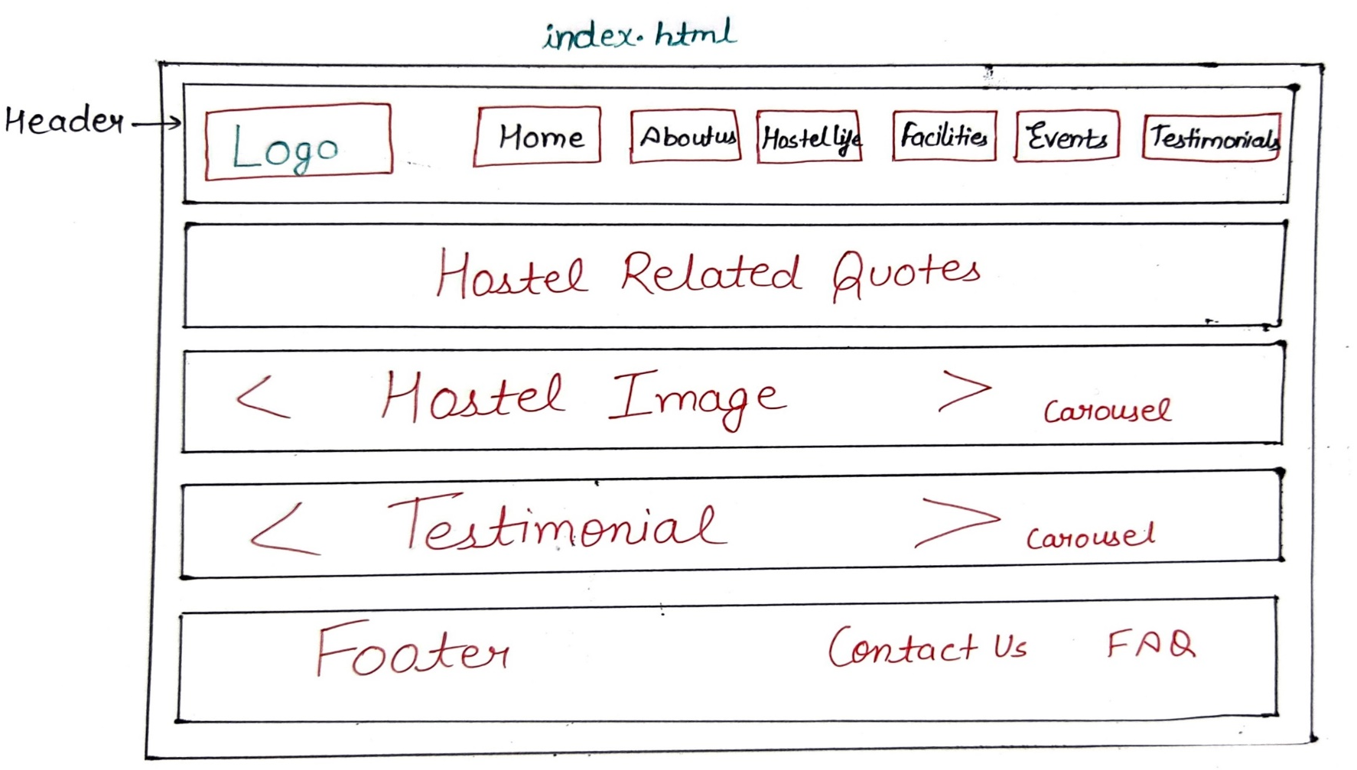
Layout

Slide 5
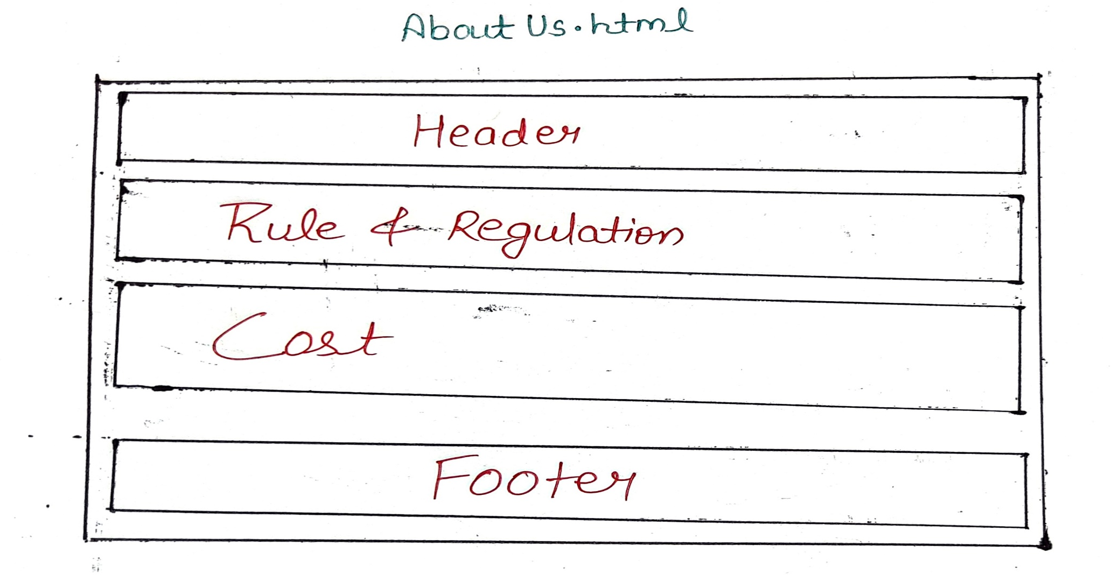
Layout

Slide 6
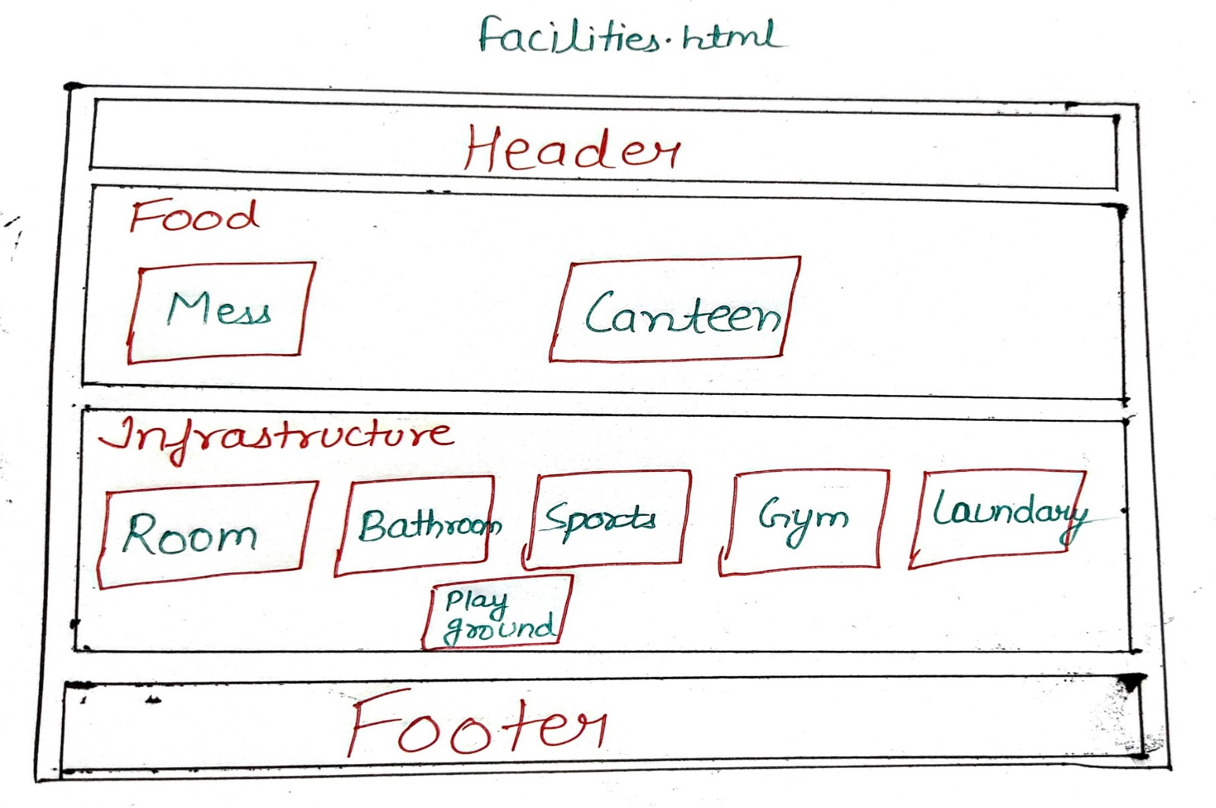
Layout

Slide 7
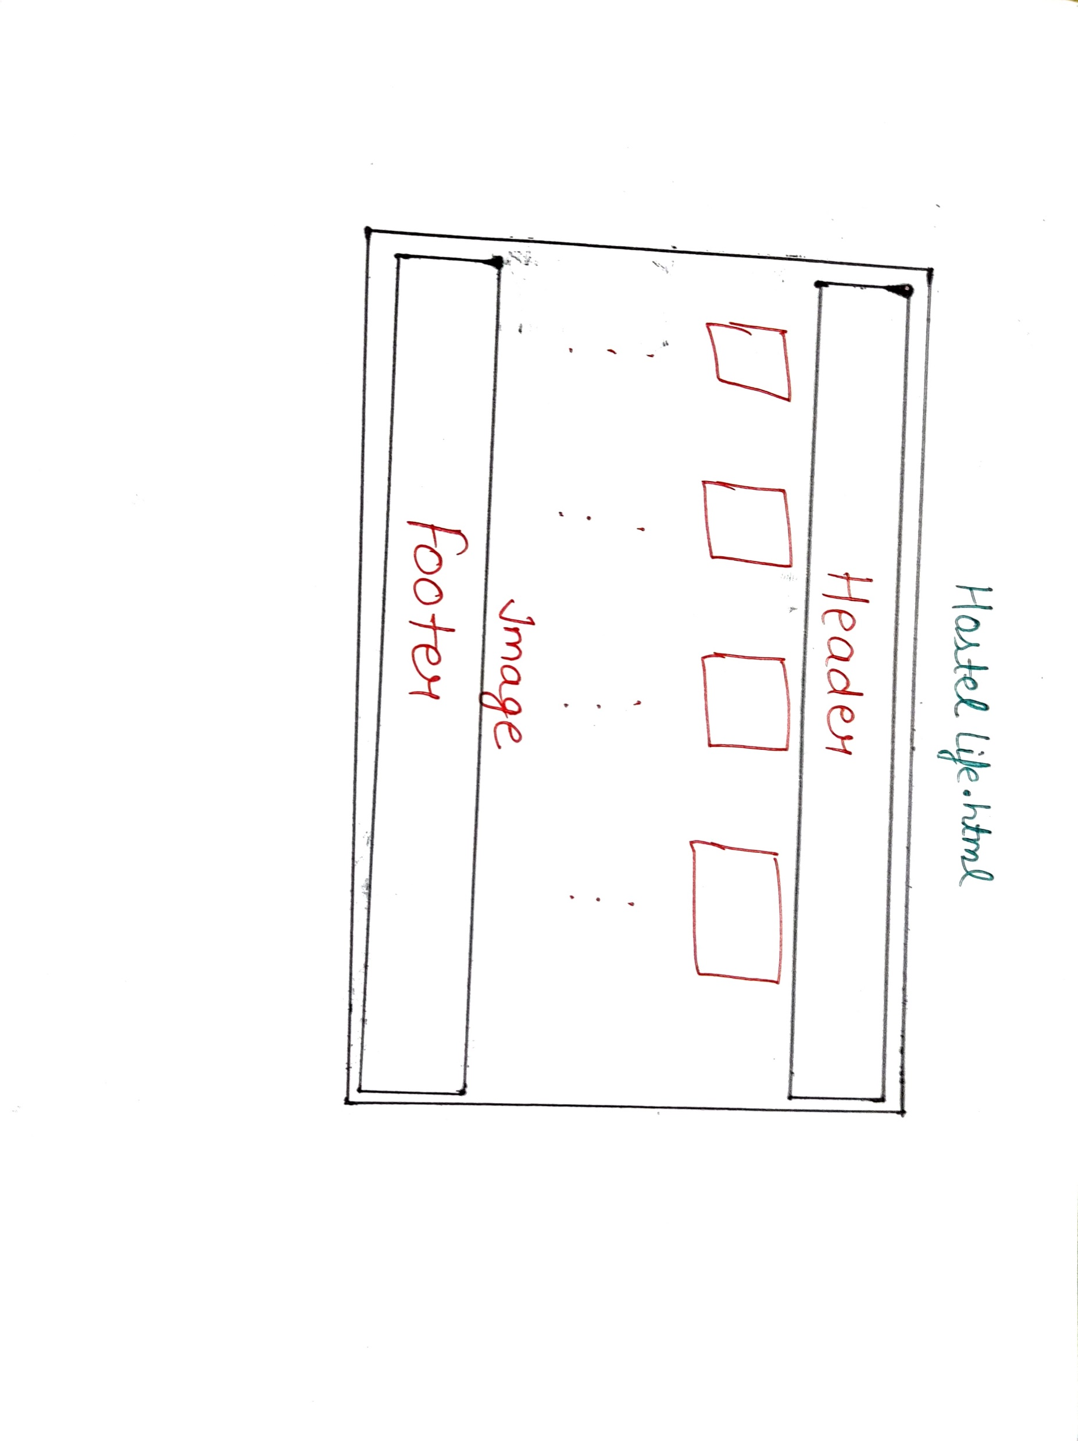
Layout

Slide 8
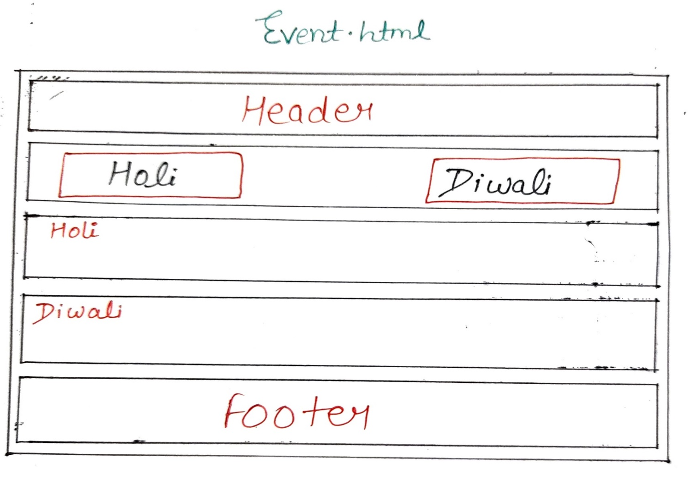
Layout

Slide 9
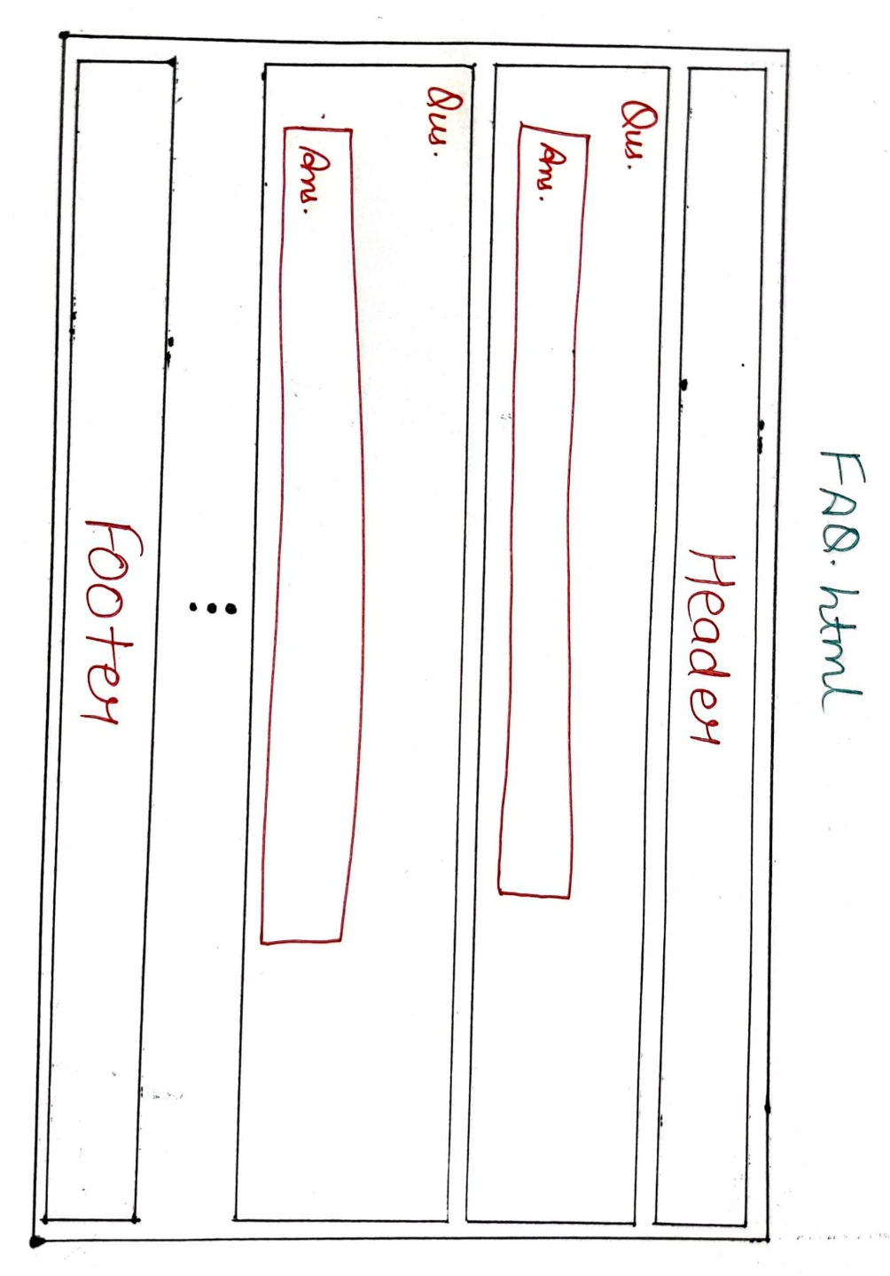
Layout

Slide 10
Details about component
These are just some of the most common web components. There are many other components available, and the specific components that are used on a web page will vary depending on the purpose of the page.
Header/Footer: These are the top and bottom sections of a web page, respectively. They typically contain important information such as the page title, navigation links, and copyright information.
Div: A div is a generic HTML element that can be used to group other elements together. It is often used to create containers for layout purposes.
Navbar: A navbar is a horizontal navigation bar that typically appears at the top of a web page. It provides links to important pages or sections of the site.

Slide 11
Details about component
Carousel: A carousel is a rotating slideshow of images or videos. It is often used to display product images or promotional content.
Card: A card is a rectangular element that is typically used to display a single piece of information. It can contain text, images, and other elements.
Dropdown: A dropdown is a menu that appears when a user clicks on an icon or text. It is often used to provide access to a list of options.
Image: An image is a visual representation of something. It can be used to add visual interest to a web page or to convey information.

Slide 12


