Slide 1
Automated Video Indexing
Arpan Mukherjee [MT17007]
Kunal Suryavanshi [MT17023]
Shubhi Tiwari [MT17057]

Slide 2
OUTLINE
Problem Definition
Dataset Collection
Data Preprocessing
Model
Evaluation
Result

Slide 3
Problem Definition
Video indexing is the process of providing viewers a way to access and navigate contents easily, similar to book indexing.
The selection of indexes derived from the content of the video to help organize video data and metadata that represents the original video stream.

Slide 4
Dataset
Different playlist follows different pattern
Decided to stick to single genre of the playlist.
Coursera Course Video
Big Data
YouTube NPTEL Video Playlists for the following courses:
Machine Learning
Artificial Intelligence
Database Management System
Introduction to Sorting (https://www.youtube.com/watch?v=kMgIlOpq_Dg)
Video transcript of the playlist was manually scrapped

Slide 5
Data Preprocessing
Used python module pysrt for processing of subtitles.
Corrected the timing information of combined videos(5 videos combined in one) so that it can be treated as a single video srt file
Data lemmatization, stop word removal etc was done
POS tagging for extracting the noun words
These nouns later used to identify topics covered in the video titles.

Slide 6
Proposed Methodologies
Introductory video inference
We tried to infer the introductory video of the NPTEL playlist to find the topics which will be covered during the course.
Along with keywords, decided to use video name and description as feature
Dropped this idea because not all NPTEL playlist contains mandatory introductory and not all video contains description
Template based Methods
Tried to create different templates for single genre of videos
Handcrafted rules to identify video initialization, e.g. - “Let us start with…”, “Today we will be talking about…” etc.
We could not infer handcrafted rules, as there was no symmetricity between the playlists.

Slide 7
Proposed Methodologies contd.
Tree-based Topic Modeling Approach(Novel Approach)
Divided merged subtitles in the window size of 50 subtitles
Extracted keywords using LDA and NMF for the fixed window.
In bottom-up manner we merged two windows of topics and their timings, if the jaccard similarity between the two is below a given threshold
Another iteration of LDA/NMF was applied to get the final top 10 words describing each merged topic.

Slide 8
Topic extraction from subtitles :Tree based LDA Model
Videos are divided in parts of equal length
Subtitles of entire playlist
Apply LDA to generate topics
...
Part n
Part 1
Part 2
Part 3
Combine parts related to similar topic
Apply LDA again to each part
...
Part n
Part a
Part b
Topic titles: part a + timing information
Topic titles: part b + timing information
Topic titles:part n + timing information

Slide 9
Evaluation:
For videos on Big Data from coursera.org, video titles serve as ground truth
For other videos, a human judge indexes the videos and the we compare
Precision, Recall , F1- score

Slide 10
Ground Truth |  | Predicted (indexer output)
Timing | Topics | Timing | Topics
0:0:0 - 0:2:21 | What, why,sorting, arrangement, algorithm | 0:0:0 - 0:2:49 | Apply, applications , data, required, sorting
0:2:22 - 0:3:45 | Sorting, applications,examples | 0:2:49 - 0:5:32 | element', 'largest', 'array', 'unsorted', 'sorting
0:3:46 - 0:11:16 | Selection, sort, algorithm, array, example,code | 0:5:32 - 0:8:32 | okay', 'element', 'portion', 'array', 'unsorted'
 |  | 0:8:32,0:11:35 | element', '17', 'portion', 'array', 'unsorted'
0:11:17 - 0:21:16 | Bubble, sort, algorithm, array, example,code | 0:11:35,0:14:21 | 'element', 'portion', 'array', 'unsorted', 'end'
 |  | 0:14:23,0:17:32 | compare', 'inner', 'greater', '10', '14'
 |  | 0:17:32,0:20:20 | 'element', 'bubble', 'portion', 'array', 'unsorted'}
0:21:17 - 0:33:22 | Quick, sort, algorithm, array, example,pseudo , code | 0:20:23 -0:23:35 | sort', 'quicksort', 'smaller', 'algorithm', 'problem'
 |  | 0:23:35 - 0:26:29 | left', 'solution', 'solve', 'array', 'problem'
 |  | 0:26:29,0:29:50 | partition', 'quicksort', 'method', 'portion', 'value'

Slide 11
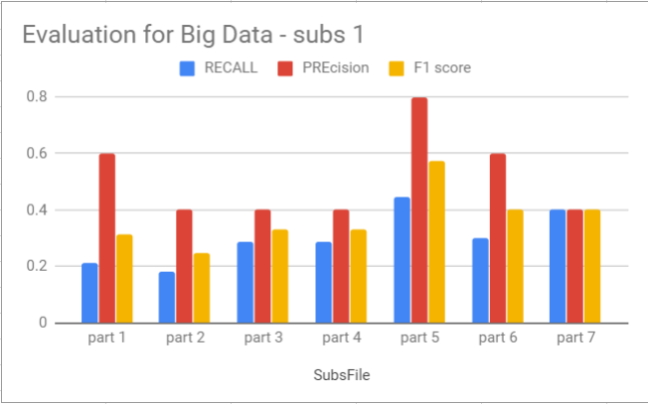
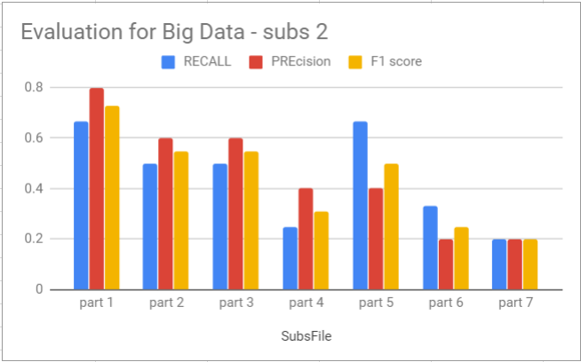
Results:

Slide 12
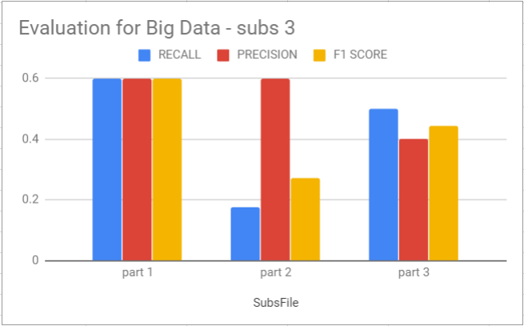
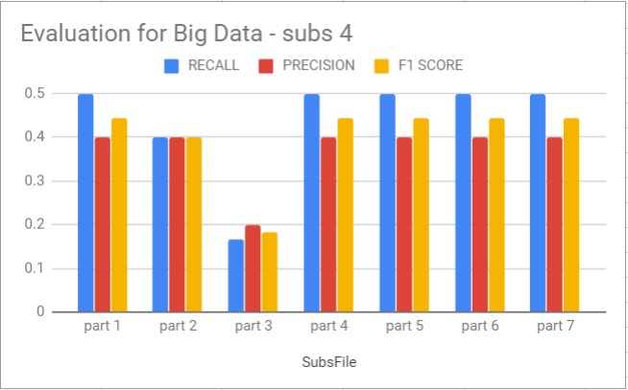
Results:

Slide 13
Conclusion and Future Work
We proposed a novel approach for indexing videos, considering no work has been done on this domain.
Ground Truth based accuracy , precision based on manually short indexed videos
Human similarity score is suggested, as even though predicted results are somewhat similar, but not exact words are the output of the model.(e.g.- medicine, health, life equivalent to patient)
Keywords representing each segment can be reconstructed in such a way, that it will summarize the segment better.

