Slide 1
MACHINE LEARNING RESEARCH PROJECT
Synthetic Data-Assisted Road Damage Detection for Indian Roads
A Deep Learning & Computer Vision Investigation Using YOLO11n and Transfer Learning
Presented by: Team LossLess

Slide 2
MACHINE LEARNING PROJECT • TEAM LOSSLESS
Team LossLess: Members & Assigned Project Roles
Member 1
Team Lead & Literature Review
Member 2
Dataset Collection & Analysis
Member 3
Data Preprocessing & Annotation
Member 4
Baseline YOLO Model
Member 5
Synthetic Data Generation
Member 6
Quality Control & Validation
Member 7
Model Training & Experimentation
Member 8
Evaluation & Statistical Analysis
Member 9
Prototype & User Interface
Member 10
Documentation & Presentation

Slide 3
MACHINE LEARNING PROJECT • TEAM LOSSLESS
Problem Statement & Real-World Motivation
1. Practical Infrastructure Challenge
• Road damage (potholes, cracks) causes frequent accidents, vehicle damage, and high maintenance costs across India.
• Manual road inspection is labor-intensive, time-consuming, subjective, and difficult to scale regularly.
• Automated computer vision detection offers a scalable solution for municipal road auditing.
2. Machine Learning Bottleneck
• Model performance drops on unfamiliar Indian road surfaces, poor lighting, rain, and varied weather.
• Public datasets suffer from severe class imbalance and lack representative examples of rare damage types.
• Annotating thousands of real field images manually is expensive and unscalable.
CORE RESEARCH QUESTION
“Can generating synthetic road-damage images and combining them with real Indian road images improve model accuracy and generalization under challenging real-world conditions?”

Slide 4
MACHINE LEARNING PROJECT • TEAM LOSSLESS
Proposed Solution & Key Project Objectives
Proposed Solution
✔ Transfer Learning
Fine-tune pretrained YOLO models on real Indian road damage images.
✔ Label Standardization
Clean multi-national RDD2022 dataset into 4 core structural damage categories.
✔ Synthetic Augmentation
Incorporate synthetic damage patches (Poisson blending / GANs) to boost rare class representation.
✔ Rigorous Evaluation
Test models against an independent held-out real test set.
Objective 1
Study existing road damage detection literature and synthetic data generation methods.
Objective 2
Collect and analyze Indian road damage images from the RDD2022 dataset.
Objective 3
Develop a baseline YOLO11n object detection model using real road images only.
Objective 4
Design a synthetic data compositing pipeline for underrepresented damage classes.
Objective 5
Evaluate and compare models on a held-out real test dataset to measure generalization.

Slide 5
MACHINE LEARNING PROJECT • TEAM LOSSLESS
Primary Dataset Overview: RDD2022 (Indian Subset)
7,706
Training Images
Indian Road Subset
1,959
Test Images
Source Test Folder
8,203
Original Objects
Pascal VOC XML Annotations
4
Target Classes
Longitudinal, Transverse, Alligator, Pothole
Dataset Characteristics & Annotation Structure
• Source Dataset: Road Damage Dataset 2022 (RDD2022) — a multi-national dataset with 47,420 road images from 6 countries (India, Japan, China, Czech Republic, Norway, United States).
• Focus Area: Our project focuses specifically on the Indian road subset (`images/train_images` with 7,706 images) to evaluate detection performance under real Indian traffic and surface conditions.
• Original Annotations: Provided in Pascal VOC XML format containing image filenames, bounding box coordinates (`xmin`, `ymin`, `xmax`, `ymax`), and damage class labels.
• Challenge Identified: Raw XML annotations contain non-structural codes (e.g., crosswalks, manholes) and fine sub-categories that require systematic cleaning.

Slide 6
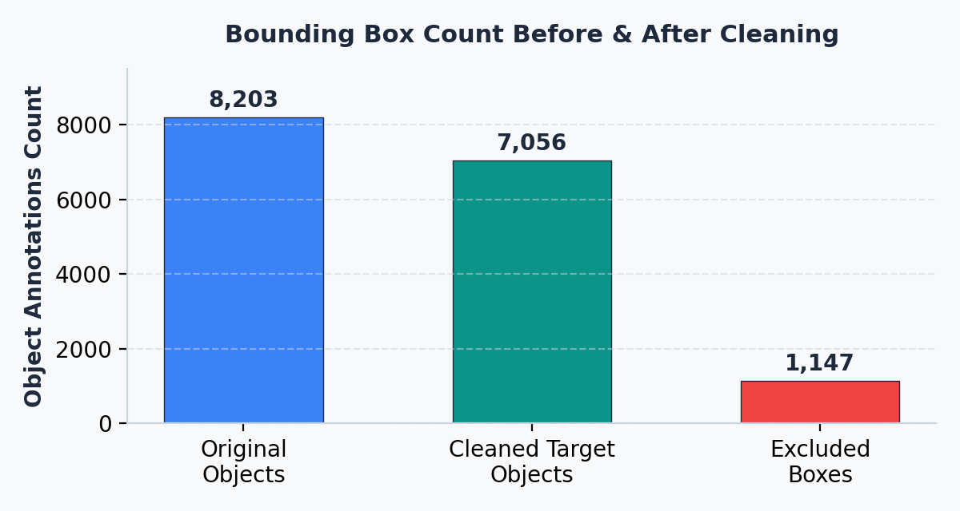
MACHINE LEARNING PROJECT • TEAM LOSSLESS
Data Cleaning & Bounding Box Standardization
Zero Data Loss Cleaning Strategy
✔ 7,706 Annotation Files Retained
100% of training image files were preserved. No image file was deleted during cleaning.
✔ Object Reduction (8,203 → 7,056)
Removed 1,147 unwanted-class bounding boxes (57 D43 crosswalk blur, 1,062 D44 extraneous, 28 D50 manholes) to focus exclusively on 4 structural damage classes.
✔ Empty Files Increase (3,921 → 4,387)
Images containing only excluded boxes became valid negative background samples, helping reduce false positive detections.
✔ Annotation Typo Correction
Visually verified and corrected single typo `D0w0` → `D00` (Longitudinal crack) preserving original bounding box coordinates.

Slide 7
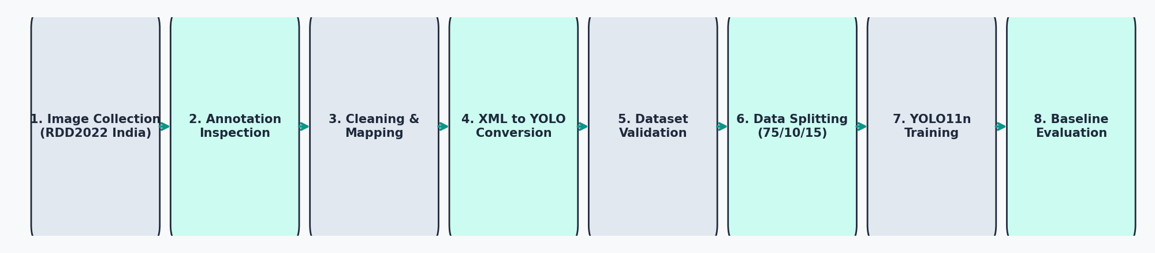
MACHINE LEARNING PROJECT • TEAM LOSSLESS
End-to-End Machine Learning Pipeline Workflow
Data Preparation Phase
• Image Collection: 7,706 India RDD2022 images.
• Annotation Inspection: Parsed XML files.
• Cleaning: Merged D01→D00, D11→D10; dropped D43, D44, D50.
Formatting & Validation
• XML-to-YOLO Conversion: Converted coordinates to normalized [0,1] format.
• Validation: Checked bounds & line formats.
• Data Splitting: 75% Train (5,779), 10% Val (770), 15% Test (1,157).
Training & Evaluation
• YOLO11n Model: Fine-tuned pretrained weights on MPS GPU.
• Training: 30 epochs, AdamW optimizer.
• Evaluation: Validation metrics established; fixed test set held out.

Slide 8
MACHINE LEARNING PROJECT • TEAM LOSSLESS
Software Environment & Technologies Used
Python 3.13
Core programming language for pipeline scripting, data cleaning, and model evaluation.
PyTorch 2.14
Deep learning framework providing tensor computations and GPU acceleration (Apple MPS).
Ultralytics YOLO 8.4
Object detection framework used for loading `yolo11n.pt` pretrained weights and training.
OpenCV (cv2)
Computer vision library used for reading images, drawing bounding boxes, and image compositing.
Pandas & NumPy
Data analysis libraries used for manifest generation, array manipulation, and class statistics.
Matplotlib
Visualization library used to plot bounding boxes, sample annotations, and result charts.
Pathlib
Standard library used for robust filesystem path management across training directories.
xml.etree.ElementTree
XML parser used to inspect, filter, modify, and convert Pascal VOC annotation files.

Slide 9
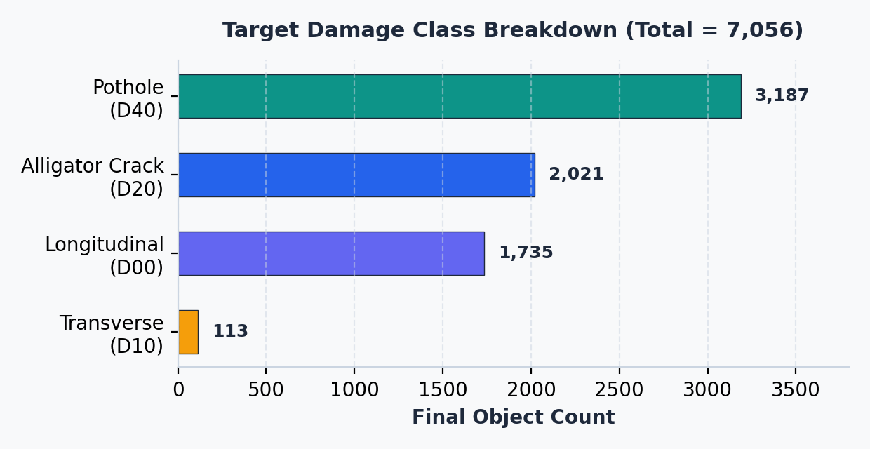
MACHINE LEARNING PROJECT • TEAM LOSSLESS
Four Target Damage Categories & Taxonomy
Target Class Consolidation Mapping
Class 0: Longitudinal Crack (D00) — 1,735 Objects
Merged raw codes D00 + D01 + corrected D0w0. Cracks running parallel to road.
Class 1: Transverse Crack (D10) — 113 Objects
Merged raw codes D10 + D11. Cracks running across the road width.
Class 2: Alligator Crack (D20) — 2,021 Objects
Network of interconnected fatigue cracks forming mesh-like patterns.
Class 3: Pothole (D40) — 3,187 Objects
Depressions or cavities in road surface; most frequent damage type.

Slide 10
MACHINE LEARNING PROJECT • TEAM LOSSLESS
YOLO11n Architecture & Training Configuration
Model Architecture & Pretraining
• Model Selection: Lightweight `yolo11n.pt` pretrained weights fine-tuned on Indian road dataset.
• Model Capacity: 2,597,780 parameters | 6.4 GFLOPs (101 fused layers).
• Hyperparameters: Image Size: 512×512 | Batch Size: 16 | Epochs: 30 (Patience = 7 early stopping).
• Optimizer & LR: AdamW (lr = 0.00125, momentum = 0.9).
• Hardware Acceleration: Apple MPS GPU (Metal Performance Shaders on M4 chip).
Reproducible Dataset Split (Seed = 42)
✔ Training Partition (75%) — 5,779 Images
Used to fine-tune YOLO11n weights during 30 epochs.
✔ Validation Partition (10%) — 770 Images
Used for hyperparameter monitoring and early stopping.
✔ Fixed Test Partition (15%) — 1,157 Images
Held out completely. Never used in training, tuning, or synthetic generation.

Slide 11
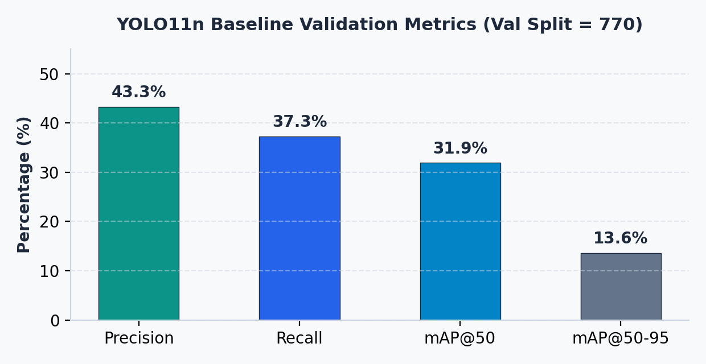
MACHINE LEARNING PROJECT • TEAM LOSSLESS
Baseline Validation Performance Results
NOTE: Results below represent Baseline Validation Set performance (770 images), NOT final held-out test results.
Per-Class Baseline Metrics Summary
Overall (All 4 Classes)
P: 43.3% | R: 37.3% | mAP50: 31.9% | mAP50-95: 13.6%
Alligator Crack (D20)
P: 42.8% | R: 67.4% | mAP50: 57.8% (Best overall class)
Pothole (D40)
P: 34.3% | R: 47.8% | mAP50: 37.8% (Moderate performance)
Longitudinal Crack (D00)
P: 38.4% | R: 19.8% | mAP50: 19.2% (Low recall)
Transverse Crack (D10)
P: 57.8% | R: 14.3% | mAP50: 13.0% (Severe class scarcity)

Slide 12
MACHINE LEARNING PROJECT • TEAM LOSSLESS
Key Learnings, Limitations & Proposed Experiments
Key Findings & Project Limitations
• Class Imbalance Effect
Extreme scarcity in Transverse cracks (113 instances vs 3,187 potholes) directly caps overall mAP.
• Background Clutter
Indian urban roads feature shadows, debris, and varied pavement, leading to false detections.
• Annotation Quality
Model performance relies strictly on precise bounding box boundaries; misaligned boxes degrade recall.
Proposed Experiments (Planned / Future Work)
⚡ Status Notice
Synthetic data augmentation is a proposed future experiment, NOT a completed result.
⚡ Compositing Method
Extract real damage patches (potholes/cracks) and blend onto background roads using OpenCV Poisson blending.
⚡ Experimental Setup
Train Model B (Real + Synthetic) and compare against Baseline Model A on the 1,157 held-out real test set.
⚡ Core Hypothesis
Targeted synthetic augmentation of rare classes will improve recall and model generalization without field data collection costs.

Slide 13
MACHINE LEARNING PROJECT • TEAM LOSSLESS
Project Summary & Conclusion
Key Project Summary
✔ Established a clean, standardized 4-class Indian road damage dataset (7,706 training images) from raw RDD2022 multi-national annotations.
✔ Built a zero-data-loss cleaning pipeline that removed 1,147 non-structural bounding boxes while preserving 4,387 background images.
✔ Successfully trained a baseline YOLO11n object detection model, establishing initial baseline validation benchmarks (31.9% mAP@50).
✔ Laid the technical foundation for condition-aware synthetic data augmentation experiments to tackle severe class imbalance.
Thank You!
Questions, Feedback & Technical Discussion
Machine Learning Research Project • Team LossLess

