Slide 1








NeuroFleetX AI-Driven Urban
Mobility Optimization
Infosys Springboard - Internship 6.0 ( Batch 1 )
Anurag Tiwari

Slide 2







Problem Definition
Rapid urbanization has led to severe traffic congestion, pollution, and inefficient public transport systems.
Commuters face long waiting times, unpredictable delays, and poor route management.
Fleet operators struggle with high operational costs, maintenance issues, and fuel inefficiency.
Lack of real-time adaptive solutions to handle dynamic traffic conditions.

Slide 3

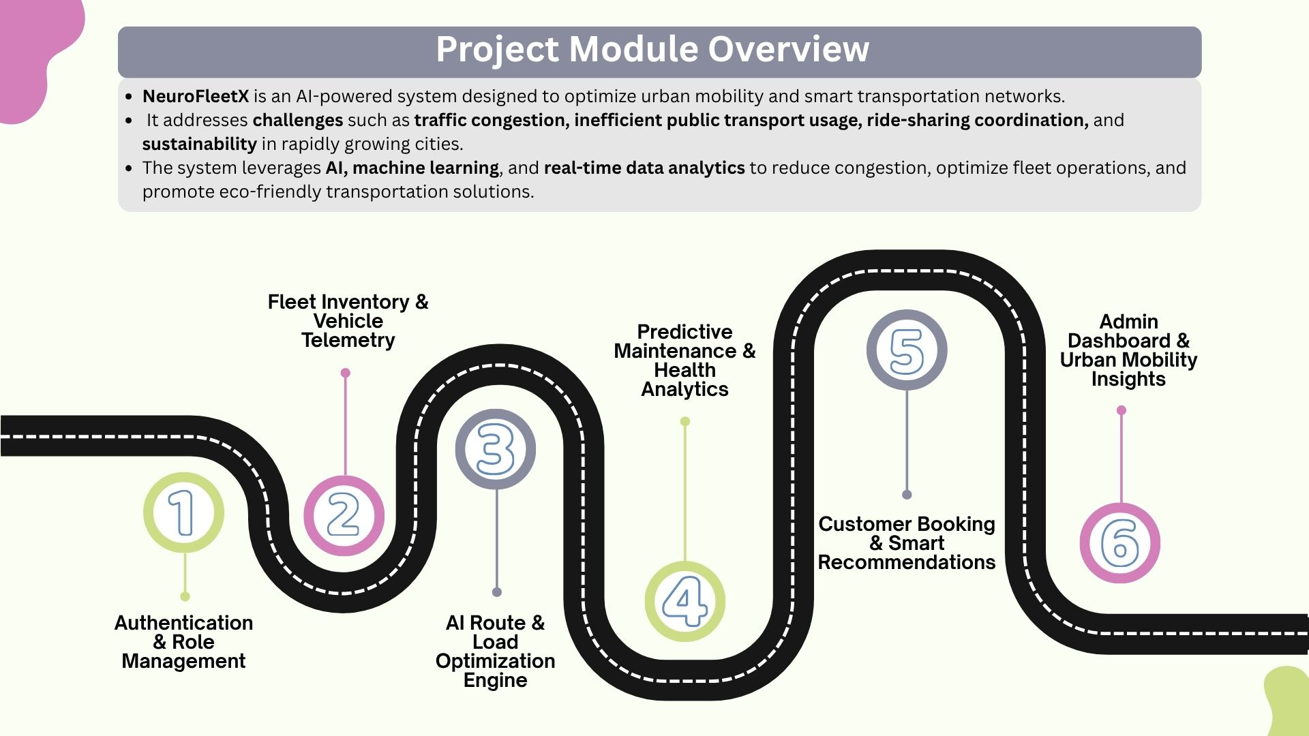














Project Module Overview
NeuroFleetX is an AI-powered system designed to optimize urban mobility and smart transportation networks.
It addresses challenges such as traffic congestion, inefficient public transport usage, ride-sharing coordination, and sustainability in rapidly growing cities.
The system leverages AI, machine learning, and real-time data analytics to reduce congestion, optimize fleet operations, and promote eco-friendly transportation solutions.
Fleet Inventory & Vehicle Telemetry
Predictive Maintenance & Health Analytics
Admin Dashboard & Urban Mobility Insights
Customer Booking & Smart Recommendations
Authentication & Role Management
AI Route & Load Optimization Engine

Slide 4






Module Specifications
Authentication & Role Management
Fleet Inventory & Vehicle Telemetry
AI Route & Load Optimization Engine
Secure JWT-based login with role-based access for Admin, Fleet Manager, Driver, and Customer. Ensures data privacy, controlled access, and smooth onboarding.
Centralized fleet database with real-time telemetry — tracks engine, fuel, tire, and battery metrics for performance monitoring and anomaly detection.
Optimizes routes using Dijkstra’s algorithm and ML-based ETA prediction. Balances loads, reduces travel time, and adapts to traffic and weather via Maps API integration.

Slide 5
Module Specifications
Fleet Owner Dashboard & Urban Mobility Insights
Predictive Maintenance & Health Analytics
Customer Booking & Smart Recommendations
Forecasts failures using telemetry data. Visual dashboards show health status (Healthy, Due, Critical) for proactive, data-driven maintenance.
Enables quick ride/delivery booking with AI-powered suggestions for best cost and time options. Ensures transparency and personalized experience.
Real-time analytics with heatmaps, fleet utilization stats, and mobility trend forecasts. Supports PDF/CSV exports for strategic decisions.

Slide 6


Detailed Module Specification

Slide 7

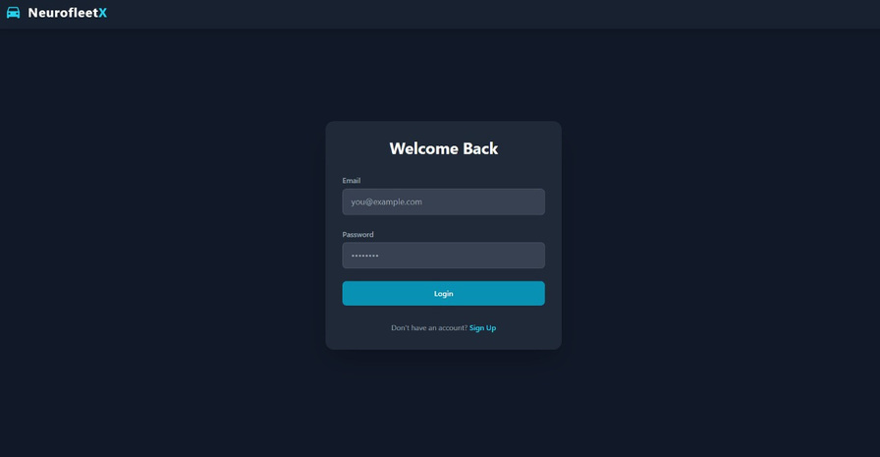
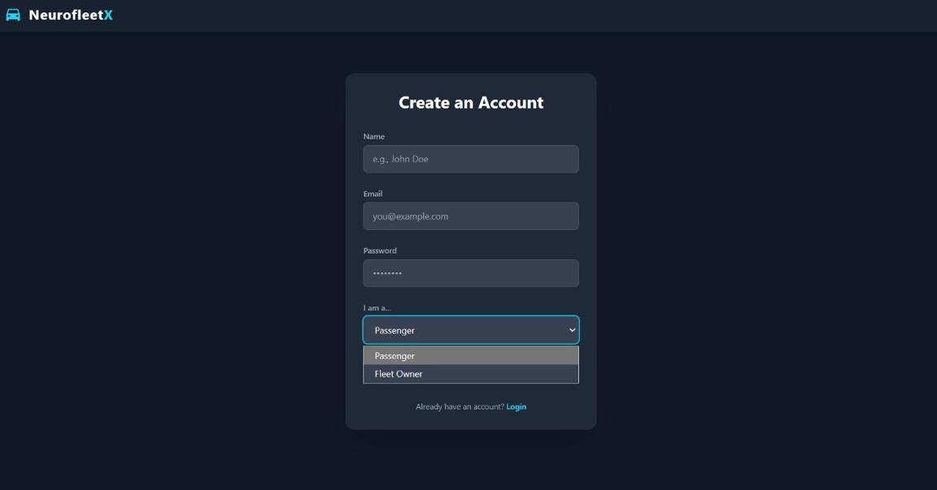

Authentication
& Role Management
Secure user access through JWT-based authentication and role-based authorization.
Supports multiple user roles — Fleet Manager, Driver, and Customer — each with tailored dashboards and permissions.
Ensures data privacy, controlled access, and streamlined user onboarding.

Slide 8
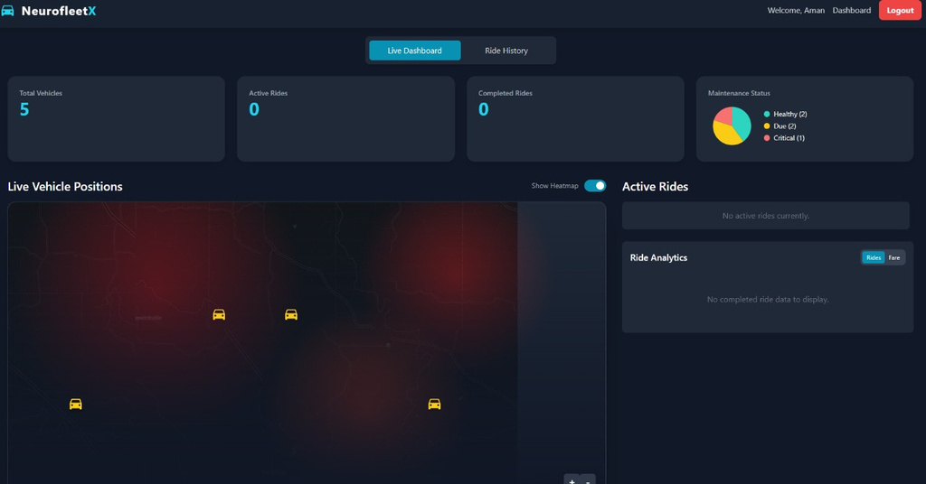
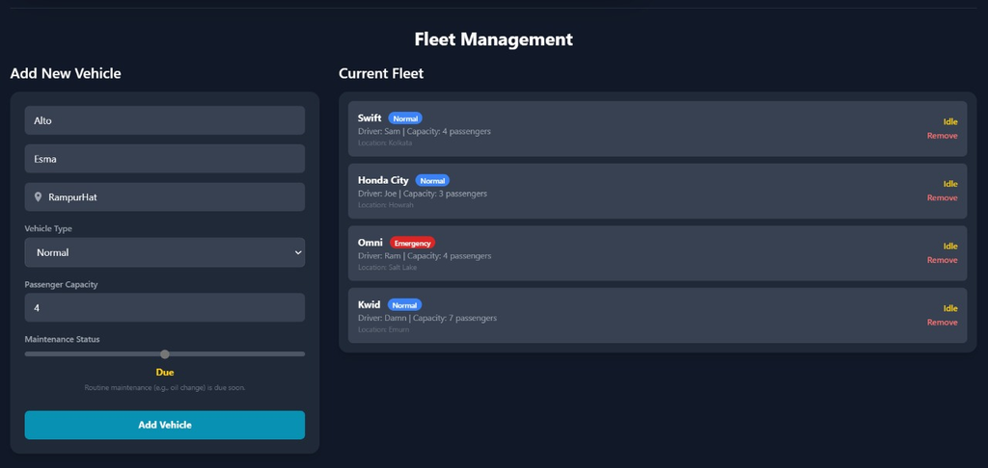
Fleet Inventory
&
Vehicle Telemetry
Real-Time Fleet Inventory: View all vehicles, drivers, and passenger capacity.
Live Location Tracking: See where every vehicle is at a glance.
Informed Dispatch: Quickly assign the right vehicle based on proximity and capacity.

Slide 9
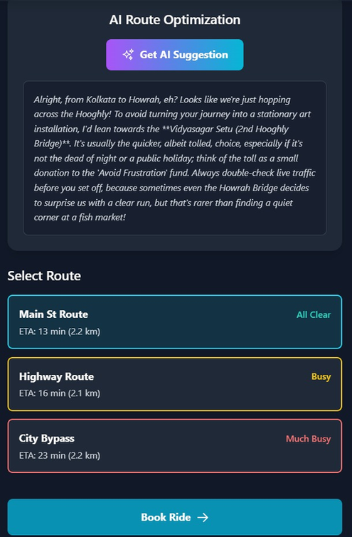
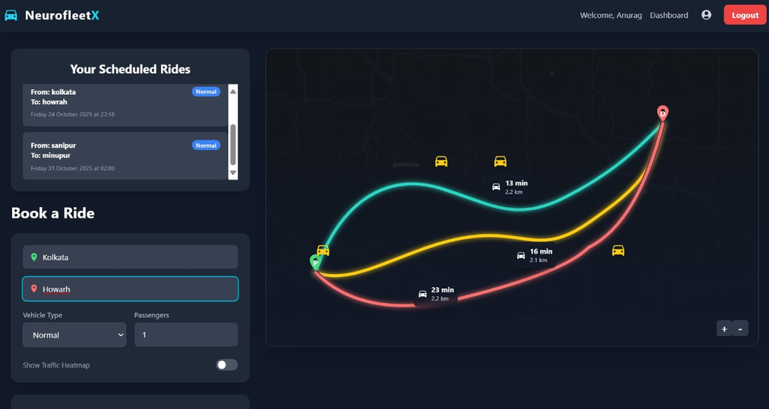
AI Route &
Load Optimization
Engine
AI-Powered Route Suggestions: Receives intelligent, conversational recommendations for the fastest route based on real-time and historical traffic data.
Multi-Route Comparison: Presents multiple route options with clear ETAs, distances, and live traffic status (e.g., "All Clear," "Busy").
Interactive Traffic Visualization: Features a "Traffic Heatmap" to give users a visual overview of congestion before they book.

Slide 10
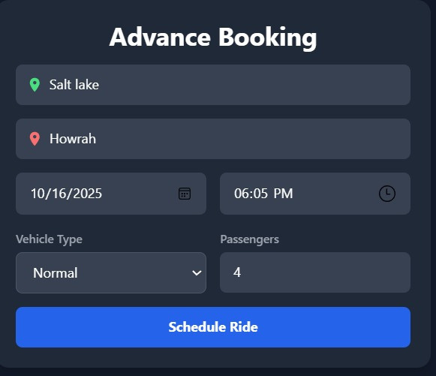
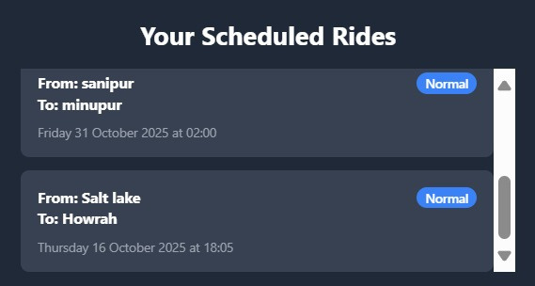
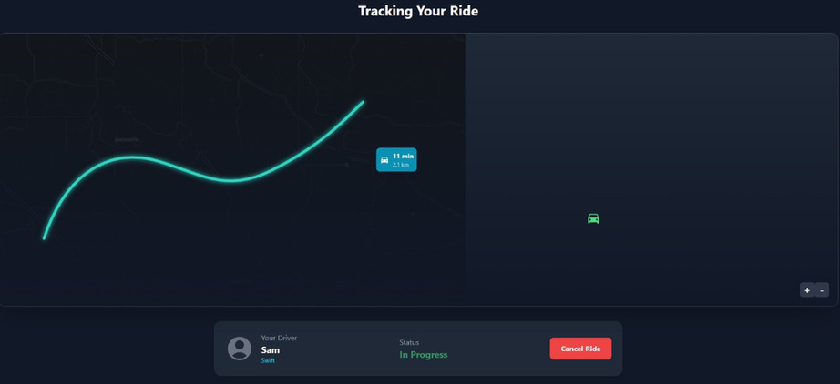
Advanced Booking
&
Scheduled Rides
Flexible Advance Scheduling: Allows users to conveniently book their rides days or weeks in advance by selecting their pickup, destination, date, and time.
Centralized Trip Management: Provides users with a dedicated "Scheduled Rides" section to easily view and manage all their upcoming journeys in one place.

Slide 11
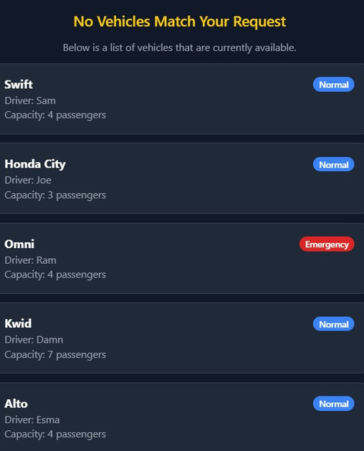
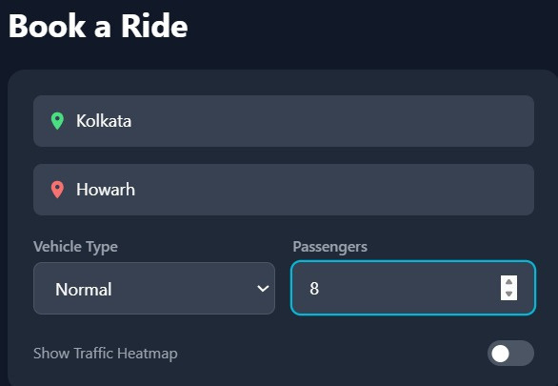



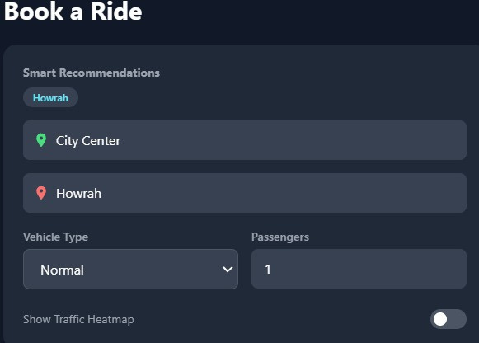
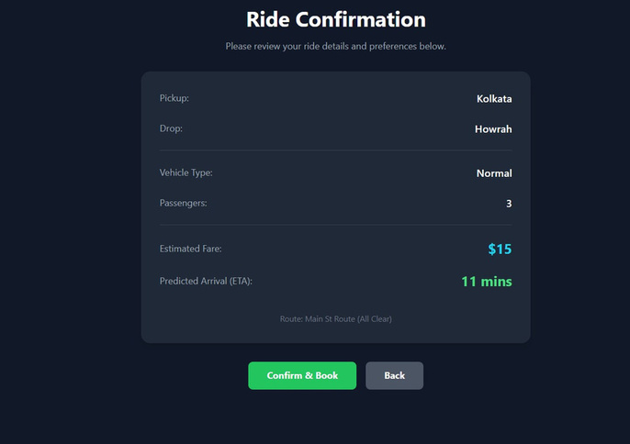
Clearly informs the user when no vehicles are available
Customer
Booking
&
Smart Recommendations
Live Availability: Shows real-time vehicle status and alternatives.
Easy Booking Form: Quick input for pickup, destination, and passengers.
Smart Vehicle Match: Auto-finds suitable vehicles with driver details.

Slide 12
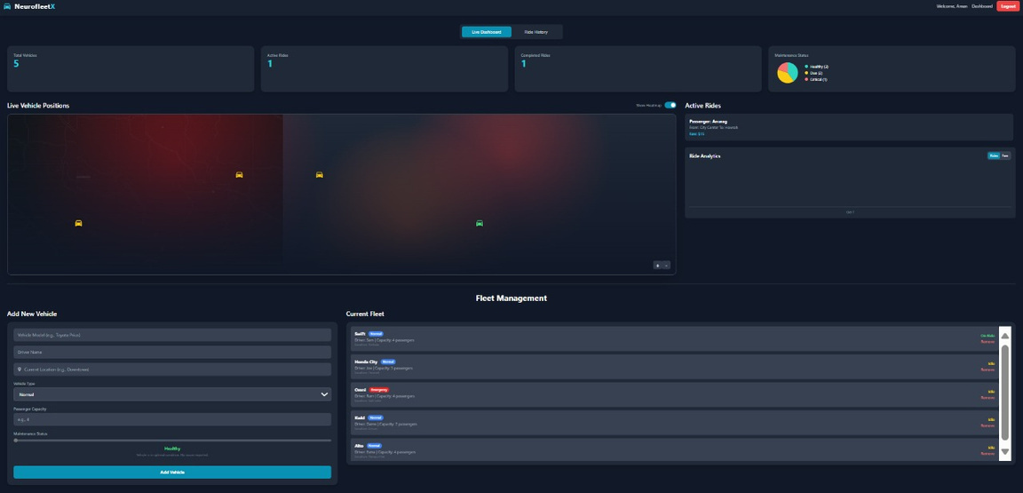
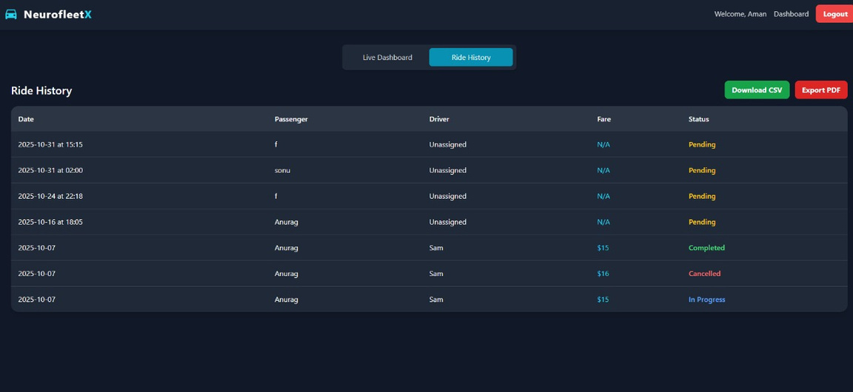
Fleet Owner Dashboard & Urban Mobility Insights
Centralized Operations Overview: A single dashboard displaying key metrics like Active Rides, Completed Rides, and real-time vehicle positions.
Proactive Fleet Maintenance Monitoring: Provides an at-a-glance maintenance status (Healthy, Due, Critical) to minimize downtime.
Data Export Functionality: Enables exporting of ride history, analytics, and reports to CSV and PDF formats for offline analysis and record-keeping.

Slide 13





Future Goals
Notification System:
Implement a notification system (e.g., email or push notifications) to alert users about ride status changes, such as driver assignment and arrival.
Live Mapping & Routing:
Integrate a real mapping service like the Google Maps API or Leaflet on the frontend to display accurate vehicle positions and calculate real-world driving routes.
Payment Gateway Integration:
Incorporate a payment provider like Stripe or Razorpay to handle fare transactions at the end of a ride.
Real-Time Vehicle Tracking:
Integrate WebSockets (using Spring WebSockets and a frontend library like StompJS) to provide live, real-time location updates of vehicles on the map.

Slide 14







Tech. Stack
</>
Backend
Frontend
Java 17
Spring Boot
Spring Security
MySQl
AI
React.js
CSS
Gemini AI API

Slide 15


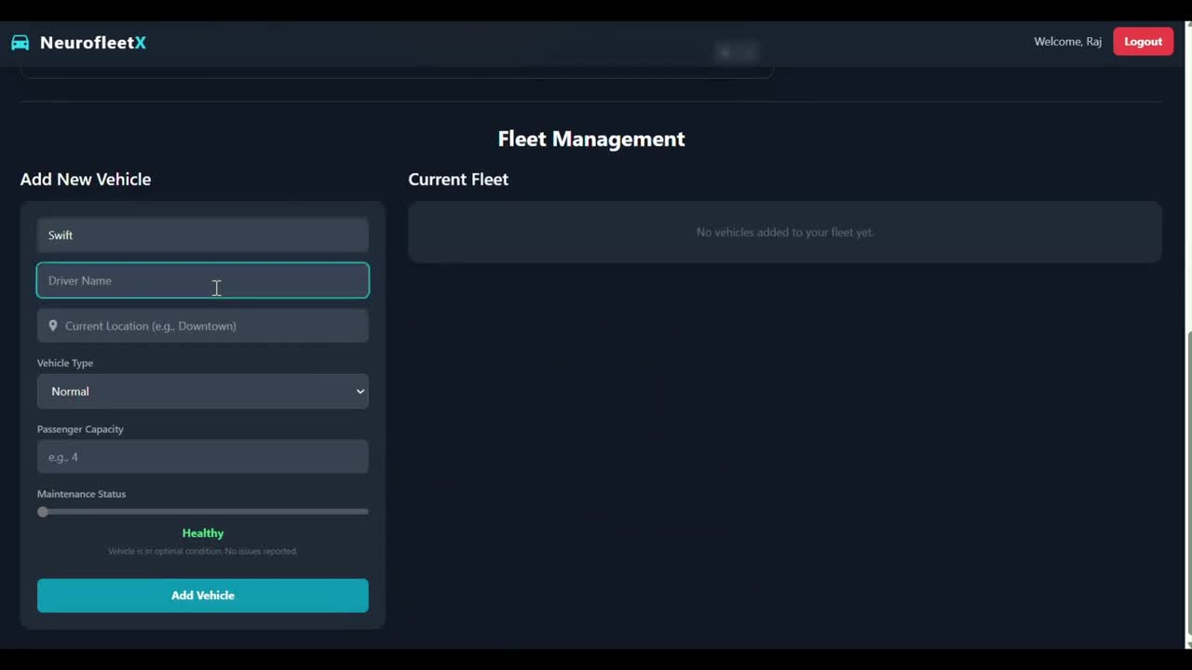

Project Demo

Slide 16

Thank you !
Open to any suggestions, feedbacks and questions.

