Slide 1
NeurofleetX
AI Powered Urban Fleet and Traffic Intelligence

Slide 2
Project Overview
NeurofleetX is an AI-powered solution designed to make urban transportation smarter, safer, and more efficient.
It focuses on two areas:
- Fleet Management (buses, taxis, trucks, delivery vehicles)
- Traffic Intelligence (monitoring and controlling traffic flow)

Slide 3
Problem Statement
- Cities face traffic congestion, pollution, and accidents.
- Fleet operators struggle with high fuel costs, delays, and poor route planning.
- Traditional traffic systems are not adaptive or smart.

Slide 4
Project Objectives
- Optimize fleet operations using AI.
- Analyze and predict traffic patterns in real-time.
- Reduce congestion, fuel usage, and emissions.
- Improve safety and efficiency in urban mobility.

Slide 5
How It Works
1. Data Collection – GPS, IoT sensors, traffic cameras, weather.
2. AI & ML Models – analyze vehicle speed, routes, driver behavior, traffic density.
3. Intelligent Decisions – route suggestions, traffic jam prediction, maintenance alerts, smart traffic signals.

Slide 6
Key Features
- Smart Traffic Control (adaptive signals, route suggestions)
- Fleet Tracking & Optimization
- Predictive Analytics for traffic & accidents
- Eco-friendly mobility
- Dashboard & Reports for managers

Slide 7
Use Cases
- Ride-sharing companies (Uber, Ola)
- Logistics firms (Delhivery, Amazon)
- Smart cities with adaptive signals
- Public transport (bus/train scheduling)

Slide 8
Tech Stack Overview:-
Java Full Stack architecture
Modern Frontend + Reactive Backend
AI/ML integration
Cloud-native deployment
Frontend (Web App)
React / Angular → Fast, dynamic UI
TailwindCSS → Responsive styling
Mapbox GL JS / Leaflet → Real-time maps
Recharts / Apache ECharts → Dashboards & analytics
WebSocket/SSE client → Live updates
PWA support → Offline & installable

Slide 9
Backend (Java Microservices)
Java 21, Spring Boot 3.x
Spring WebFlux – Reactive APIs
Spring Data JPA / R2DBC – Database access
Spring Security OAuth2 – JWT Auth
Resilience4j – Circuit breakers
MapStruct – DTO mapping
OpenAPI/Swagger – API docs
Core Microservices
Device Ingestion Service → MQTT, REST, Kafka
Geo/Routing Service → GraphHopper, OSM, ETA
Fleet Management Service → Vehicles, drivers, compliance
Dispatch/Optimization → Batching, re-routing (Kafka Streams/Flink)
Traffic Intelligence Service → Congestion, incidents, heatmaps
Notification Service → SMS, Email, Push, WebSockets
Reporting Service → KPIs, exports

Slide 10
Data & ML Layer
MySQL → Geospatial storage (routes, geofences)
Tribuo / DeepLearning4J → Forecasting, ETA models
ONNX Runtime / JPMML → ML model serving in Java
Optional Python ML Service → FastAPI + gRPC
DevOps / Infrastructure
Docker + Kubernetes (EKS/AKS/GKE) → Scalable deployment
Helm → Deployment charts
GitHub Actions / Jenkins → CI/CD pipelines
Prometheus + Grafana → Monitoring & metrics

Slide 11
System Analysis
Input Sources → GPS devices, IoT sensors, traffic cameras, weather feeds
Processing → AI/ML models analyze traffic flow, ETA, and congestion patterns
Output → Optimized routes, live dashboards, smart traffic signals, notifications

Slide 12
SWOT Analysis
Strengths (S):
Real-time AI-powered decision making
Scalable microservice architecture
Integration with smart city infrastructure
Weaknesses (W):
High initial deployment cost
Requires strong internet connectivity
Complex ML model training
Opportunities (O):
Growing demand for smart cities
Can expand to global logistics & transport
Potential integration with EV fleets & 5G
Threats (T):
Data privacy/security concerns
Dependency on external APIs (maps, traffic data)
Competition from global fleet management systems

Slide 13
Cost-Benefit Analysis
Costs:
Infrastructure setup (IoT, servers, cloud)
Development & maintenance
AI/ML model training & tuning
Benefits:
25–30% reduction in fuel & operational cost
40% improved delivery efficiency
Significant drop in traffic congestion & idle time
Long-term ROI through smart mobility adoption

Slide 14
Risk Analysis
Data Security Risks → Mitigated with OAuth2, JWT, encryption
System Downtime Risks → Mitigated with Resilience4j, Kubernetes auto-healing
Scalability Risks → Solved using Kafka, microservices, cloud infra
Adoption Risks → User training + government partnerships
Future Scope
Integration with Autonomous Vehicles
AI-powered demand prediction for ride-sharing
Green Mobility → EV fleet optimization
Integration with 5G & Edge Computing for ultra-low latency traffic management
Expansion to global mega-cities

Slide 15
Benefits
✅ Reduced traffic congestion
✅ Lower fuel & operational costs
✅ Fewer accidents
✅ Time saving for commuters
✅ Cleaner and greener cities

Slide 16

Some of the work that i done:-
Dashboard

Slide 17
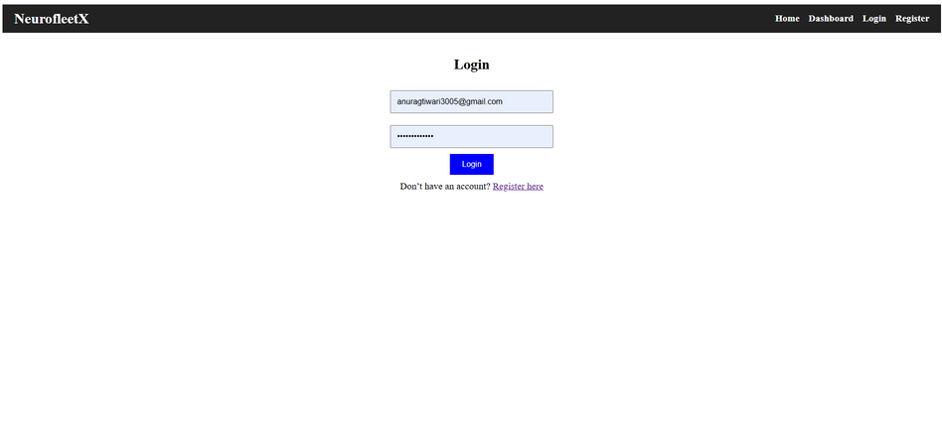
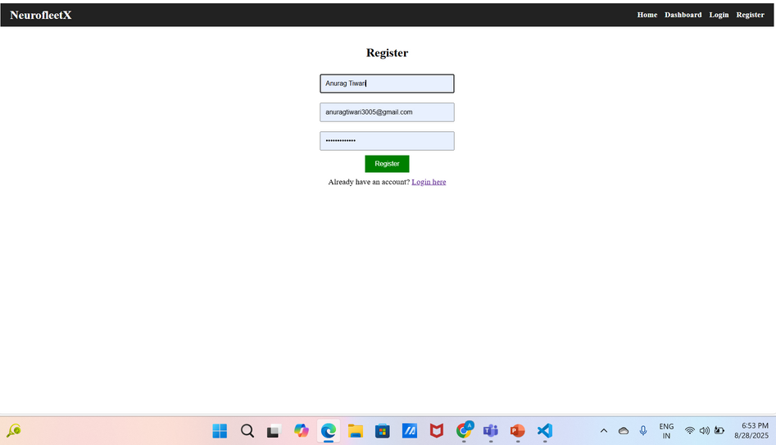
Login
Register page

