Slide 1
NeurofleetX
AI Powered Urban Fleet and Traffic Intelligence

Slide 2
Project Overview
NeurofleetX is an AI-powered solution designed to make urban transportation smarter, safer, and more efficient.
It focuses on two areas:
- Fleet Management (buses, taxis, trucks, delivery vehicles)
- Traffic Intelligence (monitoring and controlling traffic flow)

Slide 3
Problem Statement
- Cities face traffic congestion, pollution, and accidents.
- Fleet operators struggle with high fuel costs, delays, and poor route planning.
- Traditional traffic systems are not adaptive or smart.

Slide 4
Project Objectives
- Optimize fleet operations using AI.
- Analyze and predict traffic patterns in real-time.
- Reduce congestion, fuel usage, and emissions.
- Improve safety and efficiency in urban mobility.

Slide 5
How It Works
1. Data Collection – GPS, IoT sensors, traffic cameras, weather.
2. AI & ML Models – analyze vehicle speed, routes, driver behavior, traffic density.
3. Intelligent Decisions – route suggestions, traffic jam prediction, maintenance alerts, smart traffic signals.

Slide 6
Key Features
- Smart Traffic Control (adaptive signals, route suggestions)
- Fleet Tracking & Optimization
- Predictive Analytics for traffic & accidents
- Eco-friendly mobility
- Dashboard & Reports for managers

Slide 7
Use Cases
- Ride-sharing companies (Uber, Ola)
- Logistics firms (Delhivery, Amazon)
- Smart cities with adaptive signals
- Public transport (bus/train scheduling)

Slide 8
Benefits
✅ Reduced traffic congestion
✅ Lower fuel & operational costs
✅ Fewer accidents
✅ Time saving for commuters
✅ Cleaner and greener cities

Slide 9
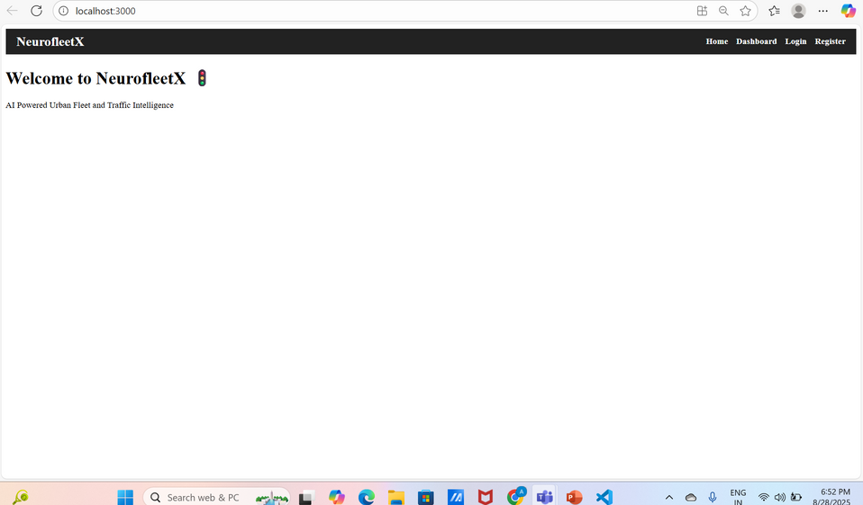
Some of the work that i done:-
Dashboard

Slide 10
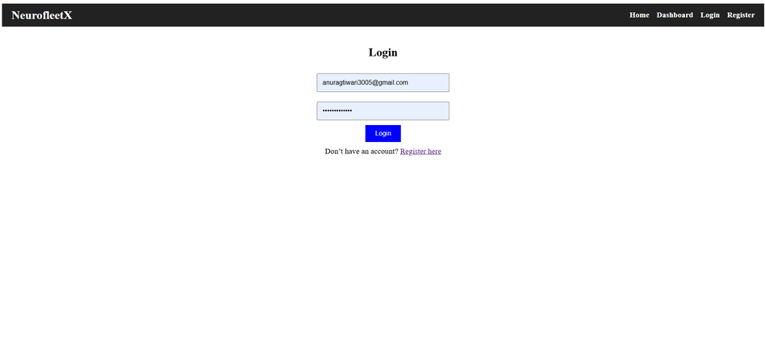
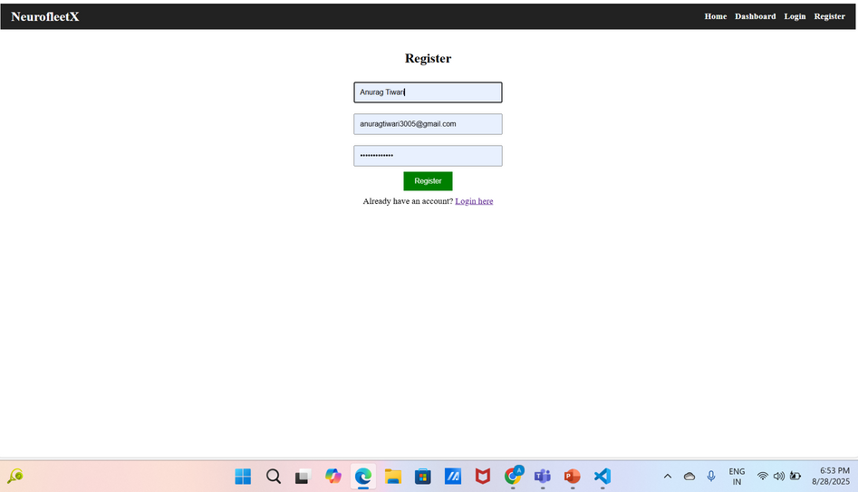
Login
Register page

