Slide 1

INFO6150 FINAL PRESENTATION ITS- Issue Tracking System
RAGHAV KHANNA
BHAVIN BHATIA
KUNINTI KEERTHI REDDY
ARJUN NANDKISHOR TIWARI
This Photo by Unknown author is licensed under CC BY-ND.

Slide 2
INTRODUCTION
An organization deals with many issues/bugs in a single project. To keep track of all the issues from all the projects is a difficult task.
Issue tracking system is a project management tool which can be used as an internal tool in an organization to track issues in the projects making it easier for employees to see status of a problem as well as monitor progress.
Administration and employees have access to different things, restricting employees from updating all the details to maintain credibility.

Slide 3
ADVANTAGES of ISSUE TRACKING SYSTEM
Helps in resolving issues priority based.
Helps is tracking unresolved issues and issues to be resolved.
Update feature helps in editing the team members and status of the projects and tickets.
Helps in maintaining over-all track of work progress.

Slide 4
Tech features and Libraries used
Built using react front end and node back end.
Used mongoose to connect to MongoDB.
Used MongoDB atlas database.
Used reactstrap library for the frontend components
Bcrypt library used for password hashing
Nodemailer library used for sending emails
JWT tokens for user authentication and session management

Slide 5
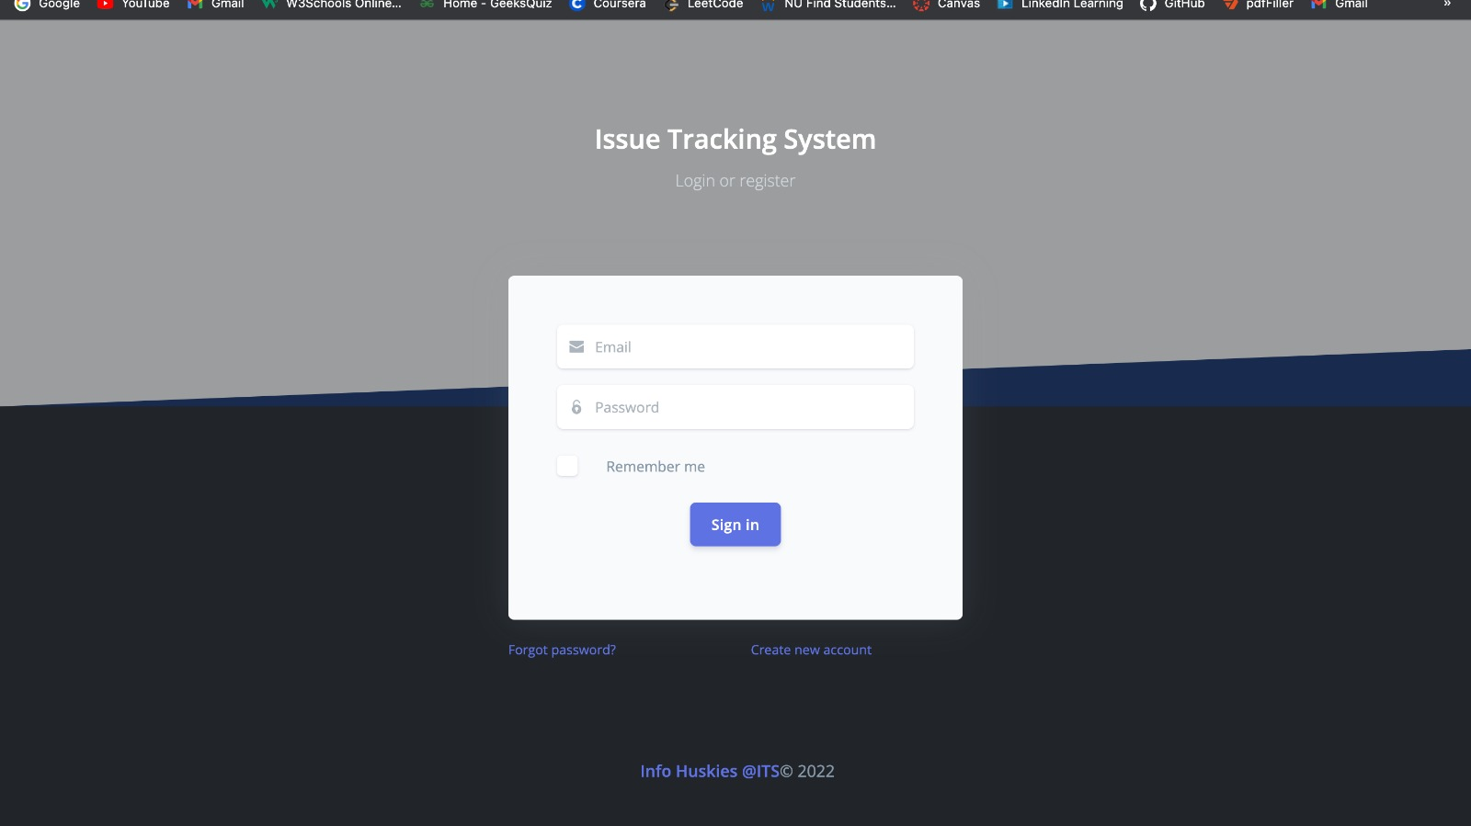
WEBSITE PICTURES

Slide 6
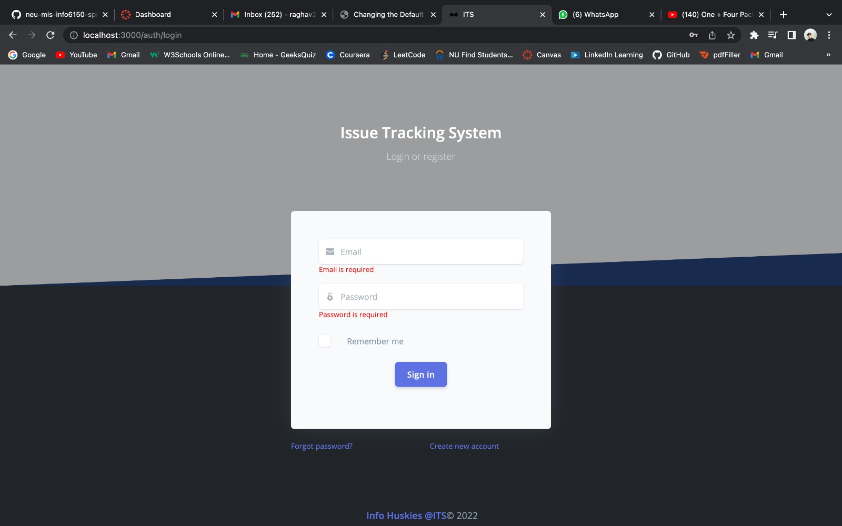

Slide 7
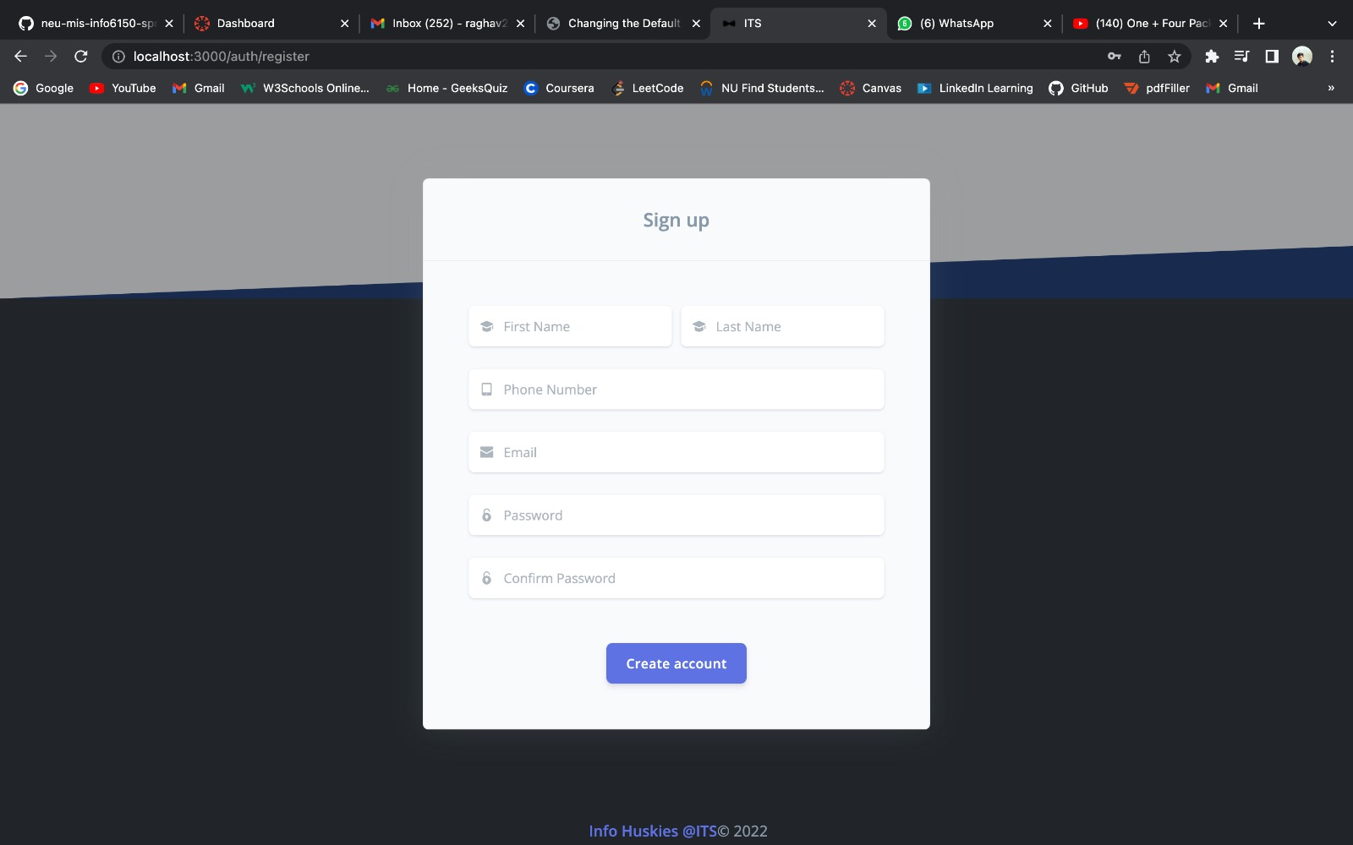

Slide 8
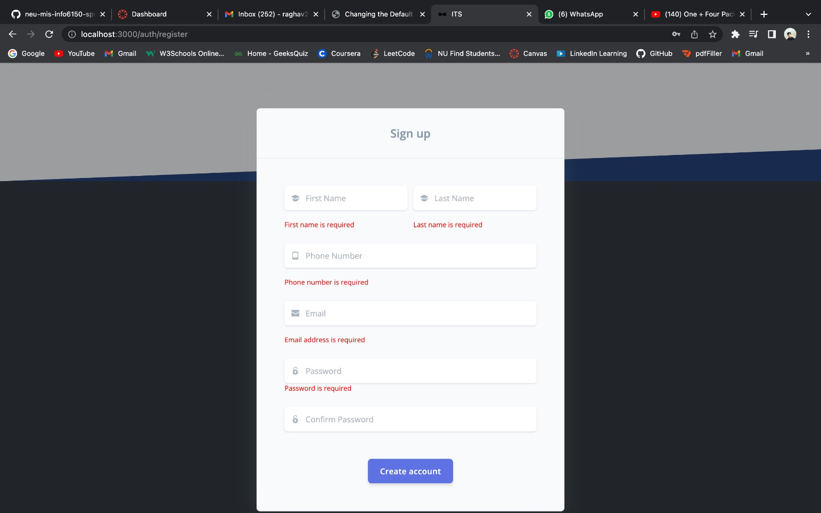

Slide 9
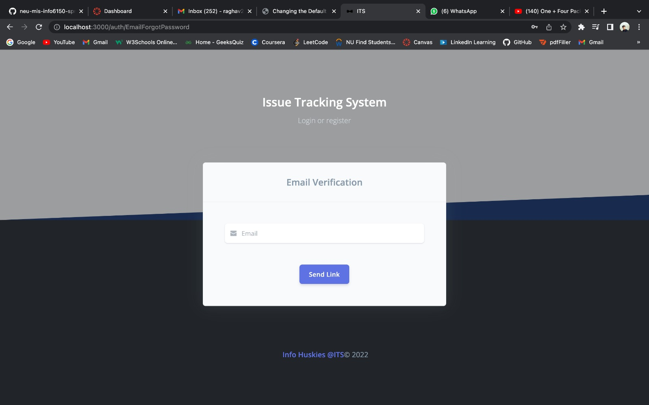

Slide 10
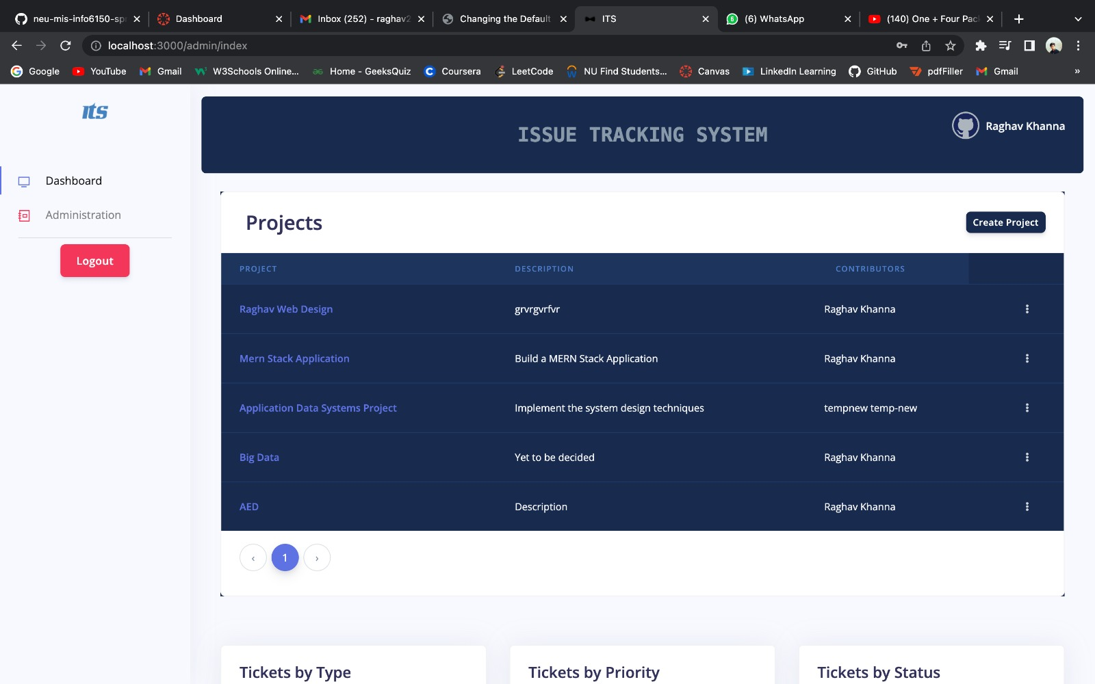

Slide 11
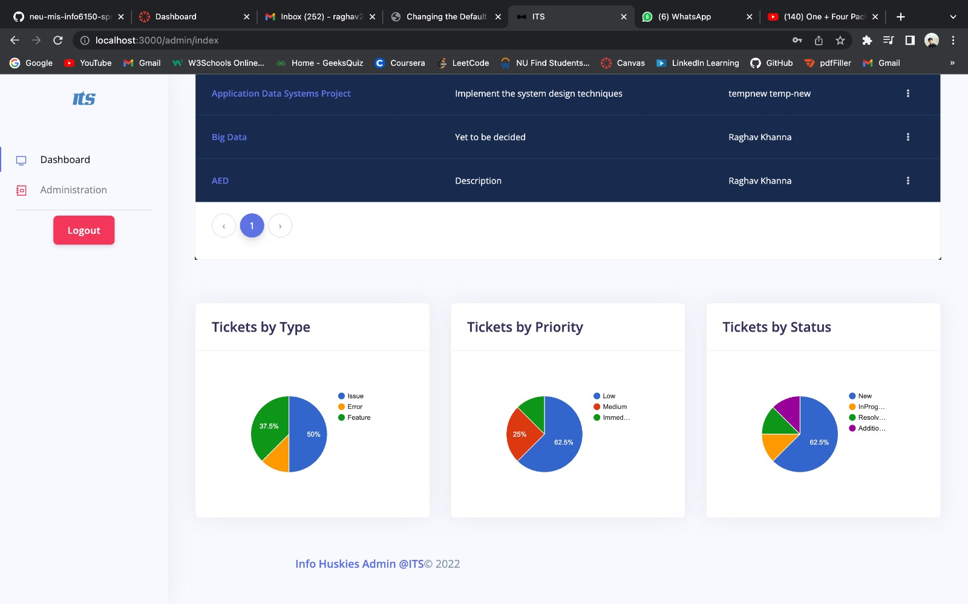

Slide 12
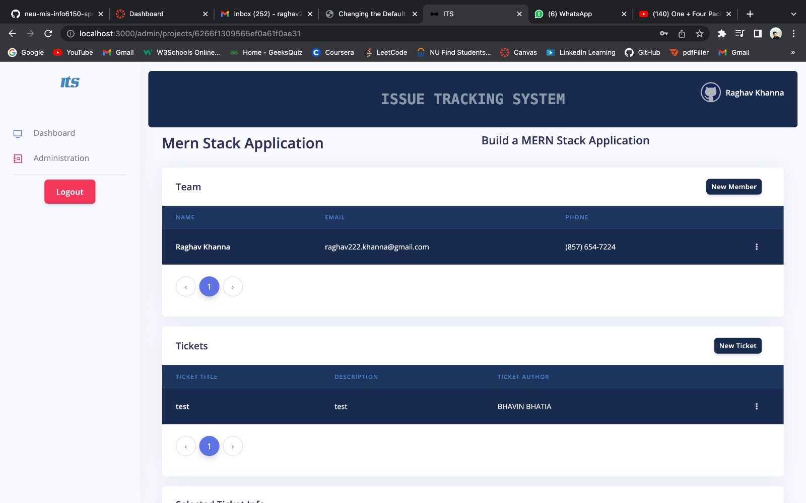

Slide 13
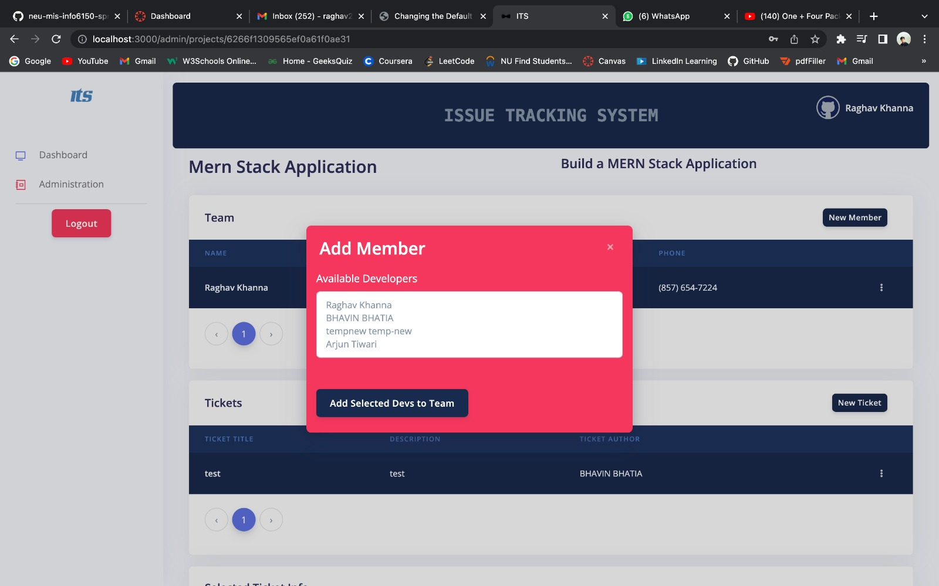

Slide 14
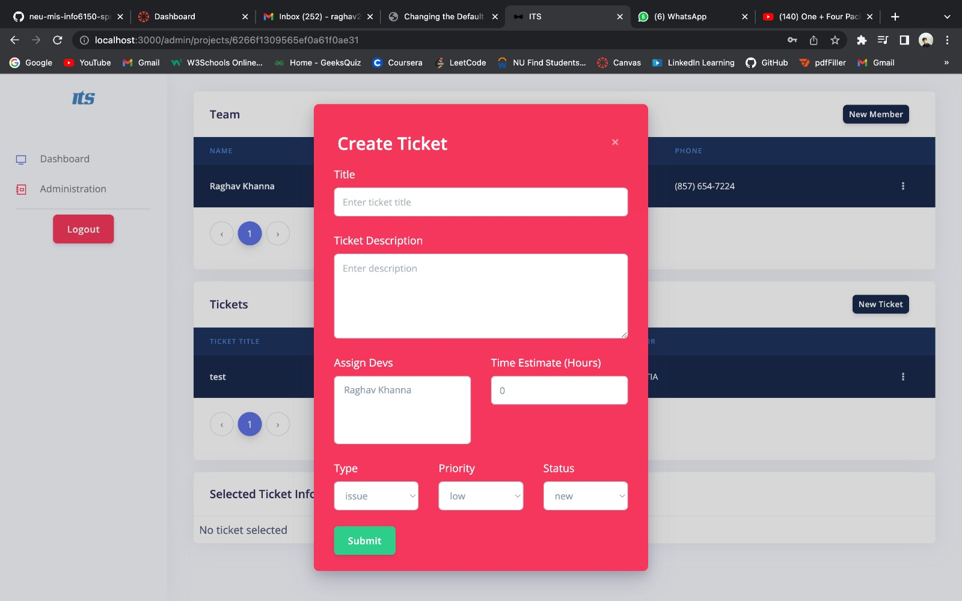

Slide 15
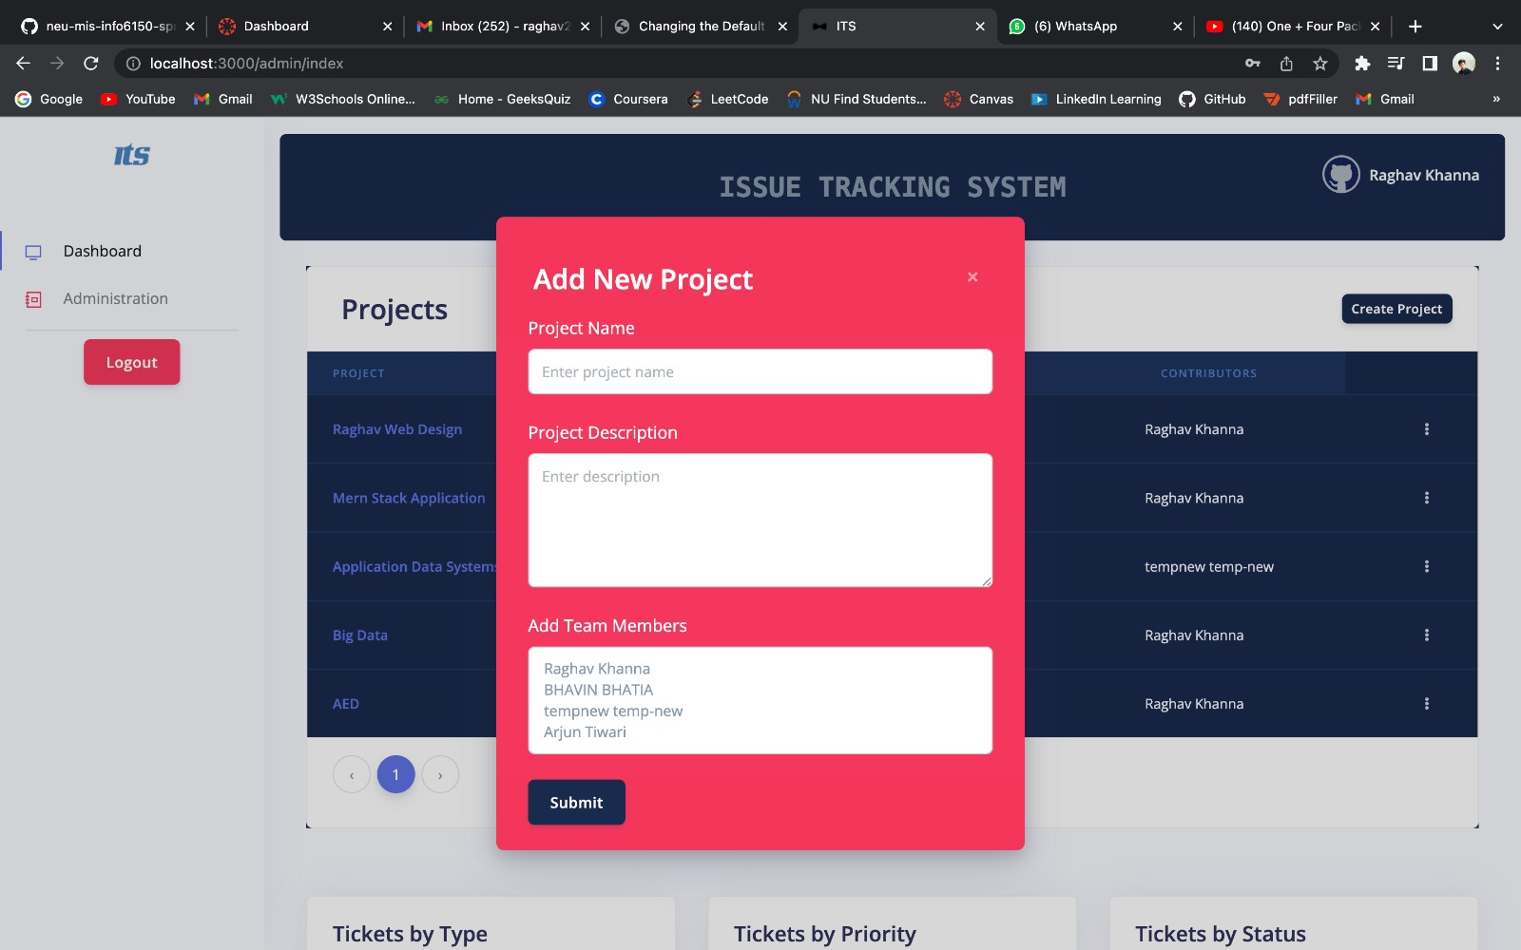

Slide 16
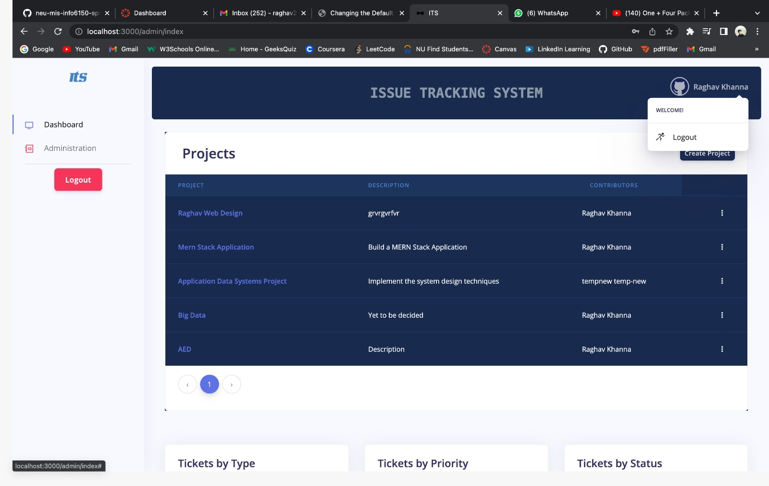

Slide 17
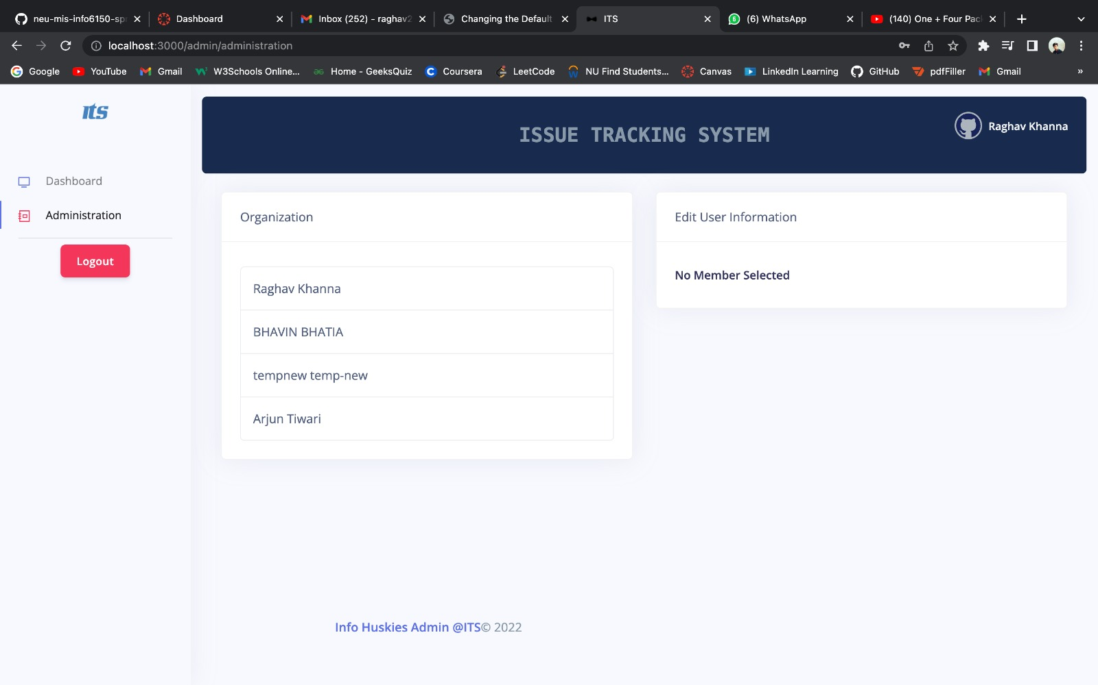

Slide 18
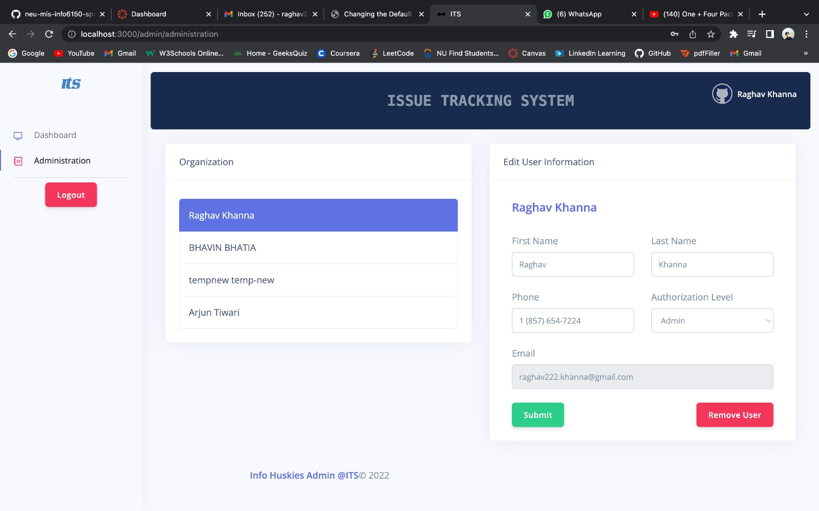

Slide 19
Contributions
Raghav Khanna - Register, Login ,Home/Admin Dashboard, Logout, Project /Team CRUD Operations and Table creation Google Pie Chart, User Authentication, Modal Creation,Update Ticket Feature, MongoDb, End to End Testing
Arjun Tiwari - Tickets Creation and Developer Assignments, Jwt Tokens, Bycrypt of password, Event handling on Ticket Selection, Selected Ticket Information component, MongoDB
Bhavin Bhatia- Forgot Password Component, Nodemailer, Project Deletion, Backend for Update Ticket, Adding/Removing Team Member, MongoDB, dotenv
Keerthi Kuninti- Login and Register Validations, User profile Updation on Admin Page, Frontend Designing, Navbar Creation, Header and Footer components, MongoDB

Slide 20
REFERENCES
https://www.creative-tim.com/product/argon-dashboard-react
https://nodemailer.com/about/
https://developers.google.com/chart/interactive/docs/gallery/piechart
https://react-bootstrap.netlify.app/getting-started/introduction/
https://www.mongodb.com/docs/
https://developer.mozilla.org/en-US/docs/Web/JavaScript

Slide 21


