Slide 1
MSCS 632 ADVANCED PROGRAMMING LANGUAGES
Simple Chat Application
Rust and Go implementation comparison
Ruthwik Pala | Arjun Nandkishor Tiwari
University of the Cumberlands
Dr. Jay Thom
October 2026
Notes:
Timing: 30 seconds. Introduce the team and explain that the project implements the same local chat application in Rust and Go so the comparison comes from equivalent functionality.

Slide 2
Project goal and required functionality
The same user experience is implemented through two language-specific backends
APPLICATION REQUIREMENTS
COMPARISON OBJECTIVE
•
Simulate Alice, Bob, and Charlie as stable users
One shared frontend keeps the workflow constant. The backend changes reveal differences in type systems, state ownership, concurrency, errors, and programming style.
•
Store messages with sender, recipient, ID, content, and timestamp
•
Search history by participant or keyword
•
Demonstrate concurrent message handling
Both servers expose the same HTTP routes and JSON field names.
MSCS 632 | Simple Chat Application
2
Notes:
Timing: 1 minute. Explain that the design controls for functionality by keeping the browser interface and API contract identical. This lets the team compare language choices instead of comparing different products.

Slide 3
System structure
Only one backend runs on port 8080 at a time
Shared browser interface
HTML | CSS | JavaScript
Rust backend
Go backend
Typed models
Tokio worker and tasks
Serde JSON
Structs and slices
Goroutines and channels
net/http JSON
Same API contract
MSCS 632 | Simple Chat Application
3
Notes:
Timing: 1 minute. Walk from the browser to either backend. Mention that both implementations serve the same static frontend and expose users, messages, conversation, and simulation endpoints.

Slide 4
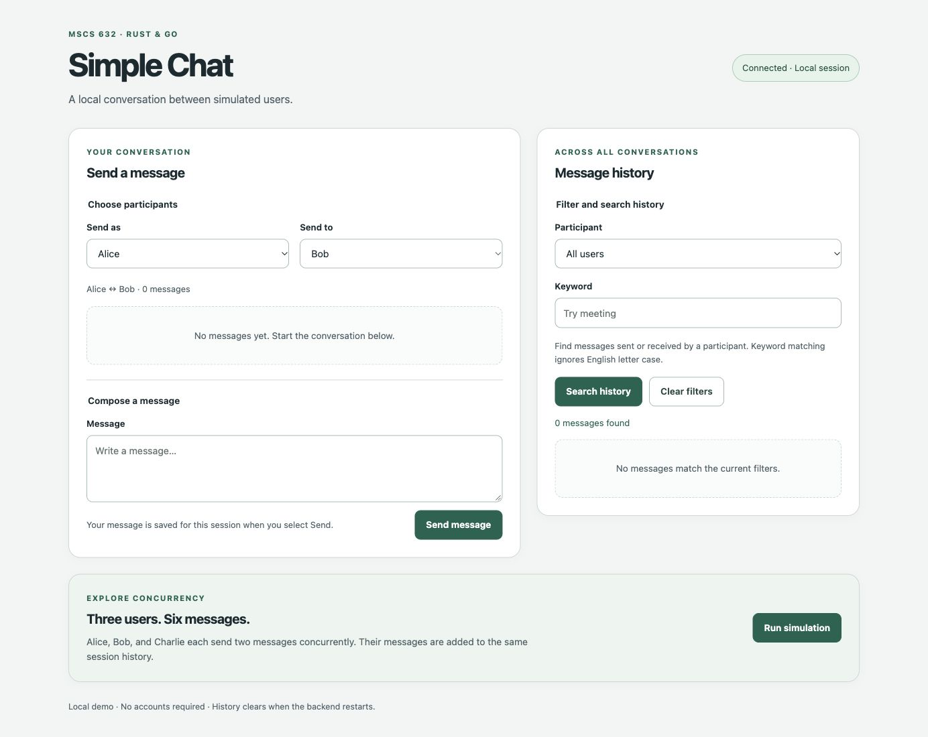
Shared application interface
The initial screen exposes messaging, search, and simulation in one view
MSCS 632 | Simple Chat Application
4
Notes:
Timing: 1 minute. Point out the sender and recipient controls, the conversation area, the global history filters, and the Run simulation control. The live demonstration should first run with Rust and then repeat after starting Go.

Slide 5
Shared API and data contract
Stable string user IDs allow the same JavaScript client to use either backend
GET /api/users
POST /api/messages
GET /api/messages
GET /api/conversation
POST /api/simulation
{
"sender_id": "alice",
"recipient_id": "bob",
"content": "Meeting at 3"
}
The browser sends alice, bob, and charlie directly. Neither backend requires frontend conversion.
MSCS 632 | Simple Chat Application
5
Notes:
Timing: 1 minute. Explain why string IDs matter: they match the shared model and remove Number conversions from the frontend. Review the five routes and one representative request.

Slide 6
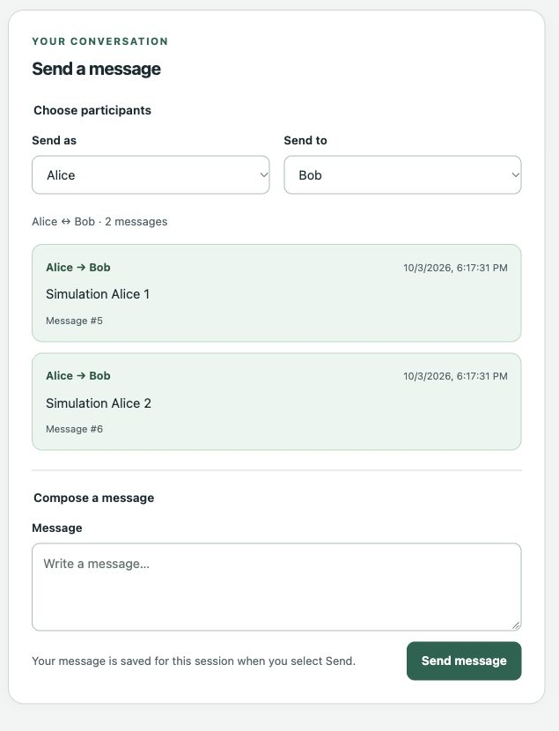
Sending messages and viewing a conversation
The shared interface exposes participant selection, stored messages, the composer, and Send action
MSCS 632 | Simple Chat Application
6
Notes:
Presenter: Ruthwik Pala. Timing: 45 seconds. Point out Alice and Bob as the selected participants, the stored messages with IDs and timestamps, the message composer, and the Send message button. During the live demonstration, enter a new message and show it appearing immediately in the conversation.

Slide 7
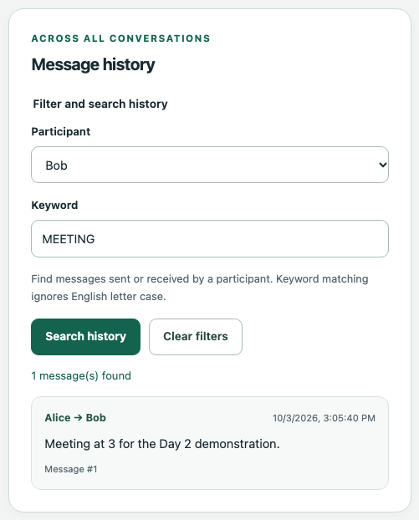
Filtering message history
Participant and keyword criteria can be used separately or together
Participant: Bob
Keyword: meeting
Result: one matching message
MSCS 632 | Simple Chat Application
7
Notes:
Presenter: Ruthwik Pala. Timing: 45 seconds. Choose Bob and search for meeting. The history query checks messages sent or received by Bob and performs case-insensitive keyword matching.

Slide 8
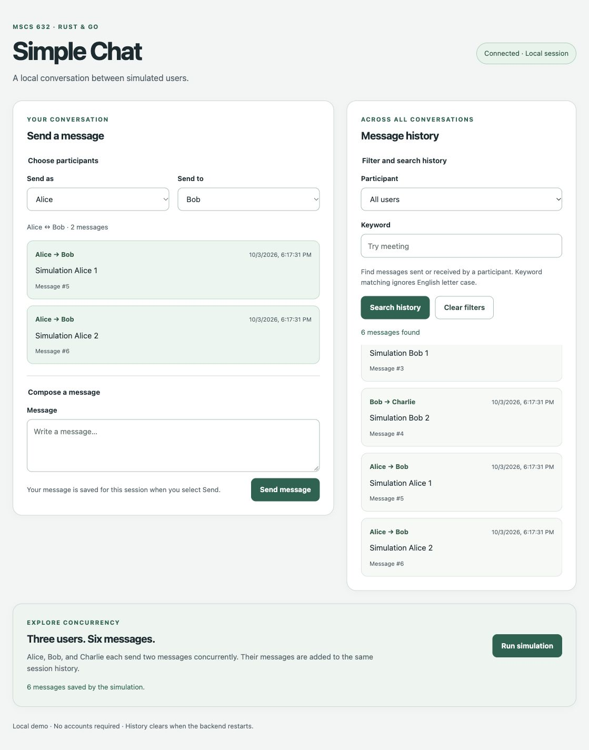
Running the concurrent simulation
Three users send two messages each while the backend preserves unique sequential IDs
VERIFIED OUTCOME
•
3 concurrent simulated users
•
6 accepted messages
•
Unique sequential message IDs
•
Messages added to shared history
MSCS 632 | Simple Chat Application
8
Notes:
Presenter: Ruthwik Pala. Timing: 1 minute. Click Run simulation and point to the success result and the six new messages. Task scheduling may change processing order, but synchronization keeps every ID unique and every accepted message in shared history.

Slide 9
Rust backend design
Ownership and typed results keep mutable session state behind one worker
pub struct ChatService {
users: HashMap<String, User>,
history: Vec<Message>,
next_message_id: u64,
}
pub fn send(&mut self, request: SendMessageRequest)
-> Result<Message, ChatError>
WHY THIS FITS RUST
•
&mut self makes mutation explicit
•
Enums define valid error states
•
Result forces callers to handle failure
•
Ownership limits shared mutable access
MSCS 632 | Simple Chat Application
9
Notes:
Timing: 1.5 minutes. Describe the HashMap, Vec, and next ID fields. Emphasize that send requires a mutable borrow and returns Result. The channel-driven worker owns the service, so HTTP handlers do not mutate history directly. Source: rust-backend/src/chat.rs.

Slide 10
Rust models and error handling
Enums and Result values make expected failures explicit
pub struct Message {
pub message_id: u64,
pub sender_id: String,
pub recipient_id: String,
pub content: String,
pub timestamp_ms: u64,
}
pub enum ChatError {
UnknownUser, SameUser, EmptyContent,
ClockUnavailable, IdExhausted,
}
RUST LANGUAGE FEATURES
•
Owned String values define clear data ownership
•
Error enums limit failures to known variants
•
Pattern matching maps errors to API codes
•
Checked arithmetic prevents ID overflow
MSCS 632 | Simple Chat Application
10
Notes:
Presenter: Ruthwik Pala. Timing: 1 minute. Compare Message and ChatError. Explain that Rust uses owned strings for stored data, Result for recoverable failure, and enums so handlers must address each meaningful error. Sources: rust-backend/src/models.rs and rust-backend/src/chat.rs.

Slide 11
Rust concurrency with Tokio
Three async tasks send through one channel-driven state owner
let mut tasks = JoinSet::new();
for (sender_id, recipient_id, name) in users {
let client = handle.clone();
tasks.spawn(async move {
for number in 1..=2 {
client.send(request).await?;
}
});
}
while let Some(result) = tasks.join_next().await { ... }
EXECUTION MODEL
•
Tokio schedules each simulated user independently
•
A cloned handle sends commands to one worker
•
The worker assigns IDs and updates history
•
Results are sorted by ID for stable output
MSCS 632 | Simple Chat Application
11
Notes:
Presenter: Ruthwik Pala. Timing: 1.5 minutes. Explain JoinSet, async move, the cloned ChatHandle, and why only the worker mutates ChatService. Each task sends two messages sequentially while tasks interleave. Source: rust-backend/src/simulation.rs.

Slide 12
Rust testing and verification
Tests cover service behavior, HTTP responses, worker ownership, and overlapping simulations
cargo fmt --manifest-path rust-backend/Cargo.toml -- --check
cargo clippy --manifest-path rust-backend/Cargo.toml
--all-targets -- -D warnings
cargo test --manifest-path rust-backend/Cargo.toml --locked
22
tests passed
•
Rejected messages preserve history and IDs
•
Concurrent runs produce ordered unique IDs
MSCS 632 | Simple Chat Application
12
Notes:
Presenter: Ruthwik Pala. Timing: 1 minute. State that all 22 Rust tests passed with formatting and Clippy checks. Mention the overlapping simulation test, which verifies IDs 1 through 20 across concurrent operations.

Slide 13
Go backend design
A mutex protects shared slices and IDs while methods return explicit errors
type ChatService struct {
users map[string]User
messages []Message
nextMessageID uint64
mu sync.RWMutex
}
func (s *ChatService) SendMessage(...)
(Message, error)
GO LANGUAGE FEATURES
•
Structs and slices keep the data model direct
•
RWMutex separates reads from writes
•
Errors remain ordinary return values
•
Small methods favor readable control flow
MSCS 632 | Simple Chat Application
13
Notes:
Presenter: Arjun Nandkishor Tiwari. Timing: 1.5 minutes. Explain the map, slice, next ID, and RWMutex. SendMessage validates first, then takes the write lock before assigning the ID and appending the message. Source: go-backend/internal/chat/chat.go.

Slide 14
Go models and error handling
Struct tags define JSON fields while sentinel errors preserve simple control flow
type Message struct {
MessageID uint64 `json:"message_id"`
SenderID string `json:"sender_id"`
RecipientID string `json:"recipient_id"`
Content string `json:"content"`
TimestampMS int64 `json:"timestamp_ms"`
}
var ErrUnknownUser = errors.New("unknown user")
GO LANGUAGE FEATURES
•
JSON tags align the shared API contract
•
Sentinel errors support errors.Is checks
•
Zero values make failed returns predictable
•
Explicit branches keep HTTP mapping visible
MSCS 632 | Simple Chat Application
14
Notes:
Presenter: Arjun Nandkishor Tiwari. Timing: 1 minute. Explain the struct tags and sentinel errors. The API layer uses errors.Is to translate service errors into matching HTTP and JSON responses. Sources: go-backend/internal/chat/models.go and chat.go.

Slide 15
Go concurrency with goroutines
Three goroutines share the service while a channel collects six results
results := make(chan simulationResult, 6)
for _, user := range users {
user := user
go func() {
for _, content := range user.messages {
message, err := s.SendMessage(...)
results <- simulationResult{message, err}
}
}()
}
for i := 0; i < 6; i++ { result := <-results }
EXECUTION MODEL
•
Goroutines schedule simulated users
•
A buffered channel collects every result
•
RWMutex protects IDs and history
•
Sorting makes the response deterministic
MSCS 632 | Simple Chat Application
15
Notes:
Presenter: Arjun Nandkishor Tiwari. Timing: 1.5 minutes. Explain the goroutine closure, buffered result channel, and six receives. SendMessage performs synchronized mutation. Source: go-backend/internal/chat/simulation.go.

Slide 16
Go testing and verification
Service and API tests run with static analysis and the race detector
gofmt
go vet ./...
go test ./...
go test -race ./...
VERIFIED BEHAVIOR
•
HTTP routes and JSON responses
•
Message validation and sequential IDs
•
Conversation and keyword queries
•
Concurrent simulation without race reports
MSCS 632 | Simple Chat Application
16
Notes:
Presenter: Arjun Nandkishor Tiwari. Timing: 1 minute. Describe the service and API tests, then emphasize the race detector because shared state uses a mutex. Source: go-backend internal chat and API test files.

Slide 17
Essential Rust and Go comparison
The same application behavior is produced through different language designs
Area | Go implementation | Rust implementation | What it means
Concurrency | Goroutines + channels | Tokio tasks + channels | Both run the three simulated users concurrently.
Chat state | Shared service + RWMutex | Worker owns mutable state | Go uses locks; Rust centralizes ownership.
Errors | error values | Result + ChatError enum | Both return clear validation failures.
Memory | Garbage collection | Ownership and borrowing | Memory is managed at runtime in Go and checked at compile time in Rust.
Integration | Same API and frontend | Same API and frontend | The browser works unchanged with either backend.
MSCS 632 | Simple Chat Application
17
Notes:
Presenters: Ruthwik Pala and Arjun Nandkishor Tiwari. Timing: 1.5 minutes. Focus on the central contrast: Go goroutines share ChatService and use RWMutex, while Rust Tokio tasks send commands to a worker that owns ChatService. Briefly compare error and memory models, then emphasize that both expose the same API to one frontend.

Slide 18
CONCLUSION
One application. Two valid concurrency models.
Rust emphasizes compile-time guarantees, explicit ownership, and typed failure paths.
Go emphasizes concise code, goroutines, channels, and synchronized shared state.
Both implementations satisfy the same functional requirements through one shared interface.
github.com/tiwariarjun91/MSCS-632-Group-Project-Simple-Chat-Application
Questions
Notes:
Presenters: Ruthwik Pala and Arjun Nandkishor Tiwari. Timing: 30 seconds plus questions. Ruthwik summarizes Rust, Arjun summarizes Go, and either presenter invites questions.

