Slide 1

Project Title - Seasonal Agriculture Performance Analysis
AICTE STU ID :STU6a281ba4ccb781781013412 __________________
BODHISATVA TIWARI
ARYA COLLEGE OF ENGG

Slide 2

PROBLEM STATEMENT
Agricultural performance changes with seasonal environmental conditions, farming practices, resource availability and market conditions. Raw agricultural data does not clearly show these seasonal differences. This project analyzes the dataset to identify meaningful patterns, trends, relationships and variations in agricultural performance across seasons.

Slide 3
Project Description The project performs a focused data analytics study of 4,000 agricultural farm records across 3 seasons, 8 crops, 8 states, 10 districts and 4 irrigation methods. The workflow covers data inspection, missing-value treatment, exploratory analysis, seasonal comparison, crop and irrigation analysis, relationship analysis, visualization and evidence-based recommendations.

Slide 4

WHO ARE THE END USERS?
• Farmers and farm managers — compare seasonal performance and resource-use patterns.
• Agricultural planners — support evidence-based seasonal planning.
• Agricultural analysts and researchers — investigate crop, environmental and economic relationships.
• Resource managers — examine irrigation and water-efficiency patterns.
• Policy and extension teams — identify areas requiring further investigation.

Slide 5

Technology Used
• Python — primary analysis language.
• Pandas — data loading, cleaning, grouping and aggregation.
• NumPy — numerical computation.
• Matplotlib — analytical charts and visualizations.
• Jupyter Notebook — analysis workflow and documentation.
• CSV dataset — source data for the project.
Workflow Data → Clean → Explore → Compare → Visualize → Interpret

Slide 6
RESULTS
4,000
farm records
28
variables
3
seasons
120
missing cells handled
• Kharif has the highest median yield: 1.94 t/ha.
• Kharif also has the highest positive-profit rate: 57.8%.
• Drip irrigation has the highest median yield (1.94 t/ha) and median profit (₹52,895).
• Yield and water efficiency show a strong positive association (r = 0.91); this is an association, not a causal claim.

Slide 7
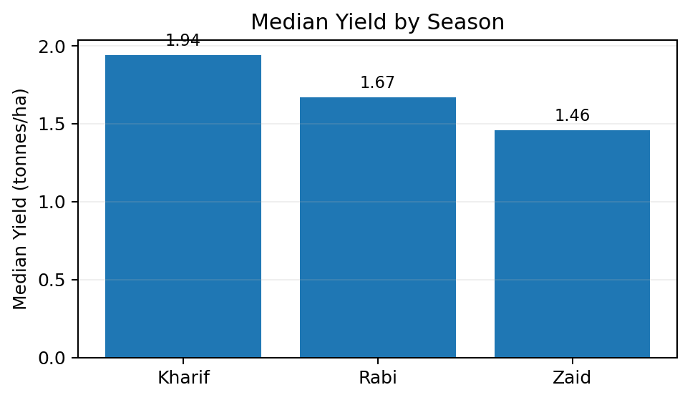
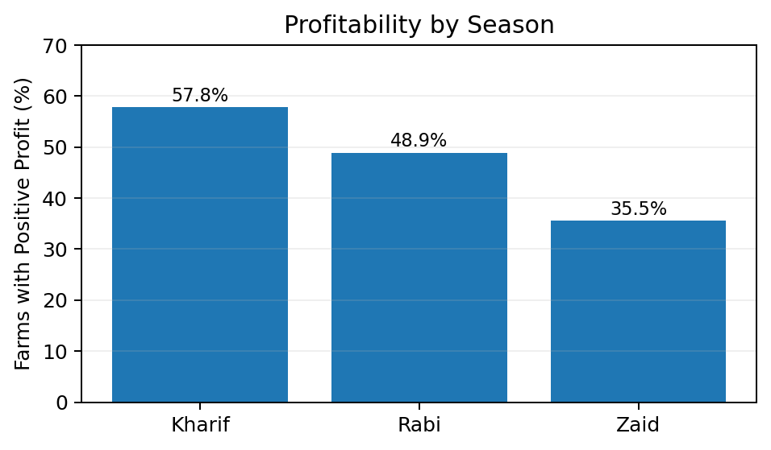
RESULTS
Seasonal comparison: Kharif leads on both median yield and positive-profit rate; Zaid records the lowest values.
Key result: Kharif leads in both median yield and positive-profit rate; Zaid is lowest on both measures.

Slide 8
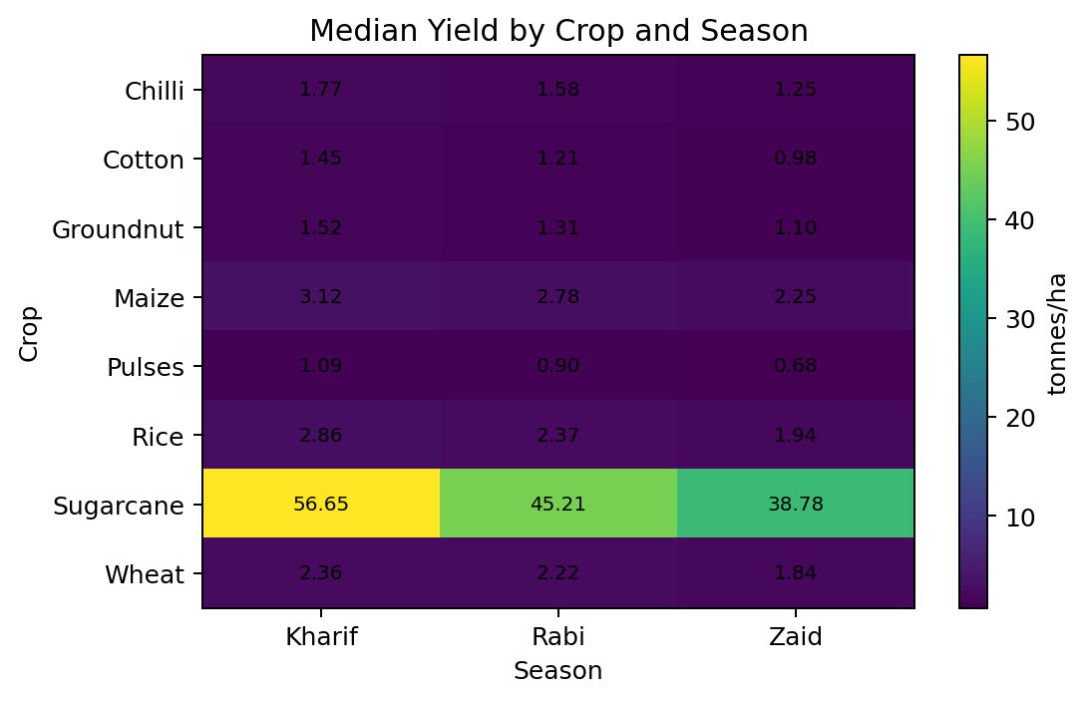
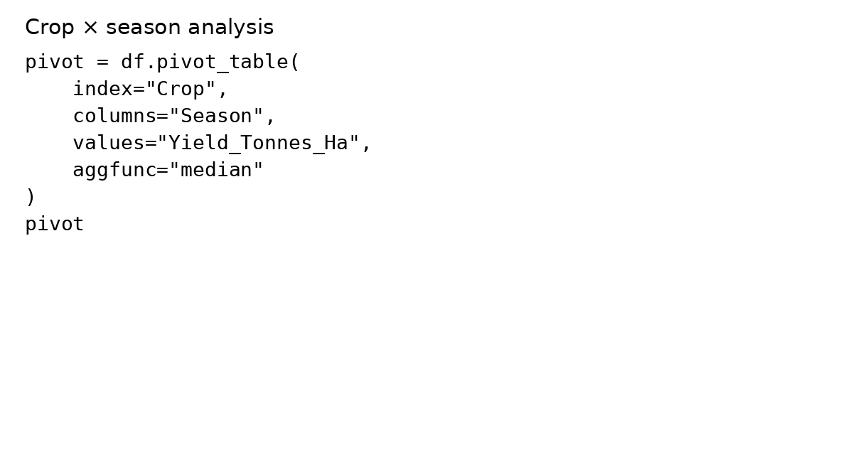
RESULTS
Sugarcane has the highest yield in every season; for the other crops, Kharif consistently records the highest median yield.
Key result: Sugarcane records the highest median yield in every season; Kharif is highest for every crop shown.

Slide 9
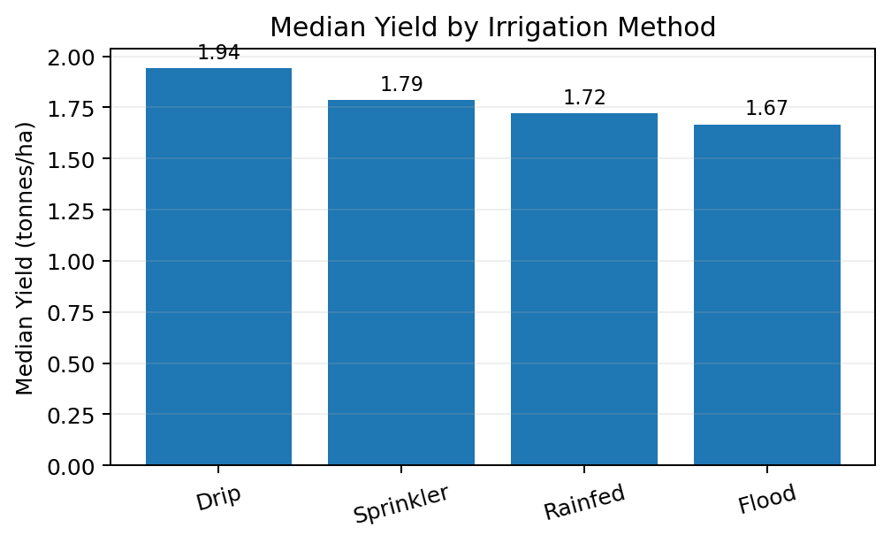
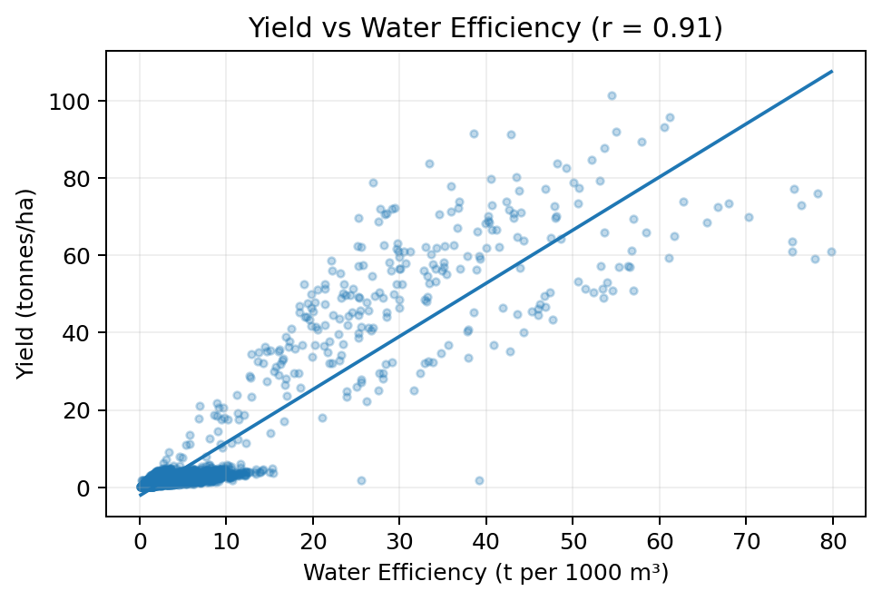
RESULTS
Drip has the highest median yield and profit. Rainfed shows higher water-efficiency values in this dataset, but lower median yield and profit than Drip.
Key result: Drip has the highest median yield and profit. The strong yield–water-efficiency relationship is descriptive, not causal.

Slide 10
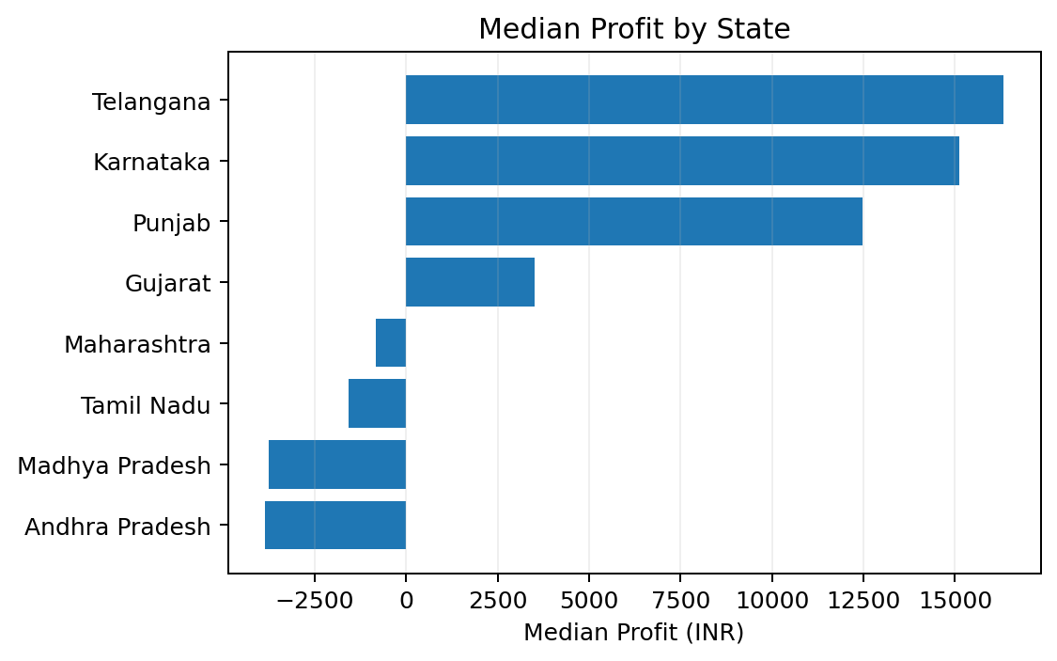
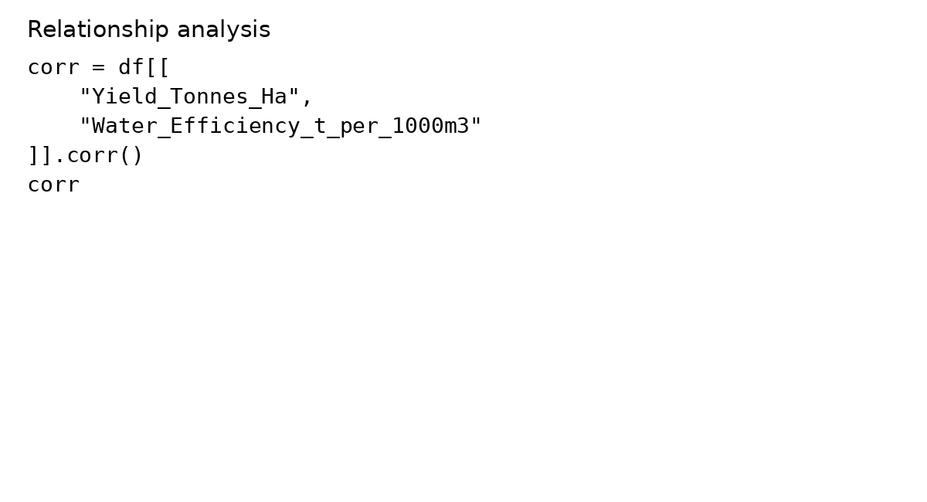
RESULTS
Median profit is highest for Telangana, followed by Karnataka and Punjab. Economic performance varies substantially across states.
Key result: Telangana has the highest median profit, followed by Karnataka and Punjab; several states have negative median profit.

Slide 11
Future scope
• Add multi-year data to separate seasonal effects from year-to-year variation.
• Build predictive models for yield, profit and disease/pest risk.
• Develop an interactive dashboard for season, crop, state and irrigation filters.
• Evaluate resource-use optimization for water, fertilizer and pesticides.
• Add weather forecasts and market-price trends for forward-looking planning.
• Validate patterns with field-level agricultural expertise before operational decisions.

Slide 12
GitHub Link
Project repository
Source code and project files are available through the GitHub repository below.

Slide 13
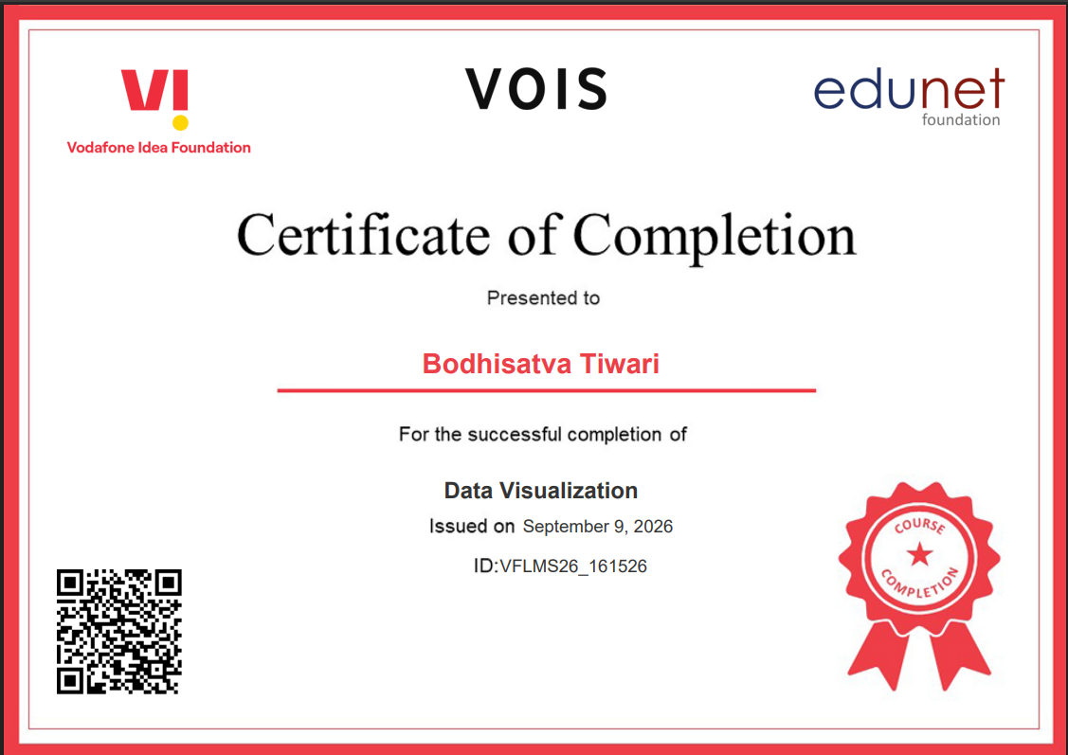
VOIS Course completion certificate - Course name: Data Visualization

Slide 14
Thank you

