Slide 1
Subquery

Slide 2
Contents
Subquery Syntax
MySQL Subquery Example
Subqueries : Guidelines and Types of Subqueries
MySQL Subquery as Scalar Operand
MySQL Subqueries : Using Comparisons
MySQL Subqueries with ALL, ANY, IN, or SOME
MySQL Row Subqueries

Slide 3
Collecting Data from Multiple Table
Set of tables are result of normalization
The required data is spread across multiple tables.
Techniques to read data from multiple tables
Joins
Subquery

Slide 4
Subquery
A sub query is a select query that is contained inside another query.
The inner select query is usually used to determine the results of the outer select query.
A MySQL subquery is a query nested within another query such as INSERT, UPDATE, DELETE and SELECT.
These subqueries can reside in the WHERE clause, the FROM clause, or the SELECT clause.
In MySQL, a subquery is also called an INNER QUERY or INNER SELECT.
In MySQL, the main query that contains the subquery is also called the OUTER QUERY or OUTER SELECT.

Slide 5
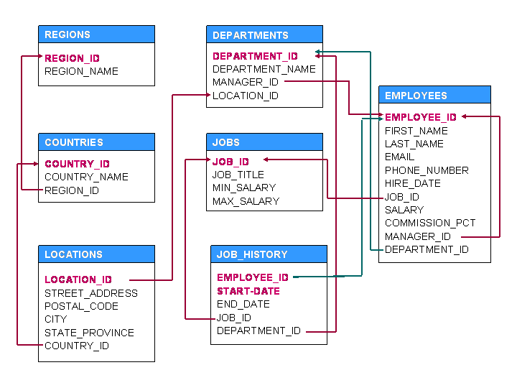
Schema for the Topic – HR Schema

Slide 6
Subquery in Select Query

Slide 7
Subquery in where clause
A subquery is a SQL query nested inside a larger query.
A subquery may occur in:
- A SELECT clause
- A FROM clause
- A WHERE clause

Slide 8
Subquery in Where Clause
Subquery returning single row should be compared with relational operators like <,>,<=,>=,= <>.
List the employees’ details who work in Accounting department.
Select * from employees where department_id = (select department_id from departments where department_name = ‘Accounting’);

Slide 9
More Examples
What is the average salary of Sales department.
Hat is
Select avg(salary) from employees where department_id = (select department_id from departments where department_name = ‘Sales’);
How many employees have salary greater than that of Susan.
Select count(*) from employees where salary > (select salary from employees where first_name = ‘Susan’);

Slide 10
More Examples
Who works in other department than that of Den .
Hat is
Select * from employees where department_id <> (select department_id from employees where first_name = ‘Den’);
Which countries come under Europe regions.
Select * from countries where region_id = (select region_id from regions where region_name=‘Europe’);

Slide 11
Try this
Which departments are available at ‘Seattle’ location.
Which employees have salary more than average salary of organization.

Slide 12
Subquery returning Multiple Rows
Subquery returning single row should be compared with relational operators like in, some, all, exists.
Which departments operates with country code US.
Select * from departments where location_id in( select location_id from locations where country_id =‘US’);

Slide 13
More examples
All operator :
5>all(1,2,3) → TRUE
5>all(6,7,8) → FALSE
5>all(2,5,7) → FALSE
List the details of employees who have more salary than everybody who joined in 2009.
select * from employees where salary > all(select salary from employees where year(hire_date)=2009);

Slide 14
More examples
Any operator :
5>any(1,2,3) → TRUE
5>any(6,7,8) → FALSE
5>any(2,5,7) → TRUE
List the details of employees who have more salary than maximum salary of either IT_PROG or ST_CLERK.
select * from employees where salary > any(select max_salary from jobs where job_id in('IT_PROG', 'ST_CLERK'));

Slide 15
More examples
SOME operator : The word SOME is an alias for ANY. Thus, these two statements are the same
5>some(1,2,3) → TRUE
5>some(6,7,8) → FALSE
5>some(2,5,7) → TRUE
List the details of employees who have more salary than maximum salary of either IT_PROG or ST_CLERK.
select * from employees where salary > some(select max_salary from jobs where job_id in('IT_PROG', 'ST_CLERK'));

Slide 16
More examples
EXISTS operator :
The EXISTS operator tests for the existence of rows in the results set of the subquery. If a subquery row value is found, EXISTS subquery is TRUE.
Find employees (employee_id, first_name, last_name, job_id, department_id) who have at least one person reporting to them.
select employee_id, first_name, last_name, job_id, department_id FROM employees E WHERE EXISTS (SELECT * FROM employees WHERE manager_id = E.employee_id);

Slide 17
More examples
EXISTS operator :
The EXISTS operator tests for the existence of rows in the results set of the subquery. If a subquery row value is found, EXISTS subquery is TRUE.
Find employees (employee_id, first_name, last_name, job_id, department_id) who have at least one person reporting to them.
select employee_id, first_name, last_name, job_id, department_id FROM employees E WHERE EXISTS (SELECT * FROM employees WHERE manager_id = E.employee_id);

Slide 18
More Example
NOT EXISTS operator :
The not EXISTS operator tests for the existence of rows in the results set of the subquery. If a subquery row value is not found, NOT EXISTS subquery is TRUE.
Find out the employees who are not managers.
select employee_id, first_name, last_name, job_id, department_id FROM employees E WHERE not EXISTS (SELECT * FROM employees WHERE manager_id = E.employee_id);

Slide 19
Try This
List the departments which are at same locations as of sales.
List the employees who have salary more than any employees of HR department.

Slide 20
Subquery in from clause
A subquery can be written in from clause where it is treated as a relation and select and where clauses are applied on it.
A derived table is an expression that generates a table within the scope of a query FROM clause. For example, a subquery in a SELECT statement FROM clause is a derived table:
Every table in a FROM clause must have a name, therefore the [AS] name clause is mandatory. Any columns in the subquery select list must have unique names.
Find out the average salary of the jobs which gets commission.
select avg(s.salary), s.job_id from (select salary,job_id from employees where commission_pct is not NULL) s group by job_id;

Slide 21
Subquery in select clause
The subquery written in select clause is used to display / project the columns which are mentioned in the select clause.
Use aliases to get proper column headers
Display the current summary of organization.
select curdate() Today,(select count(*) from departments) Dept_count,(select count(*) from employees) Emp_countfrom dual;
What is the possible maximum commission that the organization has to pay, assuming the maximum salary gainer get the maximum commission percentage..
select (select max(salary) from employees) *
(select max(commission_pct) from employees ) /100 from dual;

Slide 22
Subquery as a Scalar operand
A scalar subquery is a subquery that returns exactly one column value from one row.
A scalar subquery is a simple operand, and you can use it almost anywhere a single column value or literal is legal.
If the subquery returns 0 row then the value of scalar subquery expression in NULL and if the subquery returns more than one row then MySQL returns an error.
Display the location of employees based on the department.
SELECT employee_id, last_name, (CASE WHEN department_id=(SELECT department_id from departments WHERE location_id=2500) THEN 'Canada' ELSE 'USA' END) location FROM employees;

Slide 23
2nd Highest record
One of the way to find the Kth highest record is using subquery.
Find the employee with second maximum salary
select first_name, max(salary) from Employees where salary < ( select max(salary) from Employees );

Slide 24
Try This
Find 3rd highest salary

Slide 25
Try This
Find 3rd highest salary
SELECT * FROM table_name AS a WHERE n - 1 = ( SELECT COUNT(primary_key_column) FROM table_name b WHERE b.column_name > a. column_name)
Find 3rd highest salary
SELECT * FROM employees AS a WHERE 2 = ( SELECT COUNT(employee_id) FROM employees b WHERE b.salary > a. salary);

Slide 26
Correlated Subquery
A correlated subquery is a subquery that contains a reference to a table (in the parent query) that also appears in the outer query. MySQL evaluates from inside to outside.
Find the employees who have salary more than average their department.
SELECT last_name, salary, department_id FROM employees outerrWHERE salary > (SELECT AVG(salary) FROM employees WHERE department_id = outerr.department_id);
Display details of those employees who have changed jobs at least once.
SELECT first_name, last_name, employee_id, job_id FROM employees E WHERE 1 <= (SELECT COUNT(*) FROM Job_history WHERE employee_id = E.employee_id);

Slide 27
Try This
Find the employees who changed their jobs in other departments.

Slide 28
Try This
Find the employees who changed their jobs in other departments.
select * from employees E where employee_id in (select employee_id from job_history where E.department_id <> department_id);

Slide 29
Subquery in Having clause
You can use sub queries in the HAVING clause to filter out groups of records. Just as the WHERE clause is used to filter rows of records, the HAVING clause is used to filter groups. Because of this, it becomes very useful in filtering on aggregate values such as averages, summations, and count.
The power of using a subquery in the HAVING clause is now you don’t have to hard-code values within the comparisons. You can rely on the subquery’s results to do so for you.
Find the departments with average salary greater than the salary of Lex
select department_id, avg(salary) from employees group by department_id having avg(salary) > (select salary from employees where first_name ='Lex');

Slide 30
Nested Subquery
A subquery can be nested inside other subqueries. SQL has an ability to nest queries within one another.
A subquery is a SELECT statement that is nested within another SELECT statement and which return intermediate results.
SQL executes innermost subquery first, then next level.
List the locations in Asia region.
select * from locations where country_id in
(select country_id from countries where region_id =
( select region_id from regions where region_name = 'Asia'));

Slide 31
More Examples
List the employees working from London.
select * from employees where department_id =
(select department_id from departments where location_id =
(select location_id from locations where city ='London'));
List the employees who have ‘St’ in their office address.
select * from employees where department_id in
(select department_id from departments where location_id in
(select location_id from locations where street_address like '%St%'));

Slide 32
Subquery in DML statements
Besides subqueries within the WHERE clause of a SELECT statement, you can use subqueries within other data manipulation language (DML) statements, including the WHERE clause of DELETE and UPDATE statements.
Subquery can also be used in DML statement like INSERT statement.
The subquery does not include a correlated column name for DML.
The subquery is specified using the Condition with Subquery syntax in the WHERE clause of the DELETE or UPDATE statement.

Slide 33
Subquery in Insert statement
Insert statement does not clauses, but it has values to provide.
Subquery can be used to copy the values of one table into other table.
The general syntax is
Insert into tablename subquery
Example -
insert into student2 select * from student1;

Slide 34
Subquery in Update and Delete statement
A subquery can be written in update and delete statement in the where clause
Give 5% increment to all employees of sales department.
update employees set salary = salary * 1.05 where department_id = (select department_id from departments where department_name ='sales');
Remove all the employees from sales department.
delete from employees where department_id = (select department_id from departments where department_name ='sales');

Slide 35
Row Subquery
A row subquery is a subquery that returns a single row and more than one column value. You can use = , >, <, >=, <=, <>, !=, <=> comparison operators.
An error occurs if the subquery produces multiple rows because a row subquery can return at most one row.
Find the employee working at location 1800 and who is not a manager.
SELECT * FROM employees WHERE ROW(department_id, manager_id) = (SELECT department_id, manager_id FROM departments WHERE location_id = 1800);

Slide 36
Subquery in with clause
To specify common table expressions, use a WITH clause that has one or more comma-separated subclauses.
Each subclause provides a subquery that produces a result set, and associates a name with the subquery.
The following example defines CTEs named cte1 and cte2 in the WITH clause, and refers to them in the top-level SELECT that follows the WITH clause:
WITH cte1 AS (SELECT a, b FROM table1), cte2 AS (SELECT c, d FROM table2) SELECT b, d FROM cte1 JOIN cte2 WHERE cte1.a = cte2.c;

Slide 37
Example
with temporaryTable(averageValue) as
(SELECT avg(salary) from employees )
SELECT first_name, salary FROM employees, temporaryTable WHERE employees.salary > temporaryTable.averageValue;

Slide 38
Subquery in joins
A subquery can be used with JOIN operation.
The subquery actually returns a temporary table which is handled by database server in memory.
The temporary table from the subquery is given an alias so that we can refer to it in the outer select statement.
Find maximum salary for each country.
select max(T.salary),T.country_id from (select salary,department_id,location_id,country_id from employees natural join departments natural join locations) T group by T.country_id;

Slide 39
Subquery in joins
List the employees of the department where at least 5 employees are working.
select first_name, Last_name, s.department_id from (select department_id from employees group by department_id having count(employee_id) >5) s, employees where employees.department_id = s.department_id order by department_id;

Slide 40
Advantages of Subquery
The main advantages of subqueries are:
They allow queries that are structured so that it is possible to isolate each part of a statement.
They provide alternative ways to perform operations that would otherwise require complex joins and unions.
Many people find subqueries more readable than complex joins or unions. Indeed, it was the innovation of subqueries that gave people the original idea of calling the early SQL “Structured Query Language.”

Slide 41
Joins v/s subqueries
When compare with Joins , sub-queries are simple to use and easy to read. They are not as complicated as Joins
Hence there are frequently used by SQL beginners.
But sub-queries have performance issues. Using a join instead of a sub-query can at times give you upto 500 times performance boost.
Given a choice, it is recommended to use a JOIN over a sub query.

Slide 42
Subqueries can solve….
Here is an example of a common-form subquery comparison that cannot be done with a join. It finds all the rows in table t1 for which the column1 value is equal to a maximum value in table t2:
Another example, which again is impossible with a join because it involves aggregating for one of the tables. It finds all rows in table t1 containing a value that occurs twice in a given column:
SELECT * FROM t1 WHERE column1 = (SELECT MAX(column2) FROM t2);
SELECT * FROM t1 AS t WHERE 2 = (SELECT COUNT(*) FROM t1 WHERE t1.id = t.id);

Slide 43
Errors in Subqueries
Unsupported subquery syntax: Limit can not be used with – in, all, any
SELECT * FROM t1 WHERE s1 IN (SELECT s2 FROM t2 ORDER BY s1 LIMIT 1)
Incorrect number of columns from subquery
SELECT (SELECT column1, column2 FROM t2) FROM t1;
Incorrect number of rows from subquery: This error occurs for statements where the subquery must return at most one row but returns multiple rows. Consider the following example:
SELECT * FROM t1 WHERE column1 = (SELECT column1 FROM t2);
Incorrectly used table in subquery:
UPDATE t1 SET column2 = (SELECT MAX(column1) FROM t1);

Slide 44
Types of Subqueries
The Subquery as Scalar Operand
Comparisons using Subqueries
Subqueries with ALL, ANY, IN, or SOME
Row Subqueries
Subqueries with EXISTS or NOT EXISTS
Correlated Subqueries
Subqueries in the FROM / Derived Tables Clause

Slide 45
Summary
Subqueries are embedded queries inside another query. The embedded query is known as the inner query and the container query is known as the outer query.
Sub queries are easy to use, offer great flexibility and can be easily broken down into single logical components making up the query which is very useful when Testing and debugging the queries.
MySQL supports three types of subqueries, scalar, row and table subqueries.
Scalar sub queries only return a single row and single column.
Row sub queries only return a single row but can have more than one column.
Table subqueries can return multiple rows as well as columns.
Subqueries can also be used in INSERT, UPDATE and DELETE queries.
For performance issues, when it comes to getting data from multiple tables, it is strongly recommended to use JOINs instead of subqueries. Sub queries should only be used with good reason.

Slide 46
Practice
Display all details of the top 5 customers with respect to number of orders they placed.
List the products which are not ordered
Display the customer details along with their payment details if the payment is more than 50000.
For each employee display the number customers for each them.
Display office location details along with the number of employees working in it.
Display city of each manager.

Slide 47
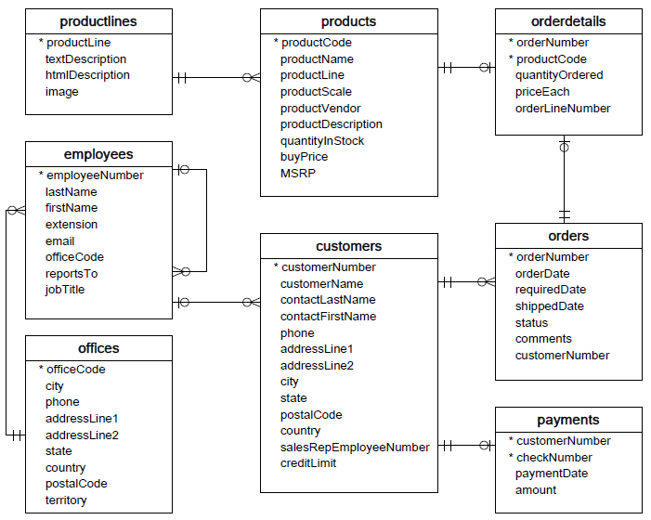
Sample Dataset – Take-home

