Slide 1

Basic Details of the Team and Problem Statement
Ministry/Organization Name/Student Innovation:
AICTE, MIC-Student Innovation
PS Code: SM972 Problem Statement Title: Student Innovation Team Name: SAYRAM-6G Team Leader Name: Shubham Institute Code (AISHE): U-1056 Institute Name: Netaji Subhas University of Technology
Theme Name: LearnX (For Next Generation Learning)

Slide 2
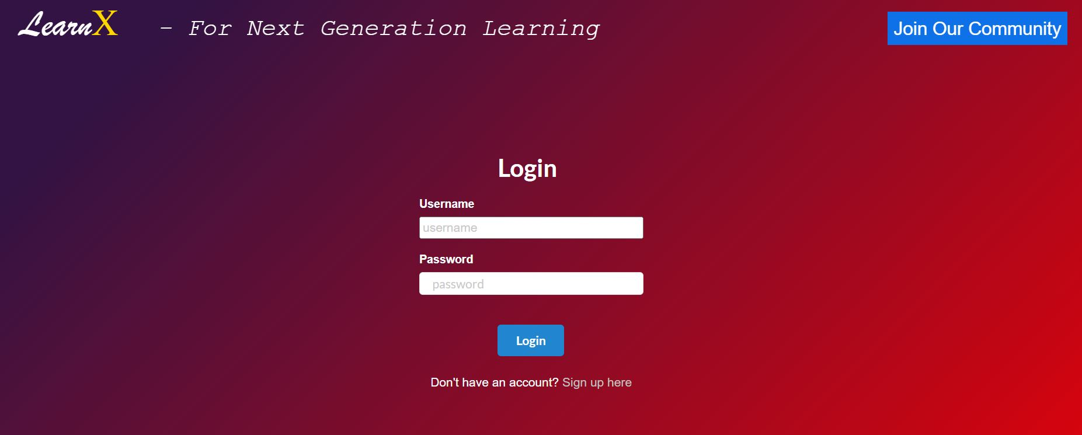
Idea/Approach Details
Solution Description:
The goal is to provide a platform for community based learning where students do not face any barriers to learning and doubt solving.
LearnX allows creation of educational communities by teachers, mentors, educators and professionals. This is supplemented by live interactive sessions(online meets) weekly to facilitate better understanding.
LearnX also displays a list of upcoming meets, events related to that community.
Tech Stack:
React js and Node js - React is used for building UI components and Node.js is used for backend.
Socket.io - It is Used for real-time bidirectional event based communication
Mongoose and express.js - Mongoose was used for database and Express.js for providing server-side logic
Multer - it was used for handling multipart / form data. Particularly for uploading files

Slide 3
Idea/Approach Details
Describe your Use Cases here
Describe your Dependencies/Show stopper here
A Teacher can create a community where she/he can post resources and materials, and students can also post their owN supplementary material that they find online.
Students can also create their own communities if they want to learn something together with their classmates/peers like peer-programming, reading books, weekly quizzes.
An organization can use the platform to enable its employees to discuss developments/updates in their projects.
Working professionals who wish to learn something on weekends can join communities and attend the weekly meets to better themself.
The platform won’t need any external dependencies to run since it will function as a website.
Determination of professionals and React scalability is a hurdle in the process.
There are multiple existing platforms online trying to tackle the education gap however none of them have bridged the gap efficiently. We don’t want our product to go through the same.
Our goal to provide a one-stop solution for both teachers and students involves a huge set of requirements due to scarcity of such solutions.

Slide 4
Team Member Details
Team Leader Name: Shubham
Branch: Btech Stream: CSAI Year: III
Team Member 1 Name: Akash Singh
Branch: Btech Stream: BT Year: III
Team Member 2 Name: Abhilasha Saini
Branch: Btech Stream: EE Year: III
Team Member 3 Name: Ritesh Kumar
Branch: Btech Stream: CSAI Year: III
Team Member 4 Name: Mrigakshi Gupta
Branch: Btech Stream: BT Year: III
Team Member 5 Name: Yash Sethia
Branch: Btech Stream: CSAI Year: III
Team Mentor 1 Name: Type Your Name Here: Dr. Mohinder Pal Singh Bhatia
Category: Academic Expertise: Software Engineering Domain Experience: 30 year
Team Mentor 2 Name: Type Your Name Here: Manusheel Gupta
Category: Academic Expertise: Operating Systems Domain Experience): 15 year

