Slide 1
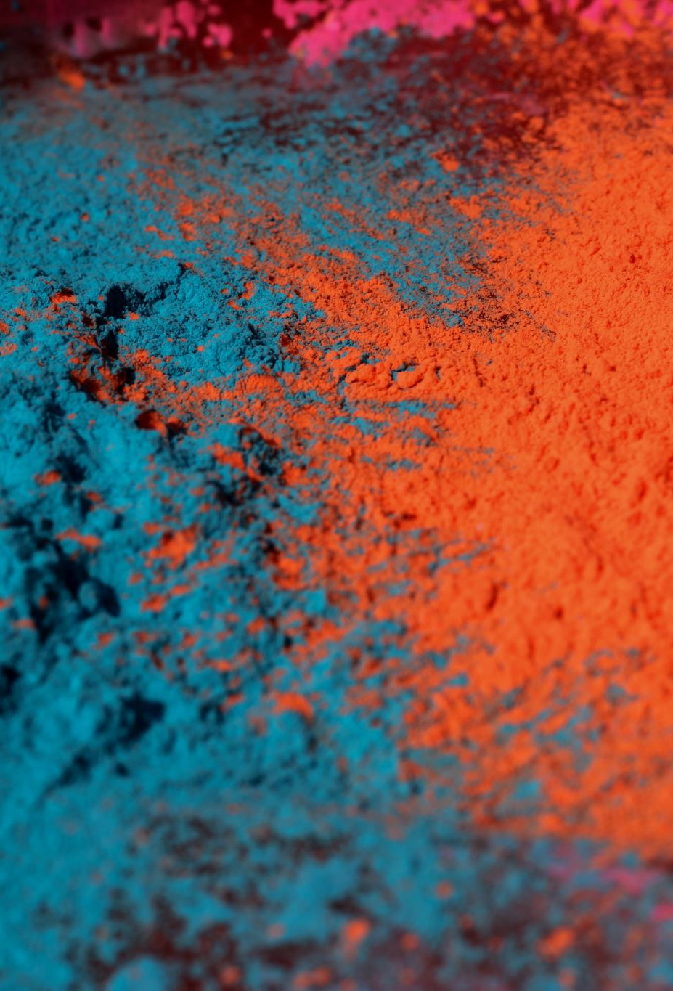
Project 3: Squash and Stretch
Tina L Stewart
Professor Annette Gonzales
CMST 295: Fundamentals of Digital Media

Slide 2
Defining squash and stretch
Squash and stretch is an exaggeration of shape that keeps an object from looking flat or boring.
By adjusting the proportions of an object while keeping the mass constant.
The motion is exaggerated and better pronounced.

Slide 3
What is the original history of squash and stretch?
Squash and Stretch is one of the 12 principles of animation.
Which are guidelines created by ex-Disney animators Frank Thomas and Ollie Johnston (https://medium.com/animation-appreciation/1-squash-and-stretch-bf688f21c13).
Squash and Stretch apply to movement in an animated object.
It exaggerates the objects form to give it movement making the object less rigid and more realistic to human eye. (https://courses.cs.washington.edu/courses/cse459/10wi/content/html/exercises/animation_principles.html).

Slide 4
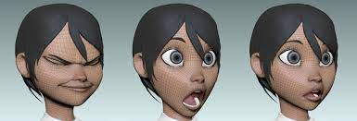
Examples of squash and stretch example #1
It can be used to give a visual animation of expression.
https://www.artstation.com/artwork/WvGO3

Slide 5
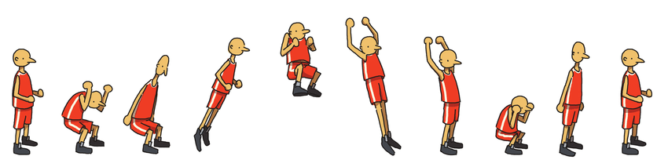
Example #2
This is an animate example of a character jumping.
The second step is the impact of gavity pulling him back to the ground.
https://www.researchgate.net/figure/A-jumping-example-of-the-squash-and-stretch-rule-for-the-case-of-the-human-character_fig1_50304544lick

Slide 6
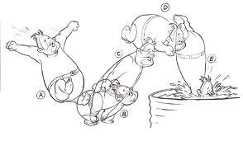
Example #3
This example starts out with his arms stretched out.
He then squat (squash).
He stretch to make a jump.
There is a second squash and stretch to demonstrate the dive.
http://ticktockcrocodile.blogspot.com/2010/12/stretch-and-squash.html
l

Slide 7
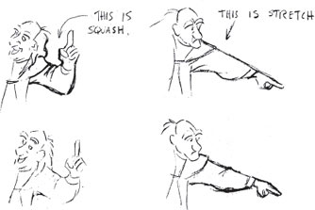
Example #4
https://www.oreilly.com/library/view/drawn-to-life/9780240810966/xhtml/17_chapter8.xhtmlk to

Slide 8
summary
The definition of Squash and Stretch
The origin of Squash and Stretch
I also stated how it applies to animation
There are four examples of this principle

Slide 9

Any Questions???

Slide 10
References
https://www.artstation.com/artwork/WvGO3
https://courses.cs.washington.edu/courses/cse459/10wi/content/html/exercises/animation_principles.html
(https://medium.com/animation-appreciation/1-squash-and-stretch-bf688f21c13
https://www.oreilly.com/library/view/drawn-to-life/9780240810966/xhtml/17_chapter8.xhtmlk to
https://www.researchgate.net/figure/A-jumping-example-of-the-squash-and-stretch-rule-for-the-case-of-the-human-character_fig1_50304544lick
http://ticktockcrocodile.blogspot.com/2010/12/stretch-and-squash.html

