Slide 1

Online Recruitment Fraud (ORF) Detection Using Deep Learning Approaches
DHANALAKSHMI SRINIVASAN ENGINEERING COLLEGE (AUTONOMOUS)
DEPARTMENT OF COMPUTER SCIENCE & ENGINEERING
PRESENTED BY
RAUSHAN KUMAR
(Reg. No. 810421104139)
SANNI K RANJAN KUMAR
(Reg. No. 810421104148)
SANSHAY KUMAR TIWARY
(Reg. No. 810421104149)
SURAJ KUMAR
(Reg. No. 810421104172)
Under the Guidance of,
Dr. R. GOPI, M.Tech., Ph.D. ,PDF.,
Professor And Head,
Department of Computer Science & Engineering,
DSEC College,
Perambalur- 621212.

Slide 2
OUTLINE OF PRESENTATION
Abstract
Introduction
Literature Review
Objective
Existing work
Proposed
Methodology
Result
Conclusion
References

Slide 3
ABSTRACT
Scammers exploit digital job platforms for fraud
Deep learning models (BERT, RoBERTa) used for detection
Dataset formed by merging three sources
SMOTE applied to address class imbalance
Best result from BERT + SMODB SMOTE
Achieved ~90% accuracy and recall

Slide 4
INTRODUCTION
Digital hiring has become the normal
Job platforms offer scalability and speed
Surge in fake postings during/after COVID-19
Need for secure recruitment ecosystems
Most systems lack fraud detection intelligence
Rise of cybercrime targeting job seekers

Slide 5
LITERATURE REVIEW
Title of the Paper | Journal Name | Author, Year | Content
1. Online Recruitment Fraud Detection Using Machine Learning | Journal of Cybersecurity and Privacy | A. Sharma, R. Mehta, 2021 | This paper investigates traditional machine learning models for detecting fraudulent job postings.
2. Deep Learning Approaches to Fake Job Postings Detection | International Journal of Artificial Intelligence and Machine Learning | N. Gupta, M. Kumar, 2020 | The authors compare deep learning approaches, particularly CNNs and RNNs, for identifying online recruitment fraud.
3. SMOTE and Its Variants: A Comprehensive Review for Fraud Detection | International Journal of Data Science and Technology | S. Rao, A. Singh, 2022 | This review paper provides an extensive look at the various SMOTE techniques, including their applications in fraud detection.

Slide 6
LITERATURE REVIEW
Title of the Paper | Journal Name | Author, Year | Content
4.Transformer Models for Text Classification in Cybercrime Detection | Journal of Information Security and Applications | L. Tan, J. Lee, 2023 | This research explores the use of transformer-based models like BERT and RoBERTa in detecting cybercrimes, with a focus on text classification for fake job postings.
5. Robust Optimization for BERT in Fraudulent Job Posting Detection | IEEE Transactions on Neural Networks and Learning Systems | F. Zhao, H. Wu, 2021 | This paper introduces a robust optimization method for pretraining BERT, improving its performance in identifying fraudulent job listings.
6. Enhancing Recruitment Fraud Detection Through Deep Learning and Text Mining | International Journal of Machine Learning and Data Mining | K. Singh, M. Sharma, 2020 | This paper integrates deep learning techniques with text mining methods for fraud detection in job postings..

Slide 7
OBJECTIVE
Detect fake job postings using state-of-the-art DL
Address data imbalance and outdated datasets
Improve detection accuracy with modern methods

Slide 8
EXISTING WORK
Datasets used in earlier research
Limitations: small size, old data, biased models
Common techniques: traditional ML, limited deep models

Slide 9
PROPOSED WORK
New dataset created from three sources
BERT & RoBERTa transformer models used
Addressed imbalance using SMOTE and its variants

Slide 10
METHODOLOGY
Data Collection
Real job postings (legit + fake)
Exploratory Data Analysis
Identify patterns, visualize imbalance

Slide 11
METHODOLOGY
Model Architecture:
BERT and RoBERTa fine-tuned
Oversampling Techniques:
SMOTE variants including SMODB

Slide 12
RESULT
Evaluation Metrics: Accuracy, Recall
Best performing model: BERT + SMODB SMOTE
Achieved ~90% accuracy and recall

Slide 13
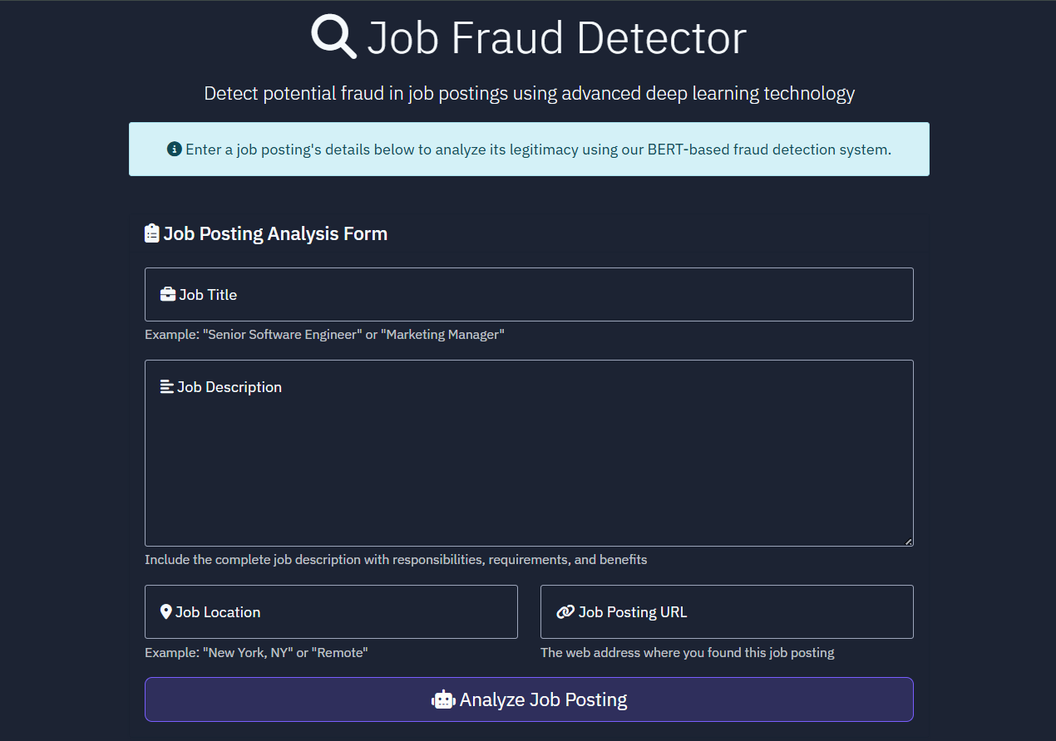
RESULT
Figure 1: Job Posting Analysis Form

Slide 14
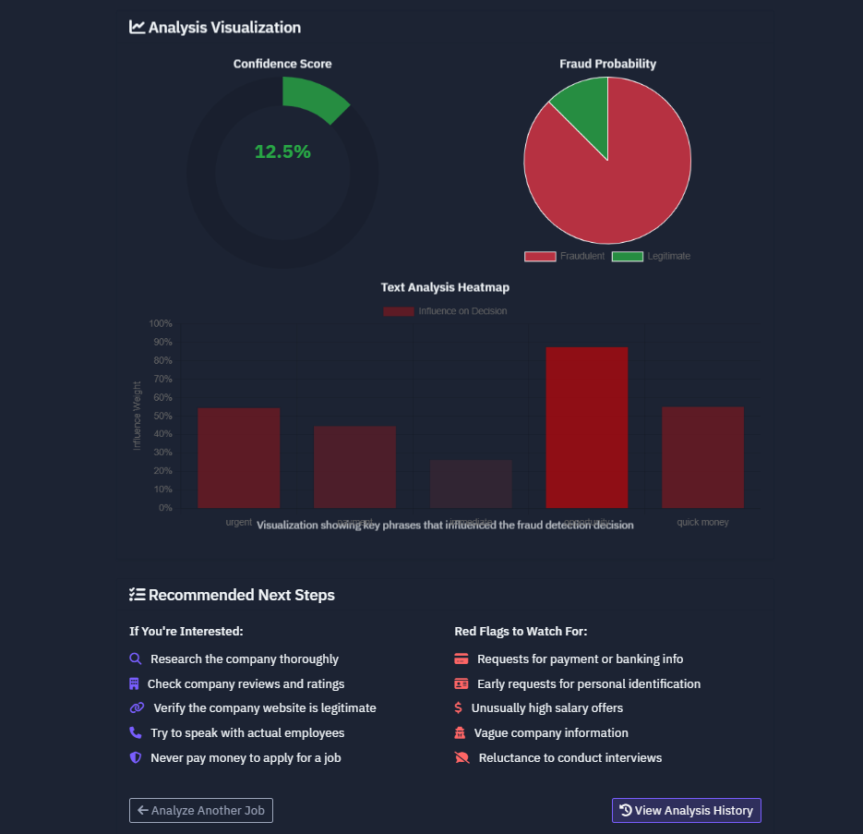
RESULT
Figure 2: Analysis Visualization

Slide 15
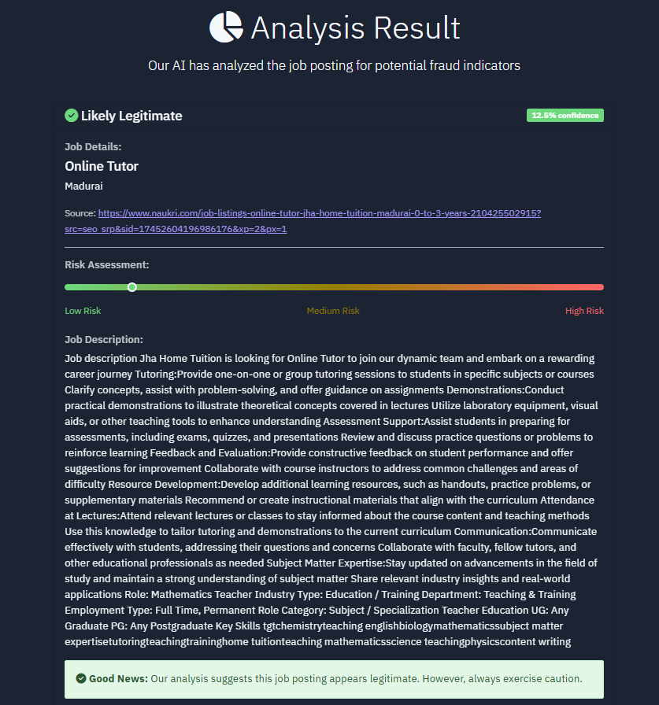
RESULT
Figure 3: Analysis Result

Slide 16
CONCLUSION
Proposed approach effective in detecting ORF
Transformer models significantly outperform traditional ones
Importance of up-to-date datasets and handling imbalance

Slide 17
REFERENCES
[1]. C. S. Anita, P. Nagarajan, G. A. Sairam, P. Ganesh, and G. Deepakkumar, ‘‘Fake job detection and analysis using machine learning and deep learning algorithms,’’ Revista Gestão Inovação e Tecnologias, vol. 11, no. 2, pp. 642–650, Jun. 2021.
[2]. S. Vidros, C. Kolias, G. Kambourakis, and L. Akoglu, ‘‘Automatic detection of online recruitment frauds: Characteristics, methods, and a public dataset,’’ Future Internet, vol. 9, no. 1, p. 6, Mar. 2017.
[3]. A. Gosain and S. Sardana, ‘‘Handling class imbalance problem using oversampling techniques: A review,’’ in Proc. Int. Conf. Adv. Comput., Commun. Informat. (ICACCI), Delhi, India, Sep. 2017, pp. 79–85.
[4]. A. Adhikari, A. Ram, R. Tang, and J. Lin, ‘‘DocBERT: BERT for document classification,’’ 2019, arXiv:1904.08398.

Slide 18
REFERENCES
[5]. S. Gazzah and N. E. B. Amara, ‘‘New oversampling approaches based on polynomial fitting for imbalanced data sets,’’ in Proc. 8th IAPR Int. Workshop Document Anal. Syst., Nara, Japan, Sep. 2008, pp. 677–684.
[6]. J. A. Sáez, J. Luengo, J. Stefanowski, and F. Herrera, ‘‘SMOTE-IPF: Addressing the noisy and borderline examples problem in imbalanced classification by a re-sampling method with filtering,’’ Inf. Sci., vol. 291, pp. 184–203, Jan. 2015
[7]. AJ. Devlin, M.-W. Chang, K. Lee, and K. Toutanova, ‘‘BERT: Pre-training of deep bidirectional transformers for language understanding,’’ 2018, arXiv:1810.04805.
[8]. Z. Yang, N. Garcia, C. Chu, M. Otani, Y. Nakashima, and H. Takemura, ‘‘BERT representations for video question answering,’’ in Proc. IEEE Winter Conf. Appl. Comput. Vis. (WACV), Mar. 2020, pp. 1545–1554.

Slide 19
Thank You

