Slide 1
CUSTOMER COHORT AND RETENTION ANALYSIS

Slide 2
Agenda
1
7
Problem Statement
Cohort Retention Matrix
2
8
2
2
Expected Deliverables
Regional & Service Channel Analysis
3
9
Data Understanding
Customer Engagement Insights
4
10
Executive Summary of Findings
Strategic Recommendations
5
11
Visual Storytelling of Retention Trends
Future Considerations
6
Key Metrics And Benchmarks

Slide 3
The client is grappling with a major issue of high customer churn rates, which are undermining their revenue and escalating the costs of acquiring new customers. Their current retention strategies are mostly reactive and fail to utilize advanced predictive analytics to proactively identify customers at risk of leaving. Consequently, the client struggles to allocate resources efficiently or implement targeted retention campaigns that cater to the specific needs and pain points of individual customers. Additionally, there is a limited understanding of the primary factors driving churn—whether it's due to service quality, pricing, customer experience, or competitor offerings—making it challenging to develop effective strategies to reduce churn.
PROBLEM STATEMENT
NFX is a digital-first professional service business serving a variety of customers across different geographies and services & tiers. Over time, NFX has seen fluctuating engagement levels across its customer base, and they want to understand how user behaviour changes after onboarding, which services / location are most effective, and how retention varies across cohorts. NFX requires a comprehensive cohort and retention analysis framework to: evaluate customer engagement trends over time, identify high-value and loyal customer segments, measure churn and retention performance, analyze acquisition channel effectiveness, and uncover actionable insights to improve customer lifecycle management, retention strategies, and long-term revenue growth.

Slide 4
Agenda
1
7
Problem Statement
Cohort Retention Matrix
2
8
2
2
Expected Deliverables
Regional & Service Channel Analysis
3
9
Data Understanding
Customer Engagement Insights
4
10
Executive Summary of Findings
Strategic Recommendations
5
11
Visual Storytelling of Retention Trends
Future Considerations
6
Key Metrics And Benchmarks

Slide 5
Expected Deliverables
I. Executive Dashboard
a. Total Customers vs Active Customers
b. Churn Rate
c. Revenue Analysis
III. Customer Engagement & Reactivation
a. Cross Product Holding Analysis
b. Engagement Bucket Analysis
c. Reactivation Rate Tracking
IV. Revenue & Acquisition Analysis
a. Revenue by acquisition channel
b. Revenue by service category
c. Revenue by service tier
II. Cohort Retention Analysis
a. Cohort Retention Heatmap
b. Quarterly Retention Trend Analysis
c. Customer Cohort Size Distribution

Slide 6
Agenda
1
7
Problem Statement
Cohort Retention Matrix
2
8
2
2
Expected Deliverables
Regional & Service Channel Analysis
3
9
Data Understanding
Customer Engagement Insights
4
10
Executive Summary of Findings
Strategic Recommendations
5
11
Visual Storytelling of Retention Trends
Future Considerations
6
Key Metrics And Benchmarks

Slide 7
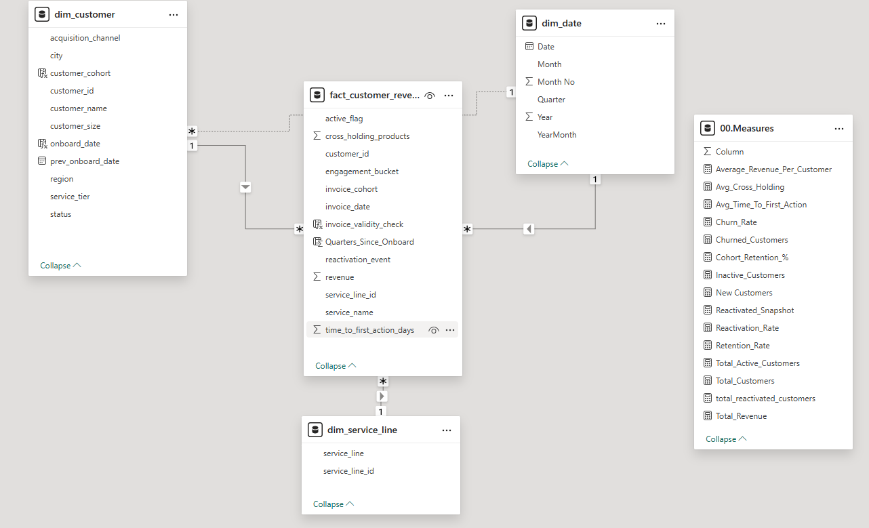
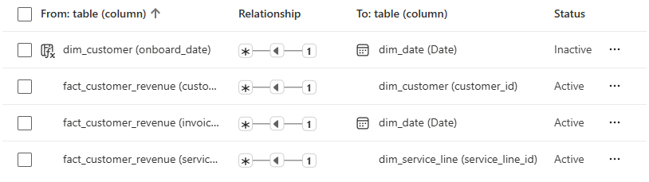
Data Understanding
The data is structured across four primary tables, designed to provide a comprehensive view of customer activity, engagement, retention, and revenue performance across the organization : -
Analyze customer retention and churn trends across cohorts
Track customer engagement behavior after onboarding
Identify high-value customer segments and lifecycle patterns
Evaluate acquisition channel and service performance
Measure revenue contribution across regions, tiers, and customer groups

Slide 8
Agenda
1
7
Problem Statement
Cohort Retention Matrix
2
8
2
2
Expected Deliverables
Regional & Service Channel Analysis
3
9
Data Understanding
Customer Engagement Insights
4
10
Executive Summary of Findings
Strategic Recommendations
5
11
Visual Storytelling of Retention Trends
Future Considerations
6
Key Metrics And Benchmarks

Slide 9
Executive Summary of Findings
10K
50.77%
32.75%
$107.95M
Total Customers
Churn Rate
Retention Rate
Total Revenue
The business generated a strong Total Revenue of 107.95M, with an Average Revenue per Customer of 10.80K, indicating good monetization of retained customers.
The Retention Rate of 32.75% suggests that only a limited portion of customers continue long-term engagement with the business.
Total customer base stands at 10K customers, with 3.275K active customers currently contributing to business activity.

Slide 10
Agenda
1
7
Problem Statement
Cohort Retention Matrix
2
8
2
2
Expected Deliverables
Regional & Service Channel Analysis
3
9
Data Understanding
Customer Engagement Insights
4
10
Executive Summary of Findings
Strategic Recommendations
5
11
Visual Storytelling of Retention Trends
Future Considerations
6
Key Metrics And Benchmarks

Slide 11
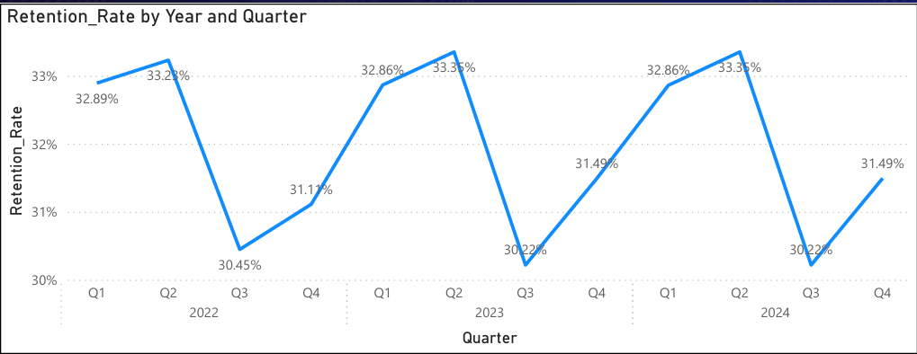
Visual Storytelling Of Retention Trends
Key Insight: Retention oscillates between 30%–33.5% quarterly. Q4 consistently dips — suggesting seasonal disengagement. Revenue remains stable at ~$9M/month, indicating retained customers compensate for churn volume.

Slide 12
Agenda
1
7
Problem Statement
Cohort Retention Matrix
2
8
2
2
Expected Deliverables
Regional & Service Channel Analysis
3
9
Data Understanding
Customer Engagement Insights
4
10
Executive Summary of Findings
Strategic Recommendations
5
11
Visual Storytelling of Retention Trends
Future Considerations
6
Key Metrics And Benchmarks

Slide 13
Key Metrics And Benchmarks
10,000
3,275
~5,077
Total Customers
Active Customers
Churned Customers
All statuses combined
32.75% of total base
50.77% churn rate
$10,795
$107.95M
~3
Avg Revenue / Customer
Total Revenue
Avg Cross-Holding
Per active customer
Across all regions 2022–2024
Products per customer
Best Cohort: 2022-Q1 started with 7,114 customers, retaining 47.60% through 11 quarters

Slide 14
Agenda
1
7
Problem Statement
Cohort Retention Matrix
2
8
2
2
Expected Deliverables
Regional & Service Channel Analysis
3
9
Data Understanding
Customer Engagement Insights
4
10
Executive Summary of Findings
Strategic Recommendations
5
11
Visual Storytelling of Retention Trends
Future Considerations
6
Key Metrics And Benchmarks

Slide 15
Cohort Retention Matrix
Cohort | Q0 | Q1 | Q2 | Q3 | Q4 | Q5 | Q6 | Q7 | Q8 | Q9 | Q10 | Q11
2022-Q1 | 63.79% | 46.84% | 47.60% | 46.36% | 46.33% | 46.56% | 47.43% | 47.51% | 46.78% | 47.55% | 47.60% | 47.60%
2022-Q2 | 60.53% | 45.03% | 42.07% | 41.91% | 41.19% | 43.32% | 44.20% | 41.86% | 42.33% | 43.73% | 45.19% | —
2022-Q3 | 58.06% | 40.90% | 37.61% | 37.76% | 37.76% | 41.34% | 41.49% | 37.61% | 36.27% | 36.72% | — | —
2022-Q4 | 58.89% | 40.56% | 33.89% | 40.56% | 39.44% | 37.22% | 39.44% | 40.00% | 36.67% | 30.00% | — | —
2023-Q1 | 59.70% | 34.33% | 37.31% | 37.31% | 34.33% | 28.36% | 34.33% | 32.84% | — | — | — | —
2023-Q2 | 62.07% | 44.83% | 37.93% | 41.38% | 20.69% | 34.48% | 27.59% | — | — | — | — | —
2023-Q3 | 53.33% | 40.00% | 40.00% | 53.33% | 40.00% | 40.00% | — | — | — | — | — | —
2023-Q4 | 100.00% | — | — | 100.00% | — | 100.00% | — | — | — | — | — | —
2024-Q1 | 100.00% | 100.00% | — | — | 100.00% | — | — | — | — | — | — | —
Retention Heatmap:
>=60%
45-59%
35-44%
25-34%
<25%

Slide 16
Agenda
1
7
Problem Statement
Cohort Retention Matrix
2
8
2
2
Expected Deliverables
Regional & Service Channel Analysis
3
9
Data Understanding
Customer Engagement Insights
4
10
Executive Summary of Findings
Strategic Recommendations
5
11
Visual Storytelling of Retention Trends
Future Considerations
6
Key Metrics And Benchmarks

Slide 17
Regional & Service Channel Analysis
Revenue by Acquisition Channel
Google Ads
Organic
$18.51M
$18.17M
Referral
LinkedIn
$17.8M
$18.36M
Email Campaign
Partner
$18.25M
$16.86M

Slide 18
Agenda
1
7
Problem Statement
Cohort Retention Matrix
2
8
2
2
Expected Deliverables
Regional & Service Channel Analysis
3
9
Data Understanding
Customer Engagement Insights
4
10
Executive Summary of Findings
Strategic Recommendations
5
11
Visual Storytelling of Retention Trends
Future Considerations
6
Key Metrics And Benchmarks

Slide 19
Customer Engagement Insights
Engagement Finding: Customers acting within 10 days have a 90% reactivation rate. Product cross-holding is evenly distributed (~20% each), suggesting upsell opportunities exist across all tiers. Engagement buckets (High/Low/Medium) show equal ~33% revenue split across all customer sizes.

Slide 20
Agenda
1
7
Problem Statement
Cohort Retention Matrix
2
8
2
2
Expected Deliverables
Regional & Service Channel Analysis
3
9
Data Understanding
Customer Engagement Insights
4
10
Executive Summary of Findings
Strategic Recommendations
5
11
Visual Storytelling of Retention Trends
Future Considerations
6
Key Metrics And Benchmarks

Slide 21
Strategic Recommendations
01
Launch Early Intervention Program
02
Prioritize High-Value Cohorts
Deploy automated re-engagement within 10 days of inactivity. The 90% reactivation rate for 0–10 day cohort confirms early action drastically reduces churn risk.
2022-Q1 customers (7,114 strong) maintain 47.6% retention after 11 quarters. Develop loyalty programs tailored to this cohort to sustain and grow their lifetime value.
03
Address Q4 Seasonal Churn
04
Cross-Sell & Upsell Initiatives
Retention consistently dips in Q4 across all years. Launch proactive retention campaigns in Q4 (Oct–Dec) including renewal incentives and exclusive content.
20% of customers hold 3 products. Structured cross-selling campaigns targeting the 20% at 1–2 products can significantly boost average revenue per customer.
05
Optimize Google Ads & LinkedIn
06
Regional Expansion Focus
Google Ads ($18.51M) and LinkedIn ($18.36M) are top revenue channels. Increase budget allocation and A/B test creatives to improve new customer acquisition quality.
Revenue is balanced across AU, UAE, SG, USA, India, and UK (~$5.9–6.2M each). Deep-dive cohort analysis per region can unlock targeted retention strategies.

Slide 22
Agenda
1
7
Problem Statement
Cohort Retention Matrix
2
8
2
2
Expected Deliverables
Regional & Service Channel Analysis
3
9
Data Understanding
Customer Engagement Insights
4
10
Executive Summary of Findings
Strategic Recommendations
5
11
Visual Storytelling of Retention Trends
Future Considerations
6
Key Metrics And Benchmarks

Slide 23
Future Considerations
1
Predictive Churn Modeling
Build ML models using engagement_bucket, time_to_first_action, and invoice_cohort fields to predict churn 60 days ahead and trigger preemptive saves.
2
Personalized Retention Journeys
Leverage customer_size and service_tier to create hyper-targeted retention playbooks — Small/Medium/Large businesses have different churn triggers.
3
NPS & Satisfaction Tracking
Integrate customer satisfaction data alongside revenue data to understand qualitative churn drivers and build a leading indicator dashboard.
4
Regional Cohort Deep-Dives
Conduct region-specific cohort analysis (AU, UAE, India, etc.) to uncover geo-specific patterns and align local account management strategies.
5
CLV Optimization Framework
Develop a Customer Lifetime Value model integrating Avg Revenue Per Customer, cross-holding data, and retention probabilities for ROI-based prioritization.

Slide 24
THANK YOU

