Slide 1



CARBON CAPTURE
WEEK 4
Economics and Policy relating to Carbon Capture

Slide 2


DAY - 3

Slide 3


CCUS Clusters for CO2 Capture and Disposition at Scale
The concept of clusters is well established in the economics of industrial development. An industry cluster is a geographic concentration of interconnected businesses, suppliers, and associated organizations in a specific geographical area. For CCUS, clusters will be advantageous for emissions-intensive facilities (both industrial facilities and power plants) co-located in geographical clusters and provide incentives to CO2 emitters to form a capture cluster, which can be connected to a large-scale CO2 storage site using an oversized shared transport infrastructure, as well as options for utilization of CO2 to produce low carbon downstream products.

Slide 4
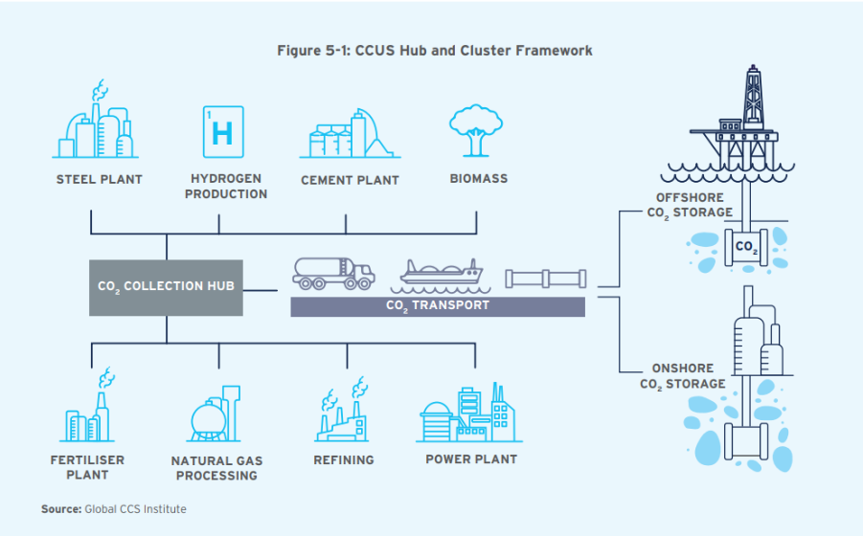

The oversized carbon disposition infrastructure would be too large for single users but rather be designed for multiple users/emitters.

Slide 5




Economic and Business Rationale for CCUS Hubs and Clusters
The large-scale development and deployment of CCUS require not only CO2 capture and utilization technologies but also enabling infrastructure and markets at Giga-tonne scale. An effective CCUS hub and cluster framework incentivizes participants, minimizes costs, maximizes benefits, and de-risks investments by widening the market and eliminating the need for bilateral agreements between CO2 sources and sinks. For these hubs and clusters to be effective, they must provide sufficient incentives for all participants, aggregate emissions to create economies of scale, exploit regional storage and use patterns, enable market clearing through interconnecting hubs, and provide open access to the network for diverse emitters.

Slide 6





CCUS project costs are influenced by factors such as CO2 source, density, purity, transportation distance, volume, and site location. Market models are necessary to encourage innovation and reduce costs. Innovations could include creating value-added products from CO2, though predicting commercialization timelines is challenging. Efficient pricing through competition is crucial, with auctions facilitating the allocation of CO2 to its highest-value uses. Initially, additional incentives may be needed for CO2 emitters, but more efficient pricing mechanisms should develop as markets mature.
Hubs and clusters act as market-making mechanisms, de-risking investments and incentivizing participation. Government support, including investments, tax credits, and carbon taxes, is essential during the initial stages to ensure sufficient participation until the market achieves scale and efficiency.

Slide 7
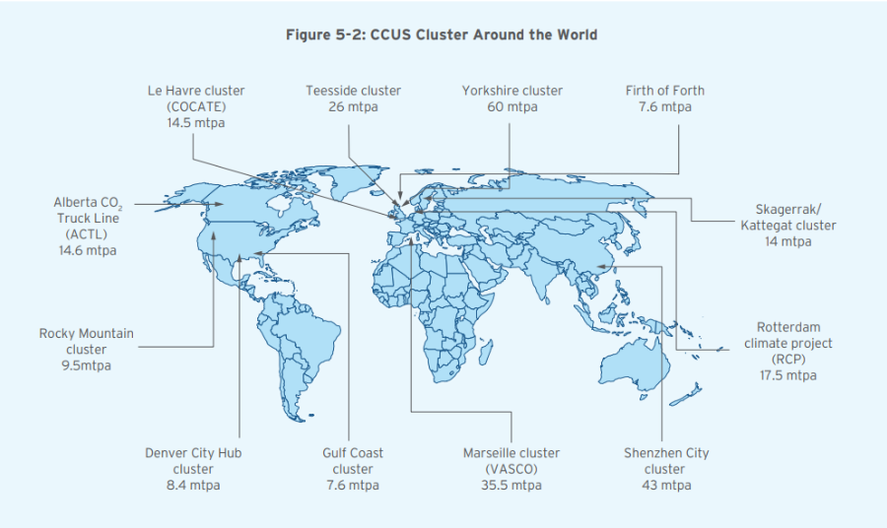
Review of CO2 Clusters Around the World
The major CCUS cluster around the world are illustrated below. Many of the clusters are located near ports with large industrial footprints, and provide regions and countries a competitive advantage in a carbon-constrained world.

Slide 8

Critical Assessment of CO2 Clusters
Global CCUS clusters that utilize CO2 for Enhanced Oil Recovery (EOR) are the most successful. Projects focusing on CO2 sequestration or storage require government support and policies to incentivize carbon capture and sequestration to bridge funding gaps. Merging CCUS infrastructure can create economies of scale, reducing pipeline and transportation costs. However, government funding is essential to cover capital costs, de-risk projects, and build confidence among emission sources. Clusters also benefit from combined organizational costs, streamlined permissions, public acceptance, and pooled professional services such as O&M, chemical supply, waste disposal, and CO2 measurement. Offshore and distant storage locations offer greater cost reductions due to high mobilization and laying expenses. The initial economics of CCUS clusters are challenging due to lower CO2 volumes and extensive infrastructure, but this can be mitigated with long-term, low-cost financing from government support and international clean funds.

Slide 9
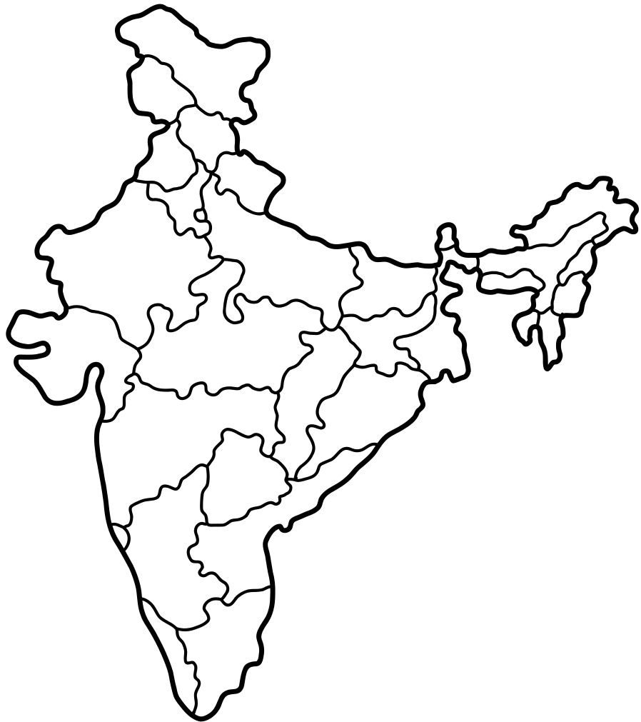

Hub and Cluster Framework for India
The merits of a hub and cluster framework make it the best suited for implementing CCUS in India. The first step is to map identified industry-wise clusters and suitable storage clusters in India. A cluster framework is both advantageous and necessary for incentivizing CO2 capture from both large and small emitters.
Region-wise Cluster Potential for India
The cluster potential has been analyzed for the five regions of India: North, South, East, West, and North-East. By identifying the nearest state/UT to the storage locations mentioned, the storage sites can be classified and mapped to the various regions. A similar practice has been carried out with the emission sources. The estimation of region-wise emission for the year 2030 is considered for analyzing the CO2 volume emitted for the duration 2030 - 2050. Figure 5-9 illustrates the region-wise cluster potential data for India.

Slide 10
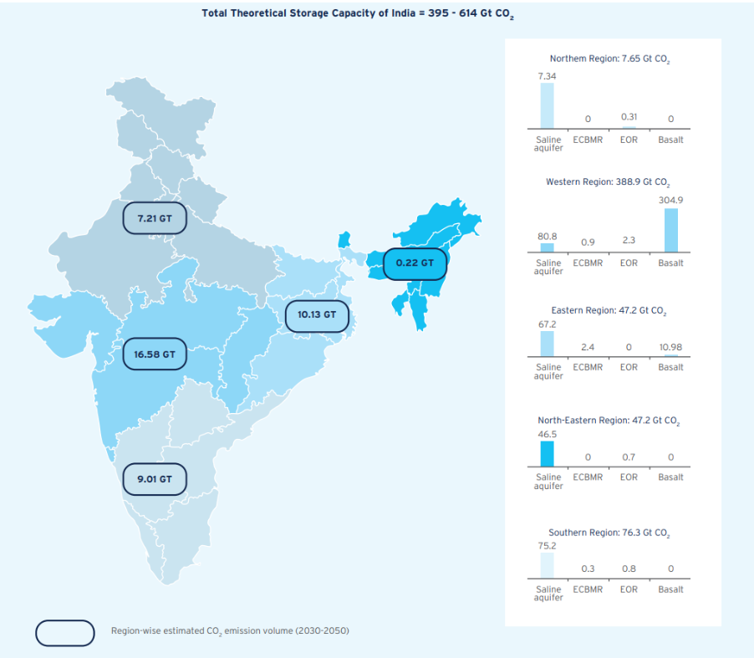
Figure:
Region-wise Storage Clusters in India

Slide 11
Key Risks Associated with CCUS

Slide 12

Technical Risks
1. Reservoir Suitability for CO2 Flooding for EOR - The effectiveness of CO2 Enhanced Oil Recovery (EOR) compared to other tertiary recovery methods (e.g., nitrogen, polymer, steam, natural gas injection, foaming agents) determines its CO2 abatement potential. Advances in other recovery methods may reduce the attractiveness of CO2 EOR, while complex hydrocarbon resources may increase its role. Monitoring developments in other recovery systems and using improved reservoir simulation tools are essential.
2. Offshore Unloading & Condition of Shipped CO2 - CO2 shipping, using vessels like semi-refrigerated LNG/LPG carriers, offers flexibility over fixed pipelines. Key challenges include converting liquid CO2 from -50°C to injection temperatures, requiring significant heat energy and potentially causing emissions if fossil fuels are used.
3. CO2 Specification Challenges - Meeting CO2 specifications, especially adequate dehydration and impurity tolerances, is critical. Integrating multiple CO2 sources and capture processes may require additional treatment of captured CO2.

Slide 13

Financial Risks
1. Cost of Capture - The primary cost in the CCUS value chain is carbon capture. In natural gas processing and gasification, carbon capture incurs no additional cost, but for thermal power plants and other industrial processes, it involves significant capital and operational expenses.
2. Financing Risks - CCUS projects involve interconnected subsystems that require coordinated operation. Multiple sources or sinks increase infrastructure costs and financing needs, especially during the early stages. Financing delays or inadequacies can lead to cost escalation. Mitigation measures include meticulous planning, access to bridge financing, and realistic funding provisions for delays.
3. Loss of Storage Site - CO2 injection complications can halt operations at storage sites. Technical risks exist in predicting a storage site's capacity. Relying on a single site is risky; hence, proving new sites and long-term planning are necessary. Contingency plans should include additional wells or reservoirs to ensure continued operations and access to drilling resources.

Slide 14
Financial Risks
4. Price of Green Products - Inadequate pricing for low-carbon products is a significant risk. Renewable energy has used feed-in tariffs to address this, but these tariffs can become inflexible over time. Ultimately, the higher costs for green products must be passed on to consumers and businesses.
5. Lack of Tradeable Long Term CO2 Emission Reduction - CCUS requires long-term investments tied to CO2 abatement levels. Financial instruments need to be designed to attract investors by linking payoffs to CO2 reductions. Investing directly in CCUS projects should be more cost-effective than buying abatement certificates. These financial products should be marketable to various investors and ideally be globally tradable.
6. Withdrawal of Key Partners & Delay - The CCUS value chain relies on multiple partners, and the loss of any partner can disrupt the entire system. Contracts should be structured to mitigate this risk and protect against ownership changes or insolvency. Centralizing core CCUS activities within a well-funded organization could reduce the risk of failure compared to having multiple partner organizations.

Slide 15

Safety Risks
Pipeline incidents - pose significant safety risks, requiring adequate insurance to cover compensation and repair costs. Severe incidents could cause permanent disruption to CO2 transportation and affect the broader CCUS industry by necessitating safety upgrades. Although no major disasters have occurred in the CCUS sector, adopting stringent international safety standards, similar to those in LNG transport, is essential to prevent incidents and ensure the industry's continued safe operation.
Large Diameter Pipeline in Populated Areas - Historical data shows that larger diameter pipelines have a lower incident frequency. To prevent incidents, some projects use automatic isolation valves and leak monitoring systems. While CO2 is generally safe in moderate quantities, transporting dense phase or supercritical CO2 in populated areas requires stringent safety and failsafe measures. For large-scale CCUS projects in densely populated regions, such as India, it is crucial to have well-defined emergency response and communication protocols.
.

