Slide 1



CARBON CAPTURE
WEEK 4
Economics and Policy relating to Carbon Capture

Slide 2


DAY - 1

Slide 3
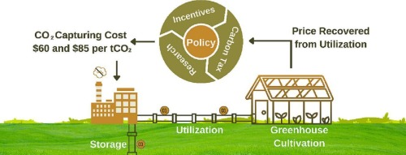
This week, we will find answers to questions about any CO2 mitigation technology: ‘How much will it cost?’ and ‘How do CCS technologies fit into a portfolio of greenhouse gas mitigation options?’ There are no simple answers to these questions. Costs for CCS technologies depend on many factors: fuel prices, the cost of capital, and costs for meeting potential regulatory requirements like monitoring, to just name a few. Add to this the uncertainties associated with technology development, the resource base for storage potential, the regulatory environment, etc., and it becomes obvious why there are many answers to what appear to be simple questions.

Slide 4
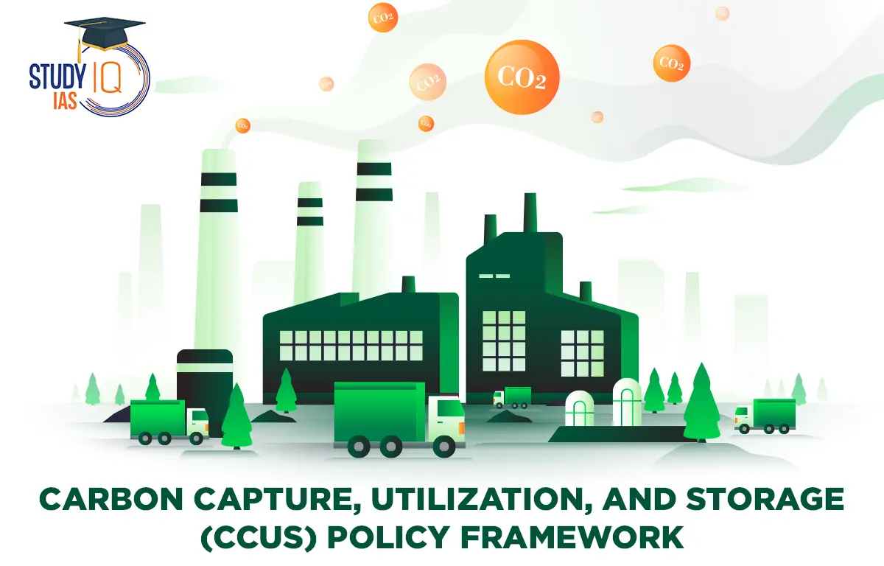

We will start by looking at the costs of the system components, namely capture and compression, transport, and storage (including monitoring costs and byproduct credits from operations such as EOR). The commercial operations associated with each of these components provide a basis for the assessment of current costs.
Although it involves greater uncertainty, an assessment is also included of how these costs will change in the future. We will also look at various policies and their effect on whole Carbon Capture scenario, and also see this in Indian context.

Slide 5




Component costs
1. Capture and compression
For most large sources of CO2 (e.g., power plants), the cost of capturing CO2 is the largest component of overall CCS costs. The total cost of CO2 capture includes the additional capital requirements, plus added operating and maintenance costs incurred for any particular application. For current technologies, a substantial portion of the overall cost is due to the energy requirements for capture and compression.
For a modern (high-efficiency) coal-burning power plant, CO2 capture using an amine-based scrubber increases the cost of electricity generation (COE) by approximately 40 to 70 per cent while reducing CO2 emissions per kilowatt-hour (kWh) by about 85%. The same CO2 capture technology applied to a new natural gas combined cycle (NGCC) plant increases the COE by approximately 40 to 70 per cent.

Slide 6
Component costs
1. Capture and compression
For a new coalbased plant employing an integrated gasification combined cycle (IGCC) system, a similar reduction in CO2 using current technology (in this case, a water gas shift reactor followed by a physical absorption system) increases the COE by 20 to 55%. The lower incremental cost for IGCC systems is due in large part to the lower gas volumes and lower energy requirements or CO2 capture relative to combustion-based systems.
CCS technologies can also be applied to other industrial processes. Since these other industrial processes produce off-gases that are very diverse in terms of pressure and CO2 concentration, the costs range very widely. In some of these non-power applications where a relatively pure CO2 stream is produced as a by-product of the process, the cost of capture is significantly lower than capture from fossil-fuel-fired power plants.

Slide 7
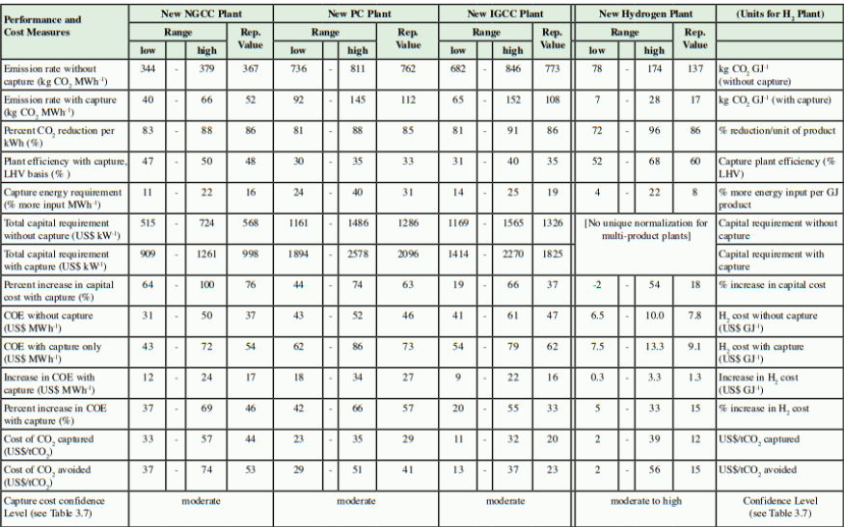

Slide 8
Transport
The most common and usually the most economical method to transport large amounts of CO2 is through pipelines. A costcompetitive transport option for longer distances at sea might be the use of large tankers. The three major cost elements for pipelines are construction costs (e.g., material, labour, possible booster station), operation and maintenance costs (e.g., monitoring, maintenance, possible energy costs) and other costs (e.g., design, insurance, fees, right-of-way). Special land conditions, like heavily populated areas, protected areas such as national parks, or crossing major waterways, may have significant cost impacts. Offshore pipelines are about 40% to 70% more costly than onshore pipes of the same size. Pipeline construction is considered to be a mature technology and the literature does not foresee many cost reductions. shows the transport costs for ‘normal’ terrain conditions. Note that economies of scale dramatically reduce the cost, but that transportation in mountainous or densely populated areas could increase cost. Tankers could also be used for transport. Here, the main cost elements are the tankers themselves (or charter costs), loading, unloading facilities, intermediate storage facilities, harbour fees, and bunker fuel.

Slide 9
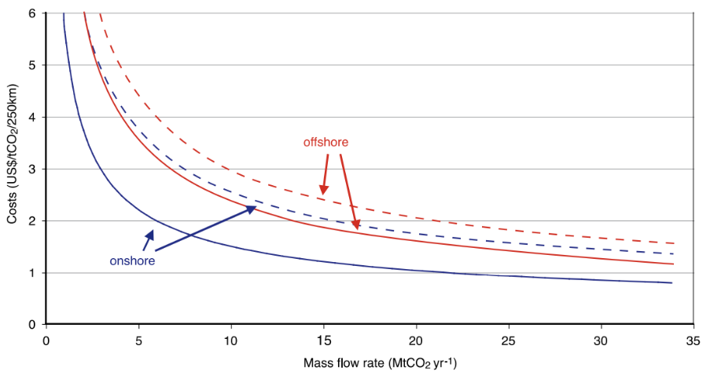
The construction costs for large special purpose CO2 tankers are not accurately known since none have been built to date. On the basis of preliminary designs, the costs of CO2 tankers are estimated at US$ 34 million for ships of 10,000 tonnes, US$ 58 million for 30,000-tonne vessels, and US$ 82 million for ships with a capacity of 50,000 tonnes
Figure 8.1 CO2 transport costs range for onshore and offshore pipelines per 250 km, ‘normal’ terrain conditions. The figure shows low (solid lines) and high ranges (dotted lines).

Slide 10

Ocean Storage
The cost of ocean storage is a function of the distance offshore and injection depth. Cost components include offshore transportation and injection of the CO2 . Various schemes for ocean storage have been considered. They include:
• tankers to transport low temperature (–55 to –50o C), high pressure (0.6–0.7 MPa) liquid CO2 to a platform, from where it could be released through a vertical pipe to a depth of 3000 m;
• carrier ships to transport liquid CO2 , with injection through a towed pipe from a moving dispenser ship;
• undersea pipelines to transport CO2 to an injection site. Table 8.2 provides a summary of costs for transport distances of 100–500 km offshore and an injection depth of 3000 m.

Slide 11

Storage via mineral carbonation
Mineral carbonation is still in its R&D phase, so costs are uncertain. They include conventional mining and chemical processing. Mining costs include ore extraction, crushing and grinding, mine reclamation and the disposal of tailings and carbonates. These are conventional mining operations and several studies have produced cost estimates of 10 US$/tCO2 (36 US$/tC) or less. Since these estimates are based on similar mature and efficient operations, this implies that there is a strong lower limit on the cost of mineral storage. Carbonation costs include chemical activation and carbonation. Translating today’s laboratory implementations into industrial practice yields rough cost estimates of about 50–100 US$/tCO2 stored.

Slide 12

Geological Storage
Because the technologies and equipment used for geological storage are widely used in the oil and gas industries, the cost estimates can be made with confidence. However, there will be a significant range and variability of costs due to sitespecific factors: onshore versus offshore, the reservoir depth and the geological characteristics of the storage formation (e.g., permeability, thickness, etc.). Representative estimates of the cost for storage in saline formations and disused oil and gas fields (see Table 8.2) are typically between 0.5–8.0 US$/ tCO2 stored (2–29 US$/tC), as explained in Section 5.9.3. The lowest storage costs will be associated with onshore, shallow, high permeability reservoirs and/or the reuse of wells and infrastructure in disused oil and gas fields.

Slide 13
Avoided costs for a fossil fuel power plant
In general, the capture, transport, and storage of CO2 require energy inputs. For a power plant, this means that amount of fuel input (and therefore CO2 emissions) increases per unit of net power output. As a result, the amount of CO2 produced per unit of product (e.g., a kWh of electricity) is greater for the power plant with CCS than the reference plant.
To determine the CO2 reductions one can attribute to CCS, one needs to compare CO2 emissions of the plant with capture to those of the reference plant without capture. These are the avoided emissions. Unless the energy requirements for capture and storage are zero, the amount of CO2 avoided is always less than the amount of CO2 captured. The cost in US$/tonne avoided is therefore greater than the cost in US$/tonne captured.

