Slide 1



CARBON CAPTURE
WEEK 4
Economics and Policy relating to Carbon Capture

Slide 2


DAY - 2

Slide 3




Economic impacts of different storage times
As discussed, geological and ocean storage might not provide permanent storage for all of the CO2 injected. The question arises of how the possibility of leakage from reservoirs can be taken into account in the evaluation of different storage options and in the comparison of CO2 storage with mitigation options in which CO2 emissions are avoided. CO2 storage and leakage can be looked upon as two separate, discrete events. They represent the value of temporary storage as a familiar economic problem, with explicitly stated assumptions about the discount rate and carbon prices. If someone stores a tonne of CO2 today, they will be credited with today’s carbon price. Any future leakage will have to be compensated by paying the carbon price in effect at that time. Whether non-permanent storage options will be economically attractive depends on assumptions about the leakage rate, discount rate and relative carbon permit prices.

Slide 4


The three risk categories should to be taken into account as well:
• ecological risk: the possibility that ‘optimal’ leakage may preclude future climate stabilization;
• political risk: the possibility that institutions with an interest in CO2 storage may manipulate the regulatory environment in their favour,
and
• financial risk: the possibility that future conditions will cause carbon prices to greatly exceed current expectations, with consequences for the maintenance of liability and distribution of costs.

Slide 5

Gaps in Knowledge
Cost developments for CCS technologies are now estimated based on literature, expert views and a few recent CCS deployments. Costs of large-scale integrated CCS applications are still uncertain and their variability depends among other things on many site-specific conditions. Especially in the case of large-scale CCS biomass based applications, there is a lack of experience and therefore little information in the literature about the costs of these systems.
In addition to current and future CCS technological costs, there are other possible issues that are not well known at this point and that would affect the future deployment of CCS systems: for example, costs related to the monitoring and regulatory framework, possible environmental damage costs, costs associated with liability and possible public-acceptance issues.

Slide 6
Gaps in Knowledge
There are at present no known, full assessments of life-cycle costs for deployed CCS systems, and in particular the economic impact of the capture, transport and storage of non-pure CO2 streams. The development of bottom-up CCS deployment cost 360 IPCC Special Report on Carbon dioxide Capture and Storage curves that take into account the interplay between large CO2 point sources and available storage capacity in various regions of the world should continue;
these cost curves would help to show how CCS technologies will deploy in practice and would also help improve the economic modelling of CCS deployment in response to various modelled scenarios.
Now we will dive into the policies surrounding Carbon Capture, Utilization and Storage (CCUS); Policy Framework and its Deployment Mechanism in India.

Slide 7
CCUS Policy Framework for India

Slide 8


The key to a successful CCUS policy for India is a framework that supports the creation of sustainable and viable markets for CCUS projects. The framework must consider the fact that the private sector is unlikely to invest in CCUS unless there are sufficient incentives to do so (or conversely penalties from inaction), or unless it can benefit from the sale of CO2 or gain credits for emissions avoided under carbon pricing regimes. Direct capital grants, tax credits, carbon pricing schemes, operational subsidies, regulatory requirements, and public procurement preference for low-carbon products are some of the policy measures required for CCUS to become a reality in India.
Let us first Review the Policies and Strategies implemented around the world.

Slide 9

USA
The US leads the world in CCUS deployment, with the earliest CCUS projects being implemented in the 1970s. There are 14 operating CCUS facilities in the US, with a combined carbon capture capacity of more than 25 mtpa. Apart from the DOE funding, CCUS projects received a major fillip in 2009 when the US Federal Government enacted the American Recovery and Reinvestment Act (ARRA), which provided another USD 3.4 BB$ specifically for CCS projects and R&D activities. While some of the projects have faced implementation challenges and delays, the policy intent in USA has clearly focused on developing large scale demonstration plants for CCS through government support and funding.
Some of the key enablers of CCUS in the US are the 45Q tax credits, California’s LCFS standards, State Primacy for CO2 injection and the SCALE Act; these are describe herein:

Slide 10
USA
45Q
The 45Q provides tax credits for CCUS, starting from USD 12.83 for each tonne of CO2 utilized for EOR in 2017, linearly increasing to US$ 35/tonne in 2026. Similarly, for CO2 captured and geologically stored, the tax credit was US$ 22.66/tonne in 2017, rising linearly to US$ 50/tonne of CO2 in 2026. Post-2026, the credit shall be inflation-adjusted.
The Global CCS Institute has long hailed USA’s 45Q tax credit mechanism as the “most progressive CCS-specific incentive globally”. The 45Q credits lower a firm’s tax liability; in case there is no tax liability, the credits can be traded in the tax equity market. Tax credits have been successful in spurring renewable energy projects in the US over the last two decades.

Slide 11
USA
State Primacy for CO2 Storage
In 2010, the US EPA created the sixth well class (Class VI) specifically to regulate the injection of CO2 into deep subsurface rock formations. At the time, very few projects were sequestering CO2 solely to reduce greenhouse gas emissions, but the EPA anticipated that technology development would be key to achieving domestic emissions reductions.
SCALE Act
The SCALE (Storing CO2 and Lowering Emissions) Act was proposed by a bipartisan coalition in 2021. The Act aims to assist the development of vital CO2 transit and storage infrastructure to support CCUS and CO2 removal technologies, as well as regional economic prospects and jobs in the US.

Slide 12

European Union
European Green Deal
The European Green Deal was approved in 2020 and provides a set of policy initiatives aimed at making EU climate neutral by 2050, i.e., no net GHG emissions by 2050. The 2030 GHG emissions reduction target is 55% below 1990 levels. The Green Deal proposes to review existing climate goals and redesign public policies, and also introduce new legislation across EU ETS, energy taxation, energy efficiency, aviation/transport fuel regulations, GHG emissions standards and regulations, land use, forestry and agriculture regulations, creating a social climate fund and carbon border adjustment mechanism.
The financing requirement of the European Green Deal is estimated at €1 trillion, and is expected to be financed from the EU budget and EU ETS (50) and the InvestEU programme (balance 50%).

Slide 13
European Union
EU Emissions Trading System (EU ETS)
-Applicable for all EU countries, plus Iceland, Liechtenstein and Norway
- Limits emissions from around 10,000 GHG emitters across power and industrial sector, as well as airlines operating between participating countries
- Covers around 40% of the total GHG emissions of the participating countries.
- Follows a ‘cap and trade’ mechanism, where a cap (or limit) is set on each installation/facility for total permissible GHG emissions, where the cap is reduced over time. Within the cap, installations buy and receive emission allowances (i.e., emissions trading) with each other. The market determines the emissions trading price and hence adds a carbon cost to the industry.

Slide 14
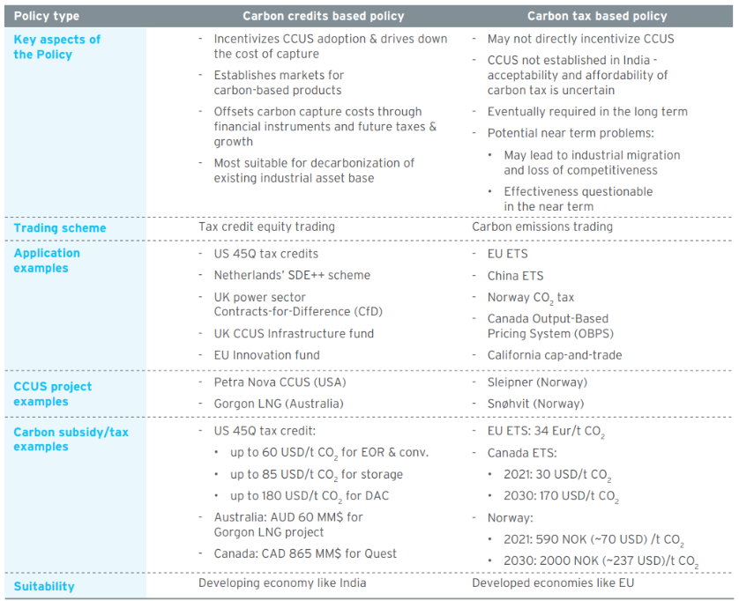
Based on the review of the prevailing policy mechanisms in different parts of the world, it is clear that there are two clear policy choices/ approaches for India to adopt, i.e. a) Carbon credits/incentives based policy b) Carbon tax based policy A comparison of the two policy approaches is provided in the Table.
Table: Comparison of Carbon Credits/Incentives and Carbon Tax Based Policy

Slide 15
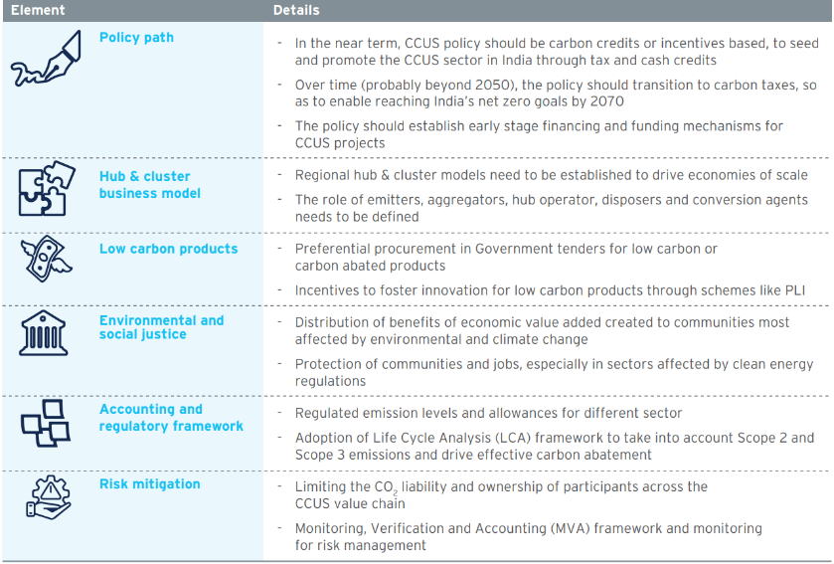
The key elements to be considered while formulating a CCUS policy framework for India are tabulated in Table.

