Slide 1
Sensor Fusion for Tizen Sensor Framework – Orientation Estimation
Ramasamy Kannan (ram.kannan@samsung.com)

Slide 2
Introduction
Sensor Fusion is the process of combining the accelerometer, gyroscope, geo-magnetic sensor, GPS data and barometer in order to generate accurate virtual sensor outputs such as Orientation, Gravity, Linear Acceleration, Altitude, Pedometer ...
Sensor Fusion is used for extracting individual virtual sensor components from composite sensor data and/or combining multiple sensor data to create new sensor component data while compensating for individual sensor errors.

Slide 3
Sensor Errors
Ideally the following errors would have to be corrected during sensor fusion:-
Bias: Any non-zero sensor output when the input is zero
Scale factor error: error resulting from aging or manufacturing tolerances
Nonlinearity: Present in most sensors to some degree
Scale factor sign asymmetry: Often mismatched push-pull amplifiers
Dead zone: usually due to mechanical lock-in
Quantization error: inherent in all digitized systems

Slide 4
Sensors
Accelerometer Sensor – It is combination of linear acceleration and gravity components. Applications would more be interested in using linear acceleration and gravity sensor data separately. Accelerometer is used for correcting the roll and pitch orientation measurements generated from the gyroscope. Using the same corrected tilt measurement (roll and pitch) sensor fusion could be used to separate linear acceleration and gravity components.
Gyroscope Sensor – It is ideal to determine the orientation of the device, but has the problem of long term drift in the measured sensor values. Sensor fusion could be used to use combine Accelerometer, Gyroscope and Geomagnetic (Compass) sensor data to produce corrected orientation data without drift.
Barometer – Measures atmospheric pressure. Height of the device from sea level could be measured based on change in atmospheric pressure at that height. Sensor Fusion could also be used to combine the altitude from the GPS data with height measured from the Barometer measurements and produce corrected altitude measurements.
Geo-Magnetic Sensor – Provides the direction the device is pointed in relation to the earth’s magnetic field. Could be used along with gyroscope angular rotation along Z axis to produce correct yaw measurement. Geo-Magnetic sensor along with GPS latitude-longitude measurements could be used to accurately estimate heading of the device.
GPS Data – Provides exact position in terms of latitude, longitude coordinates and altitude for the phone. Can be used along with Barometer for producing corrected altitude measurements. Could be used along with Geo-magnetic sensor to determine the heading of a device.
Notes:
<number>

Slide 5
Orientation Estimation
Accelerometer
Geo-magnetic
Gyroscope
Bias Compensation + Noise Filtering
Bias Compensation + Noise Filtering
Bias Compensation + Noise Filtering + Scaling
Angular Rotation Rates (δΦ, δθ, δΨ)
Compute Pitch(θ) and Roll (Φ)
Compute Yaw (Ψ)
Convert Euler Angles(Pitch, Roll and Yaw) to Quaternions
Convert Gyroscope Angular rates to Quaternions
State Vector Generation [Euler errors in form of Quaternions and gyroscope bias errors]
Measurement Noise Covariance Calculation
Driving Process Noise Covariance Calculation
Kalman Gain Computation
Time Upate Kalman Equations
Measurement Upate Kalman Equations
(Φ, θ, Ψ)

Slide 6
Orientation Estimation
Driving System:- (Gyroscope)
Gyroscope output consists for angular rates for pitch, roll and yaw
Gyroscope angular rates are corrected for bias (both static bias and bias correction from kalman filter) and noise (low pass filter).
Convert Gyroscope angular rates to Quaternions after scaling.

Slide 7
Orientation Estimation
Aiding System:- (Accelerometer and Geo-magnetic sensor)
Accelerometer and Geomagnetic sensor data is corrected for noise and compensated for static bias.
Accelerometer to compute tilt (pitch and roll)
Geomagnetic sensor is used compute yaw.
Convert computed euler angles (pitch, roll and yaw) to quaternions.

Slide 8
Orientation Estimate
Noise Covariance Calculation
Process noise covariance (Q) is calculated by computing covariance of windowed block of Driving system data.
Measurement noise covariance (R) is calculated by computing covariance of windowed block of Aiding system data.
Process and measurement covariance computed to be used in Kalman filtering.

Slide 9

Orientation estimate
Kalman Filtering
To ensure linear kalman filtering the following error state equation is used:
,where first term is the quaternion representation of the euler angles error and the next three terms are the error in knowledge of bias errors.
For the above state equations a linear kalman filter is considered.
If stability issues are seen with linear kalman filter (with above state equation), then an extended kalman filter (with different state equation) (or) thorntan-bierman kalman filter variants could be tried out.

Slide 10
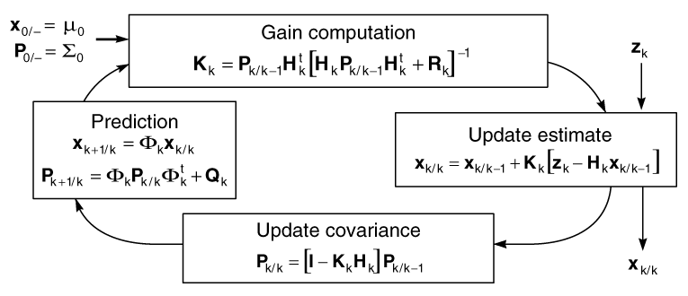
Kalman Filter Stages

Slide 11
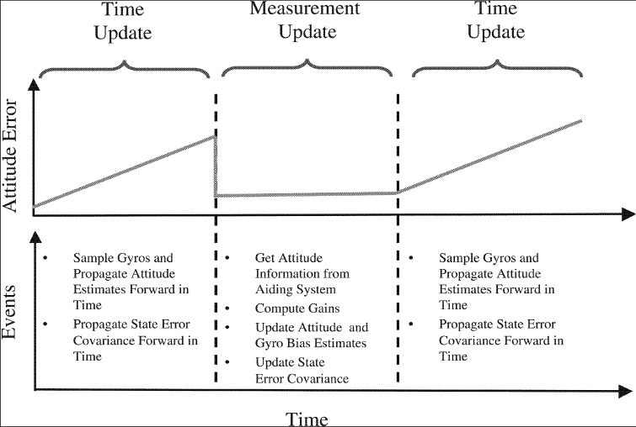
Kalman Filter Stages for Orientation Estimation

Slide 12
References
Design of Multi-Sensor Attitude Determination Systems., DEMOZ GEBRE-EGZIABHER, ROGER C. HAYWARD, J. DAVID POWELL - IEEE TRANSACTIONS ON AEROSPACE AND ELECTRONIC SYSTEMS
Implementing a Sensor Fusion Algorithm for 3D Orientation Detection with Inertial/Magnetic Sensors., Fatemeh Abyarjoo, Armando Barreto, Jonathan Cofino, Francisco R. Ortega
Design and Implementation of an attitude estimation system to control orthopedic components., Timo Von Marcard, Master thesis, Chalmers University
An introduction to the Kalman Filter., Greg Welch and Gary Bishop
The Kalman Filter: Navigation's Integration Workhorse., Larry J. Levy

