Slide 1
UNIT II

Slide 2
Topics
Syntax Parsing
Dependency Parsing
Semantics
Semantic Parsing
Word sense Disambiguation
Lexical Disambiguation
Structural Disambiguation
Word, Context and Sentence-level Semantics
Pronoun Solution
Semantic Representation of text
introduction to Semantic Relations

Slide 3
Syntax Parsing

Slide 4
Syntax parser
Syntax parsing, also known as syntactic analysis or parsing, is the process of analyzing the structure of a sentence or a sequence of words according to the rules of a formal grammar.
The goal of syntax parsing is to determine the grammatical relationships between the words in a sentence, identify the roles of various components (such as subjects, verbs, objects, modifiers, etc.), and understand how these components are organized to create meaningful sentence.
Syntax parsing involves breaking down a sentence into its constituent parts and constructing a hierarchical representation, often in the form of a syntax tree or a dependency graph. This representation visually depicts the grammatical structure of the sentence, showing how words are related to each other and how they function within the sentence.

Slide 5
Syntax parser
Example sentence with syntax error
Her goes to the store yesterday
The car red
I like to dancing
She read the book quick
I goes to the park every day
The cat sleep on the couch
She run to the store yesterday
A syntax error occurs when a sentence or phrase violates the grammatical rules and structure of the language.
Examples of syntax errors in NLP include incorrect word order, missing punctuation, or improperly formed sentences

Slide 6
Functions of syntax parser
Grammatical Structure Identification: The primary function of a syntax parser is to identify the grammatical structure of a sentence. It determines the roles of different words and phrases, such as subjects, verbs, objects, and modifiers, and how they are organized in relation to each other.
Dependency Relationships: A syntax parser identifies the dependency relationships between words in a sentence. It determines which words are connected and how they depend on each other to form meaningful sentence.
Syntax Trees and Graphs: It constructs syntax trees or dependency graphs that visually represent the hierarchical structure and relationships among the words in a sentence. These visual representations aid in understanding the sentence's composition.
Error Detection: Syntax parsers can identify grammatical errors and inconsistencies in sentences, such as subject-verb agreement, incorrect word order, and missing or extra components.
Parsing Ambiguity Resolution: Language often has ambiguities, where a sentence can be interpreted in multiple ways. A syntax parser helps resolve such ambiguities by selecting the most likely grammatical interpretation based on the given context.
Language Understanding: Its a fundamental step in language understanding. It provides a foundation for higher-level language tasks such as sentiment analysis, named entity recognition, and information extraction by determining how words interact in sentences.
Machine Translation: it ensures that the translated text retains the intended meaning.

Slide 7
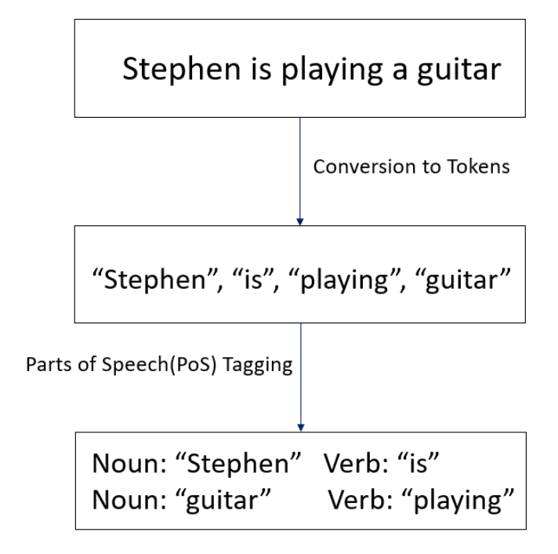
Ex of syntax parsing
Let’s try to understand parsing by an example sentence.
The sentence “Stephen is playing guitar”. Once we parse this sentence, it will be stated into individual constituents as “Stephen”, “is”, “playing”, and “guitar”.

Slide 8
Ex of syntax parsing
In the above sentence, parsing works by first breaking it down to individual tokens i.e., “Stephen”, “is”, “playing”, and “guitar” which are nothing but individual words making up the sentence.
In the next steps, part of speech is tagged like a Noun tagged to “Stephen” and “guitar” whereas Verb is tagged to “is” and “playing”.
As per the above example, it is evident that parsing a natural language sentence involves analyzing the input sentence by breaking it down into its grammatical constituents, identifying the parts of speech, and syntactic relations.

Slide 9
Challenges in Syntax Parsing
Syntax parsing is a challenging task due to the ambiguity and complexity of natural language.
Many sentences can have multiple valid parse trees or dependency structures, and determining the correct one requires understanding the context and semantics of the sentence.

Slide 10
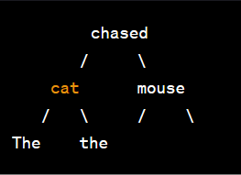
Types of syntax parser (Approaches to analyzing the syntactic structure of sentences in natural language processing)
Constituency Parsing
The output of constituency parsing is a syntax tree, also known as a parse tree or constituent tree.
In this tree, the sentence is broken down into hierarchical constituents (phrases) and their sub constituents, with non-terminal nodes representing phrases and terminal nodes representing individual words.
The syntax tree visually represents the hierarchical structure of the sentence in terms of phrases and their relationships.

Slide 11
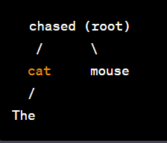
Types of syntax parser (Approaches to analyzing the syntactic structure of sentences in natural language processing)
2. Dependency Parsing
The output of dependency parsing is a dependency tree, where each word in the sentence is a node, and the relationships (dependencies) between words are represented by directed edges.
Each edge typically has a label that indicates the grammatical relationship (dependencies) between the words.
The dependency tree provides insights into how words are connected and the roles they play in the sentence's structure.

Slide 12
Grammer of syntax parser
A sentence is structured as follows:
Sentence = S = Noun Phrase + Verb Phrase + Preposition Phrase
S = NP + VP + PP
The different word groups that exist according to English grammar rules are:
Noun Phrase(NP): Determiner + Nominal Nouns = DET + Nominal
Verb Phrase (VP): Verb + range of combinations
Prepositional Phrase (PP): Preposition + Noun Phrase = P + NP
We can make different forms and structures versions of the noun phrase, verb phrase, and prepositional phrase and join in a sentence.

Slide 13
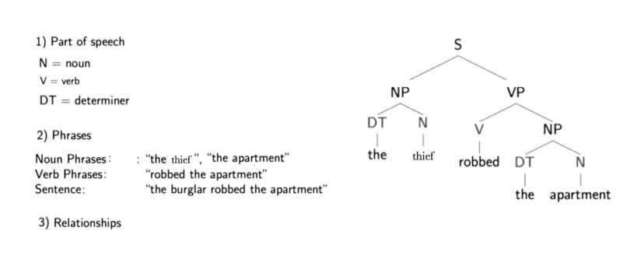
Ex of syntax parsing
Below is a parse tree for the sentence “The thief robbed the apartment.” Included is a description of the three different information types conveyed by the sentence.

Slide 14
Ex of syntax parsing
The letters directly above the single words show the parts of speech for each word (noun, verb and determiner).
One level higher is some hierarchical grouping of words into phrases.
For example, “the thief” is a noun phrase, “robbed the apartment” is a verb phrase and when put together the two phrases form a sentence, which is marked one level higher.
But what is actually meant by a noun or verb phrase?
Noun phrases are one or more words that contain a noun and maybe some descriptors, verbs or adverbs.
The idea is to group nouns with words that are in relation to them.

Slide 15
Ex of syntax parsing
A parse tree also provides us with information about the grammatical relationships of the words due to the structure of their representation.
For example, we can see in the structure that “the thief” is the subject of “robbed.”
With structure I mean that we have the verb (“robbed”), which is marked with a “V” above it and a “VP” above that, which is linked with a “S” to the subject (“the thief”), which has a “NP” above it. This is like a template for a subject-verb relationship and there are many others for other types of relationships.

Slide 16
Output of Syntax parser
Aspect | Syntax Tree | Dependency Graph
Representation | Hierarchical structure of phrases and words | Grammatical relationships and dependencies between words
Structure | Highlights hierarchical arrangement of phrases and words | Shows links between words based on grammatical roles and relationships
Visualization | Upside-down tree with branching branches | Arrows connecting words to indicate dependency or relationship
Usage | Formal linguistic analysis of phrase structure | Computational linguistics, parsing, machine translation, sentiment analysis
Focus | Structure and organization of sentence elements | Function of words in relation to each other
Analytical Insights | Syntactic structure, constituents' grouping | Grammatical roles, word dependencies
Common Representation | Tree-like diagram with branching nodes | Graph with nodes and directed edges

Slide 17
Dependency parsing

Slide 18
Dependency Parsing
The Dependency Parsing refers to the process of examining the dependencies between the phrases of a sentence to determine its grammatical structure.
It aims to determine the syntactic dependencies between words in a sentence, representing how they are connected based on their grammatical roles.
Structure of dependency parser:
In a dependency parse, each word in the sentence is considered a node, and the relationships between words are represented as directed edges between these nodes.
Each relationship has one head and a dependent that modifies the head.
Each edge is labeled with a grammatical relationship or dependency type that describes the syntactic connection between the dependent and the head.

Slide 19
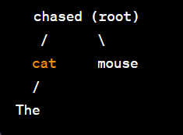
Ex of Dependency Parsing
Sentence: "The cat chased the mouse“
In this dependency tree:
"chased" is the root of the tree.
"cat" is the subject (nsubj) of the verb "chased."
"The" is a determiner (det) for "cat."
"mouse" is the direct object (dobj) of the verb "chased."
"the" is a determiner (det) for "mouse."
The labeled relationships indicate the grammatical roles of the words in the sentence and how they are connected in terms of dependency.

Slide 20
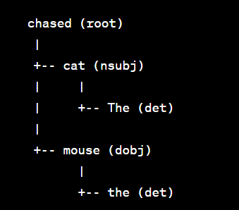
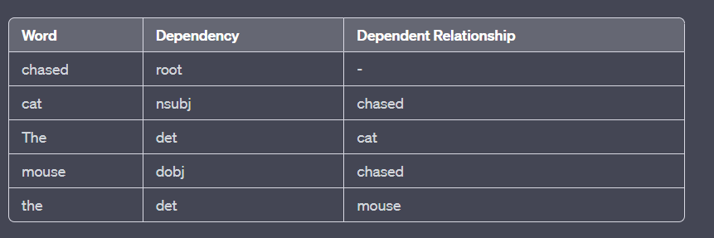
Ex of Dependency Parsing
Sentence: "The cat chased the mouse“
This table presents each word in the sentence, its corresponding dependency relationship, and the word it depends on.
The relationships indicate how the words are connected grammatically within the sentence.

Slide 21
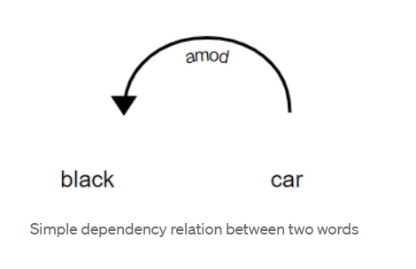
Ex of Dependency Parsing
In the above diagram, there exists a relationship between car and black because black modifies the meaning of car.
Here, car acts as the head and black is a dependent of the head.
The nature of the relationship here is amod which stands for “Adjectival Modifier”.
It is an adjective or an adjective phrase that modifies a noun.

Slide 22
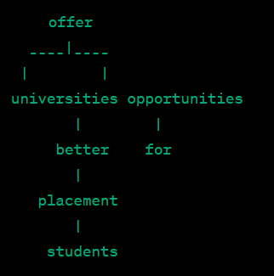
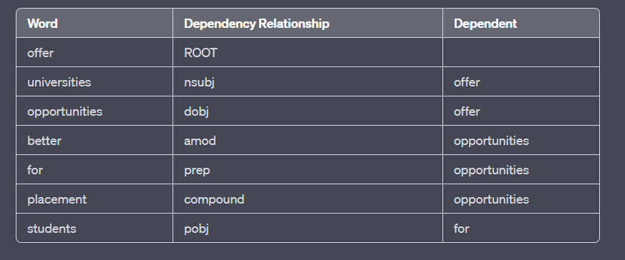
Ex of Dependency Parsing
Ex: Universities offer better placement opportunities for students
These labels / dependency relationship can be found at Universal Dependency Relations.

Slide 23
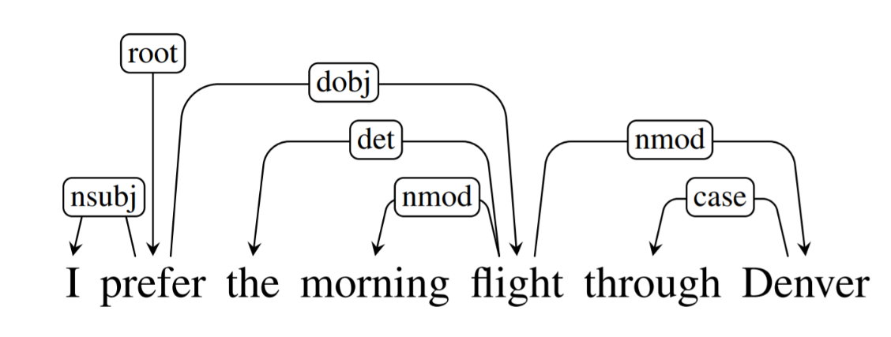
Ex of Dependency Parsing
In this labeled dependency tree:
"prefer" is the root of the tree.
"I" is the subject of the verb "prefer."
"flight" is the direct object of the verb "prefer."
"morning" is labeled as an adjective modifier (amod) for "flight."
"through" is a preposition (prep) that introduces a prepositional phrase.
"Denver" is the object of the preposition "through."
"the" is labeled as a determiner (det) for "flight."

Slide 24
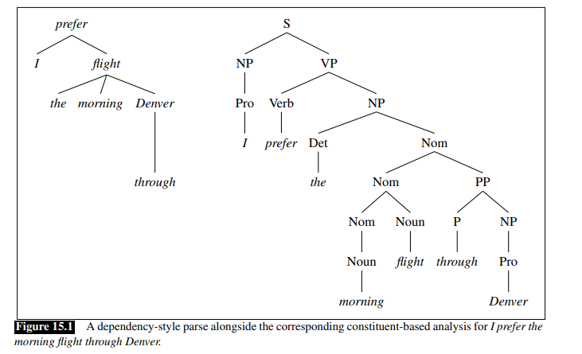
Implementation of Dependency Parsing

Slide 25
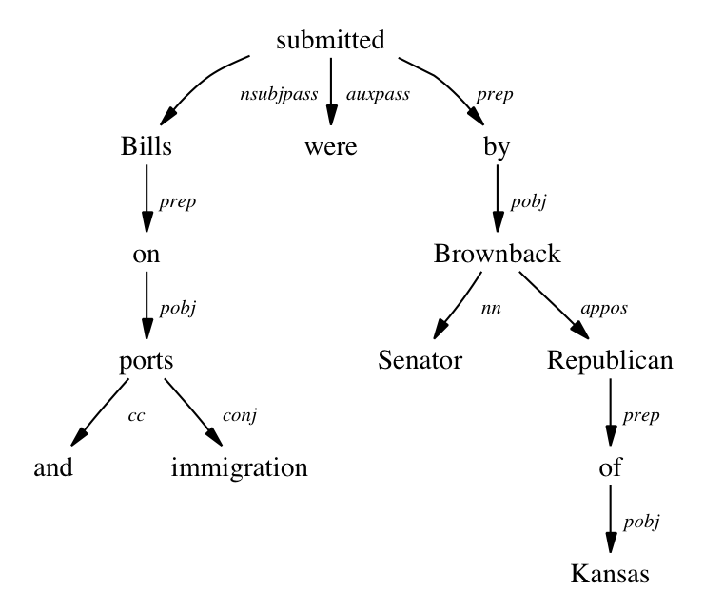
Ex of Dependency Parsing
Sentence: Bills on ports and immigration were submitted by Senator Brownback, Republican of Kansas

Slide 26
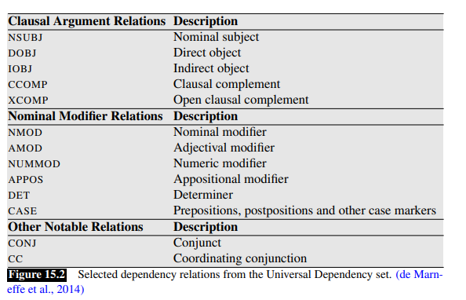
Dependency Parsing Relations / Dependency Grammer
Currently, the Common Dependency V2 taxonomy consists of 37 common syntactic relationships, as shown in the table below:
https://www.analyticsvidhya.com/blog/2021/12/dependency-parsing-in-natural-language-processing-with-examples/

Slide 27
Implementation of Dependency Parsing
Method 1: Using spaCy
Method 2: Using NLTK with Stanford CoreNLP
Visualize using NetworkX
Method 3: Using Stanza

Slide 28
Semantic

Slide 29
Semantic
Semantic- Meaning / Context
Semantic parsing analyze meaning of the text from sentences, phrases, or complete texts.
It goes beyond grammatical structure and aims to capture the semantics or the actual message that the language conveys.
The role of this is to detect all the subjective elements in an exchange: approach, positive feeling, dissatisfaction, impatience, etc.
Ex of sentence with semantic error:
The cat is a type of dog
The sun rises in the west
He drank the entire ocean
The car sings beautifully

Slide 30
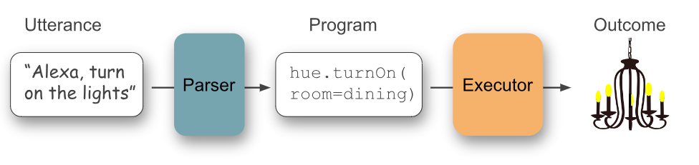
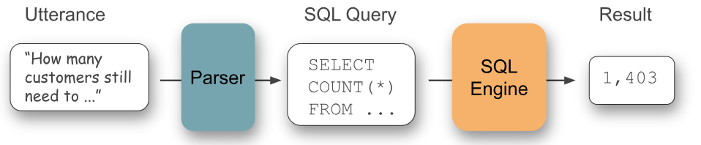
Semantic
Semantic parsing translating natural language statements into some executable meaning representation.
Semantic parsers form the backbone of voice assistants, as shown above, or they can be used to answer questions or give natural language interfaces to databases.

Slide 31
How Does Semantic Analysis Work?
Semantic analysis starts with lexical semantics, which studies individual words’ meanings (i.e., dictionary definitions).
Semantic analysis then examines relationships between individual words and analyzes the meaning of words that come together to form a sentence.
This analysis provides a clear understanding of words in context.
For example, it provides context to understand the following sentences:
“The boy ate the apple” defines an apple as a fruit.
“The boy went to Apple” defines Apple as a brand or store.

Slide 32
Elements of Semantic Analysis
A semantic system brings entities, concepts, relations and predicates together to provide more context to language so machines can understand text data with more accuracy. To better understand this, consider the following elements of semantic analysis that help support language understanding:
Hyponymy: It is an instance of a generic term
For example: ‘Color‘ is a hypernymy while ‘grey‘, ‘blue‘, ‘red‘, etc, are its hyponyms.
Homonymy: Two or more lexical terms with the same spelling and different meanings.
For example: ‘Rose‘ might mean ‘the past form of rise‘ or ‘a flower‘, – same spelling but different meanings; hence, ‘rose‘ is a homonymy.
Polysemy: Two or more terms that have the same spelling but multiple closely related meanings.
It differs from homonymy because the meanings of the terms need not be closely related in the case of homonymy. For example: ‘man‘ may mean ‘the human species‘ or ‘a male human‘ or ‘an adult male human‘ – since all these different meanings bear a close association, the lexical term ‘man‘ is a polysemy.

Slide 33
Elements of Semantic Analysis
Synonymy: Two or more lexical terms with different spellings and similar meanings.
For example: (Job, Occupation), (Large, Big), (Stop, Halt)
Antonymy: A pair of lexical terms with contrasting meanings.
they are symmetric to a semantic axis. For example: (Day, Night), (Hot, Cold), (Large, Small)
Meronomy: A relationship between a lexical term and a larger entity.
Meronomy refers to a relationship wherein one lexical term is a constituent of some larger entity. For example: ‘Wheel‘ is a meronym of ‘Automobile‘

Slide 34
Part of Semantic Analysis
Lexical analysis is the process of reading a stream of characters, identifying the lexemes and converting them into tokens that machines can read.
Grammatical analysis correlates the sequence of lexemes (words) and applies formal grammar to them so part-of-speech tagging can occur.
Syntactical analysis analyzes or parses the syntax and applies grammar rules to provide context to meaning at the word and sentence level.
Semantic analysis uses all of the above to understand the meaning of words and interpret sentence structure so machines can understand language as humans do.

Slide 35
Syntax vs Semantic
Semantic” refers to meaning.
Syntactic analysis focuses on “form” and syntax, meaning the relationships between words in a sentence.
Semantic analysis focuses on “meaning,” or the meaning of words together and not just a single word.
“parsing” means resolving a sentence into its component parts.
For example, we can build a parser that converts the natural language query “Who was the first person to walk on the moon?” to an equivalent (although complex!) SQL query such as “SELECT name FROM Person WHERE moon_walk = true ORDER BY moon_walk_date FETCH first 1 rows only.”
Semantic parsing is inherently more complicated than syntactic parsing because it requires understanding concepts from different word phrases. For instance, the following sentences (adapted from [4]) should ideally map to the same formal representation.

Slide 36
Semantic parsing

Slide 37
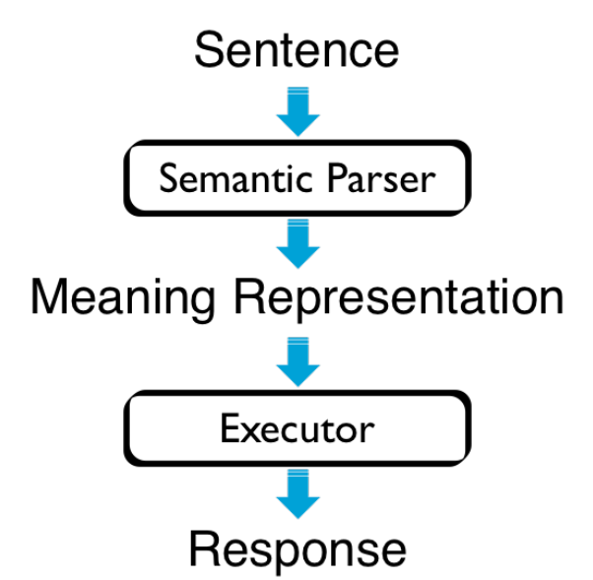
Semantic Parsing
Translate natural language utterances (NLUs) to meaning representation (MR)
f : sentence -> logical form

Slide 38
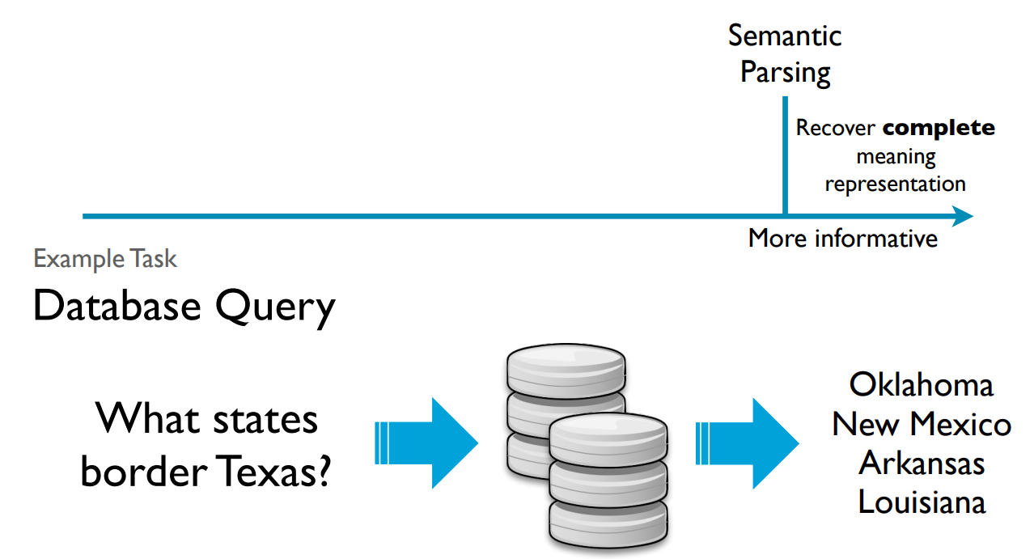
Need of Semantic Parsing
It provides language with meaning.

Slide 39
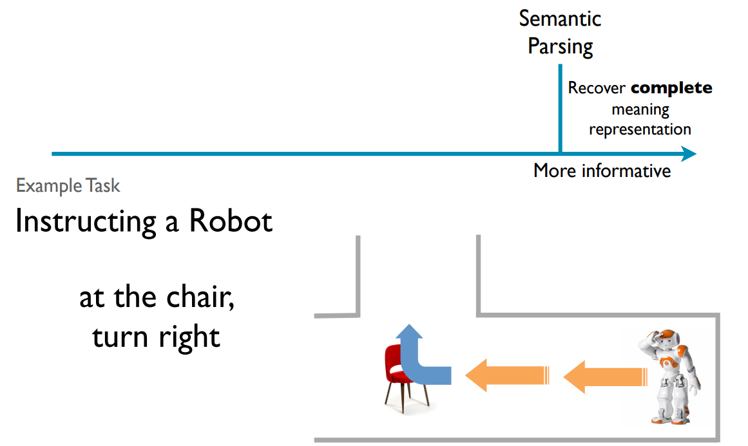
Need of Semantic Parsing
It provides language with meaning.(Language->Logical)

Slide 40
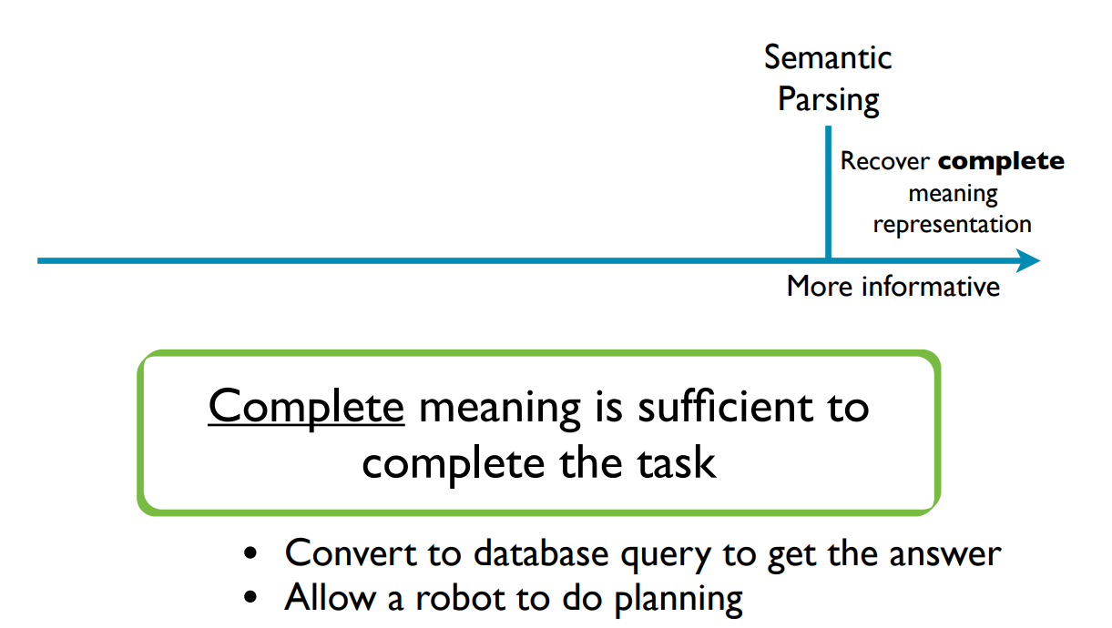
Need of Semantic Parsing
It provides language with meaning.

Slide 41
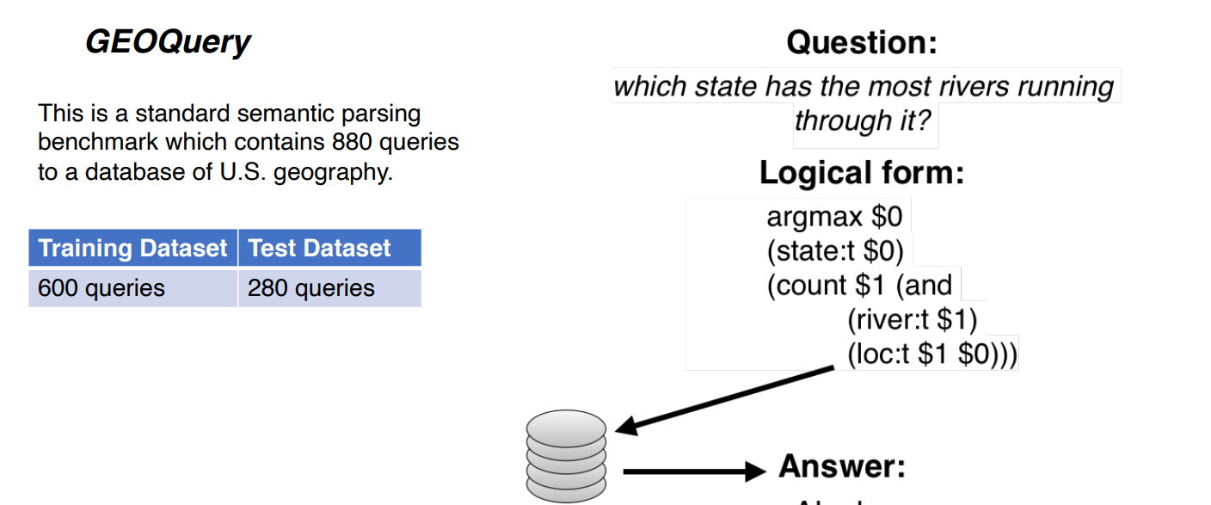
Ex of Semantic Parsing

Slide 42
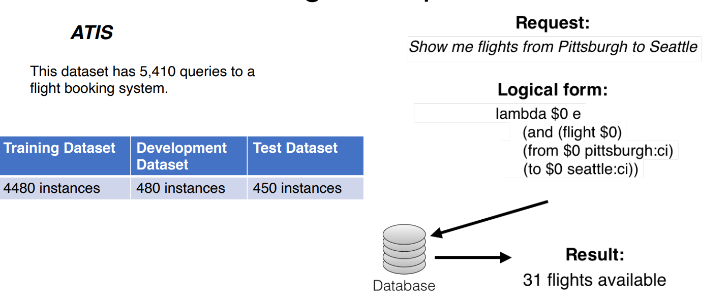
Ex of Semantic Parsing

Slide 43
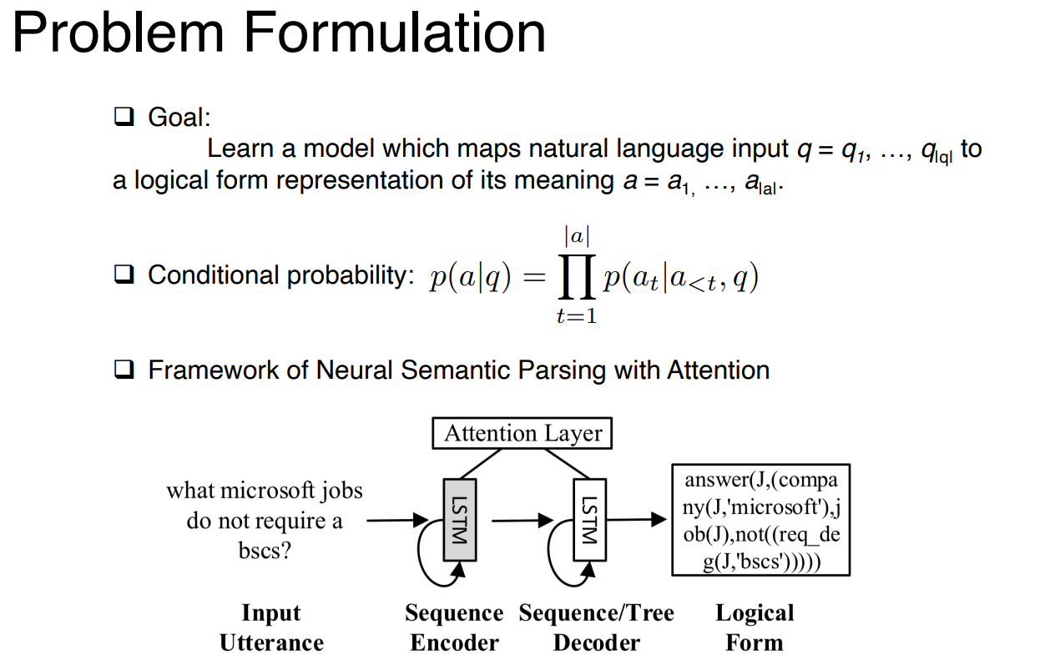
Language to Logical Form

Slide 44
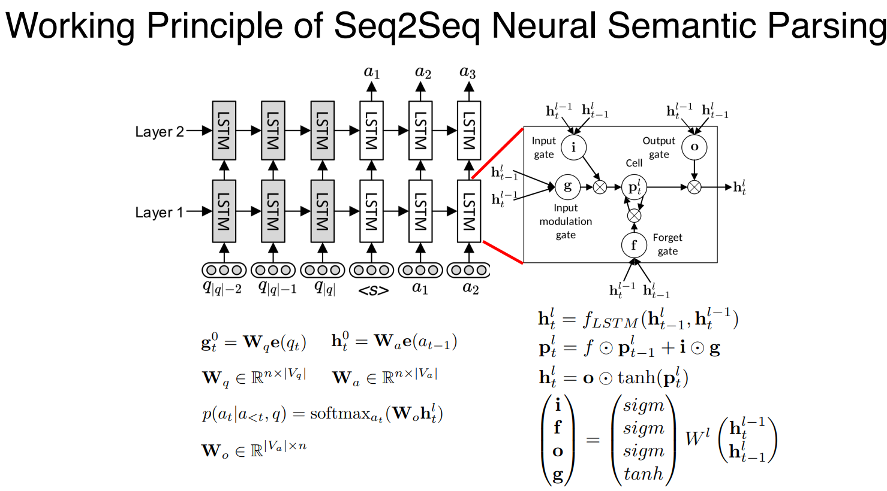
Language to Logical Form

Slide 45
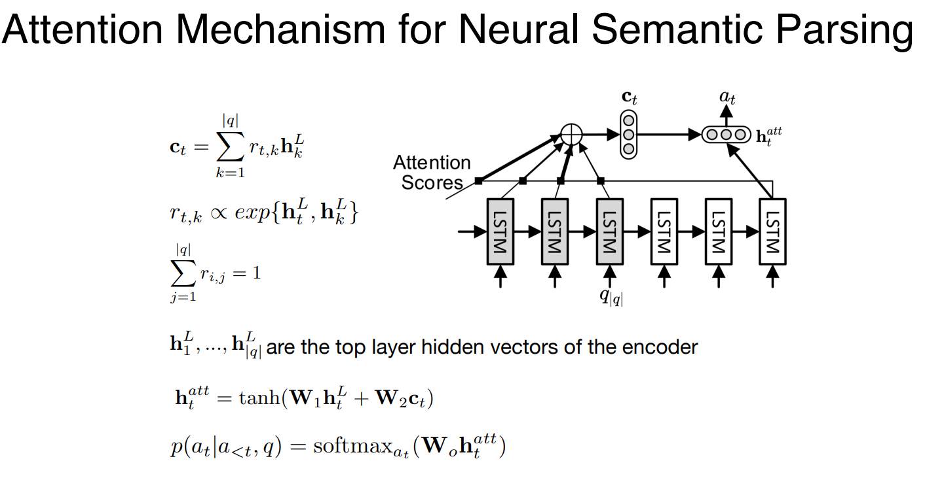
Language to Logical Form

Slide 46
Types of Disambiguation

Slide 47
Role of semantic analyser
The role of a semantic analyzer is to understand the meaning and intent behind natural language text.
This enhances accurate language comprehension and supports tasks like machine translation and sentiment analysis by:
Resolving word sense ambiguity: Choosing the correct meaning of words with multiple senses.
Handling syntactic ambiguity: Determining the right sentence structure for accurate interpretation.
Incorporating context: Analyzing surrounding words to clarify meaning in context.
Supporting NLP tasks: Enabling tasks like machine translation, question answering, and sentiment analysis.

Slide 48
Ambiguity
Words have different meanings based on the context of its usage in the sentence.
Ambiguity refers to a situation where a word, phrase, or sentence can have multiple possible meanings or interpretations.
Ambiguity arises due to the inherent complexity of human language, which can lead to confusion or uncertainty in understanding the intended meaning of a piece of text.
Disambiguation is the process of resolving ambiguity in language, where a single word or phrase could have multiple possible meanings.

Slide 49
Types of Ambiguity
Lexical Ambiguity: This occurs when a word has multiple meanings.
For example, the word "bank" can refer to a financial institution or the side of a river.
Syntactic Ambiguity / Structural Ambiguity : It is a type of ambiguity in language that arises when a sentence or phrase has multiple possible meanings due to its grammatical structure or syntax.
"I saw the man with the binoculars.“
It can be interpreted in two different ways:
I saw a man who had binoculars with him.
I saw a man through the lens of the binoculars.

Slide 50
Types of Ambiguity
Semantic Ambiguity: Semantic ambiguity arises when a word, phrase, or sentence can be interpreted in multiple ways due to the presence of words with multiple meanings or homonyms, causing uncertainty in understanding the intended sense.
John saw the bat flying over the baseball field
In this sentence, "bat" can be interpreted in two ways:
John saw the flying mammal known as a bat.
John saw the sports equipment used in baseball known as a bat.
The ambiguity arises due to the different possible meanings of "bat," illustrating semantic ambiguity.

Slide 51
Types of Ambiguity
Word sense Ambiguity:
Word has multiple sense which causes ambiguity.
"Bank" has multiple senses, such as financial institution and the side of a river.
Sentence: "I deposited money at the bank."
In this context, "bank" likely refers to a financial institution, as money is being deposited. Word sense disambiguation involves identifying the correct sense of "bank" based on the context to accurately understand the sentence's intended meaning.

Slide 52
Various disambiguation process / Process of semantic analysis
Word sense Disambiguation
Lexical Disambiguation
Structural Disambiguation

Slide 53
Word sense disambiguation
As natural language consists of words with several meanings (polysemic), the objective here is to recognize the correct meaning based on its use.
Word Sense Disambiguation (WSD) task of automatically selecting the correct sense (meaning) for a given word.
It is an automatic task to create a system that automatically disambiguates the sense for us.
Used in Information retrieval, question and answering, machine translation etc.

Slide 54
Word sense disambiguation
A famous example is to determine the sense of pen in the following passage (Bar-Hillel 1960):
Little John was looking for his toy box. Finally he found it. The box was in the pen. John was very happy.
WordNet lists five senses for the word pen:
pen — a writing implement with a point from which ink flows.
pen — an enclosure for confining livestock.
playpen, pen — a portable enclosure in which babies may be left to play.
penitentiary, pen — a correctional institution for those convicted of major crimes.
pen — female swan.

Slide 55
WordNet
WordNet® is a large lexical database of English.
Nouns, verbs, adjectives and adverbs are grouped into sets of cognitive synonyms (synsets), each expressing a distinct concept.
WordNet's structure makes it a useful tool for computational linguistics and natural language processing.

Slide 56
Approaches used in WSD
Knowledge based approach or dictionary approach
Supervised approach
Unsupervised approach
Hybrid approach

Slide 57
Knowledge based approach or dictionary approach
As the name suggests, for disambiguation, these methods primarily rely on dictionaries, treasures and lexical knowledge base.
In this approach, linguistic and semantic information is pre-defined and stored in structured databases.
When processing text, the system consults these external knowledge sources to make sense of the language used in the input. This approach contrasts with data-driven or statistical methods that learn patterns and relationships directly from large datasets.

Slide 58
Input required / Evaluation of WSD
Dictionary
A dictionary is an essential input for evaluating Word Sense Disambiguation.
It provides information about the different senses (meanings) of words.
These senses serve as the reference points for disambiguating the target words in the text.
Each word in the dictionary is associated with its various senses, usually along with their definitions or explanations.

Slide 59
Input required / Evaluation of WSD
2. Test Corpus:
Corpus that has the raw text plus annotations can be used for supervised training.
The test corpus is a collection of text passages or sentences that serve as the evaluation data for the WSD system.
This corpus contains instances of words that need to be disambiguated.
It has many lexical Samples.
The evaluation focuses on specific words chosen from the corpus, and the WSD system's performance is assessed based on its accuracy in disambiguating those words.

Slide 60
Applications of Knowledge based approach or dictionary approach
Word Sense Disambiguation: One prominent application of the knowledge-based approach is word sense disambiguation. Since many words have multiple meanings depending on context, dictionaries and lexical resources are consulted to determine the most appropriate sense of a word in a given context.
Semantic Analysis: The knowledge-based approach often involves mapping words and phrases to their semantic representations. This can include identifying synonyms, hypernyms (superordinate concepts), hyponyms (subordinate concepts), and other semantic relationships.

Slide 61
Applications of Knowledge based approach or dictionary approach
Named Entity Recognition: Knowledge-based methods can aid in identifying named entities (such as names of people, places, organizations) by referencing databases that store information about such entities.
Rule-based Systems: In some cases, the knowledge-based approach involves designing rule-based systems that use predefined linguistic rules to process and interpret text. These rules are handcrafted and encoded based on linguistic insights.

Slide 62
Pros and cons of Knowledge based approach or dictionary approach
Disadvantages: Limitation of the knowledge-based approach is its reliance on predefined knowledge sources, which can be incomplete, outdated, or unable to capture the finer details of language. Additionally, manual curation and maintenance of these resources can be time-consuming and costly.
Advancements: While the knowledge-based approach was prominent in early NLP, the field has evolved to embrace more data-driven and machine learning-based methods, which can capture complex patterns and relationships in language from vast amounts of text data.
In modern NLP, a hybrid approach is often used, combining knowledge-based methods with data-driven techniques. For example, machine learning models can be trained to learn from large text corpora while also leveraging external lexical resources to enhance their performance in tasks such as named entity recognition, sentiment analysis, and semantic role labeling.

Slide 63
Lesk method of Knowledge based approach
The Lesk method is a technique used in Natural Language Processing (NLP) as part of the knowledge-based approach to address the problem of word sense disambiguation.
The Lesk method was proposed by Michael Lesk in 1986 and is based on the idea of using the glosses (definitions) of words from a dictionary to disambiguate their meanings in a given context.
The method leverages the fact that words in a particular context tend to co-occur with other words that provide clues about their intended meaning.

Slide 64
Supervised Methods
Supervised methods for WSD are approaches that involve training machine learning models using labeled data to predict the correct sense of ambiguous words in context.
These methods rely on annotated training data where each instance contains an ambiguous word and its corresponding sense.
Overview of how supervised WSD methods work:
Data Collection: Gather a labeled dataset where each instance includes a target word that needs disambiguation, its context (surrounding words or sentence), and the correct sense label.
Feature Extraction: Convert the context of the target word into a numerical representation that can be used as input for a machine learning model. This might involve techniques like vectorization, embedding, or other transformations.

Slide 65
Supervised Methods
Feature Selection: Choose relevant features or representations from the context that are likely to help the model distinguish between different senses of the target word.
Model Selection: Choose a machine learning algorithm or model to train on the labeled data. Common choices include decision trees, support vector machines, naive Bayes, random forests, and neural networks (Word2Vec, GloVe, and BERT, LSTM, RNN, GRU).
Training: Train the selected model on the labeled dataset, using the context representations as input and the correct sense labels as output. The model learns to recognize patterns in the data that correlate with different senses.
Prediction: After training, the model can predict the sense of an ambiguous word in a new context by using the learned patterns to make an informed decision.
Evaluation: Assess the model's performance using a separate evaluation dataset. Common metrics for WSD evaluation include accuracy, precision, recall, F1-score, and more.

Slide 66
Supervised Methods
NN have surpassed traditional methods like the Lesk method for several reasons:
Contextual Understanding: Neural networks, especially deep learning models, can capture complex contextual relationships between words. They learn representations that consider not only individual word meanings but also how words interact in different contexts.
Representation Learning: Contextual embeddings like Word2Vec, GloVe, and BERT learn word representations from large text corpora. These representations encode semantic relationships and are pre-trained on massive datasets, enabling them to generalize well to various tasks and contexts.
Large-Scale Learning: Neural networks and contextual embeddings leverage the power of large-scale data and parallel computing to learn sophisticated language patterns. This enables them to capture nuances and subtle differences in word meanings.
Transfer Learning: Models like BERT are pre-trained on massive amounts of text data and then fine-tuned for specific tasks like WSD. This transfer learning approach helps in learning task-specific patterns even with limited labeled data.
Polysemy and Homonymy Handling: Traditional methods like the Lesk algorithm rely on predefined sense inventories from dictionaries, which might not cover all polysemous or homonymous instances. Neural networks can capture a broader range of sense distinctions.

Slide 67
Supervised Methods
Advantages of Supervised WSD Methods:
Can capture complex patterns in language and context.
Can generalize well to new contexts if trained on diverse and representative data.
Can incorporate various linguistic features and contextual information.
Challenges of Supervised WSD Methods:
Depend on the availability of high-quality labeled training data, which can be time-consuming and costly to create.
Might struggle with rare or unseen senses, as these may not be adequately represented in the training data.
Can overfit the training data if not properly regularized, leading to poor generalization to new data.

Slide 68
Unsupervised Methods
Unsupervised techniques for Word Sense Disambiguation (WSD) aim to disambiguate word senses without relying on labeled training data.
Instead, they leverage patterns and structures in language to make sense distinctions. Unsupervised methods are particularly useful when labeled data is unavailable. Here are a few common unsupervised techniques for WSD:
Clustering Methods::
K-Means Clustering: Group similar contexts together based on their features. Words with the same sense might cluster together, helping identify different senses.
Hierarchical Clustering: Hierarchically organize contexts based on their similarity, potentially revealing sense groupings.

Slide 69
Unsupervised Methods
Co-occurrence Graph Methods:
Graph-based Approaches: Create a graph where nodes are words, and edges represent co-occurrence relationships. Identifying clusters or communities of words can lead to sense groupings.
Graph Partitioning: Divide the graph into partitions that represent different senses. Spectral clustering and other techniques can be employed.
Contextual Similarity Measures:
Cosine Similarity: Measure the cosine similarity between word vectors representing the target word in context and sense definitions. Choose the sense with the highest similarity score.
Spectral Clustering:
Spectral Clustering: Utilize the eigenvalues and eigenvectors of an affinity matrix constructed from context similarity to cluster contexts and potentially reveal senses.

Slide 70
Hybrid approach of WSD
A hybrid approach to Word Sense Disambiguation (WSD) involves combining multiple methods or resources, often from different categories (such as supervised, knowledge-based, or unsupervised), to improve the accuracy and robustness of WSD.
The idea is to leverage the strengths of each individual method while mitigating their weaknesses. Hybrid approaches aim to achieve better results than using any single method in isolation.

Slide 71
Hybrid approach of WSD
Integration of Methods:
Combine supervised methods with knowledge-based methods: Use a supervised model trained on labeled data alongside a dictionary or ontology to provide additional sense information.
Combine unsupervised methods with supervised methods: Employ unsupervised techniques to pre-cluster contexts and then use a supervised classifier for sense disambiguation within each cluster.
Voting or Weighting:
Aggregate results from different methods using voting schemes or weighted averages. For instance, if multiple methods agree on a sense, it's more likely to be correct.
Assign different weights to the outputs of various methods based on their reliability or performance on a validation set.

Slide 72
Applications of Word Sense Disambiguation (WSD)
Machine Translation
Machine translation or MT is the most obvious application of WSD. In MT, Lexical choice for the words that have distinct translations for different senses, is done by WSD. The senses in MT are represented as words in the target language. Most of the machine translation systems do not use explicit WSD module.
Information Retrieval (IR)
Information retrieval (IR) may be defined as a software program that deals with the organization, storage, retrieval and evaluation of information from document repositories particularly textual information. The system basically assists users in finding the information they required but it does not explicitly return the answers of the questions. WSD is used to resolve the ambiguities of the queries provided to IR system. As like MT, current IR systems do not explicitly use WSD module and they rely on the concept that user would type enough context in the query to only retrieve relevant documents.

Slide 73
Applications of Word Sense Disambiguation (WSD)
Text Mining and Information Extraction (IE)
In most of the applications, WSD is necessary to do accurate analysis of text. For example, WSD helps intelligent gathering system to do flagging of the correct words. For example, medical intelligent system might need flagging of “illegal drugs” rather than “medical drugs”
Lexicography
WSD and lexicography can work together in loop because modern lexicography is corpus based. With lexicography, WSD provides rough empirical sense groupings as well as statistically significant contextual indicators of sense.

Slide 74
Difficulties in Word Sense Disambiguation (WSD)
Differences between dictionaries
The major problem of WSD is to decide the sense of the word because different senses can be very closely related. Even different dictionaries and thesauruses can provide different divisions of words into senses.
Different algorithms for different applications
Another problem of WSD is that completely different algorithm might be needed for different applications. For example, in machine translation, it takes the form of target word selection; and in information retrieval, a sense inventory is not required.
Inter-judge variance
Another problem of WSD is that WSD systems are generally tested by having their results on a task compared against the task of human beings. This is called the problem of interjudge variance.
Word-sense discreteness
Another difficulty in WSD is that words cannot be easily divided into discrete submeanings.

Slide 75
Lexical Disambiguation
Lexical ambiguity refers to a situation in which a single word has multiple meanings or senses. This can lead to confusion or uncertainty in understanding the intended meaning of the word in a particular context.
Here's an example to illustrate lexical ambiguity:
Example Sentence: "Bank customers enjoy the river view."
In this sentence, the word "bank" is ambiguous because it can refer to two different concepts:
Lexical ambiguity can occur in various contexts, including literature, communication, legal documents, and, as in the example above, natural language processing tasks like question answering and machine translation

Slide 76
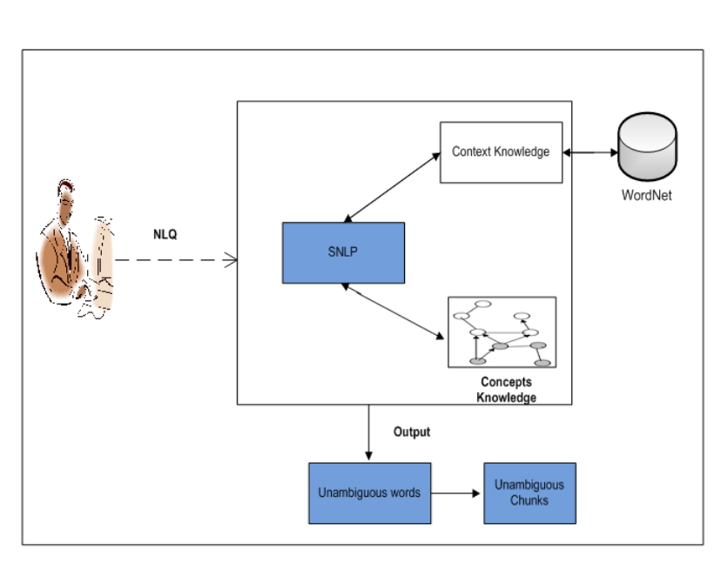
Lexical Disambiguation Framework

Slide 77
Lexical Disambiguation
The proposed approach solves lexical ambiguity in QA by considering two types of knowledge: context knowledge, and concepts knowledge.
The combination of these knowledge is used to decide the most possible meaning of the word.
Context Knowledge:
This refers to information derived from the immediate surrounding words and phrases in the text, also known as the context. The context provides clues about how a word is being used and its intended sense in that specific instance.
By analyzing the words and phrases around the ambiguous word, the approach aims to understand the context and how the word fits into the overall meaning of the sentence or passage.

Slide 78
Lexical Disambiguation
Concepts Knowledge:
Concepts knowledge likely refers to information about the various senses or meanings associated with the ambiguous word.
This knowledge might be extracted from dictionaries, thesauri, ontologies, or other lexical resources.
The approach uses this concepts knowledge to create a list of possible meanings or senses that the ambiguous word could have in the given context.
Combining Knowledge:
The key idea of your approach is to combine the context knowledge and concepts knowledge to determine the most plausible meaning of the ambiguous word.
By analyzing both the context and the available senses or meanings, the approach aims to make an informed decision about which sense is most likely intended in the specific instance.

Slide 79
Lexical Disambiguation
Decision-Making:
Once the context and concepts knowledge are combined, the approach likely employs some decision-making process to select the best-fitting sense for the ambiguous word in the given context.
This decision might involve comparing the context with the definitions or descriptions of different senses, calculating overlaps, or using a similarity metric to rank the senses.
To resolve lexical ambiguity in QA tasks by leveraging both context knowledge (information from the surrounding text) and concepts knowledge (knowledge about possible senses or meanings of the ambiguous word).
By combining these sources of information, the approach aims to determine the most appropriate sense of the word within the context, enhancing the accuracy of the QA system's responses. This method aligns with knowledge-based approaches that use external resources to aid in understanding language and resolving ambiguity.

Slide 80
Context Knowledge
Context knowledge contains a set of lexical with their semantic relations.
The set of lexical with its semantics are extracted from the WordNet database manually.
All semantics in this work are extracted from the WordNet and combined with a context label.
For instance, the word bank may have 5 possible meanings as shown in Table.

Slide 81
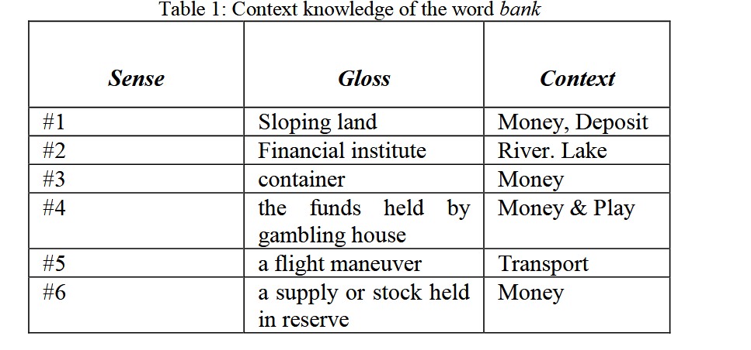

Slide 82
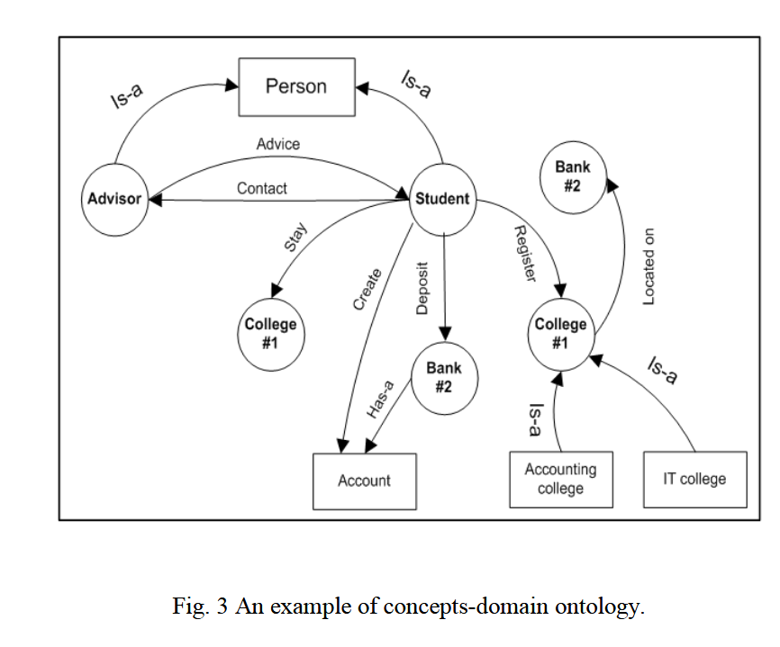
Concepts Knowledge
Concepts knowledge is ontology consists of a set of concepts which are within the domain, and the relationships between the concepts.
The ontology also specifies how knowledge is related to linguistic structures such as grammars and lexicons.

Slide 83
Structural Disambiguation

Slide 84
Example of text
“Science is important for our country.
The Government pays it much attention.”

Slide 85
Textual representation
Text is a sequence of letter.
S c i e n c e i s i m p o r t a n t f o r o u r c o u n t r y . T h e G o v e r n m e n t p a y s i t m u c h a t t e n t i o n .

Slide 86
Morfological analysis
Morphological analysis

Slide 87
Morphological representation
A sequence of words.

Slide 88
Syntactic parsing
Syntactic parsing

Slide 89
Syntactic representation
A sequence of syntactic trees.

Slide 90
Syntactic representation
What happened?
With whom happened?
... their details

Slide 91
Semantic analysis
Semantic analysis
Next lecture...

Slide 92
Syntax
The structure describing the relationships between words in a sentence
Describes the relationships implied by grammatical characteristics
not by meaning
Often allows for simple paraphrasing
John reads the book
The book is read by John

Slide 93
Early approach: Dependency syntax
Tree
Nodes: words
Arcs: modified by
Modifies means adds details, clarifies, chooses of many... makes more specific
Arcs are typed
Types are: subject, object, attribute, ...
Recipient
Subject
Object
Attribute

Slide 94
... Dependency syntax
General situation: pay
More specifically: the one where:
who pays is government
what is paid is attention
to whom it is paid is it
More specifically: attention that is much
Recipient
Subject
Object
Attribute

Slide 95
Advantages/disadvantages of Dependency Syntax
Advantages
Solid linguistic base
Rather direct translation into semantics
Easily applicable to languages with free word order
Korean? Russian, Latin
This is why solid linguistic base: good for classical languages!
Disadvantages
No nice mathematical base
No simple algorithms

Slide 96
Most popular approach: Constituency (Phrase Structure grammars)
Tree
Nodes: nested segments of the phrase
Cannot intersect, only nested
Usually are labeled with part-of-speech names
Arcs: nesting
In classical approach, arcs are not labeled
[[Our Government ] [pays [ much attention] [to it ] ] ]

Slide 97
Constituency
[[Our Government ] [pays [ much attention] [to it ] ] ]
Our Government
pays
much attention
to it

Slide 98
Constituency
[[Our_{R} Government_{N} ]_{NP}
[pays_{V} [ much_{A} attention_{N}]_{NP} [to_{P} it_{R} ]_{PP} ] _{VP}]_{S}
R: pronoun NP: noun phrase
N: noun VP: verb phrase
V: verb PP: prepositional phrase
A: adjective S: sentence

Slide 99
Constituency: graphical representation
[[Our Government ]_{NP} [pays [ much attention]_{NP} [to it ]_{PP} ] _{VP}]_{S}
S
VP
NP NP PP
NP VP NP NP
R N V A N P R
Our Government pays much attention to it

Slide 100
Phrase structure grammar
Enumerates possible configurations at nodes
Usually recursive
S ← NP VP
NP ← A NP
NP ← R NP
NP ← P NP
NP ← N
VP ← VP NP PP
VP ← V
S
VP
NP NP PP
NP VP NP NP
R N V A N P R
Our Government pays much attention to it

Slide 101
Semantic Analysis
Semantic analysis is the process of finding the meaning from text. This analysis gives the power to computers to understand and interpret sentences, paragraphs, or whole documents, by analyzing their grammatical structure, and identifying the relationships between individual words of the sentence in a particular context.
Therefore, the goal of semantic analysis is to draw exact meaning or dictionary meaning from the text. The work of a semantic analyzer is to check the text for meaningfulness.

Slide 102
How is Semantic Analysis different from Lexical Analysis?
Lexical analysis is based on smaller tokens but on the contrary, the semantic analysis focuses on larger chunks.
Since semantic analysis focuses on larger chunks, therefore we can divide the semantic analysis into the following two parts:
Studying the meaning of the Individual Word
It is the first component of semantic analysis in which we study the meaning of individual words. This component is known as lexical semantics.
Studying the combination of Individual Words
In this component, we combined the individual words to provide meaning in sentences.

Slide 103
For Example, consider the following sentence:
Sentence: Ram is great
In the above sentence, the speaker is talking either about Lord Ram or about a person whose name is Ram. That is why the task to get the proper meaning of the sentence is important.

Slide 104
Sentiment Analysis with Machine Learning
implement a semantic-based approach for machine learning, there are various sub-tasks involved including
Word sense disambiguation
Relationship extraction.

Slide 105

Word Sense Disambiguation
As we have discussed that Natural language is ambiguous and polysemic; sometimes, the same word can have different meanings depending on its use in the sentence.
Therefore, in semantic analysis with machine learning, computers use Word Sense Disambiguation to determine which meaning is correct in the given context.
For Example,
Consider the word: Orange
The above word can refer to a color, a fruit, or even a city in Florida!

Slide 106
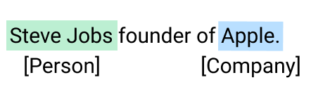
Relationship Extraction
In this task, we try to detect the semantic relationships present in a text. Usually, relationships involve two or more entities such as names of people, places, company names, etc.
These entities are joined through a semantic category, like “works at,” “lives in,” “is the CEO of,” “headquartered at.”
For Example, Consider the following phrase
Phrase: Steve Jobs is the founder of Apple, which is headquartered in California

Slide 107
Elements of Semantic Analysis
Hyponymy
It represents the relationship between a generic term and instances of that generic term. Here the generic term is known as hypernym and its instances are called hyponyms.
For Example,
The word color is hypernym, and the colors blue, yellow, green, etc. are hyponyms.

Slide 108
Elements of Semantic Analysis
Homonymy
It may be defined as the words having the same spelling or same form but having different and unrelated meanings.
For example,
The word “Bat” is a homonymy word.
The above word is homonymy word because a bat can be an implement in two ways:
To hit a ball,
Bat is a nocturnal flying mammal also.

Slide 109
Elements of Semantic Analysis
Polysemy
Polysemy is a Greek word, that means “many signs”. It is a word or phrase with a different but related sense. In other words, we can say that polysemy has the same spelling but different and related meanings.
For Example,
The word "Bank" is a Polysemy word.
The above word is a polysemy word having the following meanings:
A financial institution.
The building in which such an institution is located.
A synonym for “to rely on”.

Slide 110
Difference between Polysemy and Homonymy
Both polysemy and homonymy words have the same syntax or spelling but the main difference between them is that in polysemy, the meanings of the words are related but in homonymy, the meanings of the words are not related.
For Example, if we talk about the same word “Bank” as discussed above, we can write the meaning as
‘a financial institution’ or
‘a river bank’.
In that case, it becomes an example of a homonym, as the meanings are unrelated to each other.

Slide 111
Elements of Semantic Analysis
Synonymy
It represents the relation between two lexical items of different forms but expressing the same or a close meaning.
For Example,
‘author/writer’, ‘fate/destiny'

Slide 112
Elements of Semantic Analysis
Antonymy
It is the relation between two lexical items having symmetry between their semantic components relative to an axis. The scope of antonymy is as follows −
Application of property or not:
For Examples,
‘life/death’, ‘certitude/incertitude’
Application of scalable property:
For Examples,
‘rich/poor’, ‘hot/cold’
Application of a usage:
For Examples,
‘father/son’, ‘moon/sun’

Slide 113
Elements of Semantic Analysis
Meronomy
It is defined as the logical arrangement of text and words that denotes a constituent part of or member of something.
For Example,
A segment of an orange

Slide 114
Meaning Representation
The semantic analysis creates a representation of the meaning of a sentence. But before deep dive into the concept and approaches related to meaning representation, firstly we have to understand the building blocks of the semantic system.

Slide 115
Concepts
It represents the general category of the individuals such as a person, city, etc.
Relations
It represents the relationship between entities and concepts.
For Example,
Sentence: Ram is a person

Slide 116
Predicates
It represents the verb structures.
For Example,
Semantic roles and Case Grammar
Now, we have a brief idea of meaning representation that shows how to put together the building blocks of semantic systems. In other words, it shows how to put together entities, concepts, relations, and predicates to describe a situation. It also enables reasoning about the semantic world.

Slide 117
Approaches to Meaning Representations
The semantic analysis uses the following approaches for the representation of meaning −
First-order predicate logic (FOPL)
Semantic Nets
Frames
Conceptual dependency (CD)
Rule-based architecture
Case Grammar
Conceptual Graphs

Slide 118
Need of Meaning Representations
The reasons behind the need for the meaning representation are as follows:
Linking of linguistic elements to non-linguistic elements
With the help of meaning representation, we can link linguistic elements to non-linguistic elements.
Representing variety at the lexical level
With the help of meaning representation, we can represent unambiguously, canonical forms at the lexical level.
Can be used for reasoning
The meaning representation can be used to reason for verifying what is correct in the world as well as to extract the knowledge with the help of semantic representation.

Slide 119
Lexical Semantics
It is the first part of semantic analysis, in which we study the meaning of individual words. It involves words, sub-words, affixes (sub-units), compound words, and phrases also. All the words, sub-words, etc. are collectively known as lexical items.
In simple words, we can say that lexical semantics represents the relationship between lexical items, the meaning of sentences, and the syntax of the sentence.
The steps which we have to follow while doing lexical semantics are as follows:
Classification of lexical items.
Decomposition of lexical items.
Differences, as well as similarities between various lexical-semantic structures, are also analyzed.

Slide 120
Techniques of Semantic Analysis
We can any of the below two semantic analysis techniques depending on the type of information you would like to obtain from the given data.
text classification model(which assigns predefined categories to text)
text extractor (which pulls out particular information from the text).

Slide 121
Semantic Classification Models
Topic Classification
Based on the content, this model sorts the text into predefined categories. In a company, Customer service teams may want to classify support tickets as they drop into their help desk, and based on the category it will distribute the work.
With the help of semantic analysis, machine learning tools can recognize a ticket either as a “Payment issue” or a“Shipping problem”.
Sentiment Analysis
In Sentiment analysis, our aim is to detect the emotions as positive, negative, or neutral in a text to denote urgency.
For Example, Tagging Twitter mentions by sentiment to get a sense of how customers feel about your product and can identify unhappy customers in real-time.

Slide 122
Intent Classification
We can classify the text based on the new user requirement.
You can these types of models to tag sales emails as either “Interested” or “Not Interested” to proactively reach out to those users who may want to try your product.

Slide 123
Semantic Extraction Models
Keyword Extraction
It is used to find relevant words and expressions from a text. This technique is used separately or can be used along with one of the above methods to gain more valuable insights.
For Example, you could analyze the keywords in a bunch of tweets that have been categorized as “negative” and detect which words or topics are mentioned most often.
Entity Extraction
The idea of entity extraction is to identify named entities in text, such as names of people, companies, places, etc.
This might be useful for a customer service team to automatically extract names of products, shipping numbers, emails, and any other relevant data from customer support tickets.

Slide 124
Pronoun/Anaphora resolution
What is Anaphora / Pronoun?
Use of a grammatical substitute (such as a pronoun) to refer to the denotation of a preceding word or group of words.
Anaphora occurs when there is repeated reference to the same entities in a discourse.
A "discourse" would refer to a larger conversation, text, or communication in which anaphora occurs—where repeated references to the same entities are made. These repeated references contribute to the continuity and understanding of the discourse by linking the information and maintaining cohesion.
Example:
Jack and Jill went up the hill To fetch a pail of water Jack fell down and broke his crown And Jill came tumbling after
Anaphora is the reference that refers to the antecedent.

Slide 125
Types of Anaphora
Pronominal Anaphora: This is the most common type, where a referent is referred to by a pronoun. For example, in the sentence "John found the love of his life," 'his' refers to 'John.'
Definite Noun Phrase Anaphora: It is a type of anaphora in which a pronoun refers back to a preceding noun phrase. For instance, in the continued example: "The relationship did not last long," 'The relationship' refers to 'the love' mentioned in the preceding sentence.
Quantifier/Ordinal Anaphora: In this type, the anaphor is a quantifier such as 'one' or an ordinal such as 'first.' In the continued example: "He started a new one," 'one' refers to 'The relationship' and effectively means 'a relationship.'"

Slide 126
Pronoun/Anaphora resolution (AR)
What is Anaphora resolution / Pronoun resolution?
It is the process of identifying the antecedent or referent that a pronoun refers to in a sentence or a discourse. An antecedent is the noun or noun phrase that the pronoun replaces or refers back to.
Proper pronoun resolution is crucial for maintaining clarity and coherence in language, as it ensures that readers or listeners can understand who or what the pronoun is referring to.
For example, in the sentence "John went to the store. He bought some groceries," the pronoun "He" refers back to "John," which is the antecedent. Pronoun resolution allows us to understand that it was John who bought groceries.
Anaphora resolution is the process of interpreting the link between the anaphor (i.e., the repeated reference) and its antecedent (i.e., the previous mention of the entity). The process is of interest because it frequently involves interpretation across a sentence boundary.
AR is classically recognized as a very difficult problem in NLP.

Slide 127
Anaphora resolution - Weighting Preferences
Weighting Preferences is another anaphora resolution technique that involves assigning probabilities or scores to different potential referents based on certain factors.
These factors help determine the likelihood of a match between an anaphor and its referent.
This technique helps the algorithm choose the most probable antecedent from among the candidates.
Lappin & Leass algorithm uses the weighting preferences technique.

Slide 128
Anaphora resolution - Weighting Preferences
Here are the factors included in Weighting Preferences:
Proximity
Proximity is an anaphora resolution factor that considers the distance between an anaphor and its potential antecedents within a text.
This factor takes into account how close an antecedent phrase is to the anaphor in terms of words or sentences. The closer the antecedent, the more likely it is to be the referent of the anaphor.
Original Text: "Sarah went to the store. She bought some groceries."
In this example:
The anaphor "She" appears in the second sentence.
The technique of Proximity suggests that the antecedent for "She" is more likely to be in close proximity, meaning it's more likely to be in the immediately preceding sentence.
Since "Sarah" is the only entity mentioned in the previous sentence, it is the closest potential antecedent.
Thus, based on Proximity, "Sarah" is a likely antecedent for the anaphor "She."
Proximity recognizes that entities mentioned recently in the discourse are more relevant and accessible to the reader or listener.

Slide 129
Anaphora resolution - Weighting Preferences
Here are the factors included in Weighting Preferences:
Centering
Centering theory is a concept used in anaphora resolution that helps determine which entity in a text is the most central or prominent at a given point.
The theory suggests that an anaphor, such as a pronoun, is more likely to refer to the entity that is currently the center of attention in the text.
This is because the center is the most salient and relevant entity in the context, making it a likely candidate for an anaphor's referent.

Slide 130
Anaphora resolution - Weighting Preferences
Here are the factors included in Weighting Preferences:
Centering (Example)
Original Sentence: "John and Mary went to the zoo. He enjoyed seeing the animals."
In this example:
The initial mention of "John and Mary" establishes both individuals as relevant entities in the discourse.
The second sentence uses the pronoun "He," which is an anaphor. The question is, who does "He" refer to?
According to Centering theory, the most prominent entity or "center" in the text is often the subject of the current sentence. In this case, "John" is more likely to be the center because the sentence begins with "John and Mary went to the zoo."
Therefore, based on Centering theory, "He" is more likely to refer to "John."

Slide 131
Anaphora resolution - Weighting Preferences
Here are the factors included in Weighting Preferences:
Syntactic/Semantic Parallelism
This involves looking for similarities in the grammatical structure or semantic roles of potential antecedents and the anaphor. The idea is that an anaphor is more likely to refer to an entity that shares a similar syntactic structure or semantic role. This technique helps maintain coherence and consistency in the text.
Here's how it works, along with an example:
Original Sentence: "Sheila is an engineer. The project she is working on is impressive."
In this example:
The anaphor "she" appears in the second sentence and refers to a person mentioned earlier.
The technique of Syntactic/Semantic Parallelism considers both the grammatical structure and the semantic roles. The antecedent should have a similar syntactic structure and a matching semantic role.
The anaphor "she" has a syntactic structure of subject pronoun + verb ("she is working"). Therefore, the potential antecedent should have a similar structure.
The semantic role of "she" is that of the subject of the action. This means the antecedent should also be someone who can be a subject, like "Sheila."
Based on this parallelism, "Sheila" is a suitable antecedent for the anaphor "she."

Slide 132
Anaphora resolution - Eliminative Constraints
Eliminative Constraints is a traditional anaphora resolution technique that involves establishing a match between an anaphor (a pronoun or a referring expression) and a potential referent (the word or phrase that the anaphor refers to).
This technique uses specific attributes to determine if the anaphor and the referent can be connected logically.
These attributes/constraints include gender, number, and semantic consistency.

Slide 133
Anaphora resolution - Eliminative Constraints
Here's how Eliminative Constraints works:
Gender Agreement
If the anaphor is a pronoun that indicates gender (like 'he' or 'she'), the referent should have a corresponding gender. For instance, if the anaphor is 'he,' the referent should be a male entity. This ensures that the anaphor and referent agree in gender.
Number Agreement
An anaphor and its referent should also match in terms of number—singular or plural.
If the anaphor is singular (like 'it'), the referent should also be singular (like 'computer’).
If the anaphor is plural (like 'they'), the referent should also be plural (like 'computers').
Semantic Consistency:
This refers to ensuring that the actions or relationships described by the anaphor and the referent make sense together.
For example, if the anaphor is 'a disk' and the action is 'copied,' it makes semantic sense. On the other hand, if the anaphor is 'a computer' and the action is 'disconnected,' the semantic relationship aligns logically.

Slide 134
Algorithms for Anaphora resolution
BERT for Coreference Resolution (Bidirectional Encoder Representations from Transformers)
BERT-Early mentioned distance
Hobbs' Algorithm: A rule-based algorithm
Stanford Deterministic Coreference Resolution System (A rule-based system developed at Stanford that combines syntactic and semantic features)
Rule-Based Centering Algorithm (An algorithm based on Centering Theory, which identifies the center of attention and resolves anaphoric references accordingly
Deep Reinforcement Learning for Coreference Resolution: Algorithms that apply reinforcement learning to make decisions about coreference relationships
Graph-Based Approaches

Slide 135
Semantic representation of text
Semantic representation of text involves capturing the underlying meaning and context of a piece of text in a structured format that can be processed and understood by machines. It goes beyond just the surface-level words and their arrangements to encompass the deeper semantic relationships and nuances within the text. Here's an example to help illustrate the concept:
Example Text: "The cat chased the mouse."
Semantic Representation:
Subject: cat
Action: chased
Object: mouse

Slide 136
Semantic representation of text
In this example, the semantic representation breaks down the sentence into its core components: the subject (cat), the action (chased), and the object (mouse). This representation captures the relationship between these elements and their roles within the sentence. It conveys the meaning that a cat performed the action of chasing a mouse.
This kind of semantic representation is crucial for enabling machines to understand the meaning of the sentence beyond just recognizing individual words. It helps in tasks such as sentiment analysis, question answering, machine translation, and more.
More advanced methods, like word embeddings or transformer-based models, can capture even richer semantic relationships. For instance, word embeddings would represent "cat" and "mouse" as vectors in a high-dimensional space, where their proximity reflects their semantic similarity (both being animals in this case). A transformer model could generate contextualized embeddings that take into account the surrounding words and capture the precise relationships between all the words in the sentence.

Slide 137
Techniques for Semantic representation of text
Word Embeddings:
Techniques like Word2Vec, GloVe (Global Vectors for Word Representation), and FastText generate word embeddings. Words are represented as dense vectors in a high-dimensional space, capturing semantic relationships between words. Similar words have similar vector representations.
Example: "king" - "man" + "woman" yields a vector that is close to the vector for "queen.“
Sentence Embeddings:
Similar to word embeddings, sentence embeddings represent entire sentences as vectors. These vectors capture the overall semantic meaning of the sentence.
Techniques like averaging word embeddings, using recurrent neural networks (RNNs), or transformer models can generate sentence embeddings.
Transformers and Pretrained Models:
Transformer-based models like BERT (Bidirectional Encoder Representations from Transformers) and GPT (Generative Pre-trained Transformer) are state-of-the-art in capturing contextualized word and sentence representations.
BERT generates bidirectional contextual representations by considering both left and right contexts of each word in a sentence. This captures rich semantic relationships.

Slide 138
NLP Project Titles
Extracting Important Keywords from Text with TF-IDF and Python's Scikit-Learn
Chatbot with Seq2Seq Model
Language Identifier
Extract-Stock-Sentiment-From-News-Headlines
Sentiment Analysis with Deep Learning
Speech Emotion Analyzer
Image captioning using LSTM
Keyphrase extraction from scientific articles
Text classification
Question answering
Fake News Detector

Slide 139
NLP Project Titles
Sentiment analysis for marketing
Toxic comment classification
Spam Classification
Sentence Autocomplete
Create text summarizer
Paraphrase detection task
Generating research papers titles
Translate and summarize news
A predictive text generator
Sentence Autocomplete
Document Similarity (Quora question pair similarity)

Slide 140
References
https://blog.smart-tribune.com/en/semantic-analysis#:~:text=Syntactic%20analysis%20focuses%20on%20%E2%80%9Cform,not%20just%20a%20single%20word

