Slide 1
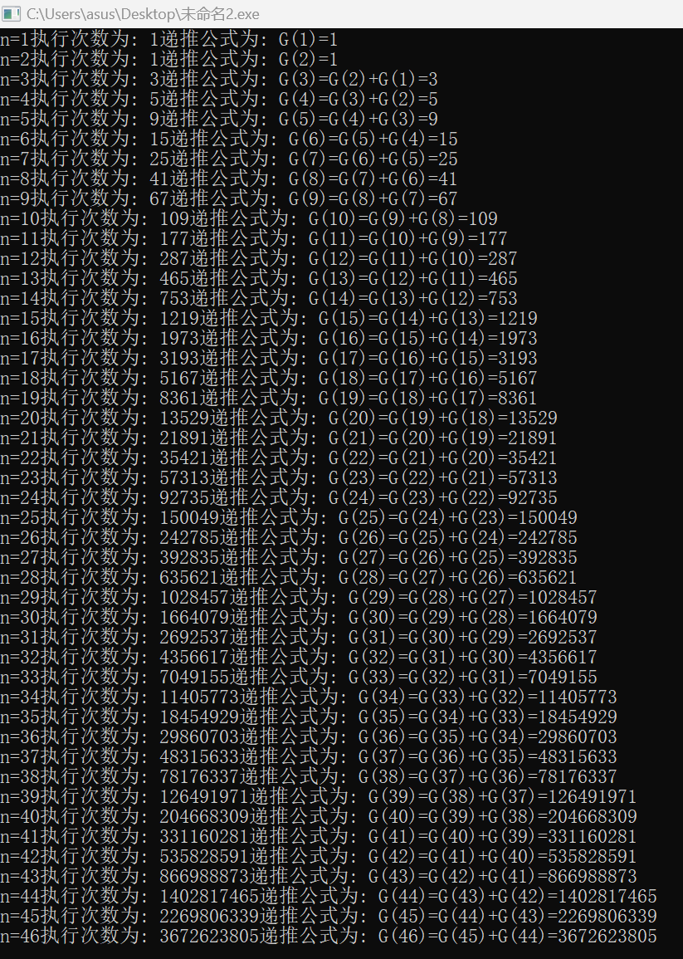
/*朱俊泽 2351114 信15*/ #include<bits/stdc++.h> using namespace std; #define int long long #define endl '\n' const int N = 50; int dp[N]; int rem[N]; int dfs(int x) { if(rem[x]!=-1)return rem[x]; if(x==1||x==2) { dp[x]=1; rem[x]=1; return 1; } else { dp[x]=dfs(x-1)+dfs(x-2)+1; rem[x]=dp[x]; return dfs(x-1)+dfs(x-2)+1; } } signed main() { ios::sync_with_stdio(0),cin.tie(0),cout.tie(0); for(int i=1;i<=46;i++)rem[i]=-1;dfs(46); for(int i=1;i<=46;i++) { if(i==1||i==2) { cout<<"n="<<i<<"执行次数为: "<<dp[i]<<"递推公式为: "<<"G("<<i<<")="<<1<<endl; } else { cout<<"n="<<i<<"执行次数为: "<<dp[i]<<"递推公式为: "<<"G("<<i<<")=G("<<i-1<<")+G("<<i-2<<")+1="<<dp[i]<<endl; } } return 0; }
递归方式，记忆化减少计算

