Slide 1
Multi-Agent Health News System (CrewAI)
AI Engineer Assessment – GOQii
By: Tushar Jadhav

Slide 2
Problem Statement
Health news is scattered across multiple sources.
→ Manual monitoring is inefficient.
→ Actionable health alerts often go unnoticed.
Goal: Automate health news monitoring, summarization, and classification.

Slide 3
Proposed Solution
We designed a Multi-Agent Health News Monitoring System where each agent has a specialized role:
Data Miner Agent → Collects health-related articles from trusted RSS feeds.
Medical Summarizer Agent → Uses LLM to produce concise medical summaries.
Decision Maker Agent → Classifies outputs into Actionable Advice or Informative.
Orchestrator → Coordinates the workflow ensuring smooth execution.
Why CrewAI?
Structured multi-agent orchestration.
Collaboration-focused, modular, scalable.
Clear role separation fits our 3-agent design.

Slide 4
Why Groq LLM?
Fast, stable inference (~1s per call).
Cost-effective vs GPT/Claude APIs.
Optimized for batch summarization and classification.

Slide 5
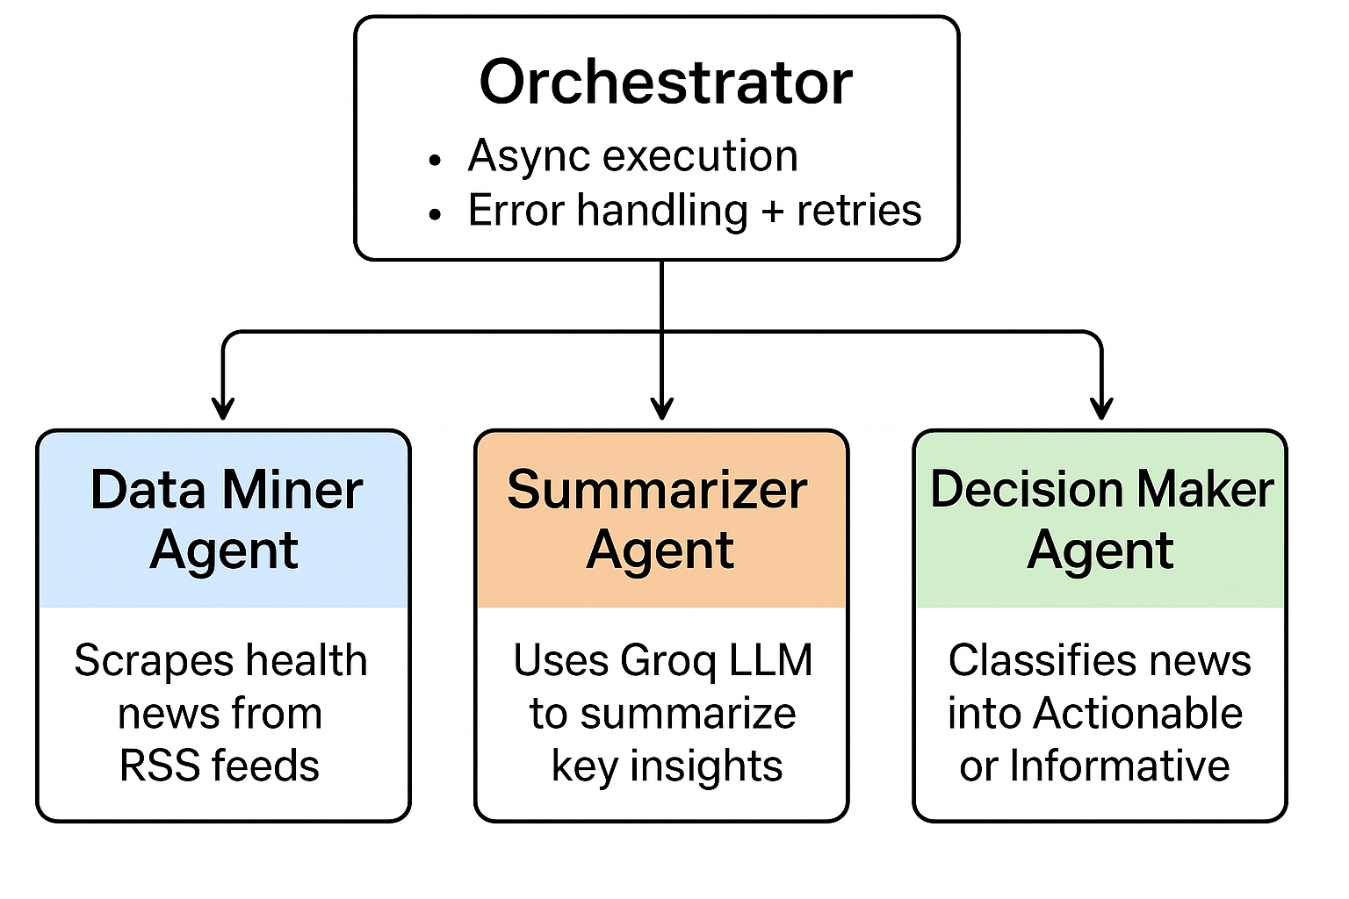
System Architecture

Slide 6
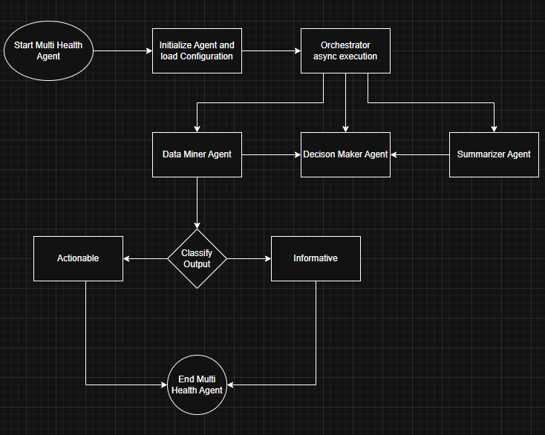
Flowchart

Slide 7
Tech Stack
- CrewAI → Multi-agent orchestration
- LangChain + Groq LLM (Gemma2-9b-it) → Summarization & Classification
- Feedparser → Fetching RSS feeds
- Python (3.10+)
- dotenv → Secure API Key Management

Slide 8
Workflow
1. Data Miner fetches latest news.
2. Summarizer generates concise summaries.
3. Decision Maker classifies into Actionable / Informative.
4. Orchestrator ensures async + error handling.
5. Results stored in JSON for further use.

Slide 9
Performance & Cost Insights
- Data Mining: <1s per feed
- Summarization: ~1.2s per article
- Classification: ~0.8s per summary
Scaling:
- Easily extendable to multiple feeds & domains
Cost:
- Groq inference cheaper than GPT-4
- Rule-based fallback saves API costs

Slide 10
Conclusion
✔ Automated health news monitoring system.
✔ CrewAI multi-agent orchestration.
✔ Async + error handling for reliability.
✔ Cost-efficient + scalable.
✅ Ready for production deployment.

