Slide 1

MID-SEM REVIEW: Engineering Design & Innovation
Vishwakarma Institute of Technology, Pune (Department of Artificial Intelligence & Data Science)
GROUP_NO-13 | CLASS – TY_C | COURSE – BTech Artificial Intelligence & Data Science
PROJECT TITLE:
AgriPilot – AI-Powered Multilingual Crop Health & Farm Advisory System
Machine Learning / Artificial Intelligence & Data Science Project
Name | Roll No | PRN
Tushar Jadhav | 01 | 12410740
Varad Jadhav | 02 | 12411400
Sahil Jagtap | 07 | 12412334
Shivaji Jamadar | 14 | 12411011
Academic Year 2025–2026 · Faculty of Technology, Vishwakarma Institute of Technology, Pune
Notes:
Respected evaluators, good morning. We are Group 13 from TY_C, presenting our Engineering Design & Innovation mid-semester review on our project titled 'AgriPilot – AI-Powered Multilingual Crop Health & Farm Advisory System'.
Our team consists of Tushar Jadhav, Varad Jadhav, Sahil Jagtap, and Shivaji Jamadar. In this presentation, we will demonstrate our machine learning pipelines for crop recommendation and leaf disease detection, explain our Grad-CAM interpretability integration, present our authentic mid-sem evaluation results, and share our roadmap for the final semester.

Slide 2
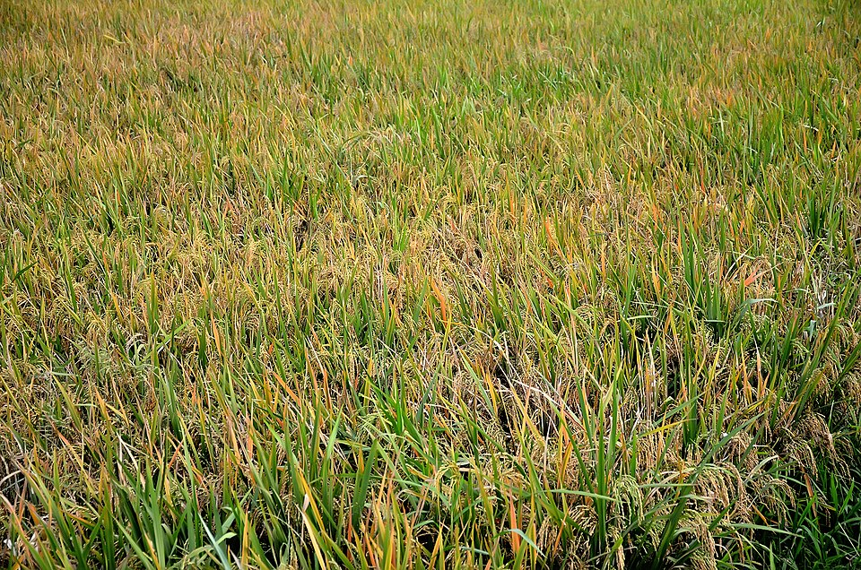
PROBLEM CONTEXT
Problem Statement
• Crop Selection Dependency: Crop selection depends heavily on multi-variable soil parameters (N, P, K, pH) and localized environmental conditions (temperature, humidity, rainfall).
• Interpretation Bottleneck: Farmers often cannot easily interpret laboratory soil chemical reports or translate soil test measurements into the most suitable crop.
• Disease Identification Difficulty: Crop diseases are difficult to diagnose accurately from leaf visual appearance alone, leading to improper or delayed chemical treatment.
• Farm History Isolation: Prediction results and farm history should remain persistently associated with the farmer's own farm profile rather than isolated one-time queries.
• Regional Linguistic Barrier: Agricultural advisory information must be accessible in regional languages (English, Hindi, Marathi) so that local farming communities can benefit directly.
• Integrated ML Decision Support: A machine-learning based decision-support system can combine tabular soil modeling, vision-based pathology detection, and farm history tracking.
Fig 1: Real-world agricultural field conditions in Maharashtra requiring data-backed crop and health advisory.
Problem Statement Summary:
"To develop and evaluate an integrated ML-powered decision-support system that recommends optimal crops from soil and weather parameters, classifies crop leaf diseases with visual Grad-CAM interpretability, and maintains isolated, multilingual farm records."
Notes:
Here we articulate the practical problem. In Indian agriculture, smallholder farmers often make cropping decisions based on habit or intuition because interpreting chemical soil reports is difficult. When foliar diseases appear, plant pathologists are rarely available immediately. Additionally, generic online advice fails because it is predominantly in English and doesn't preserve the farmer's past seasonal history. Our project addresses these interconnected challenges using a unified ML decision-support application.

Slide 3
PROJECT SCOPE
Project Objectives
MACHINE LEARNING OBJECTIVES
1. Crop Recommendation: Train and evaluate supervised classification models using 7 soil and environmental features (N, P, K, Temperature, Humidity, Soil pH, Rainfall).
2. Crop Disease Classification: Develop a deep convolutional image classification pipeline (MobileNetV2) to identify pathologies from crop leaf photographs.
3. Model Comparison & Benchmarking: Benchmark multiple algorithms (Decision Tree, Random Forest, Gradient Boosting) on held-out evaluation splits and log training/inference latency.
4. Grad-CAM Explainability: Formulate Gradient-weighted Class Activation Mapping to visually highlight image regions that contribute to the disease prediction.
APPLICATION OBJECTIVES
1. Farmer-Specific Profiles: Implement secure authentication and isolated farm profile storage (area, location, soil type, irrigation system).
2. Prediction & Scan History: Maintain persistent SQLite database records of past crop recommendations and leaf disease scans for each authenticated farmer.
3. Multilingual Interface: Provide native interface support in English, Hindi (हिंदी), and Marathi (मराठी) to bridge rural literacy barriers.
4. Farm Advisory Assistant: Provide actionable, farmer-friendly agricultural recommendations using weather context without fabricating missing soil data.
5. Analyst Analytics Dashboard: Provide a dedicated analyst dashboard for monitoring project-level data aggregates and inspecting saved model evaluation artifacts.
Core Design Principle: Machine learning models provide the analytical intelligence, while the web application provides access, isolation, and interpretability.
Notes:
We have divided our objectives into machine learning objectives and application objectives. On the ML side, we focus on training, evaluating, and explaining our crop recommendation and disease detection models using Grad-CAM. On the application side, we ensure each farmer only sees their own private history in their preferred language—English, Hindi, or Marathi—and give analysts a portal to audit saved model artifacts.

Slide 4
SYSTEM DESIGN
System Architecture
FARMER PIPELINE: Authentication → Profile Setup → Dual ML Inference
ANALYST BRANCH
FARMER → LOGIN / REGISTRATION → FARM PROFILE (Soil Type, Area, Location)
ANALYST
↓
ANALYST LOGIN
↓
ANALYST DASHBOARD
↓
DATABASE AGGREGATES
+
SAVED ML EVALUATION ARTIFACTS
(Inspects crop_model_comparison.json, disease_model_metrics.json, and system-wide metrics)
CROP RECOMMENDATION
↓
TABULAR ML MODEL
(Random Forest / Boosting)
↓
CROP PREDICTION
LEAF SCANNER
↓
IMAGE CLASSIFIER (MobileNetV2)
↓
DISEASE PREDICTION → GRAD-CAM
SQLITE DATABASE (Isolated by user_id) → FARM HISTORY & MULTILINGUAL ADVISORY
Key Architectural Properties:
• Decoupled ML Inference: Models run from pre-trained serialized bundles (.joblib / .keras), avoiding retraining latency during HTTP requests.
• Data Security: Foreign key enforcement ensures each farmer only accesses their own farm profile and prediction records.
Notes:
This diagram outlines our system architecture. A farmer registers, sets up their farm profile, and can choose either crop recommendation or the leaf scanner. The crop model processes tabular features, while the disease model classifies the leaf image and generates a Grad-CAM heatmap. All results are saved to SQLite under that farmer's ID. On the right, analysts have a separate login where they inspect project-level statistics and saved evaluation artifacts without interfering with farmer operations.

Slide 5
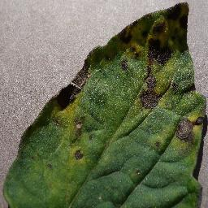
DATA ENGINEERING
Dataset & ML Features
SECTION 1: CROP RECOMMENDATION
Input Features (7 Continuous Variables):
• Nitrogen (N) – Ratio in soil (kg/ha)
• Phosphorus (P) – Ratio in soil (kg/ha)
• Potassium (K) – Ratio in soil (kg/ha)
• Temperature – Ambient temperature in °C
• Humidity – Relative humidity in %
• Soil pH – Soil acidity level (0 to 14 scale)
• Rainfall – Precipitation depth in mm
Target Variable: Recommended Crop (22 Classes: Rice, Maize, Chickpea, Cotton, Coffee, Grapes, Mango, etc.)
SECTION 2: DISEASE CLASSIFICATION
• Modality: RGB leaf photographs standardized to 224 × 224 × 3 pixels.
• Crop & Disease Classes: 11 classes across 3 crops:
• Grape: Black rot, Esca (Black Measles), Leaf blight, Healthy
• Potato: Early blight, Late blight, Healthy
• Tomato: Bacterial spot, Early blight, Late blight, Healthy
• Preprocessing: Image normalization [0, 1], channel alignment, bilinear resizing.
• Training & Evaluation Split: Training data (80%) and held-out evaluation data (20%). Model coverage strictly determines supported diagnosis classes.
DATASET PIPELINE FLOW
DATASET → PREPROCESSING → TRAIN / TEST SPLIT → MODEL TRAINING → EVALUATION → SAVED MODEL
Note: Dataset coverage defines the system boundary; unsupported crops or diseases are outside the current mid-semester model scope.
Notes:
Here we describe our datasets and features. For crop recommendation, we use seven soil and environmental inputs: Nitrogen, Phosphorus, Potassium, Temperature, Humidity, Soil pH, and Rainfall to predict the crop. For disease classification, we use 224x224 leaf images across eleven classes in Grape, Potato, and Tomato. We emphasize that our model's disease detection is bounded by these classes, and expanding coverage is planned for end-sem.

Slide 6

METHODOLOGY
Machine Learning Methodology
CROP RECOMMENDATION
Input Features [N, P, K, Temp, Humidity, pH, Rainfall]
↓
Feature Preprocessing & Range Validation
↓
Model Exploration & Benchmarking:
• Decision Tree (Baseline tree splitting)
• Random Forest (100 ensemble bagged trees)
• Gradient Boosting (Sequential error minimization)
↓
Model Evaluation (Stratified Split on Held-Out Test)
↓
Crop Prediction & Probability Ranking
• Model Comparison: Compared on accuracy, macro F1, and latency.
• Confusion Matrix: Checked per-class misclassification patterns.
• Feature Importance: Humidity and rainfall showed highest gain.
• Saved Artifacts: Scaler and model serialized in .joblib bundle.
DISEASE CLASSIFICATION & GRAD-CAM
Leaf Image (RGB Photo)
↓
Image Preprocessing (224 × 224 Resizing & [0, 1] Rescaling)
↓
Convolutional Backbone (MobileNetV2 Transfer Learning)
↓
Dense Head + Softmax (11 Crop-Disease Classes)
↓
Disease Prediction + Grad-CAM Visual Heatmap
Grad-CAM Explainability:
"Grad-CAM highlights image regions that contribute to the predicted disease class, verifying that the model focuses on actual leaf lesions rather than background noise."
Actual Output:
Left: Input Leaf
Right: Grad-CAM
Notes:
This slide covers our ML methodology. On the left, we preprocess the tabular features and benchmark Decision Tree, Random Forest, and Gradient Boosting. We save the trained model so the web application uses pre-computed weights instead of retraining on every request. On the right, our image pipeline uses MobileNetV2 for disease prediction. Importantly, we pass the gradients back to the final convolutional layer to generate a Grad-CAM heatmap, which shows exactly which spots on the leaf caused the disease detection.

Slide 7
EXPERIMENTAL RESULTS
Current ML Results
1. Crop Disease Classification Results (MobileNetV2, Held-Out Test Set)
58 / 66
Correct Predictions
Held-out test images
87.88%
Accuracy
Overall classification accuracy
87.97%
Macro F1-Score
Balanced across 11 classes
Note: Evaluation is based on the current held-out test set and does not guarantee the same performance on arbitrary field photographs.
2. Crop Recommendation Model Comparison (Saved Evaluation Artifacts, N = 440 Held-Out Samples)
Model Evaluated | Accuracy | Macro F1 | Train Time | Inference | Top Feature | Artifact Stored
Decision Tree | 97.95% | 97.94% | 0.010 s | 0.0008 s | Rainfall (30.4%) | decision_tree.joblib
Random Forest (Selected) | 99.55% | 99.55% | 0.223 s | 0.1052 s | Humidity (22.8%) | random_forest.joblib
Gradient Boosting | 99.09% | 99.09% | 11.069 s | 0.0183 s | Humidity (24.1%) | gradient_boosting.joblib
Evaluation Summary: All metrics are derived from saved project evaluation artifacts (crop_model_comparison.json & disease_model_metrics.json). Random Forest selected for production deployment.
Notes:
Here are our actual evaluation results. For disease classification, MobileNetV2 achieved 58 correct predictions out of 66 held-out test images, giving 87.88% accuracy and 87.97% macro F1. We emphasize that this is evaluated on a held-out test split, not guaranteed on arbitrary outdoor photos. For crop recommendation, Random Forest achieved 99.55% accuracy and F1 score, outperforming Decision Tree and Gradient Boosting while maintaining low latency. All values shown are from our actual saved project artifacts.

Slide 8
APPLICATION WORKFLOW
Farmer Workflow
NEW FARMER INTERACTION FLOW
Register Account (Username, Password, Preferred Language)
↓
Set Up Farm Profile
↓
Enter Farm Details (Location, District, Area, Soil Type, Irrigation)
↓
Choose Action: Crop Recommendation OR Leaf Scanner
↓
Receive ML Prediction & Actionable Advisory
↓
Save Result into Farm History
RETURNING FARMER WORKFLOW
Login with Authenticated Credentials
↓
Load Existing Farm Profile (Persisted in SQLite Database)
↓
Review Previous Prediction History & Seasonal Health Log
↓
Generate New Crop Recommendation OR Perform New Scan
↓
Automatic Association of New Predictions with Farm History
Multilingual Support: English | Hindi (हिंदी) | Marathi (मराठी)
• Account-Bound Farm Records: "Farm data and prediction history are linked to the authenticated farmer account."
• Ethical Data Entry: If soil laboratory measurements are not known, the system does not fabricate synthetic N-P-K numbers; it guides the farmer transparently.
Notes:
Here we show the farmer workflow. A new farmer registers, selects their language—English, Hindi, or Marathi—and configures their farm details. A returning farmer logs in directly and sees their existing farm records. A key design principle is that all prediction history is strictly linked to that authenticated farmer. Furthermore, we never invent soil values if a farmer doesn't know them; we provide transparent advice instead of guessing chemical numbers.

Slide 9
CRITICAL APPRAISAL
Current Limitations
Current Development Constraints (Identified During Mid-Semester Evaluation)
1. Disease Model Taxonomy Scope
The disease classifier is bounded by the 11 classes present in the training dataset (across Grape, Potato, and Tomato). Diseases outside this scope or in other regional crops cannot be diagnosed at this stage.
2. Controlled Benchmark vs. Field Photography
The 87.88% test accuracy was achieved on a held-out benchmark split. Real-world farm images introduce shadows, direct solar glare, background weeds, dirt residues, and camera blur which affect prediction confidence.
3. Out-of-Distribution (OOD) Image Gating
The system currently lacks a robust novelty detection layer. Uploading non-leaf images forces a classification within the 11 classes rather than triggering a graceful rejection.
4. Soil Data Availability Gap
Accurate crop recommendation requires N, P, K, and pH values, which may not be available for smallholder farmers who have not had their soil tested in a laboratory.
5. Absence of Automated Soil Card OCR
Automatic optical character recognition (OCR) from photographed physical Soil Health Cards is not fully implemented yet, requiring manual data entry.
6. Requirement for Real-World Field Validation
Agricultural advisories require structured agronomic validation across diverse agro-ecological zones before being used for large-scale field decisions.
These constraints represent deliberate engineering focus areas identified at mid-sem, forming the basis of our end-semester roadmap.
Notes:
As an honest mid-semester evaluation, we highlight our current developmental constraints. First, our disease model is restricted to eleven classes across three crops. Second, benchmark performance does not automatically guarantee field performance under direct sun or blur. Third, uploading a non-leaf photo currently forces a prediction rather than throwing a clean error. Fourth, farmers without soil reports must enter values manually. These points define our concrete engineering agenda for the final semester.

Slide 10
ROADMAP
Future Work & End-Sem Plan
PLANNED TECHNICAL IMPROVEMENTS (1 – 5)
1. Disease Model Robustness: Train with synthetic augmentations (motion blur, contrast jitter, shadow effects) to mimic field conditions.
2. Real-World Field Images: Incorporate diverse in-field photographs taken in varied sunlight and crop growth stages.
3. Unknown-Image Detection: Implement an out-of-distribution (OOD) filter to reject non-leaf or irrelevant images safely.
4. Unsupported-Crop Handling: Add an upfront crop-type verifier to warn farmers when an unrepresented plant species is uploaded.
5. Soil-Report OCR Pipeline: Integrate an optical character recognition module to read printed Soil Health Cards automatically.
PLANNED APPLICATION IMPROVEMENTS (6 – 10)
6. Agricultural Knowledge Base: Expand the advisory rule base to cover regional crop calendars and state agricultural university guides.
7. Multilingual Assistant Enhancement: Improve conversational natural language responses in Marathi and Hindi.
8. Farmer-Friendly Input Collection: Simplify the web input workflow with regional soil type presets when exact N-P-K is missing.
9. Real-World Field Usability Testing: Conduct usability trials with local farming samples in Maharashtra to assess latency and clarity.
10. Mid vs. End-Sem ML Benchmark: Conduct rigorous comparative evaluation showing quantitative performance improvements at final submission.
MID-SEM STATUS:
"Core ML pipeline and application integration implemented; further validation, robustness and usability improvements are planned for the end-semester version."
Thank You! · Questions & Discussion · Group 13 (TY_C) · VIT Pune
Notes:
To conclude, our roadmap outlines ten specific improvements for the final semester. These include adding field image augmentations, unknown-image detection, soil-report OCR, an expanded regional knowledge base, and testing with local farmers in Maharashtra. In summary, our core ML pipelines and application integration are working today, with a clear engineering path toward end-sem completion. Thank you, and we welcome your questions and feedback.

