Slide 1
Careersource GC Board and Center Email setup
For use with iPhone, Ipad, and select ipods

Slide 2
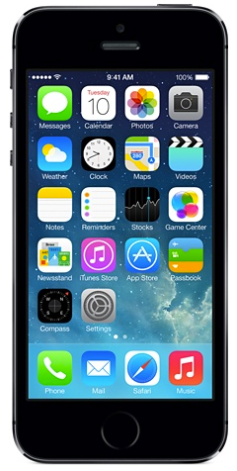
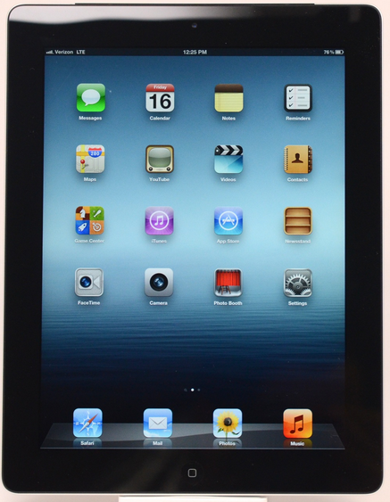
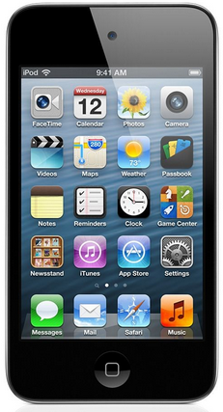
Introduction
This step by step method is for iPhone, iPad, and select iPods only. Other devices are capable, but require different information.

Slide 3
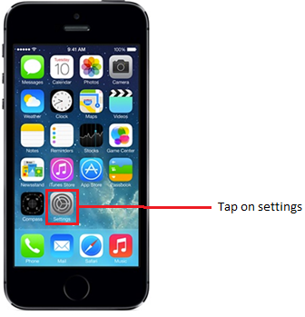
Step 1
With your device powered on, look at your home screen and tap on the Settings icon as shown above.

Slide 4
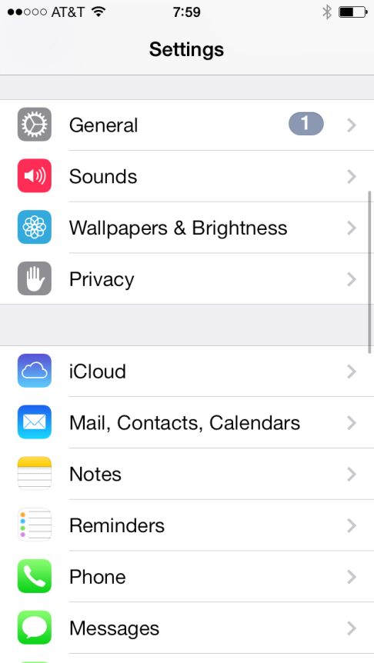
Step 2
On this screen you will want to tap on the Mail, Contacts, Calendars menu.

Slide 5
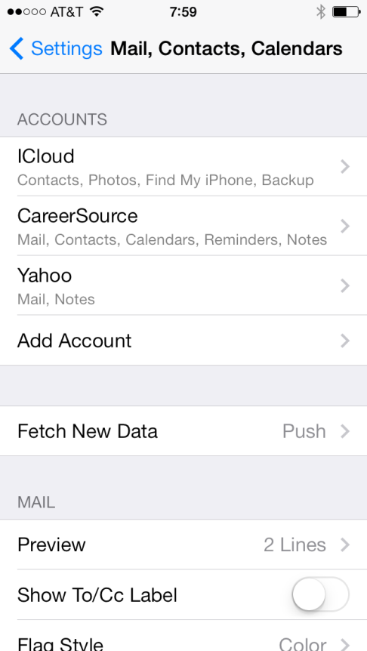

Step 3
From here you will see your existing email accounts and the option to add an account. There are also options to set up different options related to email that you can set up later such as your signature. For now, just click on the Add Account menu.

Slide 6
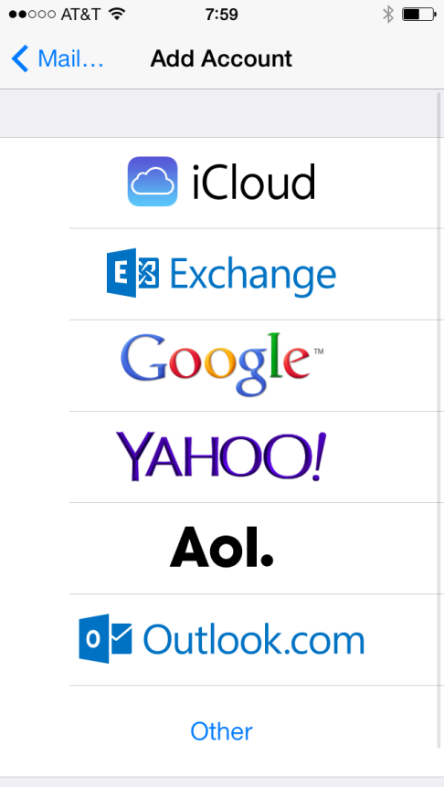
Step 4
Tap on the Exchange menu.

Slide 7
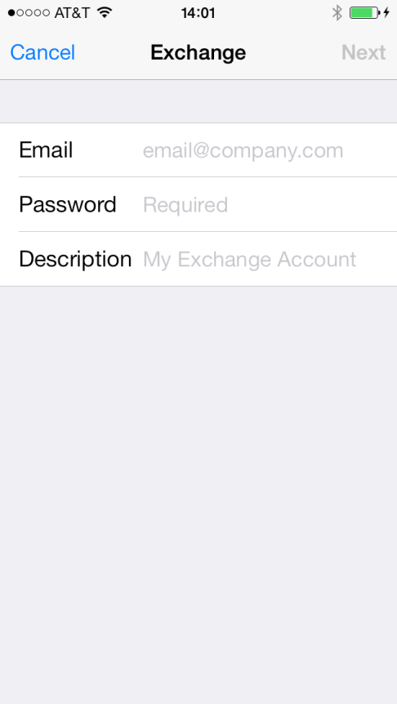
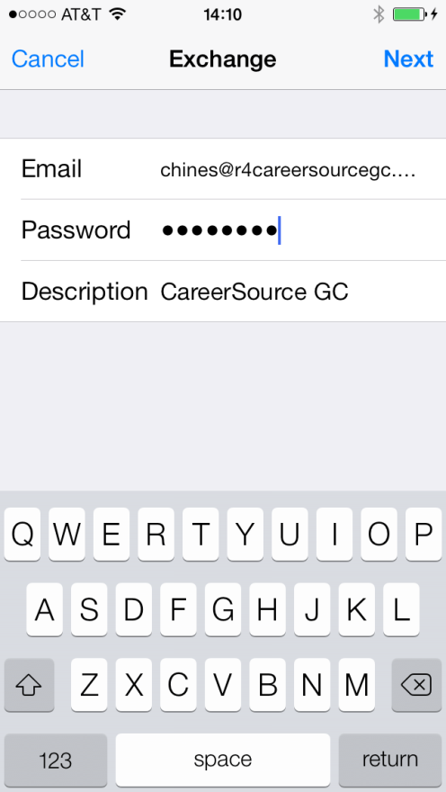
Step 5a BOARD ONLY
Here’s where the bulk of the information goes, and the information varies depending on what your email account is. This slide is for Board employees. If you are a Center employee, then please skip to slide 10.
Enter your Board email address, password, and description (This is the name of the account) and then tap Next.

Slide 8
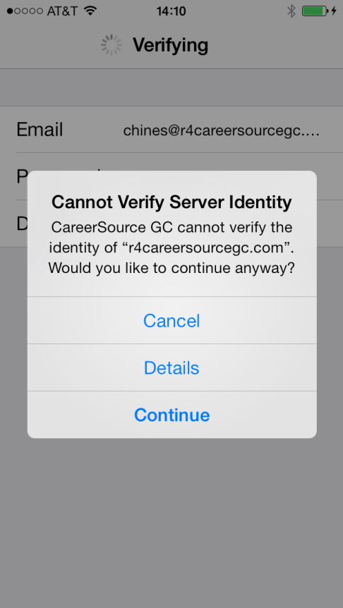
Step 5B BOARD ONLY
You may get an error message similar to the screenshot above. Tap on Continue.

Slide 9
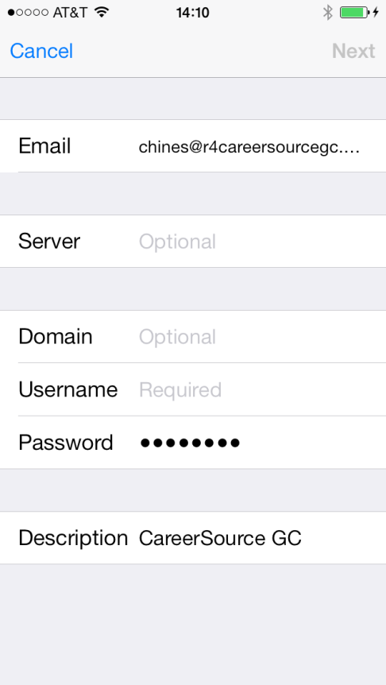
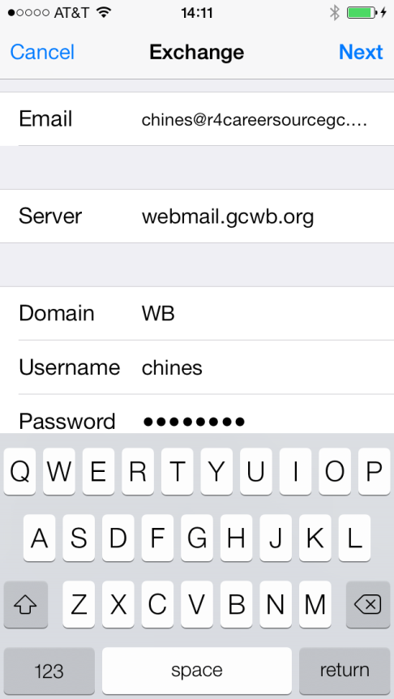
Step 5C BOARD ONLY
You will see that you are now being asked for additional information. Enter in the Server, Domain, and Username as shown in the example above and tap Next. Skip to slide 13, step 6, to configure the last options.

Slide 10
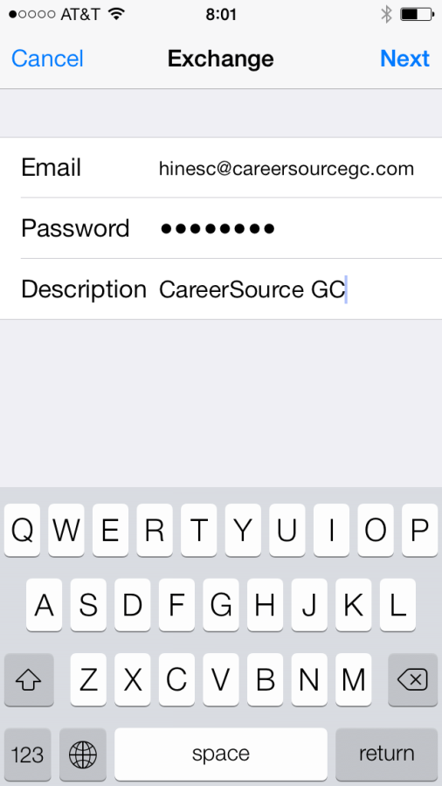
Step 5A – CENTER ONLY
Here’s where the bulk of the information goes, and the information varies depending on what your email account is. This slide is for Center employees. If you are a Board employee, then please skip to slide 13, step 6 to continue finishing your account setup.
Enter your Center email address, password, and description (This is the name of the account) and then tap Next.

Slide 11
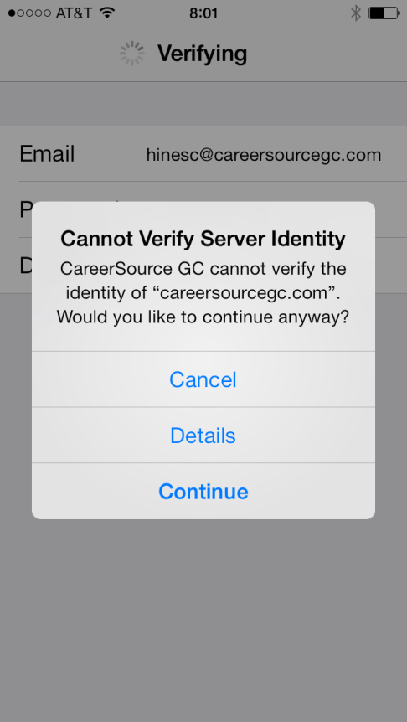
Step 5b – CENTER ONLY
You may get an error message similar to the screenshot above. Tap on Continue.

Slide 12
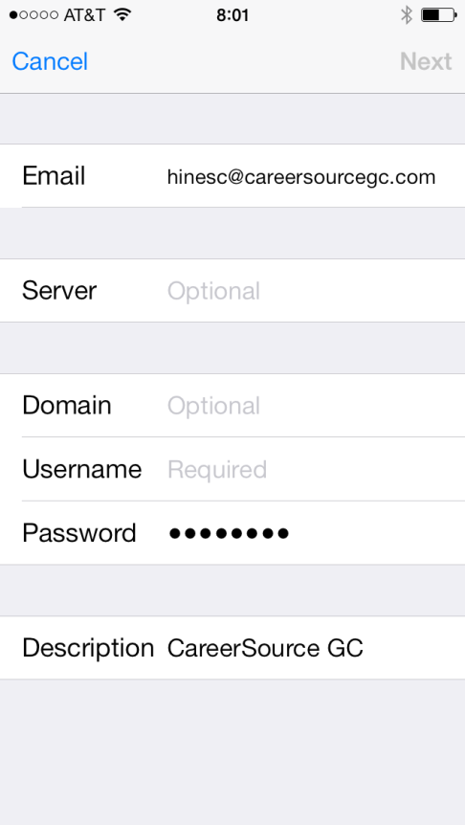
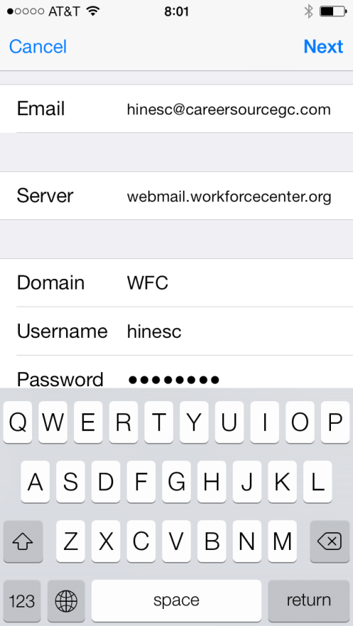
Step 5C – CENTER ONLY
You will see that you are now being asked for additional information. Enter in the Server, Domain, and Username as shown in the example above and tap Next.

Slide 13
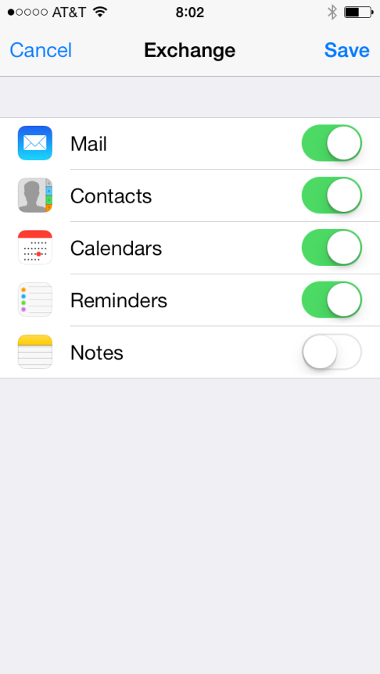
Step 6
If the settings were successful, then you should see a screen similar to the example above. These settings are used to turn on and off information related to your email account. For example, if you want to just get email and calendar information, then ensure that those switches are turned on and are green. Adjust the settings for what you want to view and click Save.

Slide 14

Finished
You should now be able to view your emails from the new account you have added. It may take a few minutes for emails to start coming in, so please be patient.

