Slide 1

Prepared by group Alpha
GomokuPRO
CSE 3117: Artificial Intelligence
Supervisor: Dr. Ahmedul Kabir
29 December, 2025

Slide 2

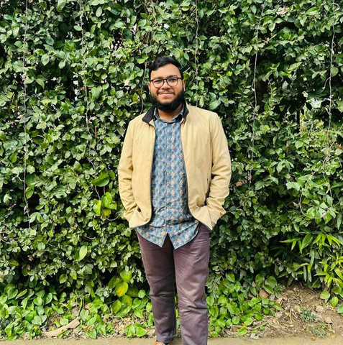
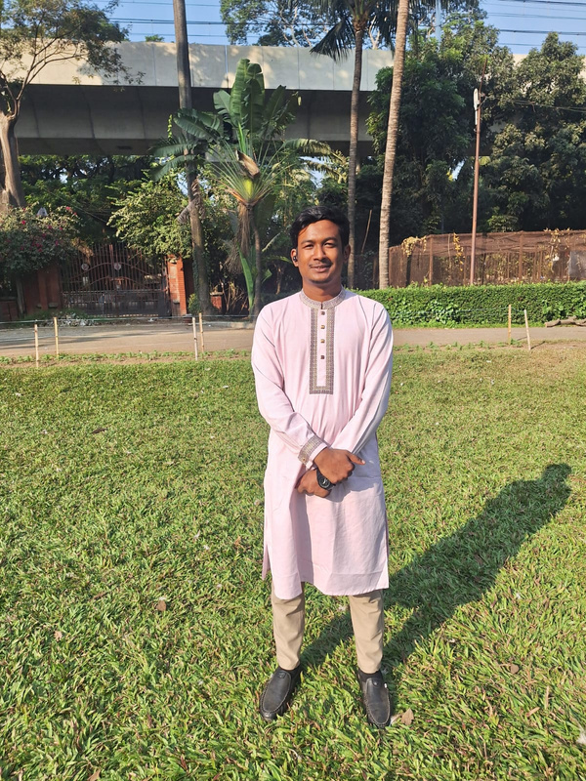
Team Members
Kazi Farhana Faruque
Md. Asad Al Mahmud
Tarek Jamil Adnan
(1506)
(1515)
(1520)

Slide 3
Introduction
  Web-based Gomoku game (Frontend + Backend)
  10×10 board, 5-in-a-row win condition
  Configurable AI opponent
  Persistent game results & statistics

Slide 4
Game AI Overview
  Minimax game tree search
  Depth-limited strategy
  Difficulty-based AI levels

Slide 5
  Moves generated near existing stones
  Heuristic-based ordering
  Only top-N promising moves explored
Move Generation & Ordering

Slide 6
Alpha-Beta Pruning
  Optimizes Minimax
  Cuts irrelevant branches
  Faster decision making

Slide 7
  Pattern-based scoring
  Open/closed sequences
  Positional & adjacency bias
Evaluation Function

Slide 8


Project Objectives
Frontend
Backend
  React + Vite
  Interactive board UI
  Settings, Scoreboard, Rules
  Node.js + Express
  MongoDB database
  REST APIs

Slide 9
  Correct gameplay
  AI efficiency
  UI responsiveness
  Data reliability
Evaluation Criteria

Slide 10
Conclusion
  Full-stack Gomoku game
  Intelligent AI opponent
  Expandable & scalable system

Slide 11
Thank you

