Slide 1
GCMD Keyword Checker Web API for ISO Metadata XML URLs
Java Spring Boot application
Thomas Jaensch
thomas.jaensch@noaa.gov
Fall 2018

Slide 2
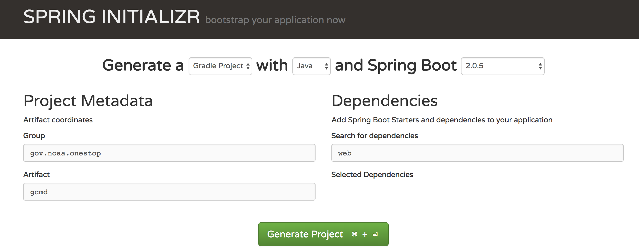
Overview
The API is written in Java utilizing the Spring Boot framework
Project structure derived from Spring Initializr https://start.spring.io/ using Gradle for dependency management
Web API that can be queried using HTTP requests by sending a URL for an ISO metadata file, returning JSON response data

Slide 3
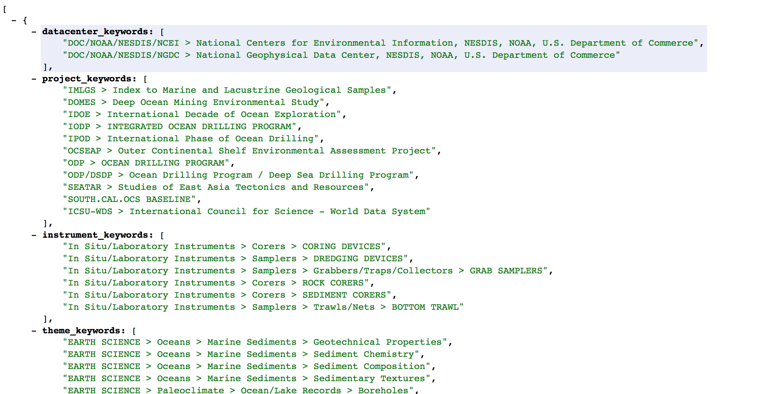
Sample Browser View

Slide 4
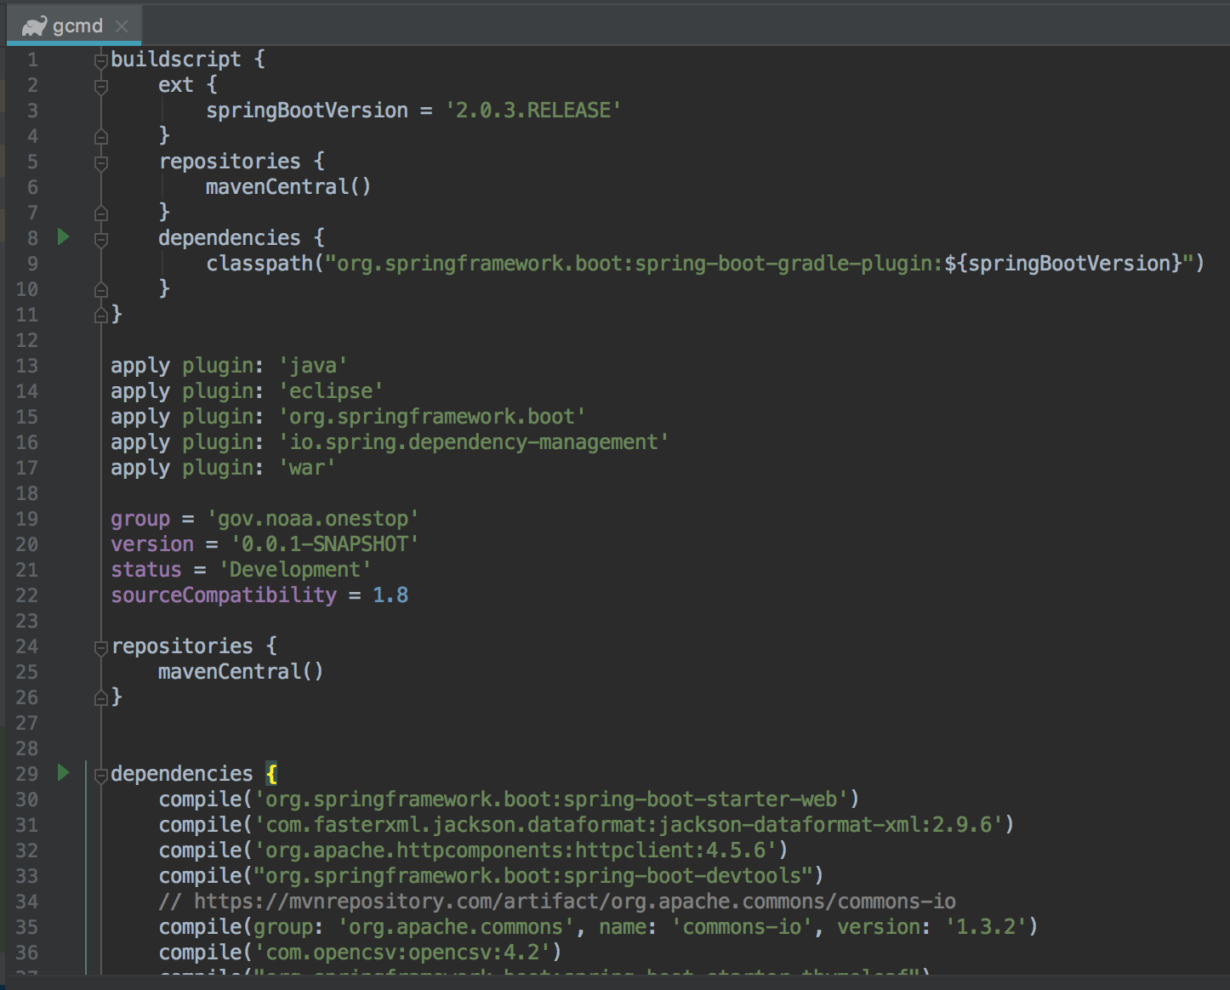
Gradle Dependency Management
build.gradle for managing dependencies

Slide 5
Project Structure
Project structure using Spring Boot smart default settings and configuration
Main folder for application logic, test folder for unit tests
Currently web and business but no data layer (no database, all data handling in memory)
GcmdController class to expose RESTful routes
GcmdService class for business logic

Slide 6
Deployment
Application can be bundled into one deployable .jar or .war file
Application can be run in a Docker container (see Dockerfile in project folder)
Bundled application jar/war file can be deployed on server or to cloud services like AWS
AWS test instance links:
http://gcmdtest-env.ej2s7tvq62.us-east-1.elasticbeanstalk.com/gcmd_keywords?url=https://data.nodc.noaa.gov/nodc/archive/metadata/approved/iso/GHRSST-EUR-L4HRfnd-GLOB-ODYSSEA.xml
http://gcmdtest-env.ej2s7tvq62.us-east-1.elasticbeanstalk.com/gcmd_keywords?url=https://data.nodc.noaa.gov/nodc/archive/metadata/approved/iso/GHRSST-EUR-L4HRfnd-GLOB-ODYSSEA.xml
http://gcmdtest-env.ej2s7tvq62.us-east-1.elasticbeanstalk.com/gcmd_keywords?url=https://www1.ncdc.noaa.gov/pub/data/metadata/published/geoportal/iso/xml/noaa-cave-23330.xml

Slide 7
Tasks
Integration with CoMET
Business logic could be broken up more to separate concerns better and achieve improved loose coupling and testability
More unit tests (currently only unit tests for business logic, no automated web layer tests yet)
Deployment in NCEI test environment

Slide 8
Resources
GitLab repo: https://git.ncei.noaa.gov/metadata/gcmd-springboot-api (instructions on how to run it in the README)

