Slide 1


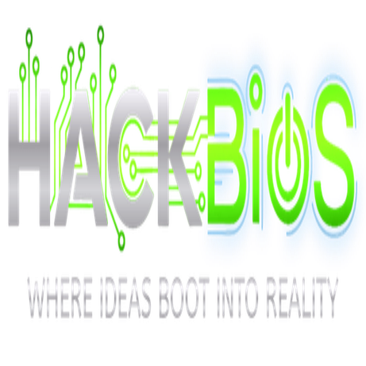

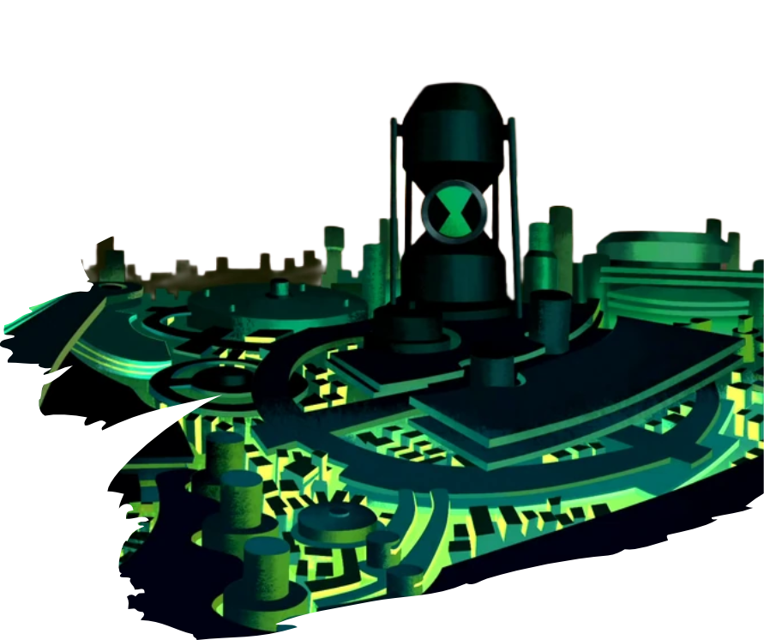

TECH
TITANS
TRINETRA-X
AI Border & Defence
Surveillance System
PROBLEM STATEMENT THEME
Software
PROBLEM STATEMENT TITLE
AI Border & Defence Surveillance System
TEAM MEMBERS
Ankur Kumar Pandey Chavi Lal Chohan
Mohammad Danishuddin Praveen Yadav
1

Slide 2

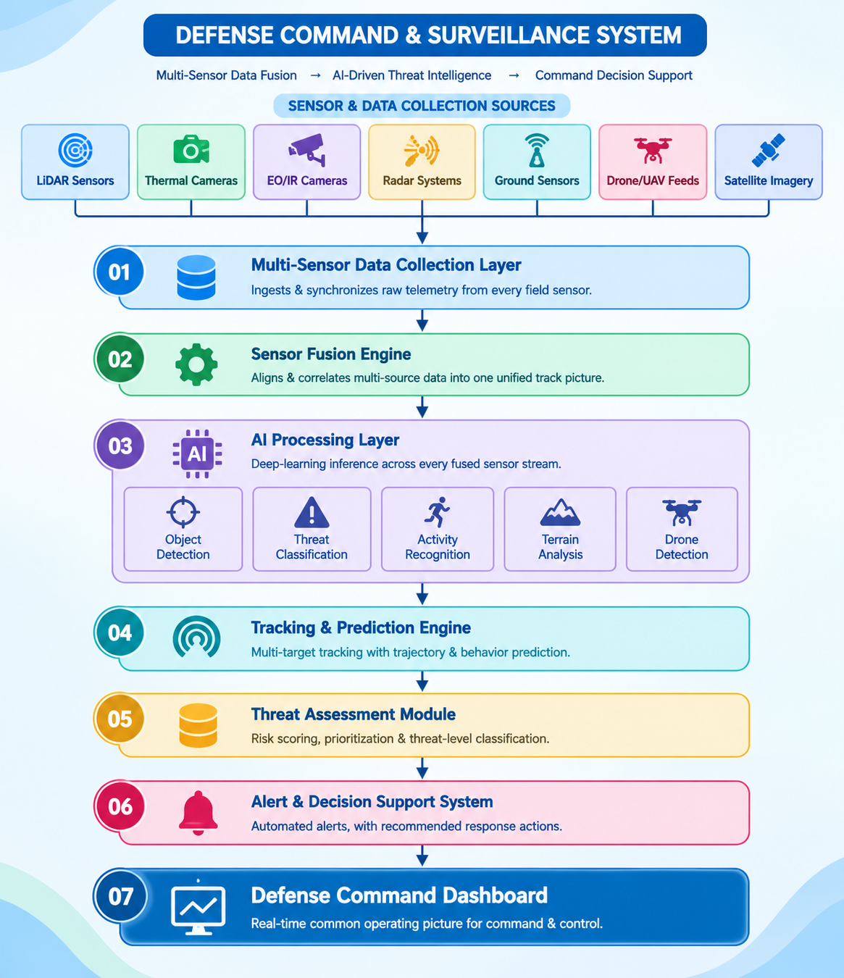
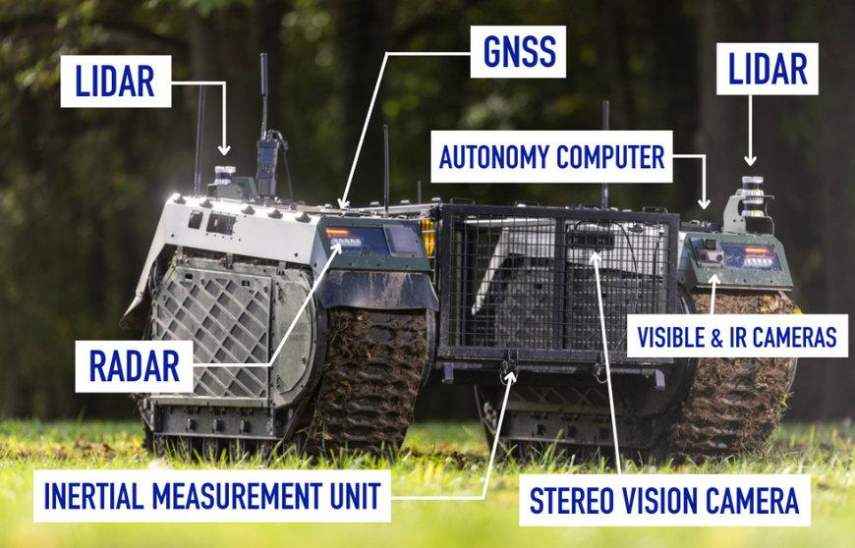
TECH
TITANS
PROPOSED SOLUTION
THE CHALLENGE
OUR SOLUTION
▸ LiDAR 3D perception + semantic segmentation for real-time scene understanding
▸ Adaptive 2.5D terrain maps: paths, obstacles, slopes, restricted zones
▸ Detects, classifies & tracks humans, vehicles and suspicious objects
▸ Risk-aware analysis assigns threat levels and flags high-risk zones
▸ Predicts threat movement and recommends safer routes
▸ Command dashboard for real-time situational awareness
▸ Works across borders, forests, mountains, deserts & disaster zones
Vast, difficult terrain
Surveillance blind spots
Night & low visibility
Too many false alarms
Many sensors, no fusion
Huge data volumes
Delayed threat awareness
No real-time picture
INNOVATION & UNIQUENESS
✓ Mission-aware adaptive intelligence
✓ Risk-aware semantic segmentation
✓ AI threat prediction & safe path planning
✓ Explainable AI threat assessment
✓ Prioritised alerts, one unified dashboard
2

Slide 3
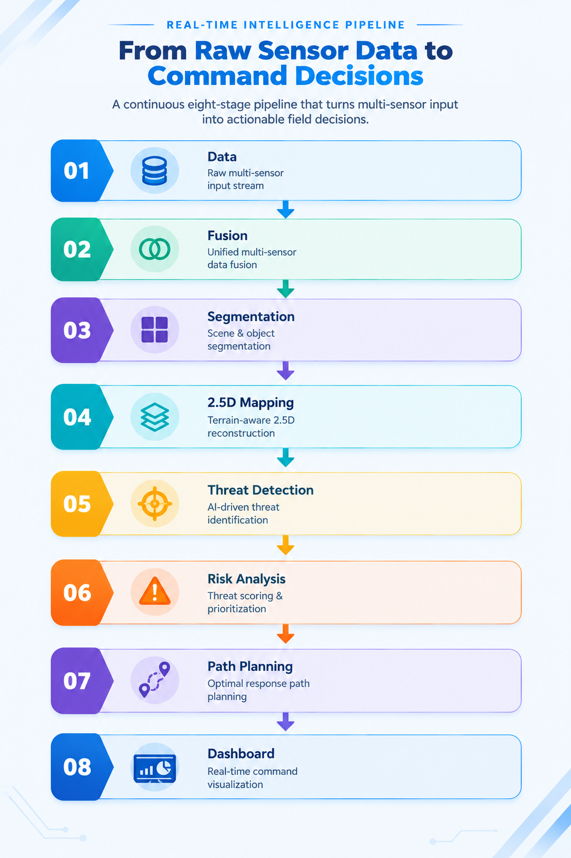
TECH
TITANS
TECHNICAL APPROACH
PROCESS OF IMPLEMENTATION
01
Dataset collection (LiDAR & images)
06
Threat detection & classification
02
Preprocessing & noise removal
07
Risk assessment & threat prediction
03
LiDAR–image data fusion
08
Safe path planning & navigation
04
Semantic segmentation & terrain understanding
09
Real-time dashboard & alerts
05
Adaptive 2.5D map generation
10
Decision support & mission intelligence
TECH STACK
AI / ML
PyTorch
OpenCV
Scikit-learn
NumPy · Pandas
LiDAR & Point Cloud
Open3D
PointNet++
DBSCAN
RANSAC
Segmentation
DeepLabV3+
U-Net
SPVCNN
Mapping & Nav
Adaptive 2.5D map
A* · Dijkstra
Occupancy grid
Backend
Python
FastAPI
Frontend
React.js
Tailwind CSS
Chart.js
Leaflet.js
Database
PostgreSQL
MongoDB
3

Slide 4
TECH
TITANS
FEASIBILITY AND VIABILITY
WHY IT IS FEASIBLE
✓ Built on proven tech: AI, LiDAR, thermal imaging, radar & IoT
✓ Prototype possible with affordable sensors and edge-computing devices
✓ Modular design scales from one outpost to an entire border
✓ Open-source AI stack keeps software costs low
CHALLENGES & RISKS
HOW WE OVERCOME THEM
High hardware cost
➜
Cost-effective modular hardware
Harsh weather conditions
➜
Multi-sensor fusion (LiDAR + thermal + radar)
False alarms
➜
Continuous AI model training & fusion
Limited connectivity
➜
Edge AI processing on-site
Power requirements
➜
Backup power & communication systems
Huge real-time data
➜
Edge filtering; send only alerts to command
4

Slide 5
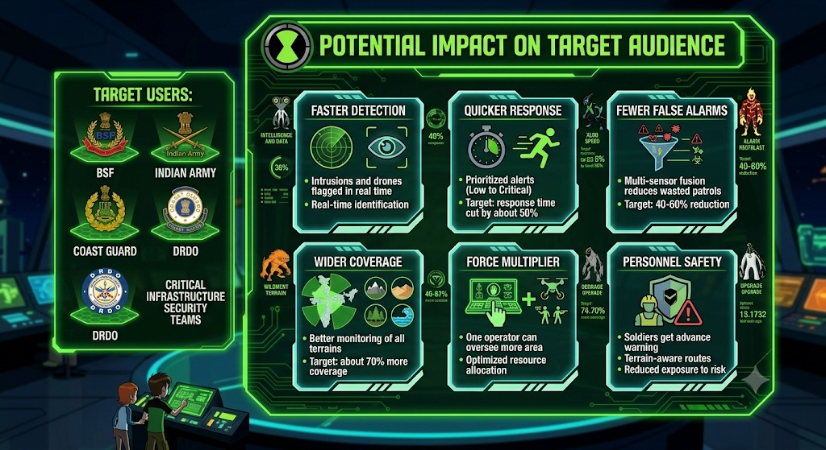
TECH
TITANS
IMPACT AND BENEFITS
SOCIAL
▸ Safer borders & public
▸ Less risk to personnel
▸ Faster disaster rescue
▸ Critical sites protected
ECONOMIC
▸ Lower surveillance cost
▸ Smarter use of resources
▸ Software-first deployment
▸ Less manpower needed
SECURITY
▸ Real-time threat detection
▸ Faster response
▸ Stronger border watch
▸ Full situational awareness
OPERATIONAL
▸ Intelligent decision support
▸ Automated threat analysis
▸ Safe route planning
▸ Higher mission success
TECHNOLOGICAL
AI threat intelligence · Adaptive 2.5D mapping · Risk-aware scene understanding · Threat prediction
5

Slide 6
TECH
TITANS
RESEARCH AND REFERENCES
RESEARCH WORK
▸ LiDAR-based 3D perception for sensing and obstacle detection
▸ Semantic segmentation of terrain, obstacles, vehicles & humans
▸ Adaptive 2.5D mapping for terrain representation & navigation
▸ Real-time threat detection & classification models
▸ Risk assessment & predictive intelligence for threat priority
▸ Path planning & autonomous navigation algorithms
▸ Existing UGV & defence surveillance systems: gaps & opportunities
▸ Situational awareness & decision-support systems
REFERENCES & LINKS
[1] KITTI Vision Benchmark Suite
Autonomous-driving LiDAR & camera dataset
[2] SemanticKITTI
Point-wise labelled LiDAR scans
[3] PointNet++ (Qi et al., NeurIPS 2017)
Point-cloud feature learning & 3D segmentation
[4] DeepLabV3+ (Chen et al., ECCV 2018)
Image semantic segmentation
[5] Open3D Documentation
3D data processing library
[6] Open3D-PointNet++ (GitHub)
Real-time LiDAR semantic segmentation
[7] Open3D: Point-cloud segmentation blog
Segmentation on KITTI & Semantic3D
6

