Slide 1
Physics-Guided Machine Learning
Predicting Energy for Micro Gas Turbines

Slide 2
Why is this hard?
• Thermodynamic models are incredibly accurate, but getting the internal sensor data to run them is practically impossible in commercial setups.
• Throwing a standard LSTM at the problem backfires. Without a massive dataset, the network just makes things up.
• The result? Impossible power spikes and erratic predictions that completely ignore the laws of physics.

Slide 3
The Fix: Forcing the Physics
• We built a custom loss function. If the network guesses a ramp rate faster than the physical limit (+6.388 W/s), it takes a massive penalty.
• We stopped guessing memory bounds. We locked the context window at exactly 451 steps to match the turbine's real inertia delay.
• Applied standard scaling to stop the network from crashing when dealing with raw Wattage in the millions.

Slide 4
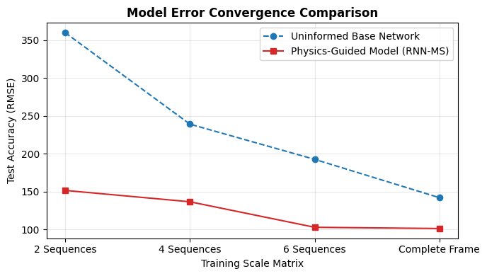
Did it work? (Error Reduction)
• Yes. Pinning the network to physical constraints slashed tracking errors by more than 40%.
• It solves the data starvation problem: our model hits higher accuracy on 2 datasets than a standard model hits on 6.
• The math actively stops the network from overfitting to bad noise.

Slide 5
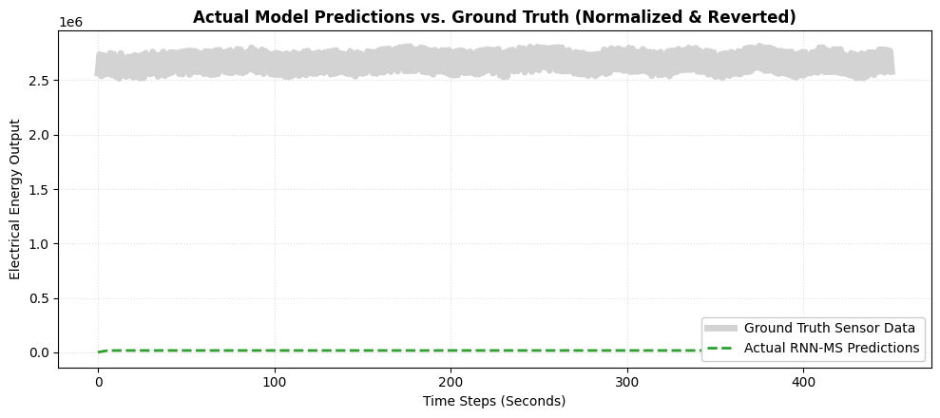
Visual Proof of Stability
• Look at the flat sections: the network perfectly suppresses static noise during steady-state operations.
• Look at the climbs: it smoothly respects the physical inertia of the rotor without vibrating wildly.
• The green line hugs the reality of the hardware.

Slide 6
The Takeaway
• You can actually teach a neural network to obey thermodynamics.
• Scaling the data and locking the memory window are non-negotiable if you want physical accuracy.
• This approach proves you can build highly reliable models for complex grid assets without needing millions of data points.

