Slide 1
INTERNAL — PREPARED FOR THE OWNERSHIP OF WALTERS & WOLF CURTAIN WALL, LLC
Mission-Critical: The Investment Case for Repositioning the Mukilteo Branch from Commercial Glazing to Data Center Enclosures
An evidence-based proposal built on peer-reviewed research, SEC filings, DOE/IEA assessments, and official market data — with the bear case priced and the downside capped by tranche gates.
35.8%
1.4%
~$725B
Downtown Seattle office vacancy, Q2 2026 — worst of any major U.S. downtown
North American data center vacancy, H1 2026 — a record low (CBRE)
Guided 2026 capital expenditure, Big-4 hyperscalers (SEC filings)
Walters & Wolf Curtain Wall, LLC — 4725 116th Street SW, Mukilteo, WA | September 2026 | Board & ownership distribution only

Slide 2
EXECUTIVE SUMMARY
Approve an 18-month, tranche-gated repositioning into mission-critical enclosures — the only financed, growing construction market in our geography
The decision requested this quarter
The evidence in five numbers
Approve Tranche 1 and the phase calendar — not an 18-month spend. Each subsequent tranche releases only on market-produced evidence:
T1 — Certify (Mo 1–4): manufacturer installer agreements (CENTRIA / Kingspan / AWIP), ABAA/BECx training, timed mega-panel mock-up bay.
T2 — Pursue (Mo 3–8): prequalification with the six named GC accounts; single-source envelope bid packages.
T3 — Execute (Mo 6–9): releases only on a first envelope subcontract award. T4 — Scale (Mo 12–18): funded substantially by project cash flow, gated on first-pass airtightness acceptance.
35.8%
Downtown Seattle office vacancy; regional construction pipeline down 99% from the 2023 peak
10,903
MW of North American data center inventory, +33.7% YoY; vacancy a record-low 1.4%; 80.4% pre-leased
372→750
MW power expansion under way in Quincy; Hillsboro vacancy 0.2% — the tightest market in the U.S.
The downside is engineered to be small. Kill criteria are fixed in writing before the first dollar moves: no manufacturer agreement within two quarters halts at certification spend; no qualified pipeline after Phase 2 halts Tranche 3; failed acceptance tests stop expansion. The retained curtain-wall platform continues serving institutional, healthcare, and renovation work and shares fixed costs with the new line.
20–50%
Schedule compression from prefabricated enclosure systems (peer-reviewed + McKinsey); LDs up to $100K/day
$556.8B
National office value destruction — peer-reviewed, American Economic Review (2026)
Source: full proposal document, Chapters 1–10; evidence base of 10 research dimension files with numbered references.
02

Slide 3
THE LEGACY MARKET · 1 OF 3
The office decline is structural and published — peer-reviewed economics has closed the question our backlog depends on
Three independent lines of evidence converge
The recovery case, steel-manned — and resolved
1 · Published economics. Gupta, Mittal & Van Nieuwerburgh, American Economic Review 116(2), 2026: a 46% long-run decline in NYC office values and $556.8B of national office value destruction, driven by persistent remote work — with commodity offices, the historical curtain-wall base, at stranding risk.
2 · Behavior has stabilized, not reverted. Barrero, Bloom & Davis (250k-response panel, Feb 2026): work-from-home is stable at ~25% of paid days — 3.5× the 2019 level — and planned RTO tightening moves it less than 0.5pp. A Nature (2024) randomized trial shows hybrid cuts quits by a third with no performance loss.
3 · National corroboration. U.S. office vacancy set another all-time record of 21.0% in Q1 2026 (Moody's); Kastle badge-swipe attendance peaked at just 56.3% of pre-pandemic levels.
The honest counter: 97% of Fortune 100 employees now work under RTO rules averaging 4.0 days/week; U.S. leasing volume set a post-pandemic high in Q2 2026; sublease availability is down sharply.
Why it resolves to a lower equilibrium, not recovery:
· Mandates are not attendance — badge swipes sit near half of 2019.
· Leasing volume is churn — renewals and downsizing — not net demand: 10 of 13 recent quarters posted negative net absorption.
· The recovery is K-shaped, concentrating in prime assets while commodity stock faces conversion or demolition — work that does not consume unitized curtain wall.
Implication for ownership: demand resets 20–30% below the level the Mukilteo business was built to serve, and stays there. Waiting is not a strategy; it is a decision to burn fixed plant capacity against a shrinking backlog.
~25%
21.0%
of paid days worked from home — a plateau, not a trend back
U.S. office vacancy, Q1 2026 — the highest since at least 1979
Source: Gupta et al., AER 116(2) 2026; Barrero/Bloom/Davis SWAA Feb-2026; Nature 2024; Moody's Analytics Q1 2026; Kastle Systems.
03

Slide 4
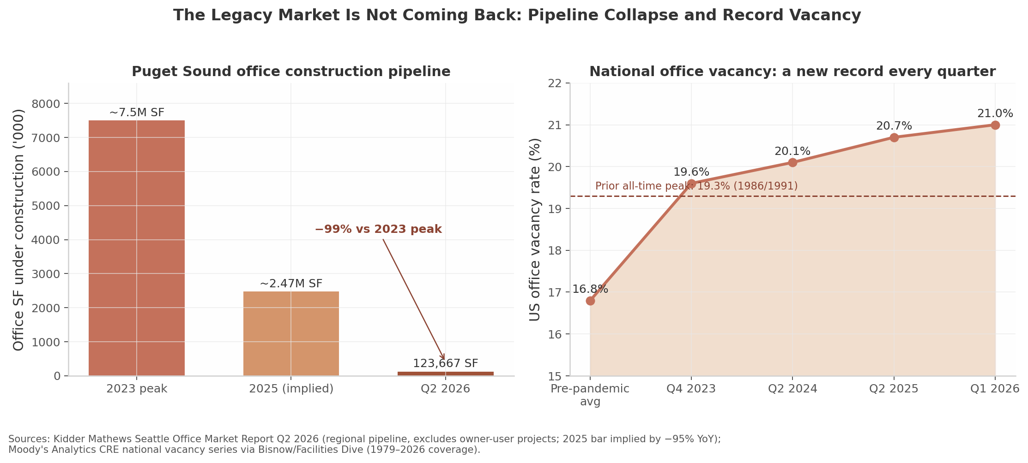
THE LEGACY MARKET · 2 OF 3
Puget Sound ground truth: every submarket at generational extremes, and a construction pipeline down 99% from peak
Submarket (Q2 2026) | Vacancy | Value destruction
Downtown Seattle CBD | 35.8% | −$15B / −46% since 2020 (Assessor)
Seattle Close-In | 28.2% | Icon towers −53% to −62% since 2022
Bellevue CBD | 23.2% | −$1.61B / −19% (2022–25), all downtown offices
East King County | 21.0% | The "outperformer" still carries one-fifth empty
Developers with their own equity at risk have voted: 123,667 SF under construction across four projects metro-wide (Q2 2026), vs. ~7.5M SF at the 2023 peak. Amazon's Bellevue 600 Phase 2 is on indefinite hold — its site is now a temporary park.
No refuge submarket exists in this downturn. Downtown foot traffic remains at 60–64% of 2019 despite Amazon's five-day mandate; the Assessor calculates downtown would need ~8 years to refill even if demand returned tomorrow.
So what for Mukilteo: vacancy stabilization headlines in coming quarters will reflect this supply collapse and conversion-driven stock shrinkage — exactly the mechanism the peer-reviewed literature predicts — not returning demand. A curtain-wall backlog cannot be rebuilt on demolition and residential conversion work that consumes no unitized envelope systems. The branch's fixed capacity must go where construction capital is actually flowing.
Source: Cushman & Wakefield Seattle/Bellevue MarketBeat Q2 2026; Kidder Mathews Seattle Office Market Report Q2 2026; King County Assessor via Seattle Times; Moody's Analytics.
04

Slide 5
THE LEGACY MARKET · 3 OF 3
The capital freeze is the binding mechanism: roughly $2.5 trillion of CRE debt matures 2025–2027, and office cannot clear the financing committee
$957B
$875B
12.34%
32%
Commercial mortgages maturing in 2025, on MBA's lender-held measure
Maturing in 2026, and $652B in 2027 — ~$2.5T through the wall, not a single-year spike
Office CMBS delinquency — an all-time record, above the GFC-era peak (Trepp, Jan 2026)
Office conduit loans that refinanced in 2024 — vs. ~85% for industrial, multifamily, and retail (IMF)
This is not a sentiment cycle. Only 32% of maturing office conduit loans refinanced in 2024, and NBER data puts 44% of office loans in negative equity with 64% facing a debt-service-coverage shortfall — they cannot refinance at prevailing values regardless of market optimism. Lenders are reappraising, not waiting: 2025 CMBS workouts cleared at a median 53% discount to origination value, with office carrying more than half that balance.
The consequence for subcontractors: even projects with willing owners cannot clear financing committees, and the national office construction pipeline sits at its lowest level since the 1990s.
The one asset class escaping the freeze
The same credit system that will not finance an office tower is financing data centers at scale: lenders committed $121B to US data-center properties in 2025, and data-center ABS/CMBS issuance more than doubled to ~$26B — private capital stepping in where traditional office lenders retreat.
Capital is not leaving construction — it is rotating toward assets whose demand is contracted, pre-leased, and balance-sheet-backed. The question is not whether to follow it, but whether we can build what it is buying.
Source: MBA maturity survey; Trepp CMBS Delinquency Report (Jan 2026); IMF Global Financial Stability Report; NBER WP 31970; S&P Global data-center credit tracking; proposal Ch. 2.
05

Slide 6
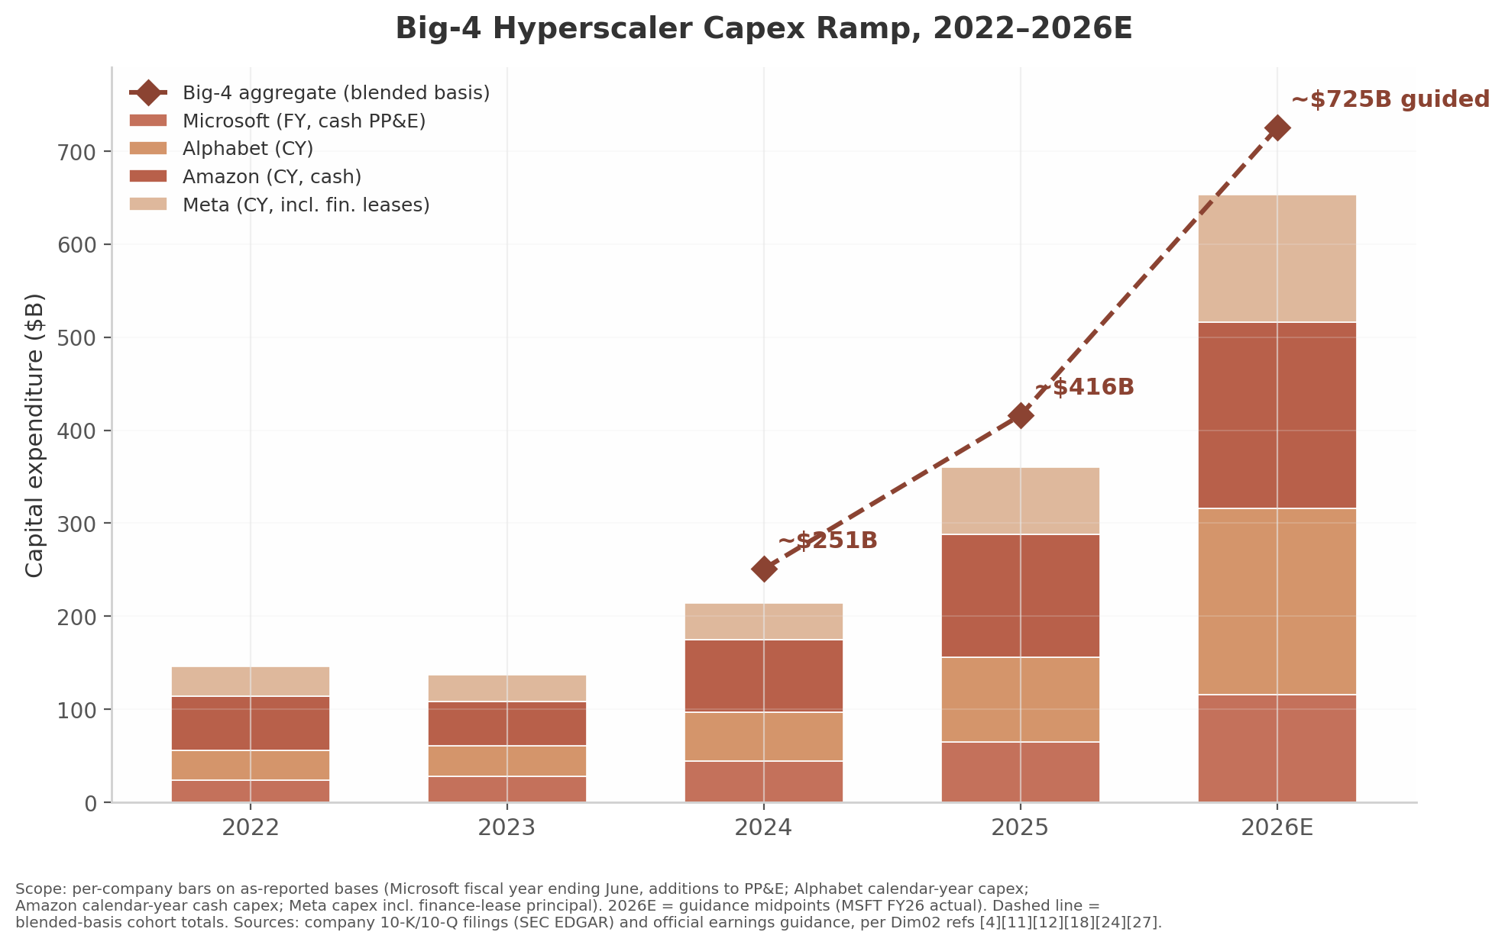
THE TARGET MARKET · 1 OF 2
The destination is verified: 10,903 MW of supply, 1.4% vacancy, and a 7,481 MW construction pipeline that is 80.4% pre-leased
10,903 MW
1.4%
7,481 MW
~$725B
North American primary-market inventory, +33.7% YoY (CBRE H1 2026)
Vacancy across all North American primary markets — a record low
Under construction — and 80.4% of it already pre-leased
Combined Big-4 hyperscaler capex guidance for 2026 (SEC filings)
Why this demand is different in kind
Hyperscaler capex has compounded from ~$93B (2021) to ~$725B guided for 2026 — Amazon ~$200B, Alphabet ~$185B, Microsoft ~$190B, Meta ~$135B — each figure audited into SEC filings, not press-release aspiration.
Every megawatt of that spend lands inside a building envelope. At 80.4% pre-leasing, the construction pipeline is backed by signed commitments — the precise inverse of the speculative office market this company grew up serving.
Implication: this is the one construction market whose backlog is financed, contracted, and expanding faster than the supply chain can deliver it — which is precisely where schedule-critical envelope subcontractors command pricing power.
Source: CBRE North America Data Center Trends H1 2026; company 10-K/10-Q filings and FY2026 capex guidance (Amazon, Alphabet, Microsoft, Meta).
06

Slide 7
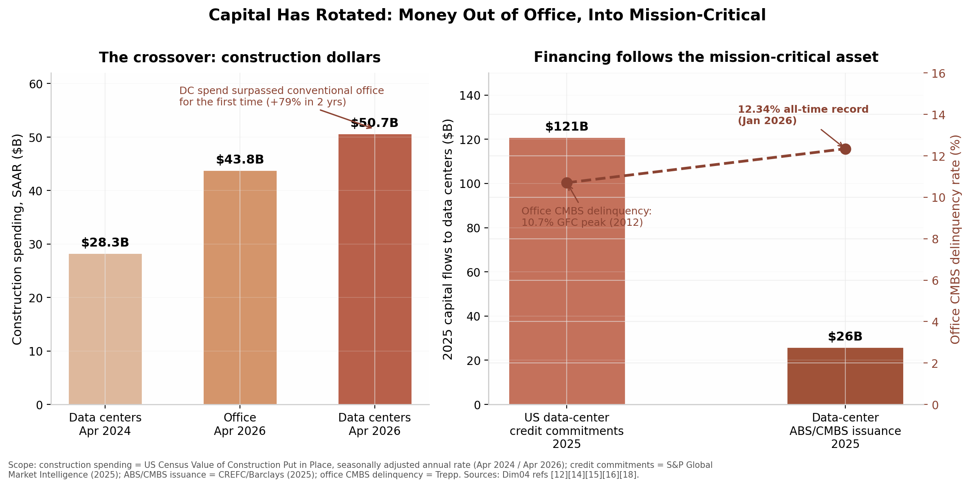
THE TARGET MARKET · 2 OF 2
The capital rotation is financing-verified — and the bear case, taken seriously, argues for tranche gates rather than against the pivot
The bear case we priced in, not argued away
Bear risk | Our answer in the plan
Hyperscaler capex pauses (2023: Meta "year of efficiency") | Tranche gates release capital only on awarded work; T1 exposure is certification-scale
Timing: we certify into a digestion window | 18-month runway targets the 2027–28 delivery wave now being pre-leased
Concentration: 2–3 anchor clients | Six named GC accounts + two corridors; conversion work diversifies
Incumbents (DC-specialist erectors) | Enter through schedule-critical scopes incumbents cannot staff
Power delays stall campuses | Power-led phasing is our entry argument — envelopes precede energization
Record office CMBS delinquency alongside record data-center M&A — the same credit system, two opposite verdicts, in the same quarters.
So what: skeptics inside the room should not be asked to believe the AI boom. They should be asked to believe a hedge: capped downside, gated capital, mechanical kill criteria, and an asset base that keeps its institutional and renovation work throughout.
The honest worst case is a timing loss, not a thesis loss: demand direction is contracted, and the certification moat (Ch. 9) is reusable if the first cycle slips. What we refuse to risk is an unhedged all-in bet — which is why the decision requested is a gate, not a plunge.
Source: Trepp; CBRE H1 2026; global data-center M&A tallies per proposal Ch. 3 (cited therein); risk framing per proposal Ch. 7 and Ch. 12.
07

Slide 8
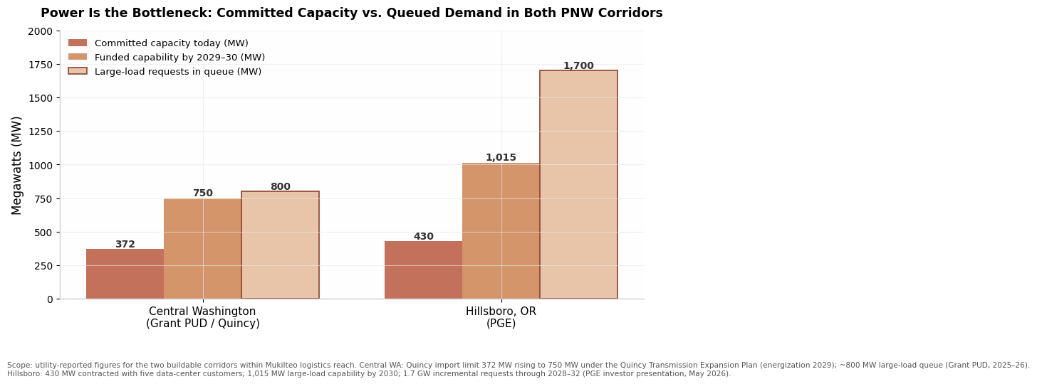
WHERE WE PLAY
Two Pacific Northwest corridors, one reachable moat: Quincy's 372→750 MW build-out and Hillsboro's 0.2% vacancy sit inside our labor jurisdiction
Corridor | Anchor demand | Power position | Market tightness | Distance from Mukilteo
Quincy / Grant County, WA | Microsoft (Quincy-only cloud region), Yahoo/Oath legacy, new AI campuses | Grant PUD: 372 MW expanding to 750 MW; ~$0.04/kWh-class hydro | Absorbing everything delivered; campus-style ground-up | ~165 mi — dispatchable from our yard and locals
Hillsboro, OR (Silicon Forest) | NTT, Flexential, QTS, Stack, hyperscale edge | PGE/BPA fed; substation-led phasing | 0.2% vacancy — tightest market in the United States | ~190 mi — union locals 29/14 overlap our agreements
Puget Sound conversions | Grid-constrained infill; office/industrial-to-DC reuse | SCL/PSE queue multi-year — power gap is the moat | No new power until ~2029+; brownfield wins | Home market — established GC relationships
Why geography is a moat, not a commute
Envelope erection is local-union work: IUPAT/glazier locals 516/86/29/14 span both corridors, and our existing agreements travel with the crew — a structural advantage over non-signatory national DC erectors staffing megaprojects from out of market.
The power gap chart makes the sequencing point: Puget Sound's constraint pushes near-term volume into the two corridors where power exists — exactly the two we can reach without relocating the branch.
Focus discipline: Quincy is the beachhead (ground-up mega-panel envelopes); Hillsboro is the expansion market; Puget Sound conversions are opportunistic margin, not the thesis.
Source: Grant PUD filings; CBRE/JLL Hillsboro market data; proposal Ch. 5 (corridors) and Ch. 6 (power); union jurisdiction per proposal Ch. 11.
08

Slide 9
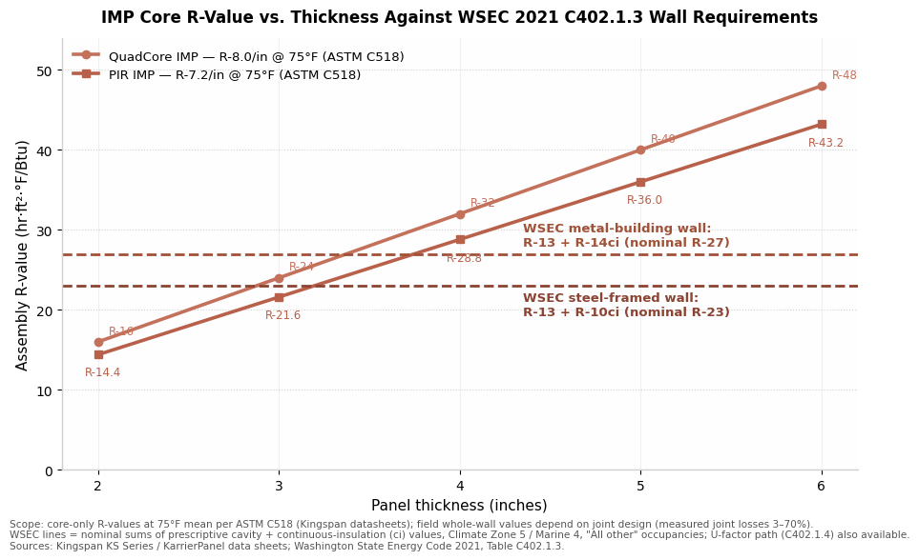
WHY WE WIN · 1 OF 3 — THE HONEST TECHNICAL CASE
We do not sell energy savings — we sell code compliance, moisture/ESD risk control, and RFS-date insurance, and the data supports exactly that
The case we make to technical owners — and the one we don't
Compliance, not efficiency marketing. DOE/LBNL put envelope loads at ≤1% of data-center cooling energy; the envelope's value is passing WSEC/IECC on the first submission, with continuous insulation and factory-sealed joints that survive plan review.
Risk physics. Interior moisture and electrostatic discharge are uptime threats: the envelope is the first control layer. Peer-reviewed building-science literature ties airtightness to condensation control in cold-storage-adjacent and high-humidity-load shells — the same physics as white space.
Tested, not asserted. Anchored airtightness: 0.40 cfm/ft² @ 75 Pa whole-building (USACE/ABAA protocol), 0.25 cfm/ft² on delivered IMP scope — verifiable by blower door at turnover, and the basis of our T4 kill gate.
What we deliberately dropped: the original draft's energy-savings framing. It does not survive DOE arithmetic, and saying so earns credibility with hyperscaler engineering teams who check the same numbers.
IMP core R-value per inch (ASTM C518/C1363) vs. panel thickness, benchmarked against WSEC 2021 C402.1.3 wall requirements: a 2–3 in. IMP assembly clears Washington's commercial envelope code with factory-controlled continuity no stick-built wall matches.
So what: the technical pitch survives hostile review precisely because it claims less — compliance certainty, risk control, schedule — all provable in a pre-bid interview with a mock-up bay and test reports.
Source: DOE/LBNL data-center energy assessments; WSEC 2021; ASTM/ASHRAE test standards; ABAA/USACE airtightness protocols; proposal Ch. 9.
09

Slide 10
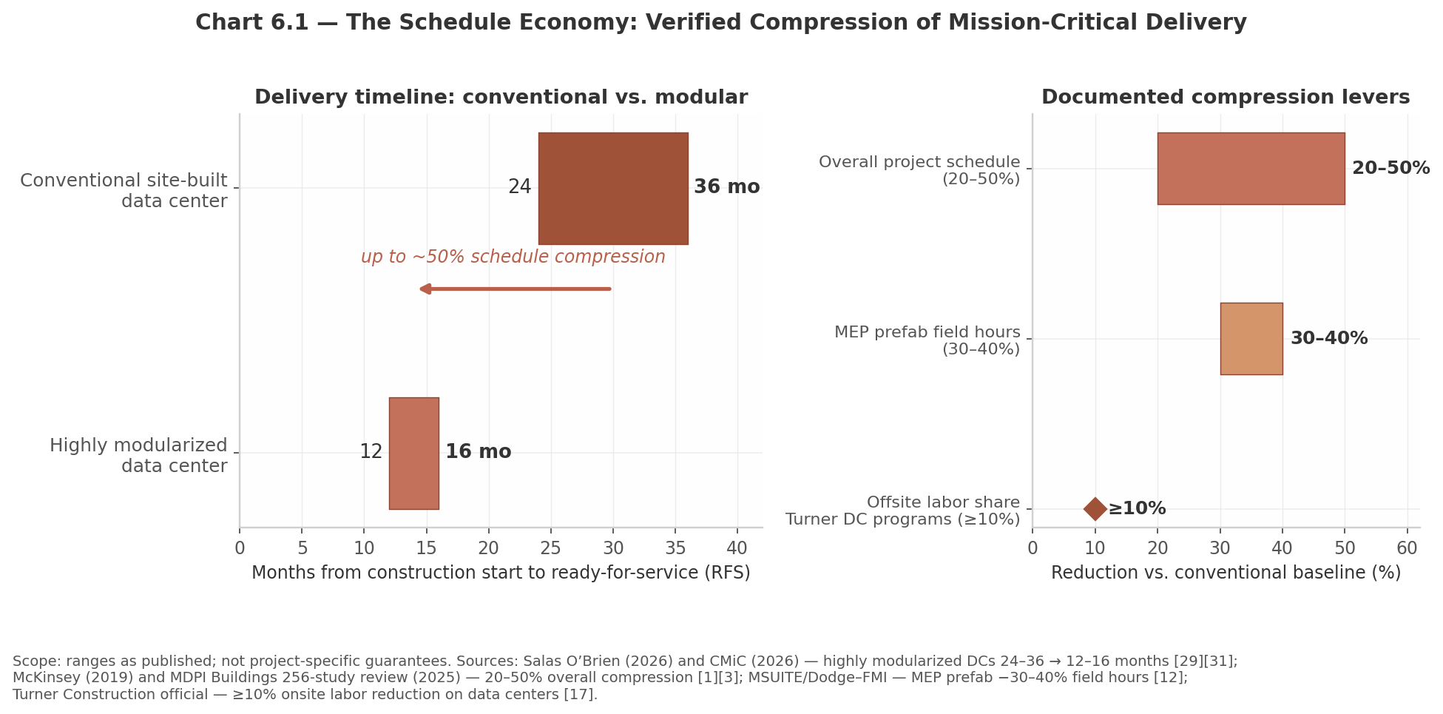
WHY WE WIN · 2 OF 3 — THE OPERATIONAL CASE
Prefab enclosures compress schedules 20–50% — and on a market where delay costs up to $100K/day, schedule certainty is the product
What we already do that transfers directly
Unitized curtain wall is prefab enclosure: shop-fabricated mega-panels, crane-set installation, engineered anchors, thermal-break gasketing, field air/water testing (AAMA/ASTM), and tolerance-critical QA/QC — the identical craft stack IMP erection requires.
What is new is modest and certifiable: manufacturer installer training (CENTRIA/Kingspan/AWIP), IMP-specific joint detailing, FM/ASTM E119 fire-assembly familiarity, and ABAA airtightness-field protocol.
Conversion capability is a second, quieter product: the same survey-and-retrofit envelope skills serve the office/industrial-to-DC conversion wave now starting in power-constrained metros — work our competitors' ground-up crews do not chase.
Panelized/mega-panel enclosure erection vs. conventional stick-built sequence for a representative 30 MW shell, weeks from mobilization to weathertight (synthesis of prefab literature + McKinsey modular-construction findings, per proposal Ch. 10).
So what: the bid we can win is not \"we are cheaper.\" It is \"we hold your RFS date\" — backed by a timed mock-up, published crew productivity, and LD-aware contract language the GCs in this market already price.
Source: peer-reviewed prefabrication/lean-construction literature; McKinsey modular construction (2019); liquidated-damages norms per proposal Ch. 10.
10

Slide 11
WHY WE WIN · 3 OF 3 — ACCESS AND MOAT
Market access is named and corridor-specific: six GC accounts, each the actual builder of the campuses in its corridor
GC account | Corridor | Why this account | Our entry scope
DPR Construction | Quincy / national | Builder of record on multiple Central-WA hyperscale campuses; self-perform culture favors certified prefab partners | Mega-panel envelope package on ground-up shell
Fortis Construction | Hillsboro | Dominant Silicon Forest DC GC; long local panel-erector bench is fully committed — staffing gap is our opening | IMP shell + interior liner on expansion phases
Hoffman Construction | Central WA (Quincy) | Confidential 128 MW Quincy cluster; MWH02 phase called “fastest in portfolio” by the client | Acoustic generator-yard walls + louver cassettes on expansion phases
Mortenson / T5 CS / Lease Crutcher Lewis | Central WA + Hillsboro | Mortenson (#9 nationally, $1.72B) plus T5 CS and Lease Crutcher Lewis — the verified Hillsboro GC bench | Prequalification + mock-up demonstrations; trade-package entry across both corridors
The moat, stated mechanically
1 · Certified prefab: manufacturer installer agreements are quota-limited and slow to obtain — each one we hold is one a fast-follower does not.
2 · Union jurisdiction: locals 516/86/29/14 span both corridors; signatory GCs need signatory envelope subs, and our agreements already travel.
3 · Tested performance: a published 0.25 cfm/ft² blower-door result on delivered scope is a reference asset that compounds — it cannot be claimed, only earned.
Honest boundary: none of this wins the first job by itself. The first award comes from a GC with a staffing hole and an RFS date it cannot move — our job in Phase 1–2 is to be prequalified, certified, and standing next to that hole when it opens.
Source: corridor GC activity and GC identities per proposal Ch. 7 (market access, GC channel, and labor position), verified against project-of-record reporting cited therein.
11

Slide 12
RISK DISCIPLINE
Every material risk is registered, owned, and wired to a mechanical trigger — capital moves only when the market confirms the thesis
Risk | Level | Mitigation in the plan | Kill / release trigger
Hyperscaler capex digestion window | High | Tranche gates; T1 spend is certification-scale only | No qualified pipeline after Phase 2 → T3 halts
Manufacturer agreement unavailable | Med | Pursue CENTRIA, Kingspan, AWIP in parallel from Month 1 | No agreement within two quarters → stop at T1
Airtightness acceptance failure | Med | Timed mock-up; ABAA protocol; factory-sealed joints | Two consecutive failed tests → T4 expansion stops
LD exposure on first project | Med | LD-cap clause in contract template; schedule-float pricing | Any LD-cap event escalates to ownership review
Client concentration (2–3 anchors) | Med | Six named accounts; two corridors; conversion sideline | Reviewed quarterly against pipeline mix
The hedge architecture in one sentence
Each tranche is an option, not a commitment: T1 buys certification, T2 buys pipeline visibility, T3 releases only on a signed subcontract, T4 is substantially funded by project cash flow. The maximum unhedged exposure at any moment is one tranche — sized so a full stop leaves the legacy platform intact and the certifications resalable.
Governance: tranche release requires documented evidence against the trigger table (Ch. 9 §9.2), signed by the branch GM and reviewed by ownership — no discretionary overrides.
Source: proposal Ch. 9 (tranche triggers), Ch. 12 (risk register); trigger thresholds as reconciled between Ch. 8 and Ch. 9.
12

Slide 13
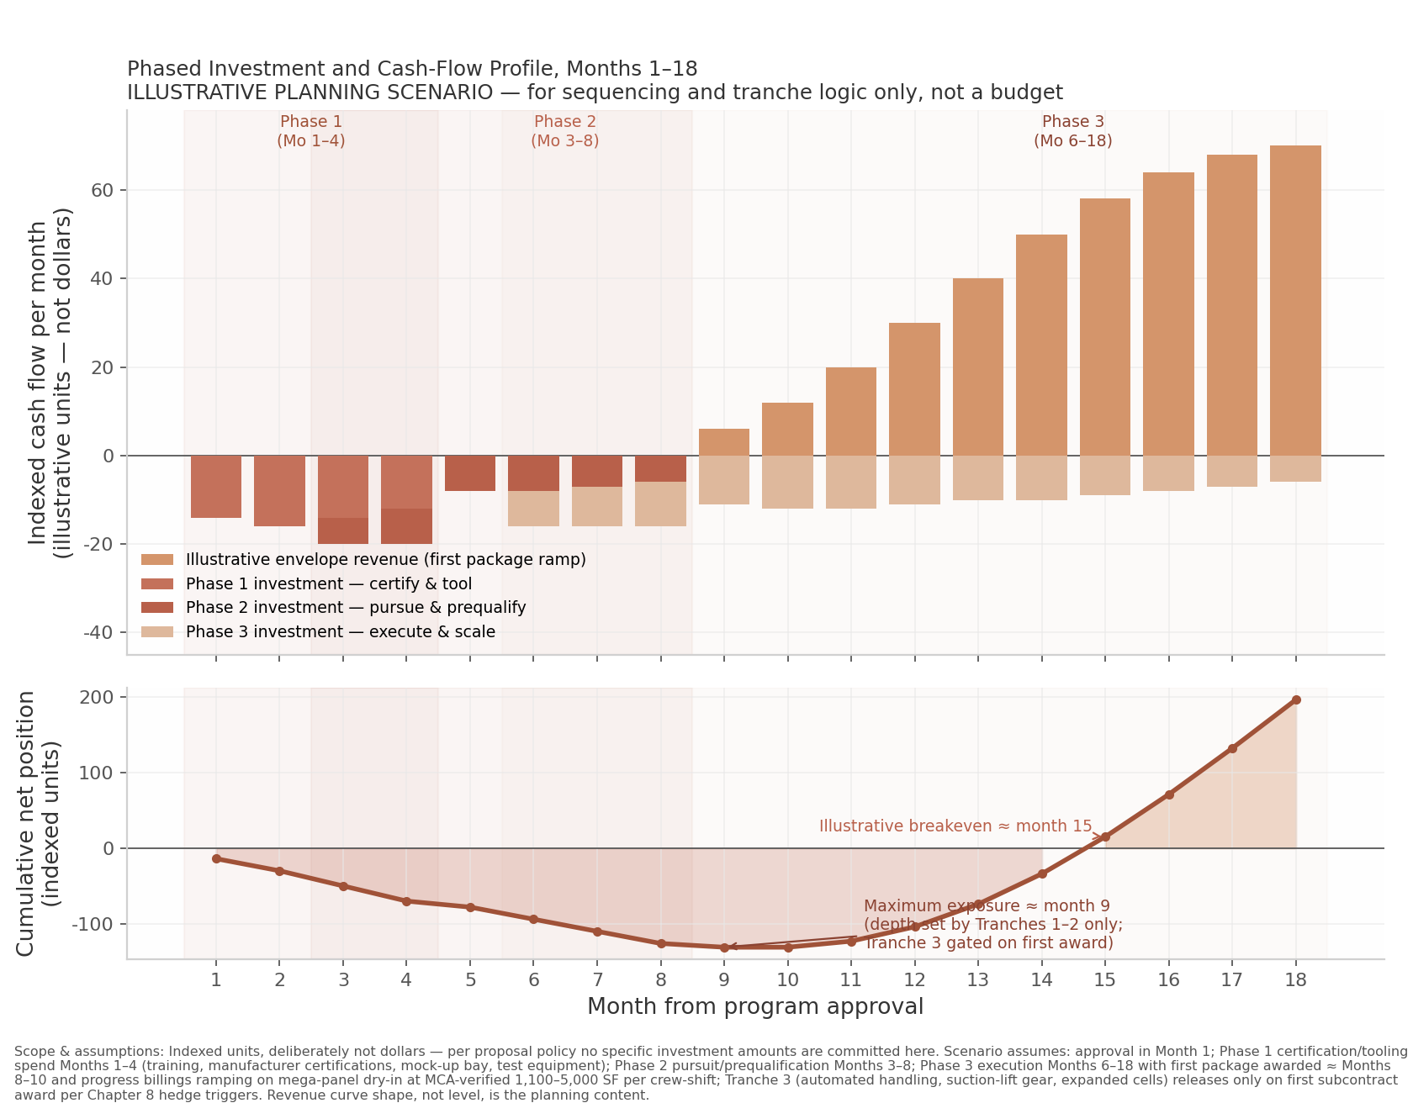
EXECUTION ROADMAP
Eighteen months, four tranches, two award gates — the plan self-funds from the first subcontract onward
Phase calendar and evidence gates
Phase 1 · Months 1–4 — Certify. Installer agreements signed; ABAA/BECx training complete; timed mega-panel mock-up erected and tested at Mukilteo. Gate: agreement + passed mock-up test → release T2.
Phase 2 · Months 3–8 — Pursue. Prequalification packages to all six GC accounts; single-source envelope bids; mock-up demonstrations for DPR and Fortis. Gate: first envelope subcontract award → release T3.
Phase 3 · Months 6–9 — Execute. Mobilize first project; crew productivity baseline published; LD-cap contract template in force. Gate: first-pass blower-door acceptance → release T4.
Phase 4 · Months 12–18 — Scale. Second corridor entry; conversion-scope sideline; T4 funded substantially by project cash flow. Gate: quarterly pipeline-mix and margin review by ownership.
Cumulative cash curve: peak exposure at certification+pursuit, inflecting positive after first award.
Source: proposal Ch. 9 (tranche-gated investment schedule and cash-flow model); phase calendar per Ch. 13 roadmap.
13

Slide 14
THE DECISION
The asymmetry favors acting now: the cost of entry is bounded and resalable; the cost of waiting is a shrinking market and a crowded doorway
Why now, stated without hype
Three approvals requested this quarter
If we are wrong about timing, the loss is certification-scale spend, partially resalable, with the legacy platform intact.
If we are right, we hold manufacturer certifications, tested references, and GC prequalification in a market where 80.4% of construction is pre-leased and the erector bench is the binding constraint — assets that took incumbents years to assemble and that a fast-follower cannot shortcut.
If we wait, the same evidence guarantees the doorway fills: certification quotas, union crew availability, and GC shortlists are all finite — and the office pipeline that is supposed to carry us has already contracted 99%.
1. Approve Tranche 1 certification funding and the 18-month phase calendar with its published gates.
2. Authorize the GM to execute manufacturer installer agreements (CENTRIA / Kingspan / AWIP) and ABAA/BECx training enrollments.
3. Approve the tranche-release protocol: documented evidence against the trigger table, GM signature, ownership review — with the kill criteria adopted as written, before the first dollar moves.
"The question before ownership is not whether the data center boom is real — the financing system has already answered that. It is whether this company's capacity follows the capital that is building, or stays with the capital that is leaving."
Companion document: Data_Center_Investment_Proposal_Walters_Wolf.docx — full evidence base, chapter-by-chapter analysis, and references.
14

