Slide 1

Course 2 Module 5 Programming Assignment Assignment is to ETL MIMIC data into the OMOP CONDITION_OCCURRENCE table
Detailed instructions with Slide Notes

Slide 2
ETL Steps
Assignment is to ETL MIMIC data into the OMOP CONDITION_OCCURRENCE table
Understand source/target data models
Profile source tables
Create ETL mappings
Write transformation code
Execute transformation
Perform data quality assessment
Package documentation

Slide 3
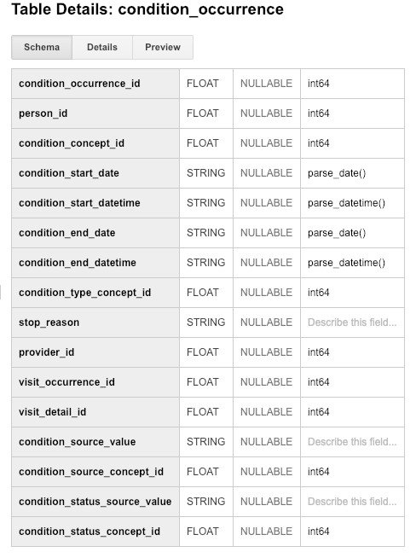
Step 1: Understand source/target data models
CONDITION_OCCURRENCE is the TARGET OMOP table.
The documentation, available at https://github.com/OHDSI/CommonDataModel/wiki/CONDITION_OCCURRENCE, describes the fields of interest as:
person_id: A required integer pointing to the PERSON table, where it describes a person experiencing a Condition.
visit_occurrence_id: An optional integer pointing to the VISIT_OCCURRENCE table, where it describes the event during which the Condition was diagnosed.
condition_source_value: An optional free-text form of up to 50 characters, which contains the original numeric code of the Condition, which is then mapped to a Standard Condition Concept in the Standardized Vocabularies.
Notes:
From the conventions described on the GitHub page, it is also stated that:
“Source Condition identifiers are mapped to Standard Concepts for Conditions in the Standardized Vocabularies. When the source code cannot be translated into a Standard Concept, a CONDITION_OCCURRENCE entry is stored with only the corresponding SOURCE_CONCEPT_ID and SOURCE_VALUE, while the CONDITION_CONCEPT_ID is set to 0.”

Slide 4
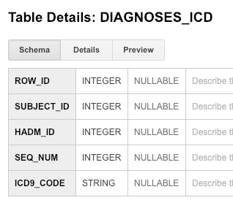
Step 1: Understand source/target data models
MIMIC-III
OMOP
Notes:
For the ETL process, I will use the extract data from the table DIAGNOSES_ICD because the OMOP field visit_occurrence_id clearly refers to the event during which the Condition was diagnosed.

Slide 5
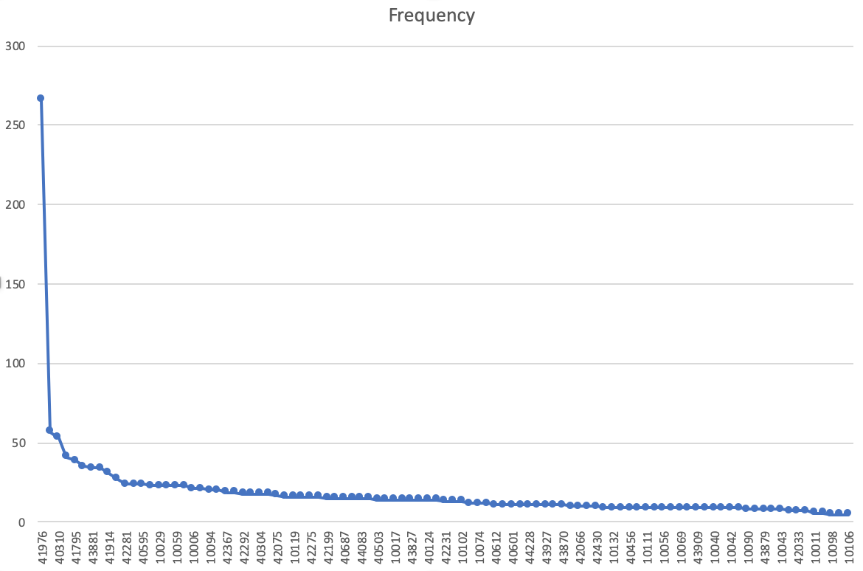
Step 2: Profile source table or tables
Using the White Rabbit profiling data from the 100 patient MIMIC database provided in the Assessment to comment on the distribution of the SUBJECT_ID field from one of the MIMIC tables selected in Step 1
DIAGNOSES_ICD
SUBJECT_ID is a heavily right-skewed distribution, with just SUBJECT_ID 41976 accounting for about 15% of the available data in the report. A similar amount of records can be obtained with the next 6 most common patients, on which there exist 2–3% of records each. The rest of the patients are more uniformly represented in the table.

Slide 6
Step 3: Create ETL mappings
SUBJECT_ID → person_id: They both contain a unique number which maps to a specialized table (PATIENTS in MIMIC-III and PERSON in OMOP) containing information about the subjects / patients.
HADM_ID → visit_occurrence_id: They both contain a unique number which refers to a visit / encounter of the patient in which a Condition was diagnosed.
ICD9_CODE → condition_source_value: Both fields contain unique strings in numeric format of the diagnosed Condition.

Slide 7
Step 4: Write transformation code
SQL statements that transform data from one or more MIMIC tables into the three OMOP CONDITION_OCCURRENCE fields (patient-id, visit_occurrence_id, condition_source_value)
WITH diagnoses1 as (
SELECT DISTINCT m3.SUBJECT_ID as person_id
FROM mimic3_demo.DIAGNOSES_ICD m3
),
diagnoses2 as (
SELECT DISTINCT d1.person_id, m3.HADM_ID as visit_occurrence_id
FROM diagnoses1 d1
JOIN mimic3_demo.DIAGNOSES_ICD m3 on d1.person_id = m3.SUBJECT_ID
),
CONDITION_OCCURRENCE as (
SELECT DISTINCT d2.person_id, d2.visit_occurrence_id, m3.ICD9_CODE as condition_source_value
FROM diagnoses2 d2
JOIN mimic3_demo.DIAGNOSES_ICD m3 on d2.visit_occurrence_id = m3.HADM_ID
)
SELECT * FROM CONDITION_OCCURRENCE

Slide 8
Step 5: Execute transformation code
Execute the ETL code from Step 4 but do not submit the output table.
Use the output table for Step 6.
There is no submission for this Step.

Slide 9
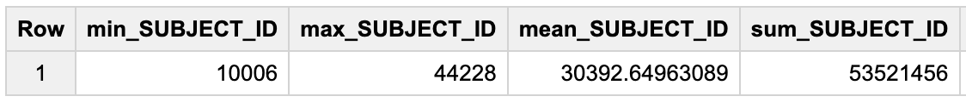
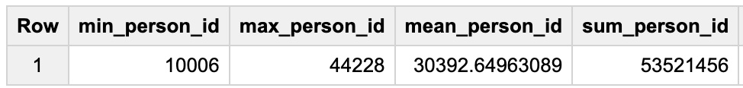
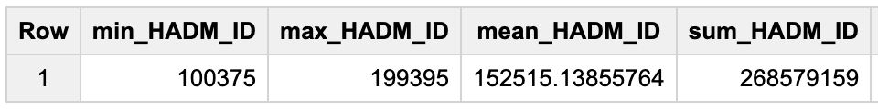
Step 6: Perform data quality assessment (1/2)
Define, implement, execute one or more data quality measures.
Submit final DQ measure and an explanation why you created your measure(s).
MIMIC-III, SUBJECT_ID
OMOP, person_id
MIMIC-III, HADM_ID
OMOP,
visit_occurrence_id
Notes:
For data quality I decided to implement two measures (the second measure is on the next slide):
The common aggregation command for numeric data types in SQL: min for the minimum, max for the maximum, avg for the mean, and sum for the sum. I chose these measures to highlight that the values in the table are the same. It is not possible for mean and sum to stay the same if some values have been wrongly transformed.
To reproduce these results, at the end of the WITH block created on step 4, use, respectively:
SELECT min(SUBJECT_ID) as min_SUBJECT_ID, max(SUBJECT_ID) as max_SUBJECT_ID, avg(SUBJECT_ID) as mean_SUBJECT_ID, sum(SUBJECT_ID) as sum_SUBJECT_ID FROM mimic3_demo.DIAGNOSES_ICD
SELECT min(person_id) as min_person_id, max(person_id) as max_person_id, avg(person_id) as mean_person_id, sum(person_id) as sum_person_id FROM CONDITION_OCCURRENCE
SELECT min(HADM_ID) as min_HADM_ID, max(HADM_ID) as max_HADM_ID, avg(HADM_ID) as mean_HADM_ID, sum(HADM_ID) as sum_HADM_ID FROM mimic3_demo.DIAGNOSES_ICD
SELECT min(visit_occurrence_id) as min_visit_occurrence_id, max(visit_occurrence_id) as max_visit_occurrence_id, avg(visit_occurrence_id) as mean_visit_occurrence_id, sum(visit_occurrence_id) as sum_visit_occurrence_id FROM CONDITION_OCCURRENCE

Slide 10
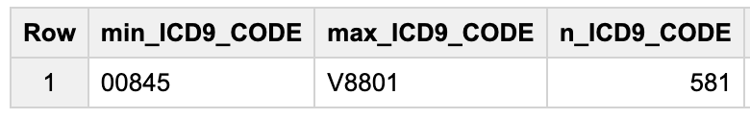
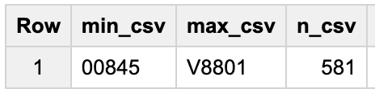
Step 6: Perform data quality assessment (2/2)
Define, implement, execute one or more data quality measures.
Submit final DQ measure and an explanation why you created your measure(s).
MIMIC-III, ICD9_CODE
OMOP, condition_source_value (csv)
Notes:
For data quality I decided to implement two measures (the first measure is on the previous slide):
Check ICD9 codes in MIMIC against OMOP’s condition_source_value, by looking at their minimum (min) and maximum (max) value, but also counting the number of unique codes (count distinct) present.
To reproduce these results, at the end of the WITH block created on step 4, use, respectively:
SELECT min(condition_source_value) as min_csv, max(condition_source_value) as max_csv, count(DISTINCT condition_source_value) as n_csv FROM CONDITION_OCCURRENCE

Slide 11
Step 7: Package documentation
Congratulations! The materials in the previous slides constitute a complete ETL package.
There is no submission for this Step.

