Slide 1
CS323 Operating Systems
Multi-Computers/Distributed Systems
Yuanyuan Zhou
Lecture 32
4/16/2003

Slide 2
Content of this lecture
Distributed/Network File Systems
  Background
  Naming and Transparency
  Remote File Access
  Stateful versus Stateless Service
  File Replication
  Example Systems
Multi-processor (read textbook)

Slide 3
Midterm 2 Review
Still grading
Will be available early next week
Not very well at short questions
How to improve
  Questions after each chapter
  Lecture discussion questions
  Thoroughly understand the concepts and algorithms.
Statistics
  Names

Slide 4
Background
Distributed file system (DFS)
  allow remote file systems to be accessed as if they were local.
Server
  machine with remote file system
Client
  machine with application accessing remote file system
Client Interface
How does it scale?
Is it transparent ?
Are the names organized the same way from any machine?

Slide 5
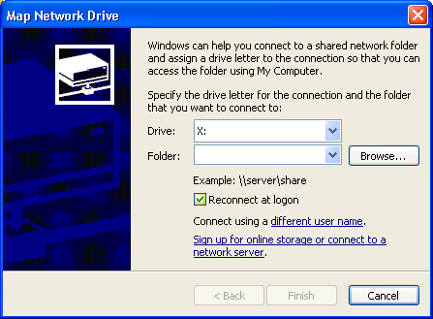
Windows Example

Slide 6
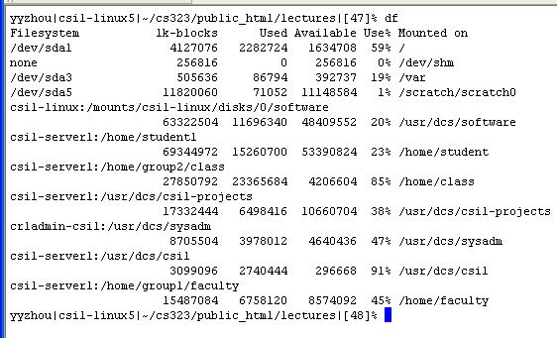
Unix Example

Slide 7
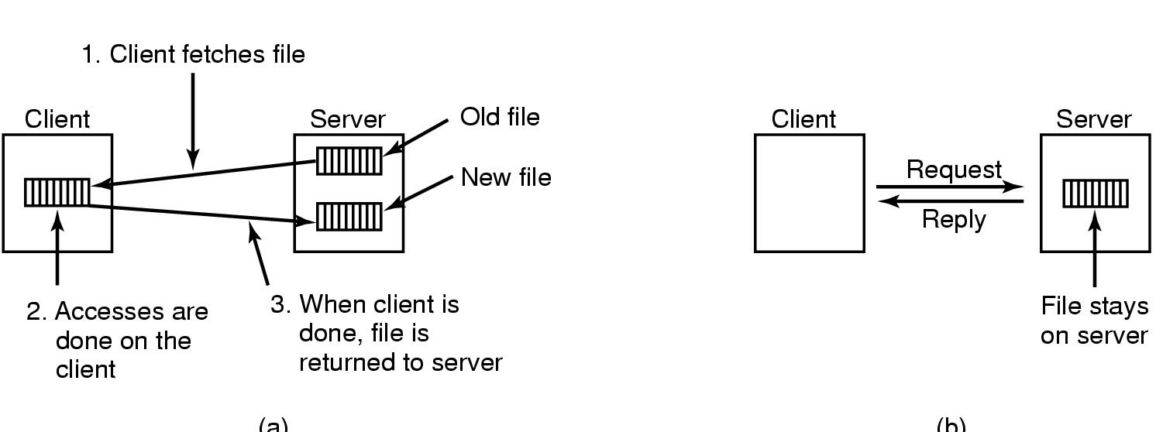
DFS
(b)
(a)
Transfer Models
  (a) upload/download model
  (b) remote access model

Slide 8
Naming and Transparency
Naming -- mapping between logical and physical objects
Multilevel mapping -- hiding where and how the disk is stored
Transparent DFS hides location of files-- is this good or bad. E.g. fault-tolerance may require copies of same file to be kept on DIFFERENT systems.
File replication -- accessed like a single file but allows redundancy
Ownership -- keeping the ownership of a file
Storage unit -- limited size of disk partitions

Slide 9
Naming Structures
Location Transparency
  unique reference to set of physical blocks
  Allow sharing conveniently (same name)
  Expose correspondence between files and machines.
Location Independence
  File can be moved without changing name
  Allows better distribution of files
  Separates file naming hierarchy from storage hierarchy

Slide 10
Naming Schemes
Files named by hostname and local name: guarantees unique system wide name
Attach remote directories to local directories, giving appearance of a coherent directory tree. Only mounted remote directories can be accessed.
Total integration of the component file systems.
  Single global name space
  Name space fragments when machines not available-- arbitrary.

Slide 11
Remote File Access
RPC of file operations
Use client-side inode-like representation of remote file to record file descriptors and file status.
Cache disk blocks, buffer caches or whole files on local machine to improve performance and reduce network traffic.
Cache consistency problem
Network transfer unit (1.5k on Ethernet) is not same as block sizes. Need disassembly and reassembly.

Slide 12
Discussion
Client caching using disks vs. client caching using memory tradeoff?

Slide 13
Location
Disk cache
  more reliable in event of crash
  Flushing disk cache to remote file system requires three extra reads and writes from memory.
Memory cache:
  permits diskless workstations
  allows fast access to data
  performance improves as memory available increases

Slide 14
Cache Update Policy
Write through --
  write data through to disk as soon as data is output to cache.
  reliable but poor performance.
  temporary files written to disk unnecessarily.
Delayed-write -- modifications written to memory. Only written to server when close or needed by open
  Poor reliability -- crash destroys data
  Flush cache to remote disk periodically (30 secs.)
  Accumulate clusters and periodically flush clusters
  By waiting, avoid temp files since they are often removed within seconds of creation.

Slide 15
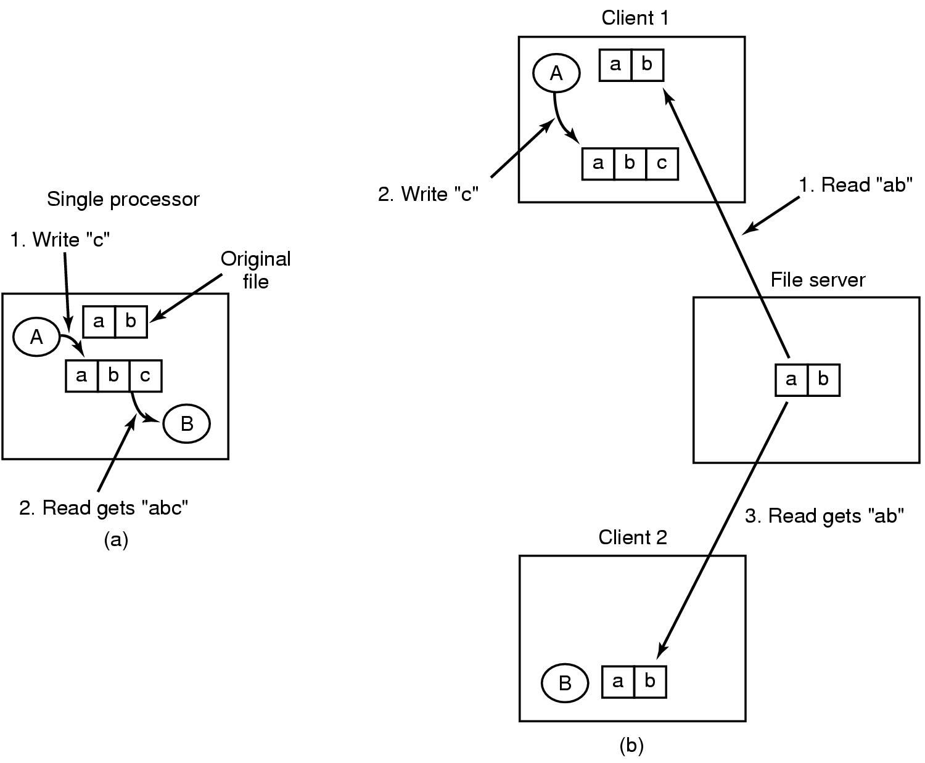
Consistency Problem
Semantics of File sharing
  (a) single processor gives sequential consistency
  (b) distributed system may return obsolete value

Slide 16
Consistency
Client Initiated Approach
  Client initiates a validity check
  Server checks whether local data is consistent with master copy
Server Initiated Approach
  Server records, for each client, the file blocks it caches.
  When server detects inconsistency, it block access or issues a invalidate request to client.

Slide 17
Comparison of Caching and Remote Service
Many remote accesses as fast as local ones. Read ahead.
Writes infrequent -- good for caches
Temporary files need not be written to disk.
Servers contacted infrequently instead of on each access-- better for scalability and network traffic
But relative overhead handling big chunks of data less than for small chunks.

Slide 18
Stateless versus Stateless Service
Stateful
  Server records which client is accessing file
  Allows easy read/write synchronization
  Permits easy caching of data -- knows about read ahead
  Server doesnt know if client crashes -- clean up is problem
  Server crash leaves clients needing to be cleaned up
  Protocol must be reliable, exactly once -- need to know write occurred
  UNIX stateful
Stateless
  Each request independent from previous requests (contains state info)
  File operations idempotent -- can repeat writes
  No need to open/close connections
  Client can crash without causing any server difficulties
  Server can crash without causing client difficulties
  longer request messages
  NFS stateless

Slide 19
File Replication
Replicas of same file reside on failure-independent machines
Improves availability
Replicas should be invisible, yet distinguished at lower levels
Updates to replicas must be duplicated -- need exactly once semantics.
Demand replication -- build a cache of whole file

Slide 20
Example: SUN Network File System
Uses UDP/IP protocol and stateless server
Each system is regarded as independent
A remote file system is mounted over a local file system directory
Local file system directory is no longer visible.
The mount command uses name of remote machine
Access rights, users need to have same ids, group ids.
No concurrency control mechanisms, modified data must be committed to server disk before request returned to client to avoid problems
Works on heterogeneous machines by using a machine independent RPC (network order).

Slide 21
Major Layers of NFS Architecture
vnode -- network wide unique (like an inode but for a network)
RPC and NFS Service layer -- NFS Protocol
Path name look up (past mount point) requires RPC per name.
client cache of remote vnodes for remote directory names
client cannot access another server through a server... remote file systems are always mounted directly

Slide 22
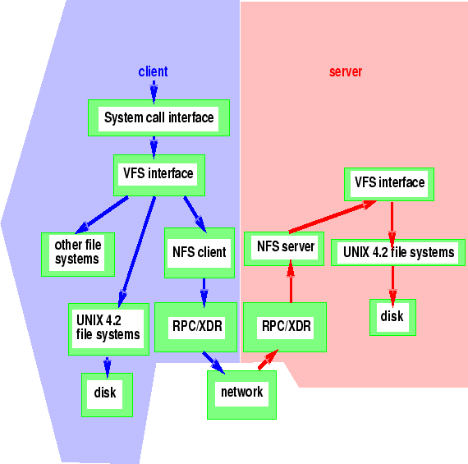
NFS Architecture

Slide 23
NFS Caching
File blocks and file-attribute caches
Attributes used only if up to date. Discarded after 60 seconds.
Read-ahead and delayed write techniques used.
Delayed write used even for concurrent access (not UNIX semantics.)
New files may not be visible for 30 seconds.
Updated files may not be visible to systems with file open for reading for a while.

Slide 24
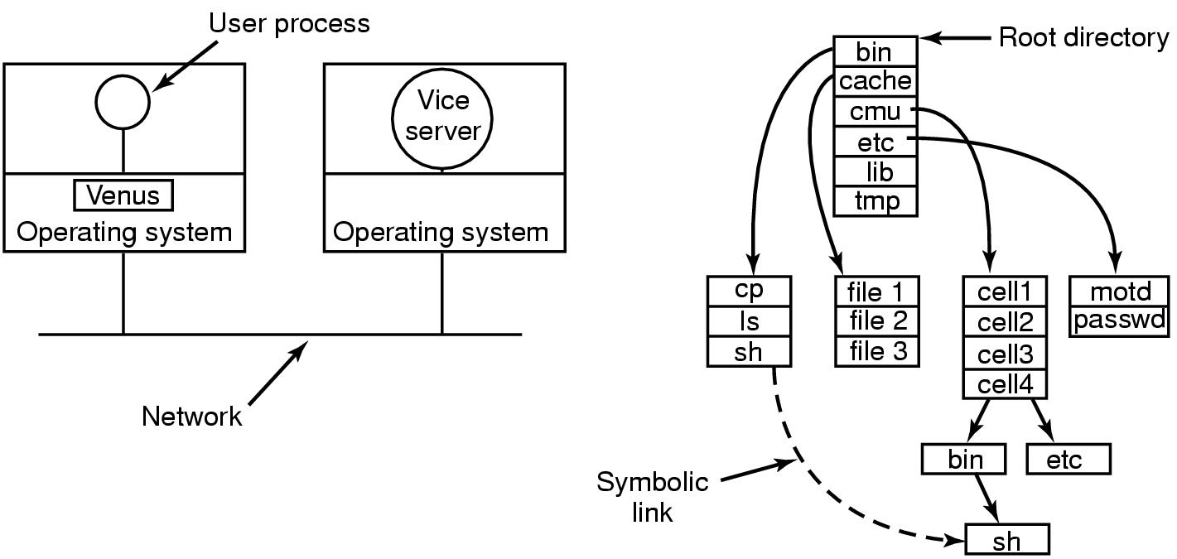
Andrew File Systems
AFS – Andrew File System
  workstations grouped into cells
  note position of venus and vice
  Client's view

Slide 25
Example: Andrew
Aimed at scalability
Clients are not servers
Local name space and shared name space
Local name space is root file system
Whole file caching
Clients may access files from any workstation using same name space
Security imposed at server interfaces -- no client programs run on servers.
Access lists for files
Client workstation interacts with servers only during opening and closing of files
Reading and writing bytes performed by kernel

