Slide 1
CS323 Operating Systems
Process Synchronization
Yuanyuan Zhou
Lecture 10
2/12/2003

Slide 2
Content of this lecture
Administrative announcements
Form groups
  this lecture: many group discussions
Semaphores
Monitor
Classic synchronization problems
Summary

Slide 3
Administrative
None

Slide 4
Review
Semaphores
  The Down (P) operation is used to acquire a resource and decrements count.
  The Up (V) operation is used to release a resource and increments count
  Atomic (Indivisible)
  Counter-based or binary

Slide 5
Busy Wait Semaphore Implementation (1)
class Semaphore {
Mutex m; // Mutual exclusion.
int count; // Resource count.
public:
Semaphore( int count );
void Up();
void Down();
};
static inline Semaphore::Semaphore( int count )
{
count = count;
}

Slide 6
Busy Wait Semaphore Implementation(2)
void
Semaphore::Down()
{ mutex_lock(m);
while ( count == 0 )
{
mutex_unlock(m);
yeild();
mutex_lock(m);
}
count--;
mutex_unlock(m);
}
void
Semaphore::Up()
{
mutex_lock(m);
count++;
mutex_unlock(m);
}

Slide 7
Implementations of Semaphore using Sleep & Wakeup
type Semaphore = record
value:integer;
L: list of processes;
Semaphore S;
Down(S):
S.value:= S.value - 1;
if S. value < 0 then
{
add this process to the S.L;
block;
};
Up(S):
S.value:= S.value + 1;
if S.value > 0 then
{
remove process P from S.L;
wakeup(P);
}
Does it work?

Slide 8
Tradeoffs
Busy waiting (spinlock)
  Waste CPU cycles
Sleep&Wakeup (blocked lock)
  Context switch overhead
Hybrid competitive solution (spin-block)
  Apply spinlocks if the waiting time is shorter than the context switch time
  Use sleep & wakeup if the waiting time is longer than the context switch time

Slide 9
Possible Deadlocks with Semaphores
Example:
P0 P1
share two semaphores S and Q
S:= 1; Q:=1;
wait(S); // S=0 ------------> wait(Q); //Q=0
wait(Q); // Q= -1 <--------
--------------------> wait(S); // S=-1
// P0 blocked // P1 blocked
DEADLOCK
signal(S); signal(Q);
signal(Q); signal(S);

Slide 10
Be Careful When Using Semaphores
// Violation of Mutual Exclusion
signal(mutex); mutexUnlock();
critical section criticalSection();
wait(mutex); mutexLock();
// Deadlock Situation
wait(mutex); mutexLock();
critical section criticalSection();
wait(mutex); mutexLock(P);
// Violation of Mutual Exclusion (omit wait(mutex)/mutexLock())
critical section critical Section();
signal(mutex); mutexUnlock();
// Deadlock Situation (omit signal(mutex)/mutexUnlock())
wait(mutex); mutexLock();
critical section criticalSection();

Slide 11
Monitor
A simpler way to synchronize
A set of programmer defined operators
monitor monitor-name
{
// variable declaration
public entry P1(..);
{... };
......
public entry Pn(..);
{...};
begin
initialization code
end

Slide 12
Monitor Properties
The internal implementation of a monitor type cannot be accessed directly by the various threads.
The encapsulation provided by the monitor type limits access to the local variables only by the local procedures.
Monitor construct does not allow concurrent access to all procedures defined within the monitor.
Only one thread/process can be active within the monitor at a time.
Synchronization is built in.

Slide 13
Barriers
Use of a barrier
  processes approaching a barrier
  all processes but one blocked at barrier
  last process arrives, all are let through
Problem:
  Waste CPU if workloads are unbalanced

Slide 14
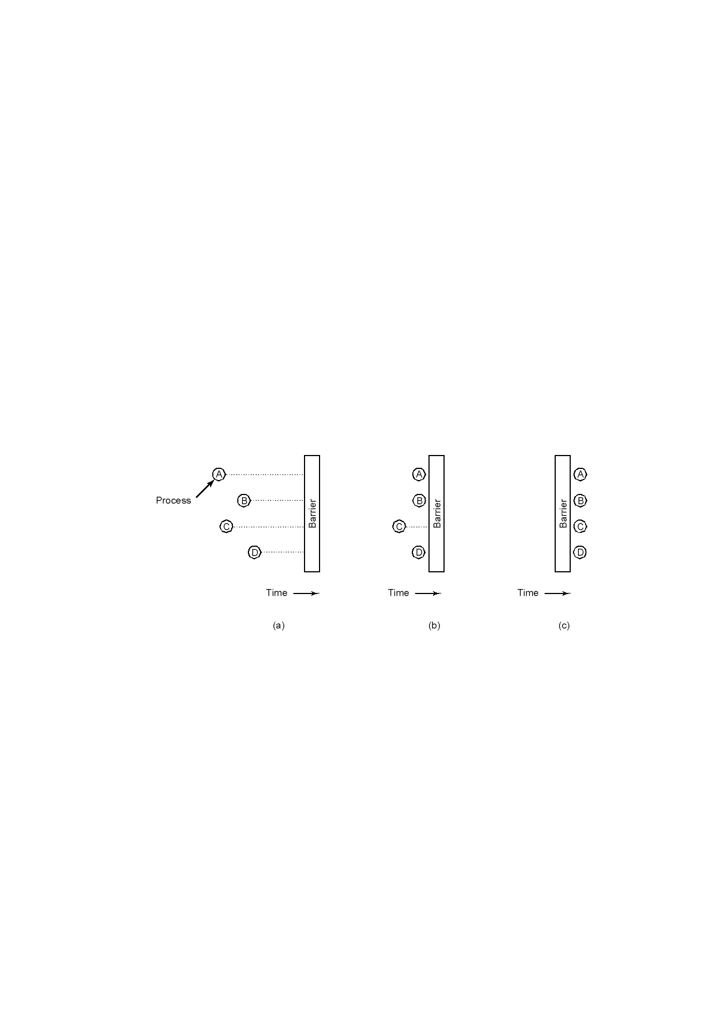
Barriers

Slide 15
Classic Problems
Producer-Consumer problem
Bounded buffer problem
First Reader-writer problem
Dining philosophers problem
Sleeping Barber Problem

Slide 16
Bounded Buffer Problem
  A producer: in an infinite loop and produce one item each iteration into the buffer
  A consumer: in an infinite look and consumes one item each iteration from the buffer
  Buffer size: can only hold at most N items

Slide 17
Bounded Buffer Problem
Semaphore mutex; // shared and initialized to 1
Semaphore empty; // counts empty buffers, initialized to n
Semaphore full; // counts full buffers, initialized to 0
// Producer // Consumer
repeat repeat
.... . ...
produce an item in nextp Down(full);
.... Down(mutex);
Down(empty); ....
Down(mutex); remove an item from buffer to nextc
.... ....
add nextp to buffer Up(mutex);
.... Up(empty);
Up(mutex); ....
Up(full); consume the item in nextc
..... ....
until false; until false;

Slide 18
First Reader-Writer Problem
A reader: read data
A writer: write data
Rule:
  Multiple readers can read the data simultaneously
  Only one writer can write the data at any time
  A reader and a writer cannot in critical section together.
Locking table: whether any two can be in the critical section simultaneously
 | Reader | Writer
Reader | OK | No
Writer | NO | No

Slide 19
First Reader-Writer Solution
Group discussion (2 minutes)
Does it work? Why?
What if ?
Problem with this solution
Semaphore mutex, wrt; // shared and initialized to 1;
int readcount; // shared and initialized to 0
// Writer // Reader
Down(mutex);
readcount:=readcount+1;
Down(wrt); if readcount == 1 then Down(wrt);
...... Up(mutex);
writing performed ....
..... reading performed
Down(mutex);
Up(wrt); readcount:=readcount-1;
if readcount == 0 then Up(wrt);
Up(mutex);

Slide 20

Dining Philosophers: an intellectual game
Philosophers eat/think
Eating needs 2 forks
Pick one fork at a time
Possible deadlock?
How to prevent deadlock?

Slide 21
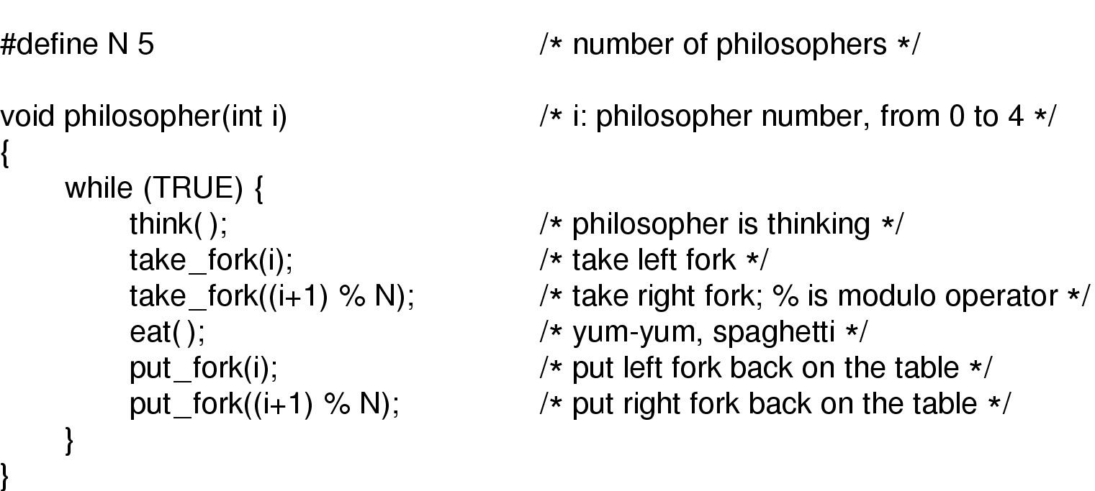
Does it solve the Dining Philosophers Problem?
A nonsolution to the dining philosophers problem

Slide 22
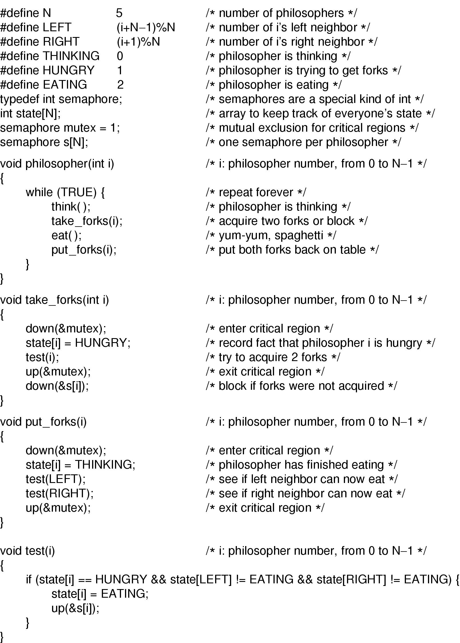
Dining Philosophers Solution

Slide 23
Dining Philosophers Solution

Slide 24
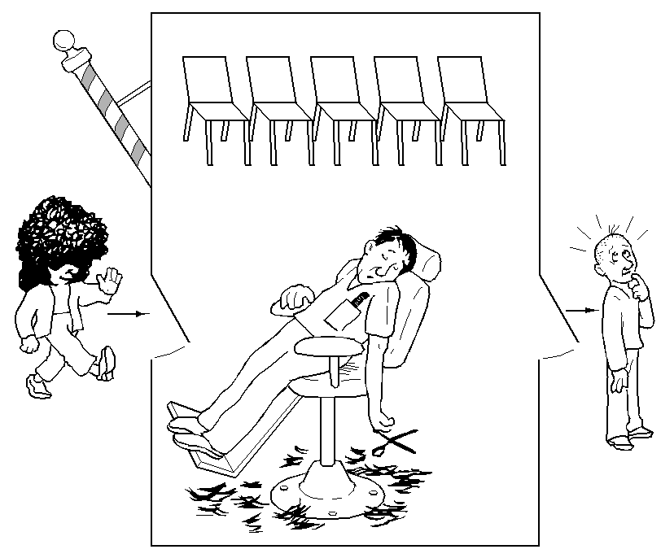
The Sleeping Barber Problem
N customer Chair
One barber can cut one customer’s hair at any time
No customer, goes to sleep
Group discussion (2 minutes)
  Solution in the textbook
  Explain it

Slide 25
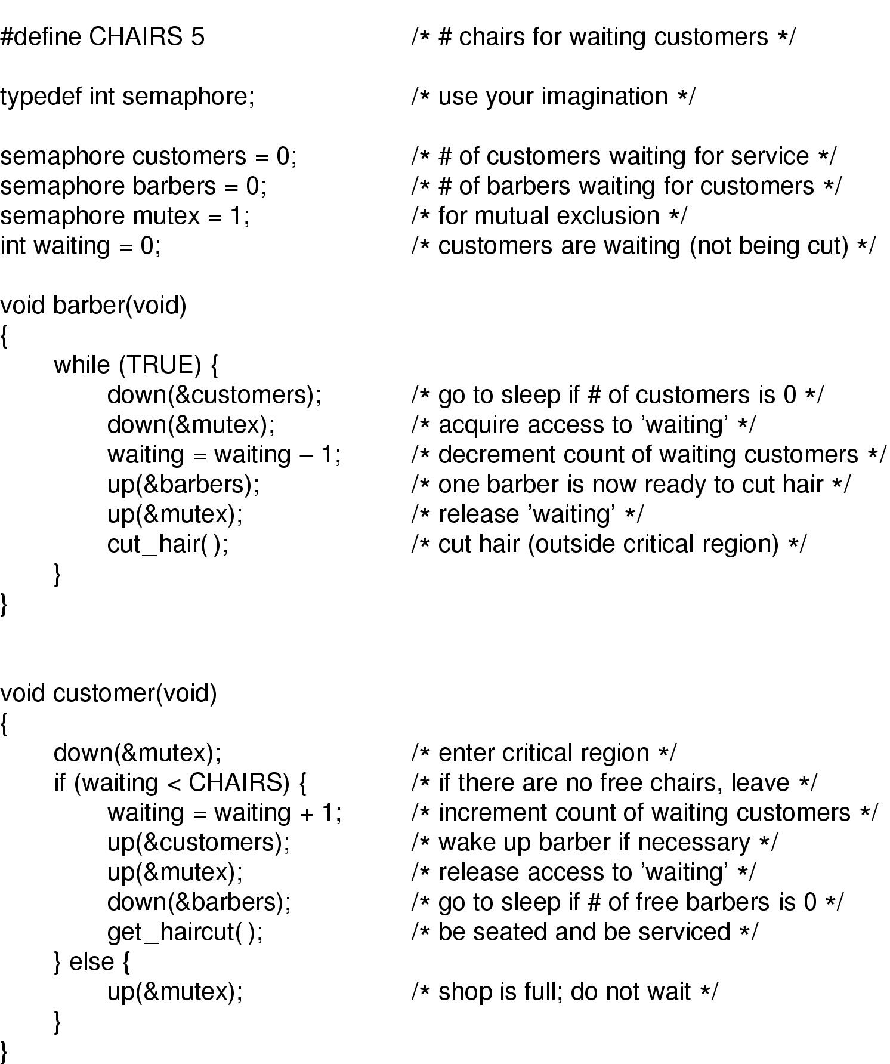
The Sleeping Barber Solution (1)

Slide 26
The Sleeping Barber Solution (2)

Slide 27
The Sleeping Barber Solution (3)
Solution to sleeping barber problem.

Slide 28
Message Passing
Send (destination, &message)
Receive (source, &message)
Message size: Fixed or Variable size.
Real life analogy: conversation

Slide 29
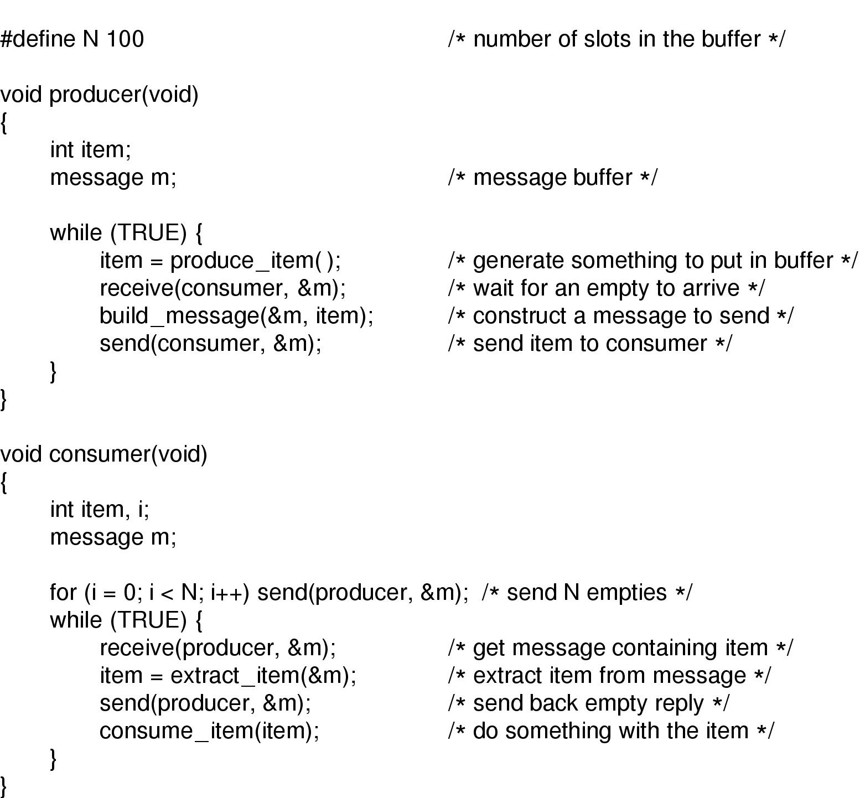
Message Passing

Slide 30
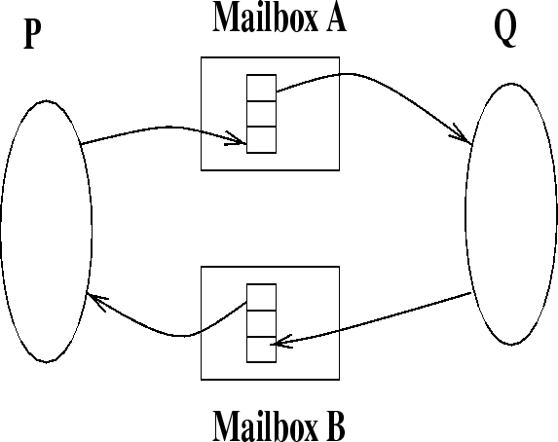
Indirect Communication
send(A,message) /* send a message to mailbox A */
receive(A,message) /* receive a message from mailbox A */
Mailbox is an abstract object into which a message can be placed to or removed from.

Slide 31
Advantage with Indirect Communication
Allows greater variety of schemes:
  two processes per link
  1 link per pair processes
  uni or bidirectional
  allow 1 process to receive a message from a link
  allow 1 process to all receive a message from a link

Slide 32
Reminder
Next lecture: Synchronization (chapter 2.3 & 2.4)
Quiz1 due today at 5pm(only 1 try)
Demo of Dinning Philosopher Solution
  3-4 philosophers
  Mutex (a person or other method)
MP1

