Slide 1
CS323 Operating Systems
Deadlock
Yuanyuan Zhou
Lecture 11
2/14/2003

Slide 2
Content of this lecture
Administrative announcements
Resource
Deadlock
Deadlock prevention
Summary

Slide 3
Administrative
None

Slide 4
Review: IPC
Data races
Critical regions and mutual exclusions
Solutions:
  Peterson’s solution
  TSL
  Semaphores & Mutex
  Monitor
  Barrier
  Message Passing
Classic IPC Problems

Slide 5
Resource (1)
A resource is a commodity needed by a process.
Resources can be either:
  serially reusable: e.g., CPU, memory, disk space, I/O devices, files.
  acquire → use → release
  consumable: produced by a process, needed by a process; e.g., messages, buffers of information, interrupts.
  create → acquire → use
  Resource ceases to exist after it has been used, so it is not released.

Slide 6
Resource (2)
Resources can also be either:
  preemptible: e.g., CPU, central memory or
  non-preemptible: e.g., tape drives.
And resources can be either:
  shared among several processes or
  dedicated exclusively to a single process.

Slide 7
Using Semaphore to Share Resource
Process P();
{ A.Down();
B.Down();
use both resource
B.Up();
A.Up(); }
Process Q();
{ A.Down();
B.Down();
use both resource
B.Up();
A.Up(); }
0
2
6
3
4
5
External Semaphore A(1), B(1);
2
External Semaphore A(0), B(1);
3
External Semaphore A(0), B(0);
4
External Semaphore A(0), B(1);
5
External Semaphore A(1), B(1);

Slide 8
But Deadlock can Happen!
1
Process P();
{ A.Down();
B.Down();
use both resources
B.Up();
A.Up(); }
Process Q();
{ B.Down();
A.Down();
use both resources
A.Up();
B.Up(); }
1
2
3
DEADLOCK
1
External Semaphore A(1), B(1);
2
External Semaphore A(0), B(1);
3
External Semaphore A(0), B(0);

Slide 9







Deadlock
Mechanism for Deadlock
Control

Slide 10
Deadlock Definition
What is a deadlock?
  A process is deadlocked if it is waiting for an event that will never occur.
  Typically, but not necessarily, more than one process will be involved together in a deadlock (the deadly embrace).
Is deadlock the same as starvation (or indefinitely postponed)?
  A process is indefinitely postponed if it is delayed repeatedly over a long period of time while the attention of the system is given to other processes. I.e., logically the process may proceed but the system never gives it the CPU.

Slide 11
Conditions for Deadlock
What conditions should exist in order to lead to a deadlock
Group discussion (2 minutes)
  Can use real life analogy such as
    “You take the monitor, I grab the keyboard”
    Cars in intersection

Slide 12
Necessary and Sufficient Conditions for Deadlock
Mutual exclusion
  Processes claim exclusive control of the resources they require
Wait-for condition
  Processes hold resources already allocated to them while waiting for additional resources
No preemption condition
  Resources cannot be removed from the processes holding them until used to completion
Circular wait condition
  A circular chain of processes exists in which each process holds one or more resources that are requested by the next process in the chain

Slide 13
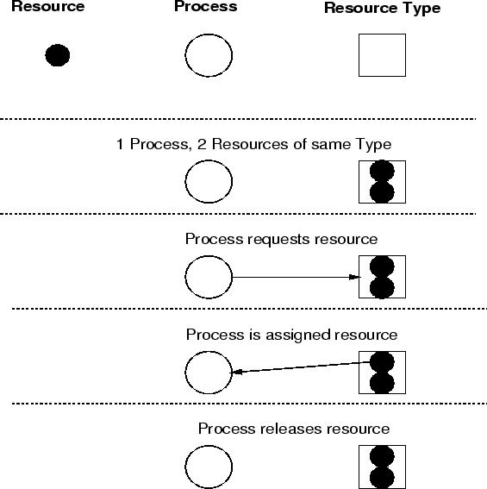
Resource Allocation Graph

Slide 14
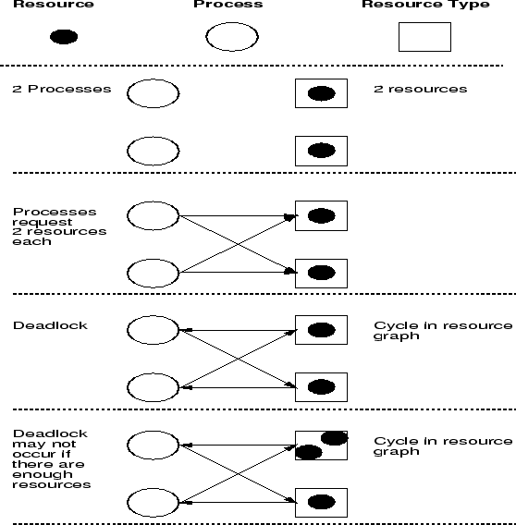
Deadlock Model

Slide 15
Deadlock Issues
Prevention
  design a system in such a way that deadlocks cannot occur, at least with respect to serially reusable resources.
Avoidance
  impose less stringent conditions than for prevention, allowing the possibility of deadlock, but sidestepping it as it approaches.
Detection
  in a system that allows the possibility of deadlock, determine if deadlock has occurred, and which processes and resources are involved.
Recovery
  after a deadlock has been detected, clear the problem, allowing the deadlocked processes to complete and the resources to be reused. Usually involves destroying the affected processes and starting them over.

Slide 16
The Ostrich Algorithm
Don’t do anything, simply restart the system (stick your head into the sand, pretend there is no problem at all).
Rational: make the common path faster and more reliable
  Deadlock prevention, avoidance or detection/recovery algorithms are expensive
  if deadlock occurs only rarely, it is not worth the overhead to implement any of these algorithms.

Slide 17
Group Discussion
How do we prevent deadlocks?
  You can use real life analogies
  If you cannot give an answer, you are like an “ostrich”?

Slide 18
Deadlock Prevention: Havender's Algorithms
Break one of the deadlock conditions.
  Mutual exclusion
    Solution: exclusive use of resources is an important feature, but for some resources (virtual memory, virtual disks, CPU), it is possible.
  Hold-and-Wait condition
    Solution: Force each process to request all required resources at once. It cannot proceed until all resources have been acquired.
  No preemption condition
    Solution: If a process holding some reusable resources makes a further request which is denied, and it wishes to wait for the new resources to become available, it must release all resources currently held and, if necessary, request them again along with the new resources. Thus, resources are removed from a process holding them.
  Circular wait condition
    Solution: All resource types are numbered. Processes must request resources in numerical order; if a resource of type is held, the only resources which can be requested must be of types .

Slide 19
Two-Phase Locking
Phase One
  process tries to lock all records it needs, one at a time
  if needed record found locked, start over
  (no real work done in phase one)
If phase one succeeds, it starts second phase,
  performing updates
  releasing locks
Note similarity to requesting all resources at once
Algorithm works where programmer can arrange program can be stopped, restarted

Slide 20
Break Circular Wait Condition
Request one resource at a time. Release the current resource when request the next one
Global ordering of resources
  Requests have to made in increasing order
  Req(resource1), req(resource2)..
  Why no circular wait?

Slide 21
Summary: Deadlock Prevention
condition | How to break it
Mutual Exclusion | Spool everything
Hold and wait | Request all resources initially
No preemption | Take resources away
Circular wait | Order resources numerically

Slide 22
Reminder
MP1 due tonight 11:59pm
MP2 starts next week
  Start earlier, don’t wait until the last week.
  Tutorial next week

