Slide 1
CS323 Operating Systems
Deadlock II
Yuanyuan Zhou
Lecture 12
2/17/2003

Slide 2
Content of this lecture
Administrative announcements
Deadlock avoidance
Deadlock detection
Summary

Slide 3
Administrative
MP2 starts today

Slide 4
Review
Resource: preemptible or non-preemptible
Deadlock conditions
  Mutual exclusion
  Hold and wait
  Non-preemption
  Circular wait
Deadlock prevention
  Break the condition
  2-phase locking

Slide 5

Dining Philosophers:Demo
Philosophers eat/think
Eating needs 2 forks
Pick one fork at a time
Possible deadlock?
How to prevent deadlock?

Slide 6
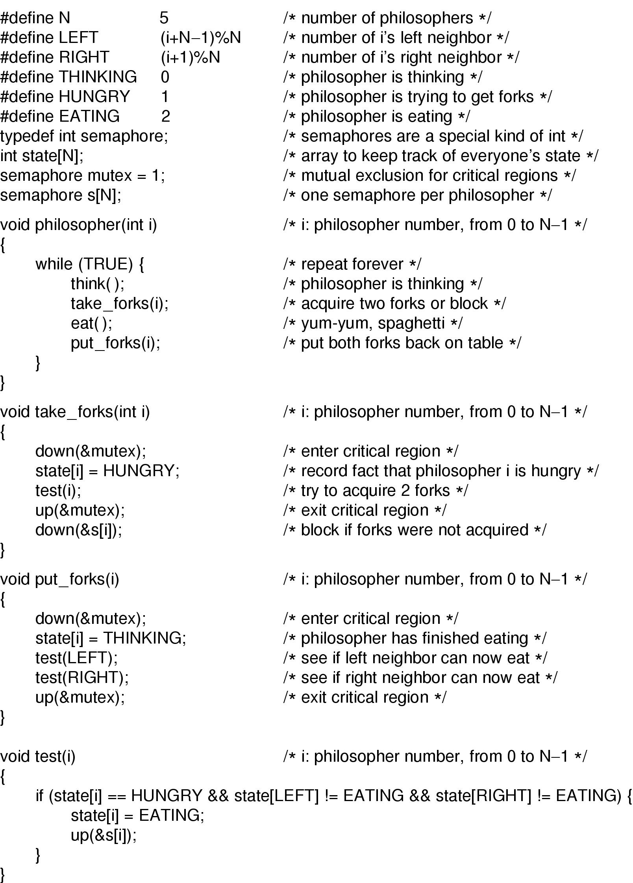
Dining Philosophers Solution

Slide 7
Dining Philosophers Solution

Slide 8
Deadlock Avoidance
The system needs to know the resource ahead of time
Banker Algorithm (Dijkstra, 1965)
  Each customer tells banker the maximum number of resources it needs
  Customer borrows resources from banker
  Customer returns resources to banker
  Customer eventually pays back loan
  Banker only lends resources if the system will be in a safe state after the loan
Safe state - there is a lending sequence such that all customers can take out a loan
Unsafe state - there is a possibility of deadlock

Slide 9
Safe State and Unsafe State
Safe State
  there is some scheduling order in which every process can run to completion even if all of them suddenly request their maximum number of resources immediately
  From safe state, the system can guarantee that all processes will finish
Unsafe state: no such guarantee
  Not deadlocked state
  Some process may be able to complete

Slide 10
How to Compute Safety
Given:
n kinds of resources
p processes
Set P of processes
struct {resource needs[n], owns[n]} ToDo[p]
resource_available[n]
while there exists a p in P such that
for all i (ToDo[p].needs[i] < available[i] )
{ do for all i
available[i] += ToDo[p].owns[i];
P = P - p;
}
If P is empty then system is safe

Slide 11
Is Allocation (1 0 2) to P1 Safe?
Process
Alloc
Max
Need
Available
A
B
C
A
B
C
A
B
C
A
B
C
P0
0
1
0
7
5
3
7
4
3
10
5
5
P1
2
0
0
3
2
2
1
2
2
3
3
2
P2
3
0
0
9
0
2
6
0
2
P3
2
1
1
2
2
2
0
1
1
P4
0
0
2
4
3
3
4
3
1
If P1 requests max resources, can complete

Slide 12
And Run Safety Test: Group Discussion
Process
Alloc
Max
Need
Available
A
B
C
A
B
C
A
B
C
A
B
C
P0
0
1
0
7
5
3
7
4
3
10
5
5
P1
3
0
2
3
2
2
0
2
0
2
3
0
P2
3
0
0
9
0
2
6
0
2
P3
2
1
1
2
2
2
0
1
1
P4
0
0
2
4
3
3
4
3
1
If P1 requests max resources, can complete

Slide 13
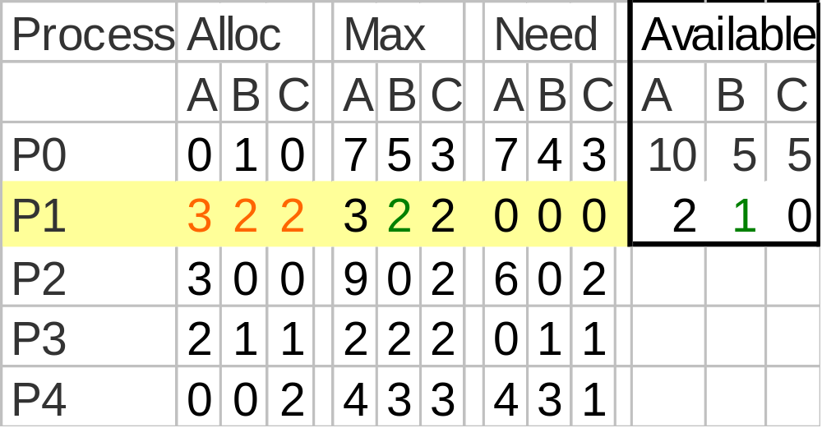
Allocate to P1, Then

Slide 14
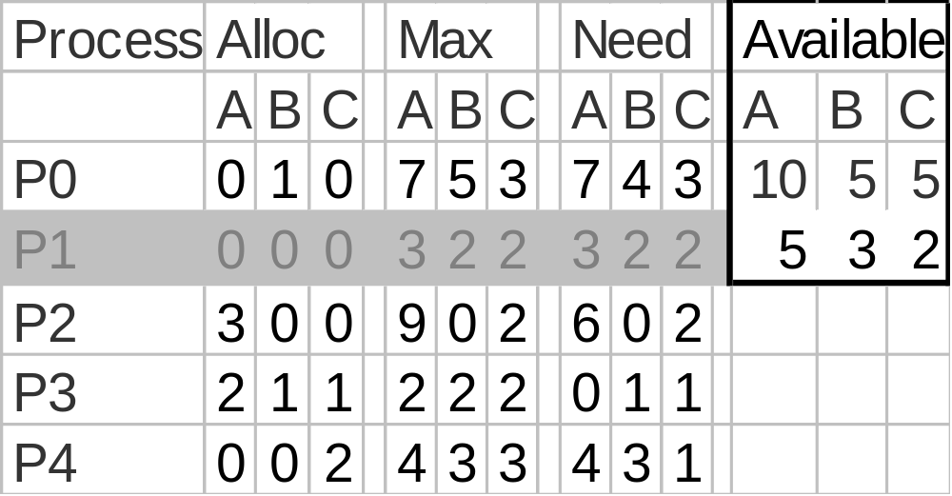
Release - P1 Finishes
Now P3 can acquire max resources and release

Slide 15
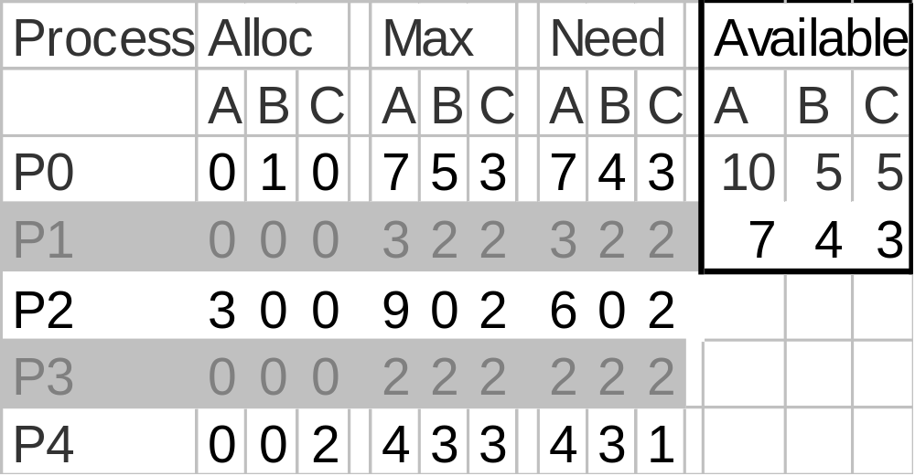
Release - P3 Finishes
Now P4 can acquire max resources and release

Slide 16
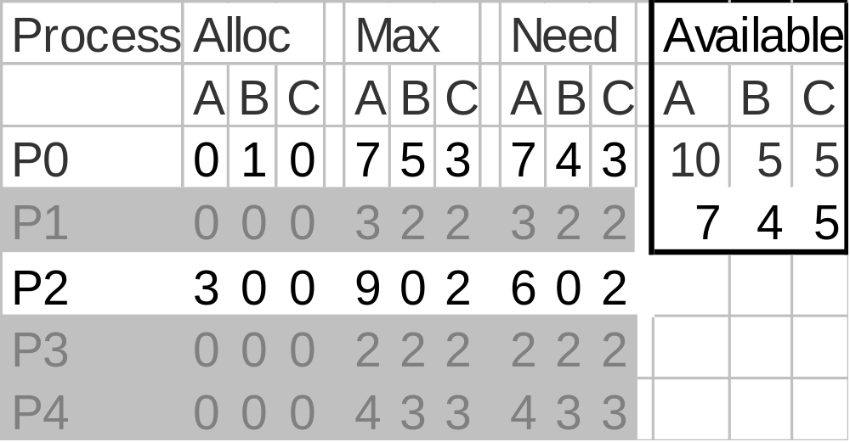
Release - P4 Finishes
Now P2 can acquire max resources and release

Slide 17
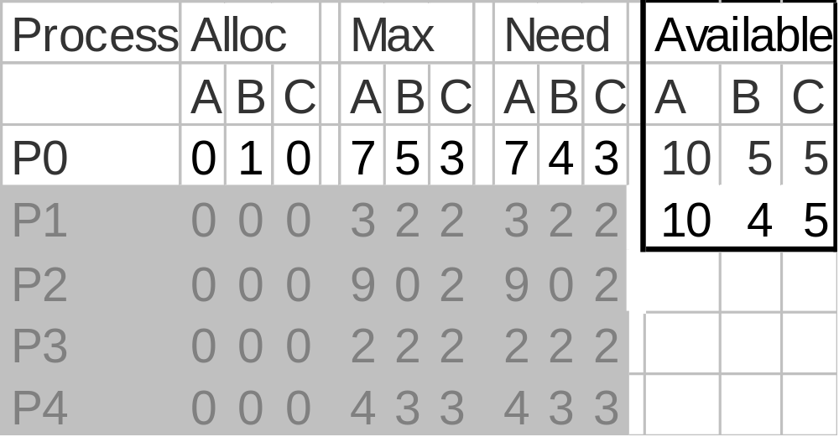
Release - P2 Finishes
Now P0 can acquire max resources and release

Slide 18
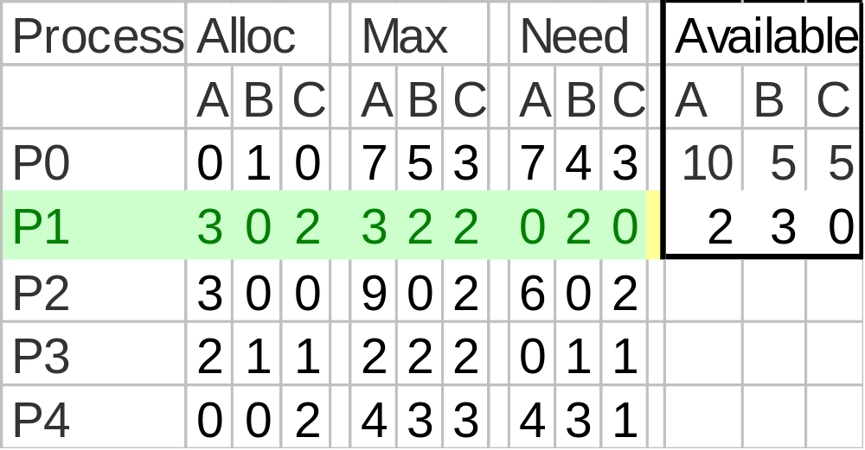
So P1 Allocation (1 0 2) Is Safe

Slide 19
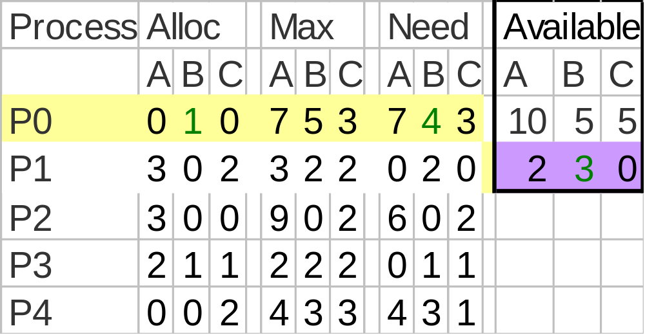
Is allocation (0 2 0) to P0 Safe?
Try to Allocate 2 B to P0

Slide 20
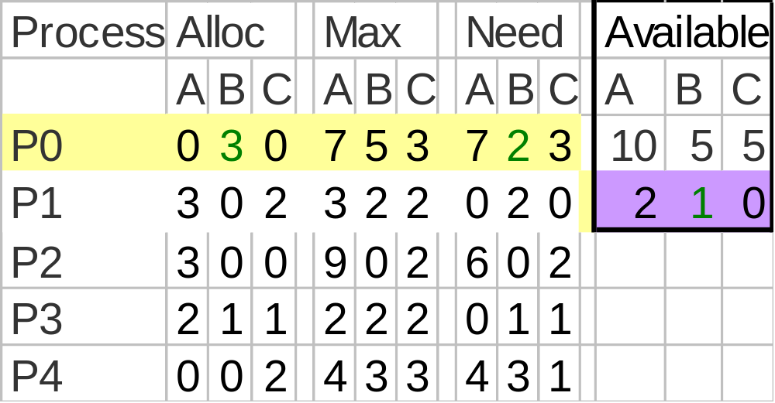
Run Safety Test
No Processes may get max resources and release

Slide 21
So Unsafe State- Do Not Enter
Return to Safe State and do not allocate resource

Slide 22
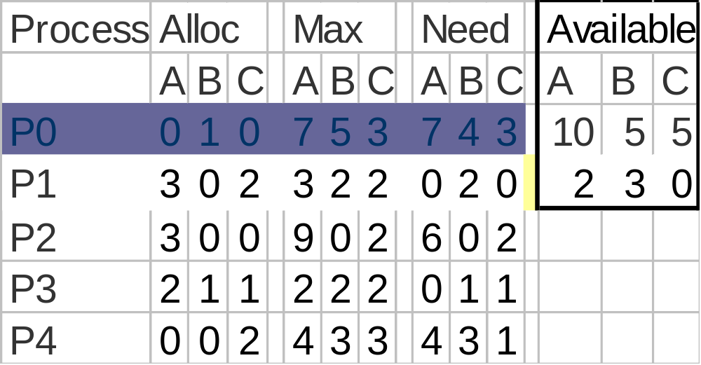
P0 Suspended Pending Request
When enough resources become available, P0 can awake

Slide 23
Results
P0’s request for 2 Bs cannot be granted because that would prevent any other process from completing if they need their maximum claim

Slide 24
Just Because Its Unsafe---
P0 could have been allocated 2 Bs and a deadlock might not have occurred if:
  P2 say didn’t use its maximum resources but finished using the resources it had

Slide 25
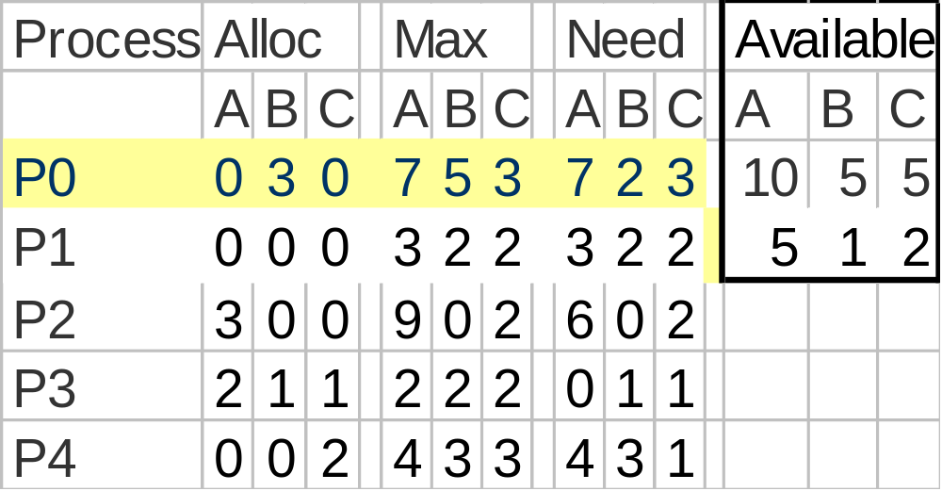
If P1 Doesn’t Need Max---
Then P0 would have finished…

Slide 26
Tradeoff
The banker’s algorithm is conservative --- it reduces parallelism for safety sake
What is the trade-off?

Slide 27
Banker Solution Issues
Process may not terminate
Process may request more than claim
A process may suffer indefinite postponement
  Solution is to check for aged process
  Select an allocation sequence that includes aged process
  Only select requests that follow that sequence until aged process executes

Slide 28
Deadlock Detection
Check to see if a deadlock has occurred!
Single resource per type
  Can use wait-for graph
  Check for cycles
  O(n²)

Slide 29
Wait for Graphs
Resource Allocation Graph
Corresponding Wait For Graph

Slide 30
How to find a circle?
Group discussion (2 minutes)
  Similar to tree traversal

Slide 31
Multiple resources per type
Run variant of banker’s algorithm to see if processes can finish
  time: O(mn2), m: #resources, n: #processes
Optimistic version --- check only that at least one process can finish
  The deadlock detection is delayed
How often should the detection algorithm be run?

Slide 32
Reminder
Next lecture
  Deadlock Recovery
  Memory Management
MP2 starts this week
  Start earlier
  Tutorial this week

