Slide 1
CS323 Operating Systems
Deadlock III &
Memory Management
Yuanyuan Zhou
Lecture 13
2/17/2003

Slide 2
Content of this lecture
Administrative announcements
Deadlock recovery
Memory Management
Summary

Slide 3
Administrative
MP2 tutorials
  Wed 6-7pm, 1310 DCL
  Thu 6:30-7:30pm, 1310 DCL
Quiz2 next week
  Chapter 2 & 3

Slide 4
Review
Resource: preemptible or non-preemptible
Deadlock avoidance
  Unsafe vs. safe state
  Banker algorithm
Deadlock detection
  Wait graph

Slide 5
Recovery From Deadlock
OPTIONS:
  Kill deadlocked processes and release resources
  Kill one deadlocked process at a time and release its resources
  Rollback all or one of the processes to a checkpoint that occurred before they requested any resources
Note: with rollback, difficult to prevent indefinite postponement

Slide 6
Deadlock Summary
In general, deadlock detection or avoidance is expensive
Must evaluate cost of deadlock against detection or avoidance costs
Deadlock avoidance and recovery may cause indefinite postponement
Unix and Windows use Ostrich Algorithm

Slide 7
Memory Management
Storage Hierarchy
Resident Monitor
Fixed Partitions for
Spooling and Multiprogramming
Variable Sized Partitions
Storage Placement Strategies
Compaction

Slide 8
Storage Hierarchy
Cost
$600 a chip
$10⁻² per byte
$10⁻⁴ per byte
$10⁻⁸ per byte
Size
2¹³ bytes
2²⁷ bytes
2³⁰ bytes
2⁴⁰ bytes
CPU Reg
32-64 bits
Cache
4-128 words
Memory
512-16k words
Secondary Storage

Slide 9
Group Discussion
Why storage hierarchy? Or benefits of storage hierarchy?

Slide 10
General Memory Problem
We have a limited (expensive) physical resource: main memory
We want to use it as efficiently as possible
We have an abundant, slower resource: disk

Slide 11
Lots of Variants
Many programs, total size less than memory
  Technically possible to pack them together
  Will programs know about each other’s existence?
One program, using lots of memory
  Can you only keep part of the program in memory?
Lots of programs, total size exceeds memory
  What programs are in memory, and how to decide?

Slide 12
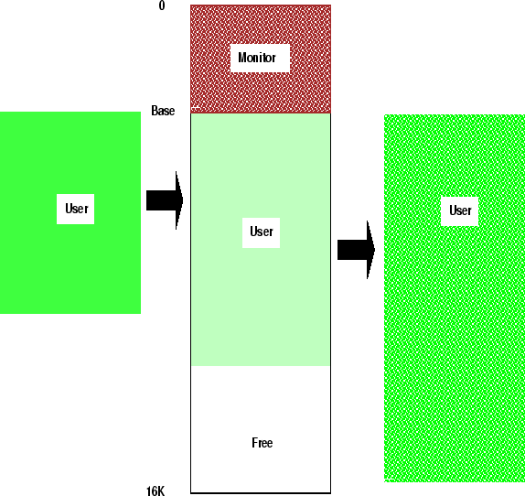
Memory Manager
Manage memory hierarchy
  Monitor used and free memory
  Allocate memory to processes
  Reclaim (De-allocate) memory
  Swapping between main memory and disk

Slide 13
Mono-programming without Swapping
Run one process at a time
  simplest possible memory management scheme
Memory is shared only between OS and the process.
Three different ways to organize memory:
  OS at the bottom of memory in RAM (Random Access Memory); was used in mainframes and minicomputers; not used anymore
  OS is in ROM (Read-Only Memory) at the top of memory; is used in some palm-tops and embedded systems
  Device drivers are in ROM at the top of memory and the rest is in RAM; was used by early PCs (e.g., running MS-DOS), where the portion in the ROM is called BIOS (Basic Input Output System).

Slide 14
Overlaying
Used when process memory requirement exceeds the physical memory space
Secondary Storage
Main Program
Overlay 1
0K
5k
Overlay Manager
Overlay 2
7k
Overlay Area
Overlay 1
Overlay 2
Overlay 3
Overlay 1
12k
Overlay 3

Slide 15
Multiprogramming with Fixed Partitions
Divide memory into n (possible unequal) partitions.
Problem:
  Fragmentation
0k
4k
16k
64k
Free Space
128k

Slide 16
Fixed Partition Allocation
Separate input queue for each partition
  Requires sorting the incoming jobs and putting them into separate queues
  Inefficient utilization of memory
    when the queue for a large partition is empty but the queue for a small partition is full. Small jobs have to wait to get into memory even though plenty of memory is free.
One single input queue for all partitions.
  Allocate a partition where the job fits in.
    Best Fit
    Available Fit

Slide 17
Relocation
Correct starting address when a program should start in the memory
Different jobs will run at different addresses
  When a program is linked, the linker must know at what address the program will begin in memory.
Logical addresses, Virtual addresses
  Logical address space , range (0 to max)
Physical addresses, Physical address space
  range (R+0 to R+max) for base value R.
User program never sees the real physical addresses
Memory-management unit (MMU)
  map virtual to physical addresses.
relocation register
  Mapping requires hardware (MMU) with the base register

Slide 18
Relocation Register
Base Register
Memory
BA
CPU
Instruction
Address
Logical
Address
Physical
Address
+
MA
MA+BA

Slide 19

Protection
Problem:
  How to prevent a malicious process to write or jump into other user's or OS partitions
Solution:
  Base bounds registers

Slide 20
Base Bounds Registers
Bounds Register
Base Register
Memory
Base Address
Logical
Address LA
Base
Address
BA
CPU
Address
<
+
MA+BA
Memory
Address
MA
Physical
Address
PA
Limit Address
Fault

Slide 21
Swapping
Move a part of or the whole process to disk
Allows several processes to share a fixed partition
Processes that grow can be swapped out and swapped back in a bigger partition

Slide 22
Swapping
Monitor
Disk
User 1
User
Partition

Slide 23
Swapping
Monitor
Disk
User 1
User 1
User
Partition

Slide 24
Swapping
Monitor
Disk
User 1
User 1
User
Partition
User 2

Slide 25
Swapping
Monitor
Disk
User 1
User 2
User
Partition
User 2

Slide 26
Swapping
Monitor
Disk
User 1
User 2
User
Partition
User 2

Slide 27
Swapping
Monitor
Disk
User 1
User 1
User
Partition
User 2

Slide 28
Variable Partitions and Fragmentation
1
Monitor
Job 1
Job 2
Job 3
Job 4
Free
2
Monitor
Job 1
Job 3
Job 4
Free
3
Monitor
Job 1
Job 5
Job 3
Job 4
Free
4
Monitor
Job 5
Job 3
Job 4
Free
Job 6
5
Monitor
Job 7
Job 5
Job 3
Job 8
Free
Job 6
Memory wasted by External Fragmentation

Slide 29
Reminder
Next lecture: Memory Management
MP2

