Slide 1
CS323 Operating Systems
Memory Management II
Yuanyuan Zhou
Lecture 14
2/21/2003

Slide 2
Content of this lecture
Administrative announcements
Storage Management
Virtual Memory and Paging
Summary

Slide 3
Administrative
MP2

Slide 4
Review
Memory Manager
  Monitor used and free memory
  Allocate memory to processes
  Reclaim (De-allocate) memory
  Swapping between main memory and disk
Mono-programming memory management
  Overlay
Multi-programming memory management
  Fixed partition
  Relocation and protection

Slide 5
Swapping
Move a part of or the whole process to disk
Allows several processes to share a fixed partition
Processes that grow can be swapped out and swapped back in a bigger partition

Slide 6
Swapping
Monitor
Disk
User 1
User
Partition

Slide 7
Swapping
Monitor
Disk
User 1
User 1
User
Partition

Slide 8
Swapping
Monitor
Disk
User 1
User 1
User
Partition
User 2

Slide 9
Swapping
Monitor
Disk
User 1
User 2
User
Partition
User 2

Slide 10
Swapping
Monitor
Disk
User 1
User 2
User
Partition
User 2

Slide 11
Swapping
Monitor
Disk
User 1
User 1
User
Partition
User 2

Slide 12
Variable Partitions and Fragmentation
1
Monitor
Job 1
Job 2
Job 3
Job 4
Free
2
Monitor
Job 1
Job 3
Job 4
Free
3
Monitor
Job 1
Job 5
Job 3
Job 4
Free
4
Monitor
Job 5
Job 3
Job 4
Free
Job 6
5
Monitor
Job 7
Job 5
Job 3
Job 8
Free
Job 6
Memory wasted by External Fragmentation

Slide 13
Memory Management with Bitmaps
Use bitmaps for free lists.
Memory is divided into allocation units.
  One allocation unit corresponds to 1bit in the bitmap
  0: free, 1: allocated
Size of allocation unit
  The smaller the allocation unit, the larger the bitmap.
Problem: allocation
  When a new process arrives, the manager must find consecutive 0 bits in the map.
  Searching a bitmap for a run of a given length is a slow operation.
1
0
1
0
1
0
0
0
1
0
1
0
0
1
0

Slide 14
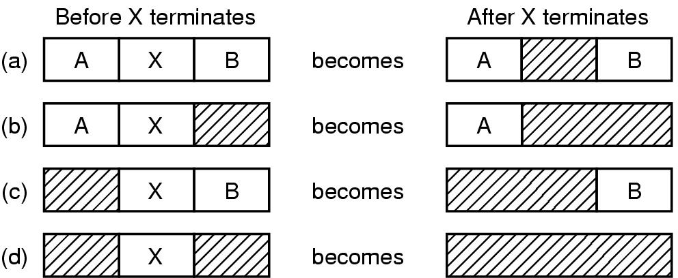
Memory Management with Linked Lists
Use a linked list of allocated and free memory segments (called hole)
  sorted by the address or by the size
Four neighbor combinations for the terminating process X

Slide 15
Storage Placement Strategies
Analogy:
  Shoe Fitting
  Valet parking
Best Fit
  Use the hole whose size is equal to the need, or if none is equal, the hole that is larger but closest in size.
  Problem: Creates small holes that can't be used.
First Fit
  Use the first available hole whose size is sufficient to meet the need.
  Problem: Creates average size holes.
Next Fit.
  Minor variation of first fit: search for the last hole stopped.
  Problem: slightly worse performance than first fit.
Worst Fit.
  Use the largest available hole.
  Problem: Gets rid of large holes making it difficult to run large programs.
Quick Fit.
  maintains separate lists for some of the more common sizes requested.
  When a request comes for placement it finds the closest fit.
  This is a very fast scheme, but a merge is expensive. If merge is not done, memory will quickly fragment in a large number of holes into which no processes fit.

Slide 16
Compaction (Similar to Garbage Collection)
Assumes programs are all relocatable
Processes must be suspended during compaction
Need be done only when fragmentation gets very bad
5
Monitor
Job 7
Job 5
Job 3
Job 8
Free
Job 6
6
Monitor
Job 7
Job 5
Job 3
Job 8
Free
Job 6
7
Monitor
Job 7
Job 5
Job 3
Job 8
Free
Job 6
8
Monitor
Job 7
Job 5
Job 3
Job 8
Free
Job 6
9
Monitor
Job 7
Job 5
Job 3
Job 8
Job 6
Free

Slide 17
Multiple Base Registers
Break programs into smaller units because they will fit better
Use multiple base registers, one for each unit
Examples
  Code/Data
  Constants/variables

Slide 18
Storage Management Problems
Fixed partitions suffer from internal fragmentation
Variable partitions suffer from external fragmentation
Compaction suffers from overhead
Partitions must be less in size than real memory
Overlays are painful to program efficiently
Swapping requires writing to disk sectors

Slide 19
How Bad Is Fragmentation?
Statistical arguments - Random sizes
First-fit
Given N allocated blocks
0.5∗N blocks will be lost because of fragmentation
Known as 50% RULE

Slide 20
Virtual Memory
Provide user with virtual memory that is as big as user needs
Store virtual memory on disk
Cache parts of virtual memory being used in real memory
Load and store cached virtual memory without user program intervention

Slide 21
Why Use Virtual Memory
Group Discussion (2 minutes)

Slide 22
Benefits of Virtual Memory
Use secondary storage($)
  Extend DRAM($$$) with reasonable performance
Protection
  Programs do not step over each other
Convenience
  Flat address space
  Programs have the same view of the world
  Load and store cached virtual memory without user program intervention
Reduce fragmentation:
  make cacheable units all the same size (page)
Remove memory deadlock possibilities:
  permit pre-emption of real memory

Slide 23
Paging Request
Real Memory
Request Page 3
Page Table
1
Memory
VM
Frame
3
1
2
2
3
3
1
2
3
4
4
4
Virtual Memory Stored on Disk
Disk
1
2
3
4
5
6
7
8

Slide 24
Paging
Real Memory
Request Page 1
Page Table
1
Memory
VM
Frame
3
1
2
1
2
3
3
1
2
3
4
4
4
Virtual Memory Stored on Disk
Disk
1
2
3
4
5
6
7
8

Slide 25
Paging
Real Memory
Request Page 6
Page Table
1
Memory
VM
Frame
3
1
2
1
2
6
3
3
1
2
3
4
4
4
Virtual Memory Stored on Disk
Disk
1
2
3
4
5
6
7
8

Slide 26
Paging
Real Memory
Request Page 2
Page Table
1
Memory
VM
Frame
3
1
2
1
2
6
3
3
1
2
3
4
2
4
4
Virtual Memory Stored on Disk
Disk
1
2
3
4
5
6
7
8

Slide 27
Paging
Real Memory
Request Page 8: Swap page 2
to disk first
Page Table
1
Memory
VM
Frame
3
1
2
1
2
6
3
3
1
2
3
4
2
4
4
Virtual Memory Stored on Disk
Disk
1
2
3
4
5
6
7
8

Slide 28
Paging
Real Memory
Load Page 8 to Memory
Page Table
1
Memory
VM
Frame
3
1
2
8
2
6
3
3
1
2
3
4
2
4
4
Virtual Memory Stored on Disk
Disk
1
2
3
4
5
6
7
8

Slide 29
Page Mapping Hardware
Virtual Memory
Virtual Address (P,D)
Page Table
P
P
D
0
D
P
1
Contents(P,D)
0
P-> F
1
1
0
Physical Memory
1
F
D
F
Physical Address (F,D)
Contents(F,D)
D

Slide 30
Page Mapping Hardware
Virtual Memory
Virtual Address (004006)
Page Table
004
004
006
0
006
4
1
Contents(4006)
0
4-> 5
1
1
0
Physical Memory
1
005
006
005
Physical Address (F,D)
Page size 1000
Number of Possible Virtual Pages 1000
Number of Page Frames 8
Contents(5006)
006

Slide 31
Reminder
MP2

