Slide 1
CS323 Operating Systems
Memory Management III
Yuanyuan Zhou
Lecture 15
2/24/2003

Slide 2
Content of this lecture
Administrative announcements
Page Table and TLB
Multi-level Paging
Inverted Page Table
Protection
Summary

Slide 3
Administrative
Quiz2 starts
MP2

Slide 4
Review
Storage management
  Bitmap or link list
  Compaction
  Best fit, quick fit, first fit, next fit, worst fit
Virtual Memory
Paging
  Page fault

Slide 5
Page Mapping Hardware (page hit)
Virtual Memory
Virtual Address (P,D)
Page Table
P
P
D
0
D
P
1
Contents(P,D)
0
P-> F
1
1
0
Physical Memory
1
F
D
F
Physical Address (F,D)
Contents(F,D)
D

Slide 6
Page Mapping Hardware
Virtual Memory
Virtual Address (004006)
Page Table
004
004
006
0
006
4
1
Contents(4006)
0
4-> 5
1
1
0
Physical Memory
1
005
006
005
Physical Address (F,D)
Page size 1000
Number of Possible Virtual Pages 1000
Number of Page Frames 8
Contents(5006)
006

Slide 7
Page Fault
Access a virtual page that is not mapped into any physical page
  A fault is triggered by hardware
Page fault handler (by VM Software, a part of OS)
  Find if there is any free physical page available
    If no, evict some resident page to disk (swapping space)
  Allocate a free physical page
  Load the faulted virtual page to the prepared physical page
  Modify the page table

Slide 8
Paging Issues
Page size is 2^{n}
  usually 512, 1k, 2k, 4k, or 8k
  E.g. 32 bit VM address may have 2²⁰ (1MB) pages with 4k (2¹² ) bytes per page
Page table:
  2²⁰ page entries take 2²² bytes (4MB)
  page frames must map into real memory
  Page Table base register must be changed for context switch
NO External fragmentation, Internal fragmentation on last page ONLY

Slide 9
Virtual-To-Physical Lookups
Programs only know virtual addresses
  The page table can be extremely large
Each virtual address must be translated
  May involve walking hierarchical page table
  Page table stored in memory
  So, each program memory access requires several actual memory accesses
Solution: cache “active” part of page table
  TLB also called “associative memory”

Slide 10
Translation Look-aside Buffer (TLB)
Virtual address
VPage #
offset
VPage#
PPage#
...
Real
page
table
VPage#
PPage#
...
Miss
.
.
.
VPage#
PPage#
...
TLB
Hit
PPage #
offset
Physical address

Slide 11
TLB Function
If a virtual address is presented to MMU, the hardware checks TLB by comparing all entries simultaneously (in parallel).
If match is valid, the page is taken from TLB without going through page table.
If match is not valid
  MMU detects miss and does an ordinary page table lookup.
  It then evicts one page out of TLB and replaces it with the new entry, so that next time that page is found in TLB.

Slide 12
Page Mapping Hardware
Virtual Memory Address (P,D)
Page Table
P
D
Associative Look Up
0
P
1
P
F
0
P-> F
First
1
1
0
1
F
D
Physical Address (F,D)

Slide 13
Page Mapping Example
Virtual Memory Address (P,D)
Page Table
004
006
Associative Look Up
0
1
12
4
1
7
4
6
9
0
First
19
3
004-> 009
1
3
7
1
0
Table organized by
LRU
1
009
006
Physical Address (F,D)
Notes:
First access, retrieve page from page table

Slide 14
Page Mapping Example: next reference
Virtual Memory Address (P,D)
Page Table
004
006
Associative Look Up
0
1
12
4
1
4
9
0
First
19
3
004-> 009
1
3
7
1
0
Table organized by
LRU
1
009
006
Physical Address (F,D)
Notes:
Second access, retrieve page from associative registers.

Slide 15
Bits in a TLB Entry
Common (necessary) bits
  Virtual page number: match with the virtual address
  Physical page number: translated address
  Valid
  Access bits: kernel and user (nil, read, write)
Optional (useful) bits
  Process tag
  Reference
  Modify
  Cacheable

Slide 16
Paging Implementation Issues
TLB can be implemented using
  Associative registers
  Look-aside memory
  Content-addressable memory
TLB hit ratio (Page address cache hit ratio)
  Percentage of time page found in associative memory

Slide 17
Hardware-Controlled TLB
On a TLB miss (different from page fault)
  Hardware loads the PTE into the TLB
    Need to write back if there is no free entry
  Generate a fault if the page containing the PTE is invalid
  VM software performs fault handling
  Restart the CPU
On a TLB hit, hardware checks the valid bit
  If valid, pointer to page frame in memory
  If invalid, the hardware generates a page fault
    Perform page fault handling
    Restart the faulting instruction

Slide 18
Software-Controlled TLB
On a miss in TLB, VM software
  Write back if there is no free entry
  Check if the page containing the PTE is in memory
  If no, perform page fault handling
  Load the PTE into the TLB
  Restart the faulting instruction
On a hit in TLB, the hardware checks valid bit
  If valid, pointer to page frame in memory
  If invalid, the hardware generates a page fault
    Perform page fault handling
    Restart the faulting instruction
Example: RISC including SPARC, Alpha, MIPS, HP PA

Slide 19
Hardware vs. Software Controlled
Hardware approach
  Efficient
  Inflexible
  Need more space for page table
Software approach
  Flexible
  Software can do mappings by hashing
    PP# → (Pid, VP#)
    (Pid, VP#) → PP#
  Can deal with large virtual address space

Slide 20
Group Discussion
Similarity between Cache and TLB
Difference between Cache and TLB

Slide 21
Cache vs. TLBs
Similarities
  Both cache a portion of memory
  Both write back on a miss
Combine L1 cache with TLB
  Virtually addressed cache
  Why wouldn’t everyone use virtually addressed caches?
Differences
  Associativity
    TLB is usually fully set-associative
    Cache can be direct-mapped
  Consistency
    TLB does not deal with consistency with memory
    TLB can be controlled by software

Slide 22
Issues
What TLB entry to be replaced?
  Random
  Pseudo Least Recently Used (LRU)
What happens on a context switch?
  Process tag: change TLB registers and process register
  No process tag: Invalidate the entire TLB contents
What happens when changing a page table entry?
  Change the entry in memory
  Invalidate the TLB entry

Slide 23
Effective Access Time
TLB lookup time = ε time unit
Memory cycle -- m microsecond
TLB Hit ratio -- α
Effective access time
  Eat = (1m+ε)α+(2m+ε)(1-α)
  Eat = 2m+ε-α
Notes:
This is how much access time is sped up when memory address is derefenced to physical address using an associative register.

Slide 24
Multilevel Page Tables
Since the page table can be very large, one solution is to page the page table
Divide the page number into
  An index into a page table of second level page tables
  A page within a second level page table
Advantage
  No need to keeping all the page tables in memory all the time
  Only recently accessed memory’s mapping need to be kept in memory, the rest can be fetched on demand

Slide 25
Multiple-Level Page Tables
Virtual address
pte
dir
table
offset
.
.
.
Directory
.
.
.
.
.
.
.
.
.
What does this buy us? Sparse address spaces and easier paging

Slide 26
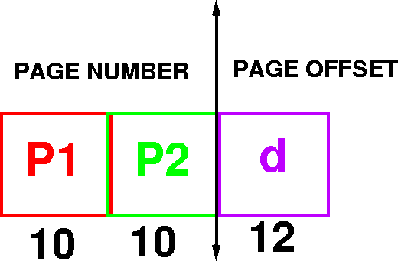
Example Addressing on a Multilevel Page Table System
A logical address (on 32 bit machine with 4k page size) is divided into
  A page number consisting of 20 bits
  A page offset consisting of 12 bits
Divide the page number into
  A 10-bit page number
  A 10-bit page offset

Slide 27
Multilevel Paging and Performance
Since each level is stored as a separate table in memory, converting a logical address to a physical one in a four-level paging may take five memory accesses. Why?

Slide 28
Inverted Page Tables
Physical
address
Main idea
  One PTE for each physical page frame
  Hash (Vpage, pid) to Ppage#
  Trade off space for time
Pros
  Small page table for large address space
Cons
  Lookup is difficult
  Overhead of managing hash chains, etc
Virtual
address
pid
vpage
offset
k
offset
0
pid
vpage
k
n-1
Inverted page table

Slide 29
Inverted Page Table
Virtual Address (004006)
Page Table
004
006
0
1
5
0
1
4
1
0
1
005
006
Physical Address (005006)

Slide 30
Inverted Page Table Implementation
TLB is same as before
TLB miss is handled by software
In-memory page table is managed using a hash table
  number of entries = number of physical frames
  Not found: page fault
Virtual page
Physical page
Hash table

Slide 31
Sharing Pages
Code and data can be shared among processes
  mapping them into pages with common page frame mappings
Code and data must be position independent if VM mappings for the shared data are different
Code and data cannot store VM addresses for functions and variables not in shared pages
Shared code and data usually are not position independent resulting in certain regions of memory being reserved for shared libraries and the operating system
Notes:
A relative jump forward to a location on the same page is position independent code. So is an offset of a data byte in a data structure if the data structure can be stored on one page.
However, virtual addresses cannot be stored in a shared page if they refer to page addresses that are mapped differently in the different virtual memories that share them.

Slide 32
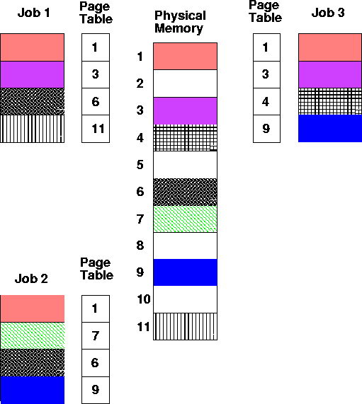
Shared Pages

Slide 33
Incorrect Sharing
Physical Memory
Virtual Memory 1
Virtual Memory 2
Load(3,5)
Load(3,5)
5
Load(3,5)
1
1
6
$20
$100
2
$100
$100
7
3
3
$20
8
Notes:
Program 1 and program 2 load a variable from the address 3,5
In VM 1's case 3 has a green mapping and the value selected
is $100. In VM2s case, there is a red mapping and the value selected is $20.

Slide 34
Protection
Can add read, write, execute protection bits to page table to protect memory
Check is done by hardware during access
shared memory location
  different protections from different processes
  Solution:
    associate protection lock with page frame. Each process has its own key. If the key fits the lock, the process may access the page frame

Slide 35
Protection
Typically many different keys can fit a lock using a priority numbering scheme
(E.G. Key 3 fits all locks 3, 7, 15
Key 4 fits 5,6,7,12,13,14,15.)

Slide 36
Keys and Locks
Process A
Keys
Page Frames
Process B

Slide 37
Reminder
MP2

