Slide 1
CS323 Operating Systems
Memory Management IV
Yuanyuan Zhou
Lecture 16
2/23/2003

Slide 2
Content of this lecture
Administrative announcements
Inverted Page Table
Multi-level page table
Page Sharing and protection
Demand paging
Page Replacement

Slide 3
Administrative
MP2
Quiz2

Slide 4
Review
Page Table
  Paging mapping hardware
TLB: cache of page table
  TLB miss

Slide 5
Effective Access Time
TLB lookup time = ε time unit
Memory cycle -- m microsecond
TLB Hit ratio -- α
Effective access time
  Eat = (1m+ε)α+(2m+ε)(1-α)
  Eat = 2m+ε-α
Notes:
This is how much access time is sped up when memory address is derefenced to physical address using an associative register.

Slide 6
Multilevel Page Tables
Since the page table can be very large, one solution is to page the page table
Divide the page number into
  An index into a page table of second level page tables
  A page within a second level page table
Advantage
  No need to keeping all the page tables in memory all the time
  Only recently accessed memory’s mapping need to be kept in memory, the rest can be fetched on demand

Slide 7
Multiple-Level Page Tables
Virtual address
pte
dir
table
offset
.
.
.
Directory
.
.
.
.
.
.
.
.
.
What does this buy us? Sparse address spaces and easier paging

Slide 8
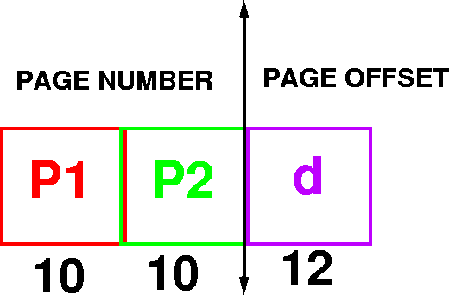
Example Addressing on a Multilevel Page Table System
A logical address (on 32 bit machine with 4k page size) is divided into
  A page number consisting of 20 bits
  A page offset consisting of 12 bits
Divide the page number into
  A 10-bit page number
  A 10-bit page offset

Slide 9
Multilevel Paging and Performance
Since each level is stored as a separate table in memory, converting a logical address to a physical one in a four-level paging may take five memory accesses. Why?

Slide 10
Inverted Page Tables
Physical
address
Main idea
  One PTE for each physical page frame
  Hash (Vpage, pid) to Ppage#
  Trade off space for time
Pros
  Small page table for large address space
Cons
  Lookup is difficult
  Overhead of managing hash chains, etc
Virtual
address
pid
vpage
offset
k
offset
0
pid
vpage
k
n-1
Inverted page table

Slide 11
Inverted Page Table
Virtual Address (004006)
Page Table
004
006
0
1
5
0
1
4
1
0
1
005
006
Physical Address (005006)

Slide 12
Inverted Page Table Implementation
TLB is same as before
TLB miss is handled by software
In-memory page table is managed using a hash table
  number of entries = number of physical frames
  Not found: page fault
Virtual page
Physical page
Hash table

Slide 13
Group Discussion
Can processes share pages?
What pages can be shared?
How do they share?

Slide 14
Sharing Pages
Code and data can be shared among processes
  mapping them into pages with common page frame mappings
Code and data must be position independent if VM mappings for the shared data are different
Code and data cannot store VM addresses for functions and variables not in shared pages
Shared code and data usually are not position independent resulting in certain regions of memory being reserved for shared libraries and the operating system
Notes:
A relative jump forward to a location on the same page is position independent code. So is an offset of a data byte in a data structure if the data structure can be stored on one page.
However, virtual addresses cannot be stored in a shared page if they refer to page addresses that are mapped differently in the different virtual memories that share them.

Slide 15
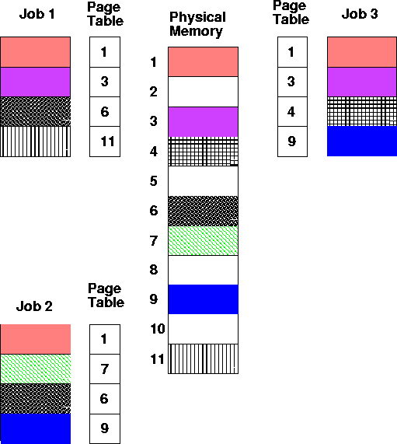
Shared Pages

Slide 16
Incorrect Sharing
Physical Memory
Virtual Memory 1
Virtual Memory 2
Load(3,5)
Load(3,5)
5
Load(3,5)
1
1
6
$20
$100
2
$100
$100
7
3
3
$20
8
Notes:
Program 1 and program 2 load a variable from the address 3,5
In VM 1's case 3 has a green mapping and the value selected
is $100. In VM2s case, there is a red mapping and the value selected is $20.

Slide 17
Protection
Can add read, write, execute protection bits to page table to protect memory
Check is done by hardware during access
shared memory location
  different protections from different processes
  Solution:
    associate protection lock with page frame. Each process has its own key. If the key fits the lock, the process may access the page frame

Slide 18
Paging Policies
Fetch Strategies
  When should a page be brought into primary (main) memory from secondary (disk) storage.
Placement Strategies
  When a page is brought into primary storage, where is it to be put?
Replacement Strategies
  Which page now in primary storage is to be removed from primary storage when some other page or segment is to be brought in and there is not enough room.

Slide 19
Demand Paging
Algorithm Never bring a page into primary memory until its needed.
  Page fault
  Check if a valid virtual memory address. Kill job if not.
  If valid reference, check if its cached in memory already (perhaps for some other process.) If so, skip to 7).
  Find a free page frame.
  Map address into disk block and fetch disk block into page frame. Suspend user process.
  When disk read finished, add vm mapping for page frame.
  If necessary, restart process.

Slide 20
Demand Paging Example
VM
fault
ref
Load M
i
Page
table
Free frame

Slide 21
Page Replacement
Find location of page on disk
Find a free page frame
  If free page frame use it
  Otherwise, select a page frame using the page replacement algorithm
  Write the selected page to the disk and update any necessary tables
Read the requested page from the disk.
Restart the user process.
It is necessary to be careful of synchronization problems. For example, page faults may occur for pages being paged out.

Slide 22
Issue: Eviction
Hopefully, kick out a less-useful page
  Dirty pages require writing, clean pages don’t
    Hardware has a dirty bit for each page frame indicating this page has been updated or not
  Where do you write? To “swap space”
Goal: kick out the page that’s least useful
Problem: how do you determine utility?
  Heuristic: temporal locality exists
  Kick out pages that aren’t likely to be used again

Slide 23
Terminology
Reference string: the memory reference sequence generated by a program.
Paging – moving pages to (from) disk
Optimal – the best (theoretical) strategy
Eviction – throwing something out
Pollution – bringing in useless pages/lines

Slide 24
Page Replacement Strategies
The Principle of Optimality
  Replace the page that will not be used again the farthest time in the future.
Random page replacement
  Choose a page randomly
FIFO - First in First Out
  Replace the page that has been in primary memory the longest
LRU - Least Recently Used
  Replace the page that has not been used for the longest time
LFU - Least Frequently Used
  Replace the page that is used least often
NRU - Not Recently Used
  An approximation to LRU.
Working Set
  Keep in memory those pages that the process is actively using.

Slide 25
Principal of Optimality
Description:
  Assume that each page can be labeled with the number of instructions that will be executed before that page is first references, i.e., we would know the future reference string for a program.
  Then the optimal page algorithm would choose the page with the highest label to be removed from the memory.
This algorithm provides a basis for comparison with other schemes.
Impractical because it needs future references
If future references are known
  should not use demand paging
  should use pre paging to allow paging to be overlapped with computation.

Slide 26
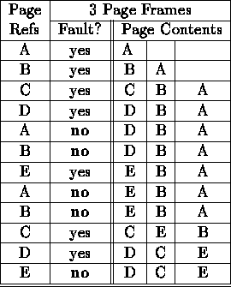
Optimal Example
12 references, 7 faults

Slide 27
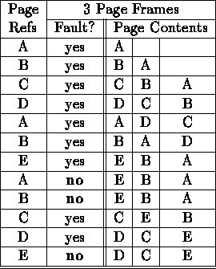
FIFO
12 references, 9 faults

Slide 28
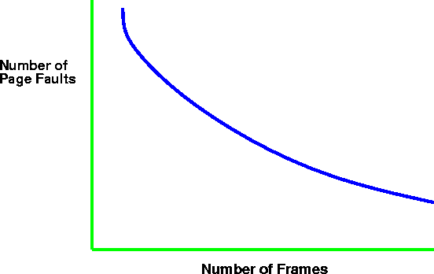
Paging Behavior with Increasing
Number of Page Frames

Slide 29
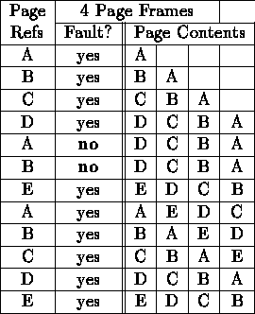
Belady's Anomaly (for FIFO)
As the number of page frames increase, so does the fault rate.
12 references, 10 faults

Slide 30
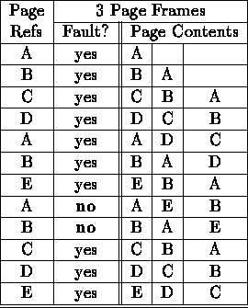
LRU
12 references, 10 faults

Slide 31
Least Recently Used Issues
Does not suffer from Belady's anomaly
How to track “recency”?
  use time
    record time of reference with page table entry
    use counter as clock
    search for smallest time.
  use stack
    remove reference of page from stack (linked list)
    push it on top of stack
both approaches require large processing overhead, more space, and hardware support.

Slide 32
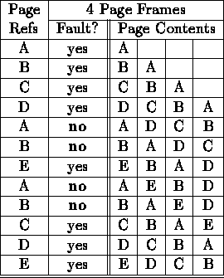
LRU and Anomalies
Anomalies cannot occur, why?
12 references, 8 faults

Slide 33
NUR: A LRU Approximation
NRU: Evict a page that is NOT recently used;
LRU: evict a page that is LEAST recently used;
NRU Implementation: simpler than LRU
  additional reference bits
  a register is kept per page
  a one bit is set in the register if the page is referenced
  the register is shifted by one after some time interval
  00110011 would be accessed more recently than 00010111
  the page with register holding the lowest number is the least recently used.
  the value may not be unique. use FIFO to resolve conflicts.

Slide 34
Second Chance
Only one reference bit in the page table entry.
  0 initially
  1 When a page is referenced
pages are kept in FIFO order using a circular list.
Choose “victim” to evict
  Select head of FIFO
  If page has reference bit set, reset bit and select next page in FIFO list.
  keep processing until reach page with zero reference bit and page that one out.
system v, r4 uses a variant of second chance

Slide 35
Second Chance
if page has reference bit set, reset bit and select next page in FIFO list.
keep processing until reach page with zero reference bit and page that one out.
system v, r4 uses a variant of second chance.

Slide 36
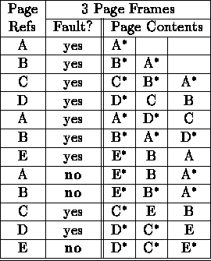
Second Chance Example
12 references, 9 faults

Slide 37
Second Chance Example
12 references, 9 faults

Slide 38
Reminder
Quiz2
Mp2

Slide 39
MP2

