Slide 1
CS323 Operating Systems
Memory Management V
Yuanyuan Zhou
Lecture 17
2/25/2003

Slide 2
Content of this lecture
Administrative announcements
Page replacement algorithms
Multi-program memory management
Summary

Slide 3
Administrative
Quiz2
MP2

Slide 4
Midterm1
  Time: 3/10, 7-8pm
  Content: 1,2,3, 4 except replacement algorithms
  Room:
    DCL 1320, first letter in last name: A-L
    MSEB 100, first letter in last name: M-Z
  Conflict exam

Slide 5
Review
Inverted page table
Multi-level page table
Demand paging
Page Replacement
  Optimal

Slide 6
Principal of Optimality
Description:
  Assume that each page can be labeled with the number of instructions that will be executed before that page is first references, i.e., we would know the future reference string for a program.
  Then the optimal page algorithm would choose the page with the highest label to be removed from the memory.
This algorithm provides a basis for comparison with other schemes.
Impractical because it needs future references
If future references are known
  should not use demand paging
  should use pre paging to allow paging to be overlapped with computation.

Slide 7
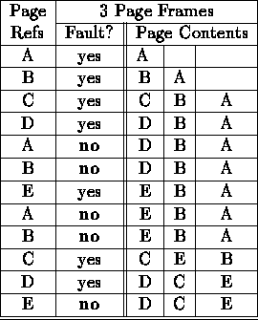
Optimal Example
12 references, 7 faults

Slide 8
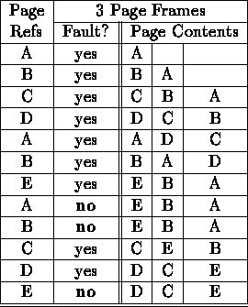
FIFO
12 references, 9 faults

Slide 9
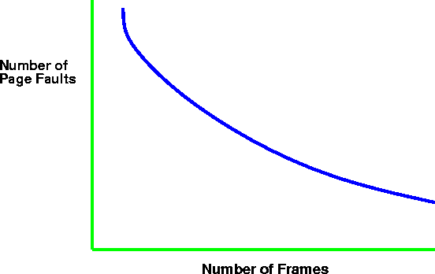
Paging Behavior with Increasing
Number of Page Frames

Slide 10
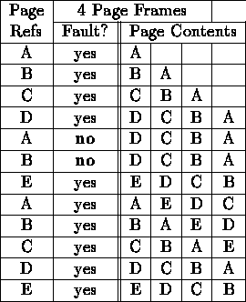
Belady's Anomaly (for FIFO)
As the number of page frames increase, so does the fault rate.
12 references, 10 faults

Slide 11
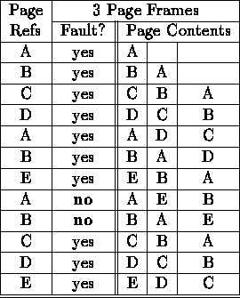
LRU
12 references, 10 faults

Slide 12
Least Recently Used Issues
Does not suffer from Belady's anomaly
How to track “recency”?
  use time
    record time of reference with page table entry
    use counter as clock
    search for smallest time.
  use stack
    remove reference of page from stack (linked list)
    push it on top of stack
both approaches require large processing overhead, more space, and hardware support.

Slide 13
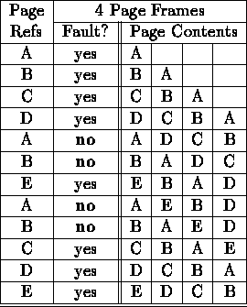
LRU and Anomalies
Anomalies cannot occur, why?
12 references, 8 faults

Slide 14
Discussion
Why does Optimal give the best hit ratio?
What is the worst algorithm?

Slide 15
NUR: A LRU Approximation
NRU: Evict a page that is NOT recently used;
LRU: evict a page that is LEAST recently used;
NRU Implementation: simpler than LRU
  additional reference bits
  a register is kept per page
  a one bit is set in the register if the page is referenced
  the register is shifted by one after some time interval
  00110011 would be accessed more recently than 00010111
  the page with register holding the lowest number is the least recently used.
  the value may not be unique. use FIFO to resolve conflicts.

Slide 16
Second Chance
Only one reference bit in the page table entry.
  0 initially
  1 When a page is referenced
pages are kept in FIFO order using a circular list.
Choose “victim” to evict
  Select head of FIFO
  If page has reference bit set, reset bit and select next page in FIFO list.
  keep processing until reach page with zero reference bit and page that one out.
system v, r4 uses a variant of second chance

Slide 17
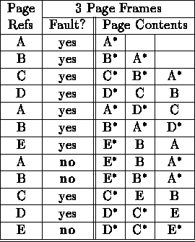
Second Chance Example
12 references, 9 faults

Slide 18
Second Chance Example
12 references, 9 faults

Slide 19
Reminder
Quiz2
Mp2

