Slide 1
CS323 Operating Systems
Memory Management V
Yuanyuan Zhou
Lecture 18
3/3/2003

Slide 2
Content of this lecture
Administrative announcements
Page replacement algorithms
Multi-program memory management
Summary

Slide 3
Administrative
MP2
Midterm1
  Close-notes, close-book
  No calculator
  Midterm samples
  Conflict exam: 3/11 5-6pm

Slide 4
Review
Replacement algorithms
  Optimal
  FIFO
  LRU
  NRU
  Second chance

Slide 5
Second Chance
Only one reference bit in the page table entry.
  0 initially
  1 When a page is referenced
pages are kept in FIFO order using a circular list.
Choose “victim” to evict
  Select head of FIFO
  If page has reference bit set, reset bit and select next page in FIFO list.
  keep processing until reach page with zero reference bit and page that one out.
system v, r4 uses a variant of second chance

Slide 6
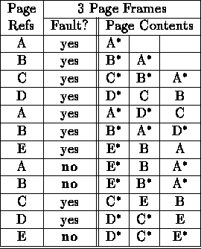
Second Chance Example
12 references, 9 faults

Slide 7
Page Classes
1.(0,0) neither referenced nor dirtied
2.(0,1) not referenced (recently) but dirtied
3.(1,0) referenced but clean
4.(1,1) referenced and dirtied
select a page from lowest class
if conflict, use random or FIFO.

Slide 8
Ad Hoc Techniques
Separate Page Out from Page In.
  Keep a pool of free frames.
  When a page is to be replaced, use a free frame.
  Read the faulting page and restart the faulting process while page out is occurring.
Write dirty pages to disk whenever the paging device is free and reset the dirty bit. This allows page replacement algorithms to replace clean pages.
Cache paged out pages in primary memory.
  Page out dirty pages as before.
  Return pages to a free pool but remember which page frame they are.
  If system needs to map page in again, reuse page.
  If system needs to page in data, choose any page in pool.
  System V, R4 implements this strategy

Slide 9
Frame Allocation: Minimum
How are the page frames allocated to individual virtual memories in a multi- programmed environment?
The simple case would be to allocate a minimum number of frames per process.
  most instructions require two operands
  include an extra page for paging out and one for paging in.
  moves and indirection instructions might require more.

Slide 10
Equal Allocation
allocate an equal number of frames per job
  but jobs use memory unequally
  high priority jobs have same number of page frames and low priority jobs
  degree of multiprogramming might vary

Slide 11
Proportional Allocation
allocate a number of frames per job proportional to job size
  Challenge: how do you determine job size: by run command parameters or dynamically?

Slide 12
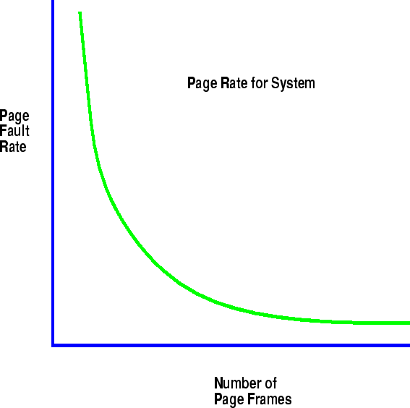
Page Fault Rate Curve
As page frames per VM space decrease, the page fault rate increases.

Slide 13
Thrashing
Computations have locality.
As page frames decrease, the page frames available are not large enough to contain the locality of the process.
The processes start faulting heavily.
Pages that are read in, are used and immediately paged out.

Slide 14
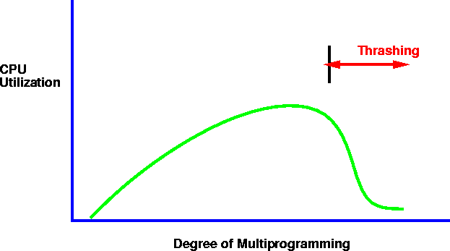
Thrashing and CPU Utilization
As the page rate goes up, processes get suspended on page out queues for the disk.
the system may try to optimize performance by starting new jobs.
starting new jobs will reduce the number of page frames available to each process, increasing the page fault requests.
system throughput plunges.

Slide 15
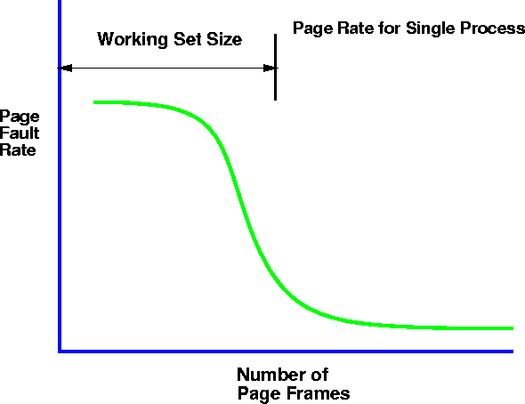
Working Set
the working set model assumes locality.
the principle of locality states that a program clusters its access to data and text temporally.
As the number of page frames increases above some threshold, the page fault rate will drop dramatically.

Slide 16
Working Set in Action
Algorithm
  if # free page frames > working set of some suspended process, then activate process and map in all its working set
  if working set size of some process increases and no page frame is free, suspend process and release all its pages
moving window over reference string used for determination.
keeping track of working set.

Slide 17
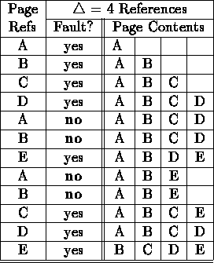
Working Set Example
Window size is ⬇
12 references, 8 faults

Slide 18
Working Set Solution
Approximate working set model using timer and reference bit.
Set timer to interrupt after approximately x references, τ.
Remove pages that have not been referenced and reset reference bit.

Slide 19
Page Fault Frequency
Version of Working Set
Assume that if the working set is correct there will not be many page faults.
If page fault rate increases beyond assumed knee of curve, then increase number of page frames available to process.
If page fault rate decreases below foot of knee of curve, then decrease number of page frames available to process.

Slide 20
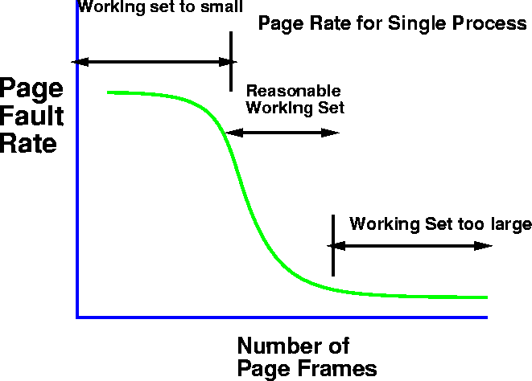
Page Fault Frequency Version of Working Set

Slide 21
WSClock Page Replacement Algorithm
Carr and Hennessey, 1981
Used very widely (Linux)
Circular list as in the clock algorithm.
  Initially, list is empty.
  As pages are loaded into memory, pages are added to the list
  Each entry contains Time of last use as well as reference and dirty bits.
Algorithm:
  At each page fault, the page pointed to by the clock hand is examined.
  (Step 1) If reference bit is 1, then the page has been reference during the current tick, so it is in working set and not ideal candidate to remove.
  If reference bit is 0, then check if it is in working set window (i.e., if Current Time minus Time of last use is less than the working set window size time).
  If page is not in the working set and the page is clean, then replace it.
  If the page is not in working set and page is dirty, request write to disk, and move on to the next page in the circular list.
  Repeat (Step 1).

Slide 22
Page Size Considerations
Small pages
  Reason:
    Locality of reference tends to be small (256)
    Less fragmentation
  Problem
    require large page tables
Large pages
  Reason
    Small page table
    I/O transfers have high seek time, so better to transfer more data per seek
  Problem:
    Internal fragmentation

Slide 23
Summary
protection hardware
example systems
fragmentation
paging policies
random
optimal
FIFO

Slide 24
Reminder
Mp2
Midterm1

