Slide 1
CS323 Operating Systems
Input/Output I
Yuanyuan Zhou
Lecture 19
3/5/2003

Slide 2
Content of this lecture
Administrative announcements
I/O basic concepts
Interrupts
DMA
Memory Mapped I/O
Summary

Slide 3
Administrative
MP2
Midterm1
  Conflict exam: 3/11, 5-6pm

Slide 4
Review
protection hardware
example systems
fragmentation
paging policies
random
optimal
FIFO

Slide 5
Overview
Basic I/O hardware
  ports, buses, devices and controllers
I/O Software
  Interrupt Handlers, Device Driver, Device-Independent Software, User-Space I/O Software
Real I/O devices
  Disks, Character-Oriented Terminals, Graphical User Interfaces, Network Terminals,
Power Management

Slide 6
Devices
Devices
  Storage devices (disk, tapes)
  Transmission devices (network card, modem)
  Human interface devices (screen, keyboard, mouse)
  Specialized device (joystick)

Slide 7
Device-Computer/Device-Device Communication
Physically: via signals over a cable or through air
Logically: via a connection point - port (e.G., Serial port)
Multiple devices are connected via a bus
  A common set of wires and a rigidly defined protocol that specifies a set of messages that can be sent on the wires

Slide 8
Device Controller
I/O units typically consist of a mechanical component and an electronic component. The electronic component is called the device controller or adapter. Example is a circuit board. The mechanical component is the device itself.
Interface between controller and device is a very low level interface.
Example:
  Disk's controller converts the serial bit stream, coming off the drive into a block of bytes, and performs error correction. The block of bytes is first assembled in a buffer inside the controller. After its checksum has been verified, the error-free block is copied to main memory.
  Built-in controllers

Slide 9
I/O Controller
Disk controller - implements the disk side of the protocol that does: bad error mapping, prefetching, buffering, caching
Controller has registers for data and control
CPU and controllers communicate via I/O instructions and registers
Memory-mapped I/O

Slide 10
I/O Ports
4 registers - status, control, data-in, data-out
  Status - states whether the current command is completed, byte is available, device has an error, etc
  Control - host determines to start a command or change the mode of a device
  Data-in - host reads to get input
  Data-out - host writes to send output
Size of registers - 1 to 4 bytes

Slide 11
Host-controller interface: Interrupts
CPU hardware has the interrupt report line that the CPU senses after executing every instruction
  device raises an interrupt
  CPU catches the interrupt and saves the state (e.g., Instruction pointer)
  CPU dispatches the interrupt handler
  interrupt handler determines cause, services the device and clears the interrupt
Why interrupts?
Real life analogy?

Slide 12
Support for Interrupts
Need the ability to defer interrupt handling during critical processing
CPUs have two interrupt request lines
  non-maskable interrupt (reserved for unrecoverable memory errors)
  maskable interrupt (can be turned off by cpus before the execution of critical instructions
Need efficient way to dispatch the proper device
  Interrupt comes with an address (offset in interrupt vector) that selects a specific interrupt handling
Need multilevel interrupts - interrupt priority level

Slide 13
Interrupt Handler
At boot time, OS probes the hardware buses to determine what devices are present and installs corresponding interrupt handlers into the interrupt vector
During I/O interrupt, controller signals that device is ready

Slide 14
Other Types of Interrupts
Interrupt mechanisms are used to handle wide variety of exceptions:
  Division by zero, wrong address
  Virtual memory paging
  System calls (software interrupts, trap)
  Multi-threaded systems

Slide 15
Direct Memory Access (DMA)
Programmed I/O (PIO)
  use CPU to watch status bits and feed data into a controller register 1 byte at a time - EXPENSIVE for large transfers
Direct memory access (DMA)
  use a special purpose processor, called a DMA controller

Slide 16
Discussion
Why use DMA? The benefits of DMA?

Slide 17
DMA-CPU Protocol
Host writes a DMA command block into memory
  pointer to source, pointer to destination, count of bytes to be transferred
CPU writes the address of this command block to the DMA controller and goes on with other work
DMA controller proceeds to operate the memory bus directly without help of main CPU

Slide 18

Direct Memory Access (DMA)
Operation of a DMA transfer

Slide 19
DMA Issues
Handshaking between DMA controller and the device controller
Cycle stealing
  DMA controller takes away CPU cycles when it uses CPU memory bus, hence blocks the CPU from accessing the memory
In general DMA controller improves the total system performance

Slide 20
Device Classification
Character-stream or block devices
Sequential or random access devices
Synchronous or asynchronous devices
Sharable or dedicated devices
Speed of operation
WO, RO, RW devices

Slide 21
Block Devices
Block device - transfers blocks of data (e.G., Disk device)
Commands: read, write, seek (if random access device)
Memory-mapped files access can be layered on top of block-device drivers

Slide 22
Character Devices
Character device - transfers byte by byte (e.G., Keyboard)
Commands: get, put one character
Libraries can built on top of this device which provide line-at-a time access with buffering and editing services, etc
Question: can block device be implemented using character device?

Slide 23
Network Devices
Network socket interface
Commands; create socket, connect local socket to remote address, select information from a socket
Other interfaces: half-duplex pipes, full-duplex fifos, message queues, sockets (UNIX)

Slide 24
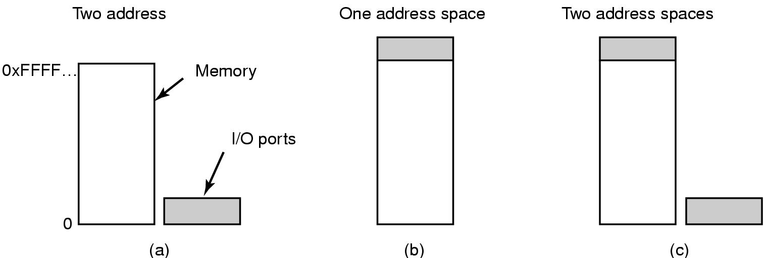
Memory-Mapped I/O (1)
(a) Separate I/O and memory space
(b) Memory-mapped I/O
© Hybrid

Slide 25
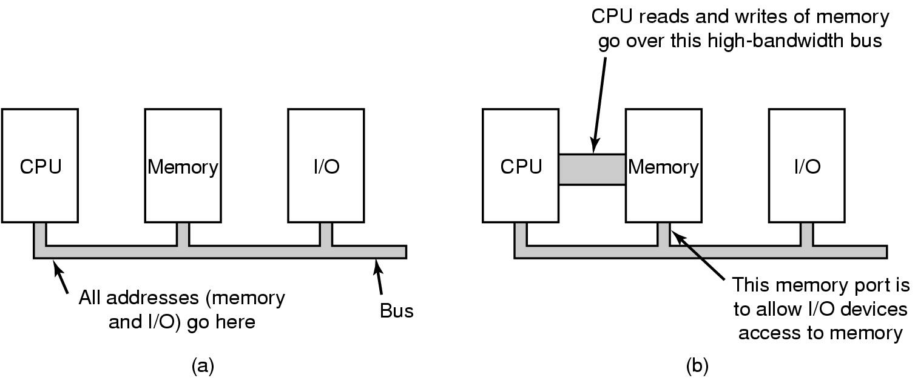
Memory-Mapped I/O (2)
(a) A single-bus architecture
(b) A dual-bus memory architecture

Slide 26
Reminder
MP2
Midterm1

