Slide 1
CS323
Operating Systems
Yuanyuan Zhou
Lecture 1
Jan 22, 2003

Slide 2
Content of this lecture
Course information (personnel, policy, schedule, misc.)
What is OS? What does it do?
History of OS
Summary

Slide 3
Who am I?
Yuanyuan (YY) Zhou
Princeton-2000
Research: operating systems, memory management, file/storage systems, system architecture, databases
Why?
  Interesting
  Useful
  “I know what’s going on with your system!”

Slide 4
Overview
Office Assistant: Sheila Clark
Teaching Assistants:
  Jeff Carlyle
  Alexander Kramnik
  Pierre Salverda
Required Textbook:
Modern Operating Systems, Andrew Tanenbaum, Prentice Happ, second edition, 2001
Class Website
http://www-courses.cs.uiuc.edu/~cs323/
Newsgroup: uiuc.class.cs323

Slide 5
Course Information
Prerequisites
  CS225, cs232 or ECE291
Laboratory Facilities
  CSIL-suna cluster
Office hours: available in web page
  YY: Wed, Fri, 10-11am
  Jeff, Wed, Fri, 10-11am
  Alex: Tue, Thur, 12:30-1:30pm
  Pierre: Mon, Wed 12:30-1:30pm
Notes:
You should all have taken CS 223. Students have a set of responsibilities. This is not a 200 level course. 300 level courses require you to do much more individual study. Read the text book. Try things out on UNIX or Windows. Browse the web site. Look at the OS news groups.
You may use any Computer, but if you have problems the machines in the Sparc Lab and the engineering college workstation lab are set up to be appropriate for your use although a personal PC will do as well.
It is up to you to make sure you are using the right software so that you can hand your machine problems in on-time.

Slide 6
Why are you here?
Fulfill the requirement
Prerequisite for other courses
  Network
  Distributed systems
  Real-time systems
  Multimedia systems
Future plans
  Graduate schools for CS
  Employment

Slide 7
About this course…
Principles
System concepts
OS design
Some theory
Rationale
Practice
Goals
Understand OS decisions
Basis for future learning
Get hands dirty

Slide 8
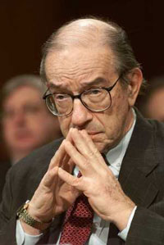
Expect (Some) Pain
Fast pace
Many hard material
Lots of MPs (programming)
Lots of quizzes
But….
Not end of the world – students survived last semester’s cs323!

Slide 9
Why so many grades?
Intended to reduce pressure/anxiety
More data points = less noise
Final exam: 35%
Mid-exam1: 15%
Mid-exam2: 15%
5 Quizzes: 5%
5 MPs: 30%
Final grade: based on mean/deviation
  Mean corresponding to B
  Graduate students are separated from undergraduates

Slide 10
Grading policy
Available on web page
Gradebook
Late policy
  2% lower each hour the assignment is late
  2 hours: 4% lower, 24 hours: 48% lower
  No late quizzes!
It is your responsibility!
  Check announcements in lectures, newsgroups, or web pages

Slide 11
Re-grading policy
Students have 1 week (after the grade for a quiz/MP/exam is released into gradebook) to request for re-grading
Re-grading requests need to be in writing and submitted after lecture
After the re-grading period, no re-grading request will be granted for this quiz/MP/exam.

Slide 12
Cheating Policy
Academic integrity
Your work in this class must be your own - we have a zero tolerance policy towards cheating of any kind and any student who cheats will get a failing grade in the course.
Both the cheater and the student who aided the cheater will be held responsible for the cheating
Notes:
Unfortunately it is necessary to mention cheating. The campus has a set of regulations concerning academic integrity. You should know them. You're work in this class must be your own.
We have extensive machine problem cheat detection programs.
Unless told otherwise, all work must be done individually. I will punish offenders and this includes giving individuals a failing grade or suspending them from the university. Grades are used to see if you are learning the material and to certify to future employers and educators that you know the material from this course. Cheating devalues the meaning of the grade and accomplishment of everyone else in the class. Cheating includes making it easy for someone else to copy your results. If you have taken every precaution against someone stealing your work and someone does, we will try to verify you are innocent using logs etc. We try to be fair. But the best scheme for you to follow is to be very careful with your work because it is very difficult sometimes to find the evidence to clear your name.
Be warned. I have caught undergraduate and graduates cheating in CS323 before. I don’t like doing it, but I have failed students and I have also asked the University to remove students from the program.

Slide 13
Lecture Format
Help you understand important and hard OS concepts
  Group discussions
  Animation
  Real life examples
Lectures do not cover everything
  Not all questions in quizzes or exams are from lectures
Students responsibility
  Attend lectures
  Read textbooks
  Quiz, MP, Exam
  Periodically check web page
  Read/utilize newsgroup

Slide 14
MPs
2/14,11:59pm CDT | MP1 | Thread scheduling
3/7,11:59pm CDT | MP2 | Synchronization
4/4,11:59pm CDT | MP3 | Virtual Memory
4/25,11:59pm CDT | MP4 | File system
5/7, 11:59pm CDT | MP5 | Network/Distribute Sys.
A tutorial before each MP due date
MP releases and tutorial date will be announced in
course web page

Slide 15
Quizzes & Exams
1/27-1/31, 5pm CDT | Quiz0 (test quiz)
2/3-2/7,5pm CDT | Quiz1
2/24-2/28, 5pm CDT | Quiz2
3/5, 9-9:50am, 1320 DCL | Mid-exam1
3/17-3/21, 5pm CDT | Quiz3
4/7-4/11,5pm CDT | Quiz4
4/16, 9-9:50am, 1320 DCL | Mid-exam1
4/28-5/2 5pm CDT | Quiz5
5/7, 11:59pm CDT | Final-exam
Announcement in web page
No makeup quizzes
No makeup exams unless
with documented
medical emergency

Slide 16
¼ Unit Project: graduate student
Final grade is decided upon ¾ unit performance
No ¼ unit project: fail
Individual or group
Choices
  Implementation project
  Animation project
  Survey
Proposal due: 2/24, Monday, 5pm, by email
Details in web page

Slide 17
What Is an OS? Real life example?
2-3 persons group discussion
2 minutes

Slide 18
What Is an OS?
“Code” that:
Sits between programs & hardware
Sits between different programs
Sits betweens different users
But what does it do?
to provide an orderly and controlled allocation of the processors, memories and I/O devices among the various programs competing for them
Real life example:
  Government?

Slide 19
What Is an OS?
Resources
Allocation
Protection
Reclamation
Virtualization
Services
Abstraction
Simplification
Convenience
Standardization
Makes computers simpler

Slide 20
What Is an OS?
Government
Resources
Allocation
Protection
Reclamation
Virtualization
Finite resources
Competing demands
Examples:
CPU
Memory
Disk
Network
Limited budget,
Land,
Oil,
Gas,
Linux or Windows?
Democrat or Republic?

Slide 21
What Is an OS?
Government
Resources
Allocation
Protection
Reclamation
Virtualization
You can’t hurt me
I can’t hurt you
Implies some degree of safety & security
Law and order

Slide 22
What Is an OS?
Government
Resources
Allocation
Protection
Reclamation
Virtualization
Income Tax
The OS giveth
The OS taketh away
Voluntary at run time
Implied at termination
Involuntary
Cooperative

Slide 23
What Is an OS?
Government
Resources
Allocation
Protection
Reclamation
Virtualization
illusion of infinite, private resources
Memory versus disk
Timeshared CPU
More extreme cases possible (& exist)
Social security

Slide 24
History of Operating Systems (1)
First generation 1945 – 1955 (Anarchy)
  vacuum tubes, plug boards
Second generation 1955 – 1965 (Monarchy)
  transistors, batch systems
Third generation 1965 – 1980 (Feudalism)
  ICs and multiprogramming
Fourth generation 1980 – present (Capitalism or Communism)
  personal computers

Slide 25

History of Operating Systems (Anarchy)
Early batch system
  bring cards to 1401
  read cards to tape
  put tape on 7094 which does computing
  put tape on 1401 which prints output

Slide 26
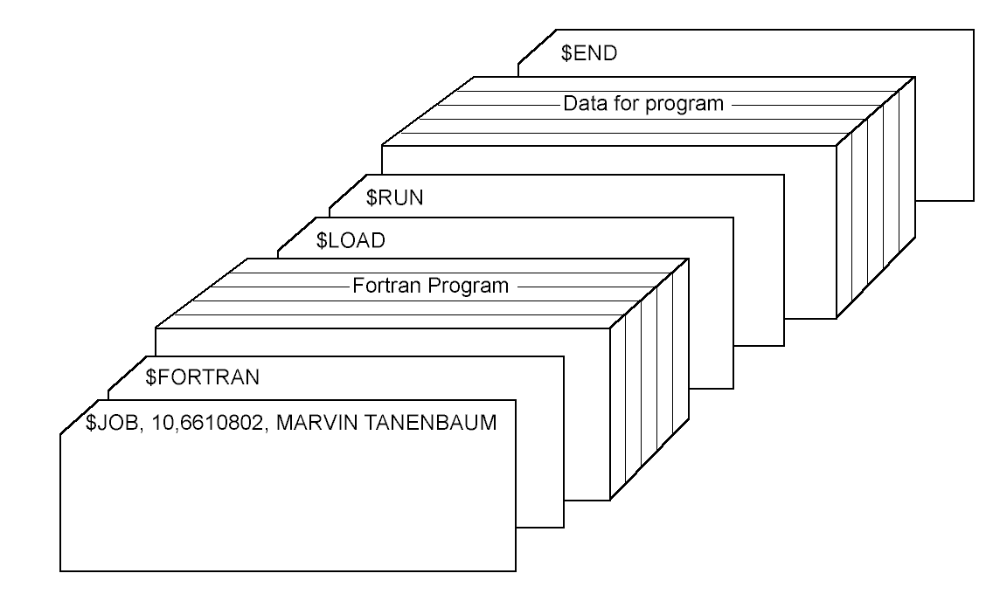
History of Operating Systems (Monarchy)
Structure of a typical FMS job – 2nd generation

Slide 27

History of Operating Systems (Feudalism)
Multiprogramming system
  three jobs in memory – 3rd generation

Slide 28
The Operating System Zoo
(Capitalism or Communism)
Mainframe operating systems
Server operating systems
Multiprocessor operating systems
Personal computer operating systems
Real-time operating systems
Embedded operating systems
Smart card operating systems

Slide 29
Historical Comparison
 | Mainframe | Mini | Micro
System $/ Worker Salary | 10:1 – 100:1 | 10:1 – 1:1 | 1:10-1:100
Goal | System utilization | Overall cost | Productivity
Target | Capacity | Features | Ease of Use

Slide 30
Summary
Course overview
Policy and requirement
What is OS?
OS history
Next lecture: system overview (chapter 1)

Slide 31
After this lecture…
Reading assignment: chapter 1
Start next Monday with Chapter 2
Browse the web site
Subscribe newsgroup
Login to csil machines
Tutorial for Nacho and MP1: 1/27
Try out test quiz (quiz0)
Think about what are the criteria to evaluate an OS? (or what are the criteria to evaluate a government)?
Notes:
To conclude, welcome to the course, start reading chapter 1, and think about Resources, operating systems, and what is wrong with them.
Visit our Web site.
See if you can use the webboard.

Slide 32
By the way
Sorry for the accent
But you need to listen carefully, otherwise…
You will miss my jokes!

