Slide 1
CS323 Operating Systems
Input/Output II
Yuanyuan Zhou
Lecture 20
3/7/2003

Slide 2
Content of this lecture
Administrative announcements
I/O software
Summary

Slide 3


Administrative
No class next Monday!!
MP2
Midterm1
  Time: 3/10, 7-8pm,
    DCL 1320, students with last name A-L
    MSEB 100, students with last name M-Z
  Conflict exam: 3/11, 5-6pm, DCL 1320

Slide 4
Review
I/O basic concepts
Interrupts
DMA
Memory Mapped I/O

Slide 5
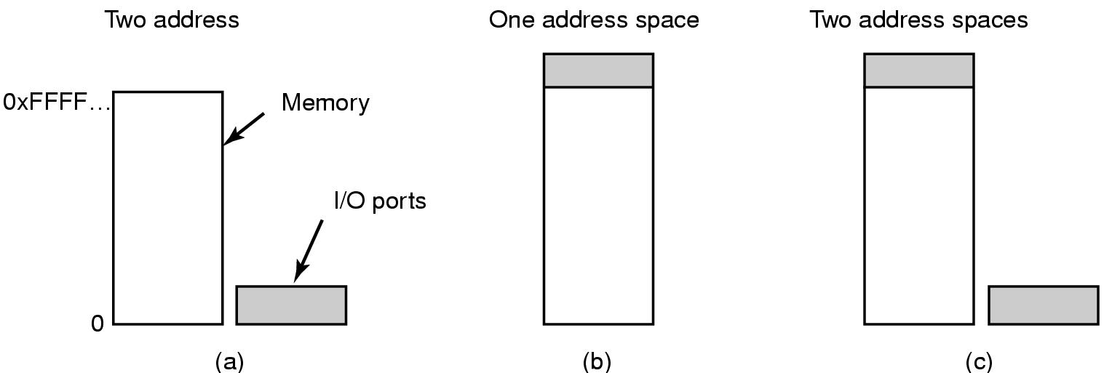
Memory-Mapped I/O (1)
(a) Separate I/O and memory space
(b) Memory-mapped I/O
© Hybrid

Slide 6
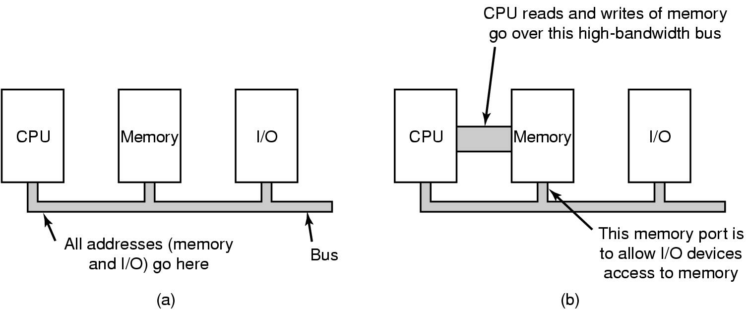
Memory-Mapped I/O (2)
(a) A single-bus architecture
(b) A dual-bus memory architecture

Slide 7
I/O Software: Principles
device independence
  possible to write programs that can access any IO device without having to specify the device in advance.
  read file as input on a floppy, hard disk, or CD-ROM, without modifying the program for each device
uniform naming
  the name of a file or a device should simply be a string or an integer and not depend on the device in any way
  Example: In Unix all files and devices are addressed the same way by a path name.
Synchronous (blocking) vs asynchronous (interrupt-driven) transfers
  Example: most devices are asynchronous. User programs are easier to write if the IO operations are synchronous. Hence, it is up to OS to make asynchronous operations look like synchronous to the user programs.

Slide 8
Principles (cont.)
Buffering
  data might need to be buffered because they might not be stored immediately
  Example: Network packets come in off the network, and need to be buffered for protocol processing, audio buffering between audio speakers and network.
shared vs dedicated devices
  allowing for sharing, considering two users having open files on the same device, or allowing dedicated devices and deal with deadlock problems.
  Example: Disk, audio devices.

Slide 9
Programmed I/O
Three ways to perform I/O
  Interrupt-driven IO
  IO using DMA
  programmed IO.
    Every IO operation is programmed and controlled.
    Example: printing a file from user program to the printer means that data is first copied to the kernel, then the OS enters a tight loop outputting the characters one at a time.
    Essential aspect of programmed IO is that the CPU continuously polls the device to see if it is ready to accept another character. It uses polling (or busy waiting) behavior.
    Programmed IO is simple but required CPU full time until all the IO is done.

Slide 10
Host-Controller Interface: Polling
Consider a producer-consumer relation between controller and host
Controller indicates through busy bit (status bit) if it is busy to work or not
Host signals its wishes via command-ready bit (command register)
Polling behavior

Slide 11
Handshaking Protocol
Host reads busy bit (poll) until bit is clear
Host sets write bit in command register and writes byte into the data-out register
Host sets the command-ready bit in command register
When controller notices command-ready bit, it sets busy bit and starts to work
Controller reads the command register and sees the write command. It reads data-out and performs I/O
Controller clears the command-ready bit, error bit and busy bit

Slide 12
Interrupt-Driven IO
CPU hardware has the interrupt report line that the CPU senses after executing every instruction.
  Device raises an interrupt
  CPU catches the interrupt and saves the state (e.g., instruction pointer)
  CPU dispatches the interrupt handler
  Interrupt handler determines the cause of the interrupt, services the device and clears the interrupt.

Slide 13

Direct Memory Access (DMA)
DMA controller feeds the characters to the printer one at the time, without CPU being bothered. DMA is actually the programmed IO, only with DMA controller doing the work.

Slide 14
Discussion
Tradeoffs between
  Programmed I/O
  Interrupt-driven I/O
  I/O using DMA

Slide 15
Tradeoffs
Interrupt-drive IO:
  Pro: save CPU time for busy polling
  Con: triggering interrupt takes time, too.
Programmed I/O
  Pro: require no interrupt or DMA support
  Con: waste CPU time
I/O using DMA:
  Pro: relieve CPU from I/O operation
  Con: DMA is slower than CPU

Slide 16
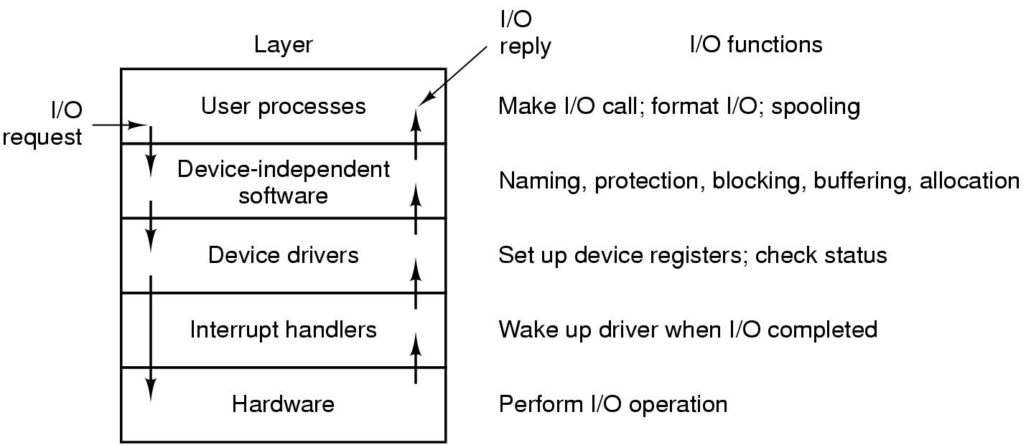
I/O Software
Layers of the I/O system and the main functions of each layer

Slide 17
I/O Software Layer: Principle
Interrupts are facts of life, but should be hidden away, so that as little of the OS as possible knows about them.
The best way to hide interrupts is to have the driver starting an IO operation block until IO has completed and the interrupt occurs.
When interrupt happens, the interrupt handler handles the interrupt.
Once the handling of interrupt is done, the interrupt handler unblocks the device driver that started it.
This model works if drivers are structures as kernel processes with their own states, stacks and program counters.

Slide 18
Device Drivers
Device-specific code to control an IO device, is usually written by device's manufacturer
  Each controller has some device registers used to give it commands. The number of device registers and the nature of commands vary from device to device (e.g., mouse driver accepts information from the mouse how far it has moved, disk driver has to know about sectors, tracks, heads, etc).
A device driver is usually part of the OS kernel
  Compiled with the OS
  Dynamically loaded into the OS during execution
Each device driver handles
  one device type (e.g., mouse)
  one class of closely related devices (e.g., SCSI disk driver to handle multiple disks of different sizes and different speeds.).
Categories:
  Block devices
  Character devices

Slide 19
Functions in Device Drivers
Accept abstract read and write requests from the device-independent layer above;
Initialize the device;
Manage power requirements and log events
Check input parameters if the are valid
Translate valid input from abstract to concrete terms
  e.g., convert linear block number into the head, track, sector and cylinder number for disk access
Check the device if it is in use
Control the device by issuing a sequence of commands. The driver determines what commands will be issued.

Slide 20
Device Driver Protocol
  After driver knows which commands to issue, it starts to write them into controller's device registers
  After writing each command, it checks to see if the controller accepted the command and is prepared to accept the next one.
  After command have been issues, either (a) the device waits until the controller does some work and it blocks itself until interrupt comes to unblock it; or (b) the device doesn't wait because the command finished without any delay.

Slide 21
Device-Independent IO Software
Functions :
  Uniform interfacing for device drivers
  Buffering
  Error reporting
  Allocating and releasing dedicated devices
  providing a device-independent block size

Slide 22
Uniform Interfacing for Device Drivers:
Goal: how to make all IO devices and drivers look similar
Problem: interface between drivers and the rest of OS might differ, which might mean that each new driver would require a lot of new programming effort
Solution: There are specifications which functions and kernel calls to use in device drivers to make the drivers pluggable. Not all devices are absolutely identical, but usually there are only small number of device types.
Example: block and character devices, but they also have many functions common

Slide 23
Naming of IO devices
The device-independent software takes care of mapping symbolic device names onto the proper driver.
Example
  in UNIX, the symbolic device name dev/disk0 uniquely specifies the disk

Slide 24
Buffering
Buffer is a memory area that stores data while they are transferred between two devices or between a device and an application.
Reasons of buffering:
  cope with speed mismatch between the producer and consumer of a data stream - use double buffering
  adapt between devices that have different data-transfer sizes
  support of copy semantics for application I/O - application writes to an application buffer and the OS copies it to the kernel buffer and then writes it to the disk.
  Unbuffered input strategy is ineffective, as the user process must be started up with every incoming character.
  Buffering is also important on output.
Caching
  cache is region of fast memory that holds copies of data and it allows for more efficient access.
Difference?

Slide 25
Buffering Issues
Pros:
  Unbuffered input strategy is ineffective, as the user process must be started up with every incoming character.
Buffering in user space
  if the buffer is paged out, where should the character be put? One solution would be to pin the pages into the real memory, but this could degrade performance if many processes start to lock pages in memory.
Buffering in kernel followed by copying to user space:
  far more efficient than the previous methods, but again the problem occurs if the kernel buffer becomes full and the user buffer page is paged out. In this case again there is no space to put the incoming data.
Double buffering in the kernel
  as long as one kernel buffer takes incoming data, the other buffer is copied to the user space.
Note: if data get buffered too many times, performance suffers.

Slide 26
Error Reporting
Programming IO Errors
  these errors occur when a process asks for something impossible (e.g., write to an input device such as keyboard, or read from output device such as printer).
Actual IO Errors
  errors occur at the device level (e.g., read disk block that has been damaged, or try to read from video camera which is switched off)
The device-independent IO software detects the errors and responds to them by reporting to the user-space IO software.

Slide 27
Allocating and releasing Dedicated Devices
Some devices can be used only by single process at any given time
  e.g., CD-ROM recorders, some audio devices
Two approaches:
  perform open on the special file for devices directly. If device is not available, open fails.
  A process requests a device. If it is not available, the process is blocked, instead failing, and waits until the device become available.

Slide 28
Device Independent Block Size
Different disks have different sector sizes.
The device independent IP software should hide this fact and provide uniform block size to higher layers.
  introduce the same logical block at the user-space IO level and do the mapping between the logical block size and the underlying several sectors in the device independent IO software.

Slide 29
User-Space IO Software
Applications in user space call IO system calls to access IO.
IO system calls are normally made by library procedures.
Steps to perform an IO system call:
  User-space library calls the device-independent IO software
  Device-independent I/O software calls the corresponding device driver
  Device driver accesses the device controller and through it the corresponding device.

Slide 30
More on System Calls
Interface between running application and operating system
Assembly language macros or subroutines
Need to use an SVC instruction
Pass parameters through registers, in memory tables, or on stack
Unix has about 32 system calls:
  Read(), write(), open(), close(), fork(), exec(), ioctl(),

Slide 31
Spooling
Another way to do IO is the spooling system.
Spooling is an approach to deal with IO devices in a multiprogramming system
  Example: printer (spooled device)
Spooling includes a special process, called daemon, and special directory, called spooling directory.
Example: To print a file, the printing process creates the entire file, puts it in the spooling directory, and the daemon then takes out the file and prints it.

Slide 32
How System Calls Work
1.SVC Causes a Trap
2.System Privilege Mode Entered
3.Trap Handler Decodes Which SVC
4.Branch to System Function
5.Access Arguments From the Stack

Slide 33
Animation
User State
Program requests system call
Program pushes arguments
SVC
Arguments
Program does SVC
Access
arguments
Process
Stack
System
Stack
Select which system
routine
Interrupt Vector
Enter Supervisor
State

Slide 34
How System Return Work
6.Push Results on the Stack
7.Return to Trap Handler
8.Resume Application Privilege Mode
9.Return to Instruction Following SVC

Slide 35
Animation
User State
Program returns from system call
SVC return
Arguments
Process
Stack
OS pushes return arguments
Complete system routine
System
Stack
Supervisor
State
OS does return

Slide 36
Blocking and Non-blocking I/O
When an application calls a blocking system call, the execution of the application is suspended.
  The application waits for the I/O result.
  The physical action performed by I/O devices is generally asynchronous (they take unpredictable/varying amount of time)
Non-blocking I/O system call means that the application calls the I/O system call, and returns quickly with the returned value
  Examples: video application which reads from the disk and simultaneously displays video frames

Slide 37
Asynchronous System Call
Alternative to non-blocking system call is asynchronous system call.
An asynchronous system call returns immediately, without waiting for the I/O to complete.
  The application continues to execute its code and the completion of the I/O call is communicated to the application in the future
Multi-threaded applications benefit from non-blocking system calls

Slide 38
Performance
Heavy demands on CPU to execute device driver code and to schedule processes fairly and efficiently as they block and unblock.
Several principles to improve the efficiency of I/O:
  reduce the number of context switches
  reduce the number of times that data must be copied in memory while passing between device and application
  reduce frequency of interrupts (user large transfers, smart controllers, polling, etc)
  increase concurrency by using DMA controllers
  move processing primitives into hardware
  balance CPU, memory subsystem, bus and I/O performance
  Caching
Place to implement I/O functionality
  device hardware, device driver, kernel, application?
  Device-functionality progression (the lower level implementation, the better performance, efficiency, however also increased development cost, and decreased flexibility.

Slide 39
Discussion
Tradeoff between
  Blocking I/O
  Non-blocking I/O
  Asynchronous I/O

Slide 40
Reminder
MP2
Midterm1

