Slide 1
CS323 Operating Systems
Power Management
Yuanyuan Zhou
Lecture 22
3/17/2003

Slide 2
Content of this lecture
Administrative announcements
Power management
  Hardware issues
  OS issues
File systems
Summary

Slide 3
Administrative
Midterm grades available
MP1 grades available
Options
  Drop-class
  Try harder
    Understand the material
      Ask questions if you don’t
      Try the questions on the textbook
      Exercise with more examples
      Study group

Slide 4
Midterm Overview
Graduate students have not been separated from the distribution yet
  10: 90-99
  8: 80-89
  2: 70-79
  2: absent
The hardest question:
  Using swap to implement mutex

Slide 5
Problem 2 in Midterm
typedef int mutex;
Mutex m = 1; // initially mutex is free
Semaphore::P(Mutex *m) {
{
char temp = 0;
swap(m, &temp ); // can be omitted
while ( temp == 0 ) {
swap(m, &temp );
}
}
Semaphore::V(mutex *m)
{
char temp = 1;
swap(m, &temp ); // or *m = 1;
}
Is the following correct?
typedef int mutex;
Mutex m = 1; // initially mutex is free
Semaphore::P(Mutex *m) {
{
char temp = 0;
while(temp == 0);
swap(m, &temp );
}
Semaphore::V(mutex *m)
{
char temp = 1;
swap(m, &temp ); // or *m = 1;
}

Slide 6
Admin
Regrading Period
  MP1: until this Friday, 3/21 5pm
  Midterm1: until Friday, 3/21 5pm
    Pick/up your midterm from TA’s office
  Submit written request to TA
  After this deadline, no regrading request will be granted!!
MP3 Released
Quiz 3 released
3/31 & 4/2 lectures
  Given by TA: Jeff

Slide 7
Review
Blocking, non-blocking, asynchronous I/O
Clock and Timer
  Functionalities
  Soft timer
  Watchdog timer
  Virtual clocks
Power management

Slide 8
Power Management
Mobile Device
  Battery life is short: 2-4 hours for laptop
Servers
  High electricity bill
  Wiring demand
  Heat dissipation
    reliability

Slide 9
Approaches to reduce energy consumption
OS turns off parts of the computer when are not in use (mostly IO devices such as display)
Application program uses less energy, possibly degrading quality of the user experience

Slide 10
Hardware Issues
Battery
  Handheld devices: disposable batteries,
  Laptops: rechargeable batteries
Multiple power states for CPU, memory and I/O devices
  Sleeping
  Hibernating
  Off
Transition between power states:
  Idle for a certain period of time, transition into lower power state
  Activated when it is accessed

Slide 11
OS Issues
Keep track of the states of different devices
Which device to transition into low-power state?
  if it shuts down a device and that device is needed again quickly, then there is overhead delay to restart the device;
  if the device is long on, and it is not needed, then energy is wasted.

Slide 12
Display Energy Management
The biggest energy consumption
Reason
  Require backlit to get a bright sharp image
Solution:
  shut down the display if there is no activity for some number of minutes.
  divide the screen into zones and turn on only zones where the active window resides (work by Flinn and Satyanarayanan)

Slide 13
Hard Disk
Disk takes substantial energy
  spinning at high speed, even of there are no accesses.
Solution:
  spin the disk down after a certain idle time of activities.
  When it is needed, it is spun up again
Spin-up takes
  Considerable time: 12 sec
  Energy: 135J
Disk cache in RAM can save energy
  If a needed block is in the cache, the idle disk does not have to be restarted.
Another possibility is to keep application programs informed when disk is down.

Slide 14
Group Discussion
Spin-up takes
  Considerable time: 12 sec
  Energy: 135J
If the disk energy consumption is 12w (J/s), what is the break point?
  Or how much time a disk should stay idle?
Or rent vs. buy
  Ski boards/shoes $400
  Ski boards/shoes rental: $30 every time
  When does it make sense to buy

Slide 15
CPU
Laptop CPU can be put to sleep, reducing power to almost zero.
CPU wakes up when interrupt is sensed.
Important relationship between CPU voltage, clock cycle and power usage

Slide 16
Memory
Two options to save energy with memory:
  cache is flushed and then switched off (hibernation)
  write content of memory to disk and switch off the memory
When memory is shut off
  CPU has to shut off or has to execute out of ROM;
  If CPU is off and interrupt wakes it up, it has to read from ROM to load the memory.
Tradeoff
  Switching off memory has high overhead
  but it might be worth while if the idle times are long.
Multiple power-mode
  Active
  Nap
  Standby
  Power-down

Slide 17
Wireless Communication
If radio receivers always listen for messages, this can be expensive.
Solution
  turn off the receiver if it is being idle for some time.
  Challenge: how to avoid lost incoming messages?
    use base-stations to buffer incoming messages.
When to turn off the radio?
  determined by the application;
  or by the system
  Or decided by users

Slide 18
Thermal Management
Heat dissipation
  CPUs or devices get hot due to their high speeds
Solutions:
  electric fan to blow the hot air out of the chassis
  Switch device off
OS needs to monitor the temperature
  the OS can make a decision to turn on or off the fan.
  OS performs thermal management
    If the system gets close to the maximum allowable temperature, the OS may reduce the back-lighting of the screen, slow down the CPU, spin down the disk to reduce the energy, hence decrease the temperature, hence avoiding to turn the fan on.

Slide 19
Battery Management
Smart batteries can communicate with OS.
  report on maximum voltage, current voltage, maximum charge, current charge, maximum drain rate, and other parameters.
Laptops can query for these parameters and visualize them.
Multiple batteries possible.
  The OS switches in a graceful manner from one battery to another.

Slide 20
Driver Interface
Window's ACDI - Advanced Configuration and Power Interface
OS sends commands asking the device driver to report on device's states (power information)

Slide 21
Input/Output Summary
I/O Hardware
I/O software
Clock/timers
Power management
Others (read textbook)
  Disks (merged into file systems)
  Character terminals
  GUI
  Network terminals

Slide 22
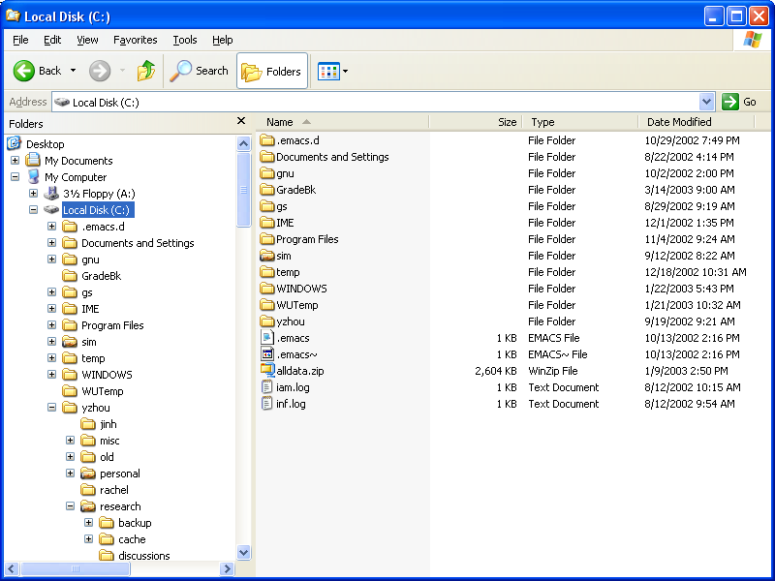
File Systems

Slide 23
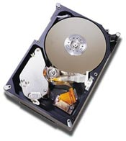
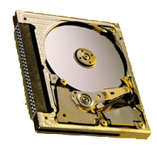
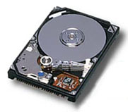
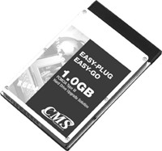
Disks First, Then File Systems
Form factor:
.5-1”× 4”× 5.7”
Storage:
18-73GB
Form factor:
.4-.7” × 2.7” × 3.9”
Storage:
4-27GB
Form factor:
.2-.4” × 2.1” × 3.4”
Storage:
170MB-1GB

Slide 24
Magnetic Disk Capacity
80%/year
100,000
3.5”
10,000
2.5”
1,000
8-14”
1.8”
100
MBytes
10
5.25”
1
80
84
88
92
96
00

Slide 25
Disk Technology Trends
Disks are getting smaller for similar capacity
  Spin faster, less rotational delay, higher bandwidth
  Less distance for head to travel (faster seeks)
  Lighter weight (for portables)
Disk data is getting denser
  More bits/square inch
  Tracks are closer together
  Doubles density every 18 months
Disks are getting cheaper ($/MB)
  Factor of ~2 per year since 1991
  Head close to surface

Slide 26
Disk Organization
Disk surface
  Circular disk coated with magnetic material
Tracks
  Concentric rings around disk surface, bits laid out serially along each track
Sectors
  Each track is split into arc of track (min unit of transfer)
sector

Slide 27
Disk Organization As Fiction
Fixed arc implies inefficiency
  short inner sectors, long outer sectors
Reality
  More sectors on outer tracks
  Disks map transparently
sector

Slide 28
More on Disks
CD’s and floppies come individually, but magnetic disks come organized in a disk pack
Cylinder
  Certain track of the platter
Disk arm
  Seek the right cylinder
seek a cylinder

Slide 29
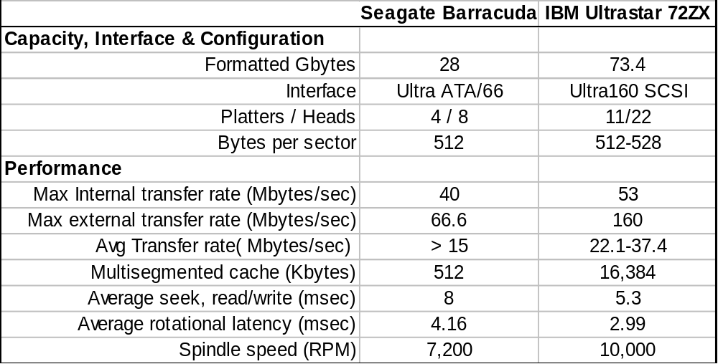
Disk Examples (Summarized Specs)

Slide 30
Reminder

